Slide 1


NEURAL NETWORKS IN ASSET MANAGEMENT
IDENTIFYING INEFFICIENCIES WITH SYSTEMIC MARKET FACTORS
By AJ Fabbri
Advisor: Andrea Golfari
Economics Major

Slide 2

Everyone says “Buy low, sell high.”
We often do the opposite.
Can machines help?

Slide 3
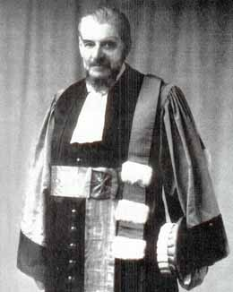
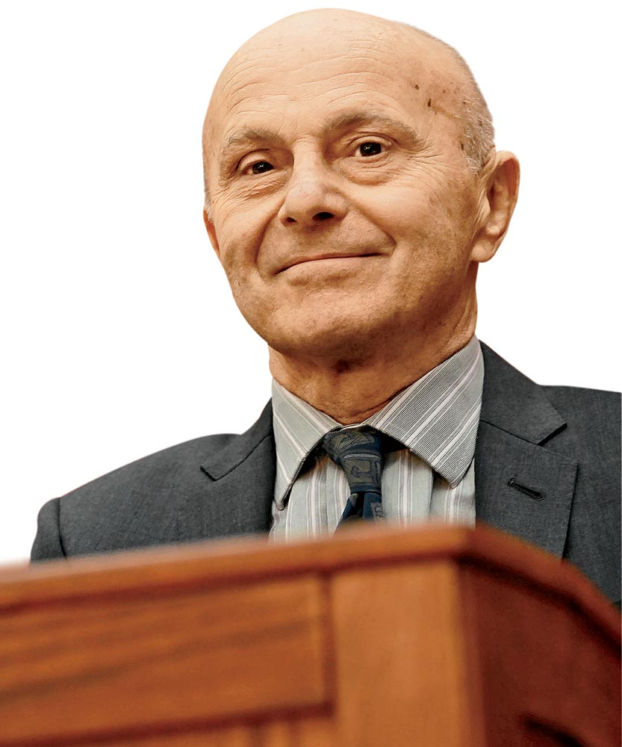
Random Walk and EMH
1900: Louis Bachelier’s Random Walk Theory
Prices follow a random pattern in the short to medium term; unpredictable.
Movements reflect past pricing, current pricing, and external factors.
1960: Eugene Fama’s Efficient Market Hypothesis
Asset prices instantly reflect all available information; no exploitable edge
Weak form: Prices reflect all past trading data (price, volume, technicals).
Semi-strong: Weak form + all public info (earnings, news, etc.).
Strong form: Prices reflect ALL info, including insider knowledge.

Slide 4
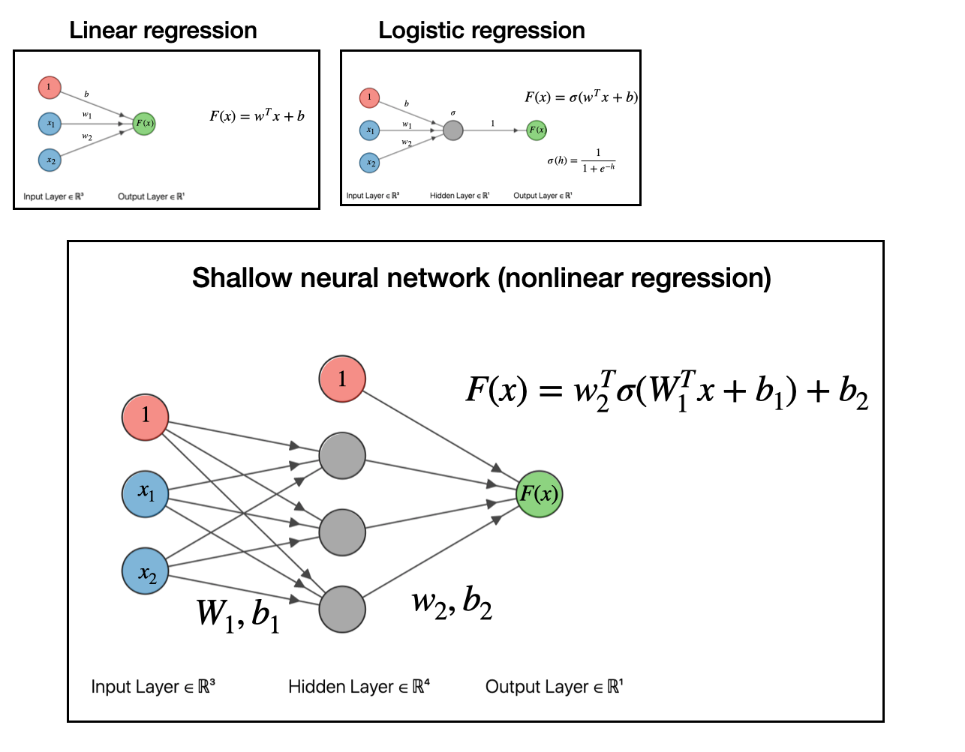
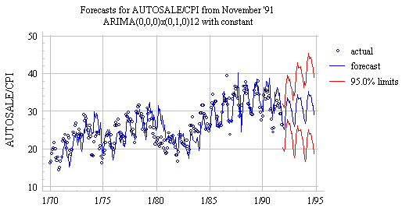
Why Machine Learning?
Traditional models (ARIMA, ARCH, linear regression) only use past prices and follow set patterns.
They often miss nonlinear/non-repeating patterns and/or external factors.
ML can learn nonlinear patterns across many inputs.

Slide 5
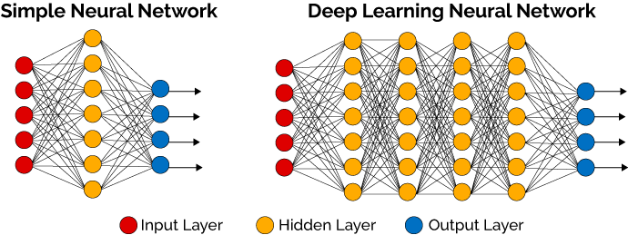
What is a Neural Network?
A model made of layers of neurons.
Input layer:
One node per independent variable
(ex: price, volume, factor values)
Hidden layers:
Create new features by combining inputs (like abstract interaction terms)
Allow the network to learn complex, non‑linear relationships
Output layer:
One node for regression (ex: next‑day price)
Or multiple nodes for classification (classification probabilities or a multi-day sequence)
How It Works:
Hidden layers mix inputs into new features.
Each feature gets a coefficient that measures its impact (like β in linear regression).
Final node adds up those weighted features to predict something.
Notes:
Multicollinearity not an issue

Slide 6
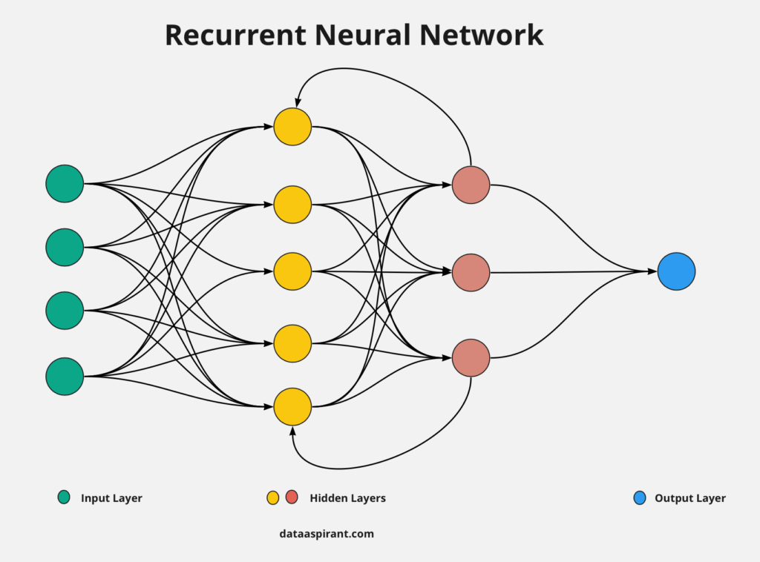
Recurrent Neural Network (RNN)
At each time step, new inputs (e.g., daily prices) enter the network.
The hidden layer’s outputs loop back in.
Remembers useful patterns from past steps using trained weights.
Feedback (recurrence) lets the model learn trends, seasonality, and lagged effects.

Slide 7
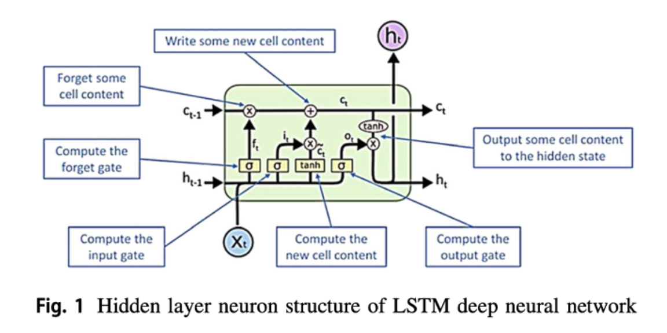
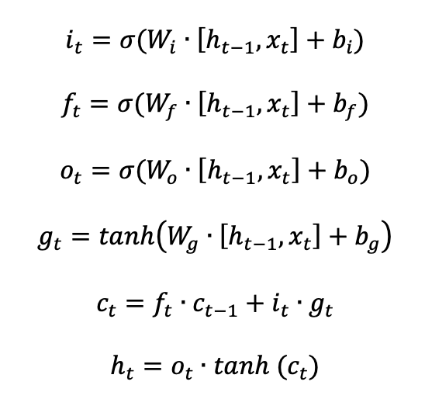
Long Short-Term Memory (LSTM)
Enhanced RNN, better for large datasets.
LSTM cells add gates to:
Forget irrelevant info
Input new info
Output what matters
Memory mechanism is now split into two parts:
Cell state: long-term memory
Hidden state: short-term memory

Slide 8
Research Questions and Hypotheses
Will an MLS-LSTM informed by stock price movements and Fama-French factors outperform technical-only versions?
Will the model capture inefficiencies differently across low- versus high-information segments?
Hypothesis 1:
LSTM + Fama‑French factors will outperform a technical‑only LSTM.
Hypothesis 2:
The model will perform better in low-info segments (small caps, cryptocurrencies).

Slide 9
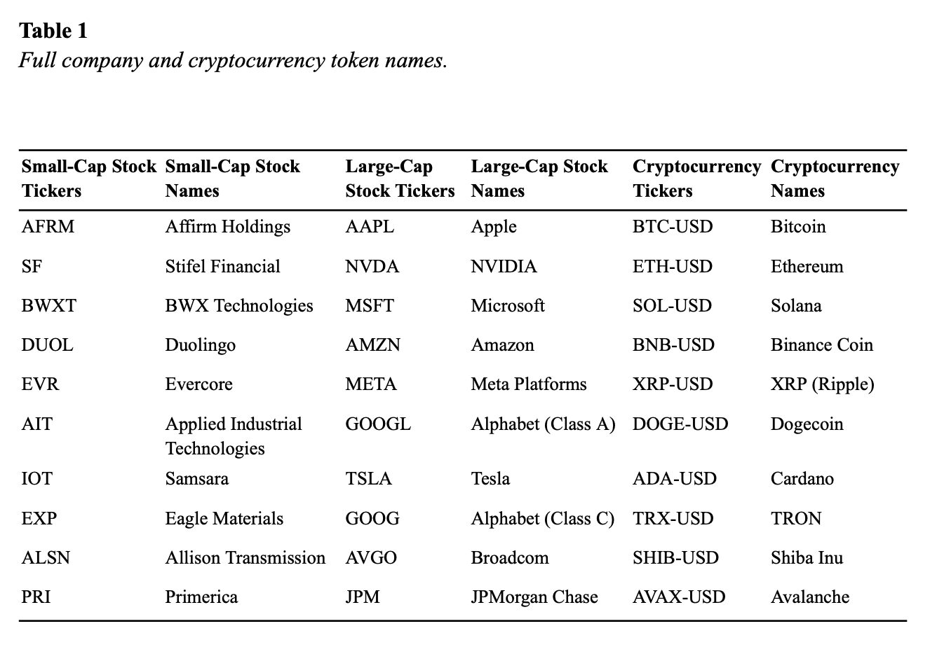
Data: Assets
All technical data: from yfinance Python library
Price, volume, dividends, splits
In practice, EMH holds to varying degrees → information segments
Large cap: from SPY top holdings
Small cap: from SCHA top holdings
Crypto: top by market cap

Slide 10
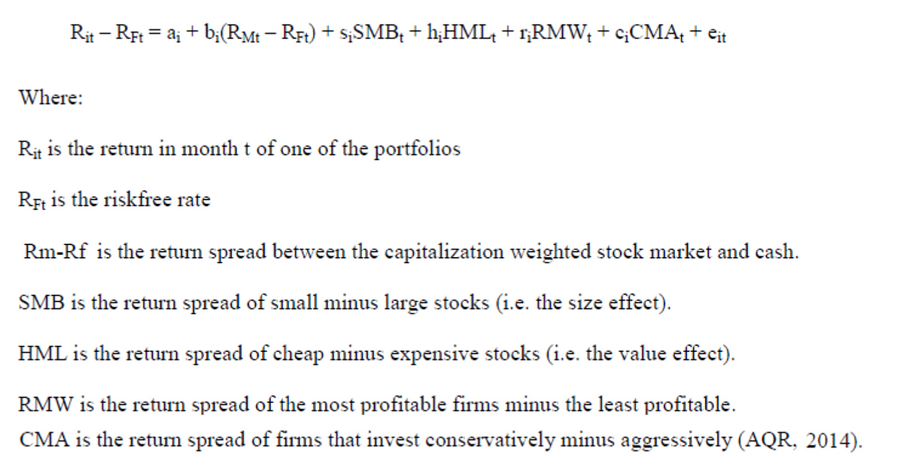
Data: Fama-French Factors
Source: Kenneth French data library
Daily 5-factor asset pricing model data;
Merged with yfinance dataframes date-wise
Information about:
Market risk premium (Mkt-Rf or Ri-Rf)
Size (SMB)
Value (HML)
Profitability (RMW)
Investment style (CMA)
Risk-free rates of return (Rf): 1-month U.S. T-bills
Factors allow the LSTM to learn beyond technical analysis.

Slide 11
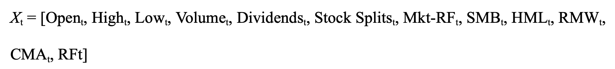
Input Vector
X_{t} : independent variables to predict Close price sequences
For this project, I set the model to predict 5 days into the future.

Slide 12
Methodology Steps
1. Gather & normalize data
2. Train technical vs. factor‑augmented LSTM
3. Predict next 5‑day Close
4. Backtest signals
5. Evaluate alpha, Sharpe, error metrics
Descriptive statistics
ANOVA and t-tests across categories
Categorical regression with Alpha as DV

Slide 13
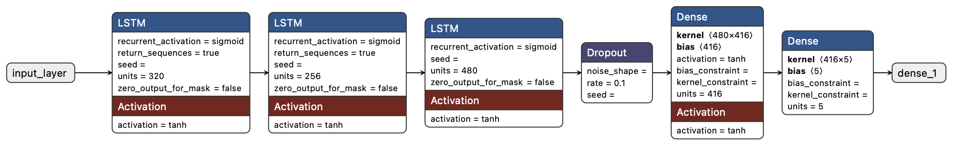
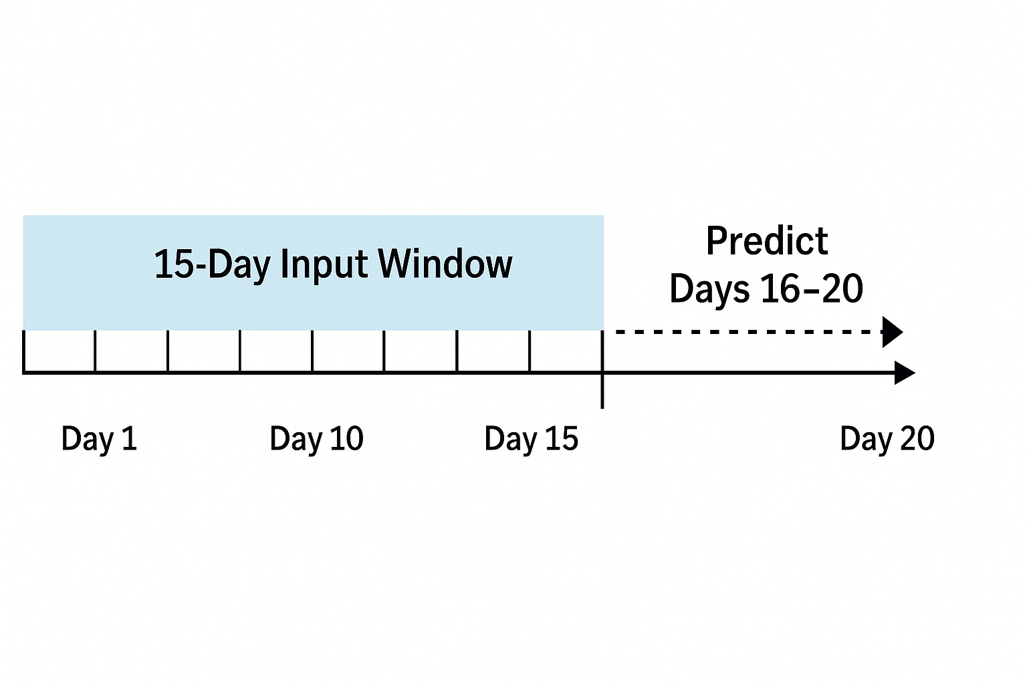
Sliding Window Training
15‑day input window → predict days 16–20
Slide window by 1 day to maximize data coverage
Model runs thousands of iterations across trials.
Bayesian optimization shapes individual neural network layers.
Lightweight models; size ranges from 1 to 20 MB

Slide 14
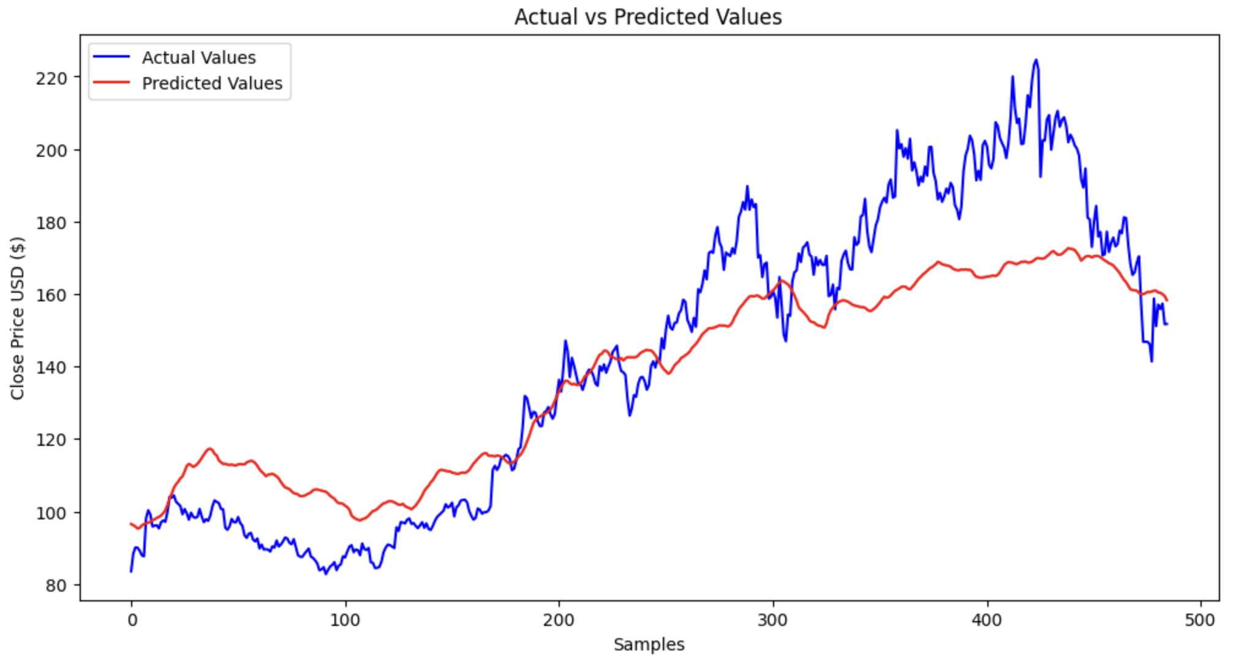
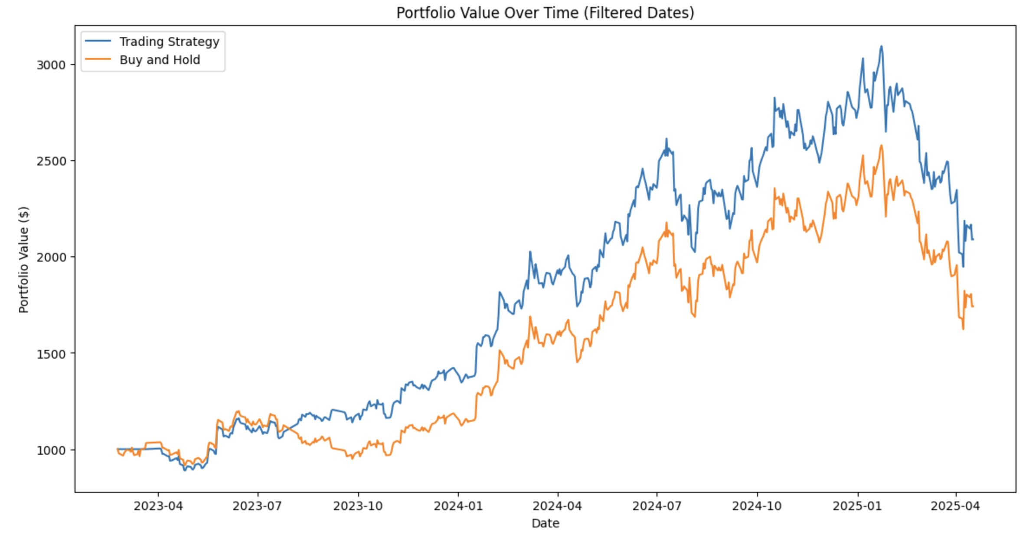
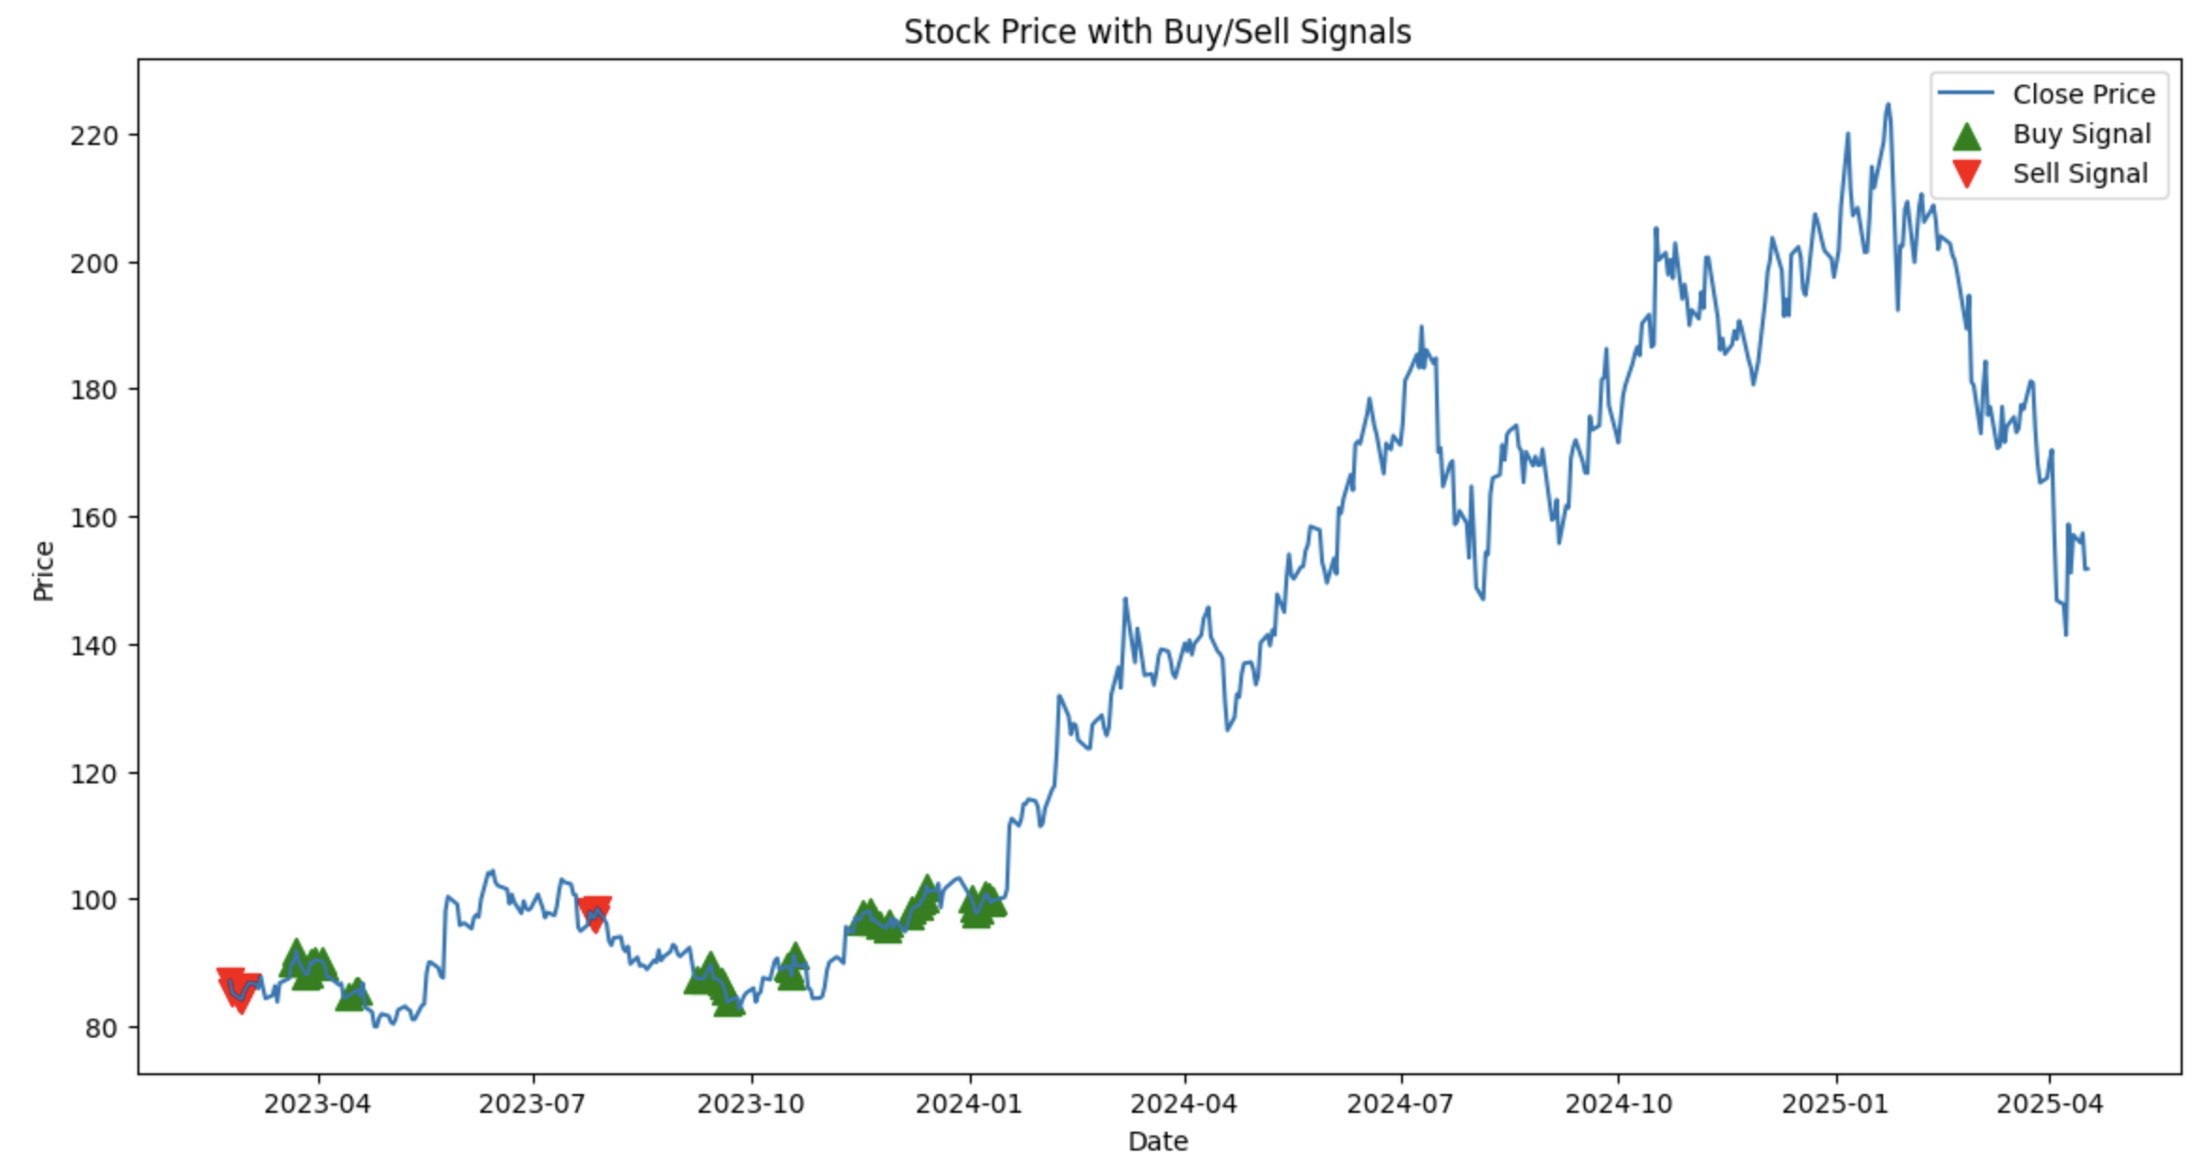
Signals & Backtesting
Signal execution criteria:
Buy if predicted 5‑day return > 30‑day vol & price ≤0.95×last_sell
Sell if drop > 1.5×vol & price ≥1.05×last_buy
AND enter a short position

Slide 15
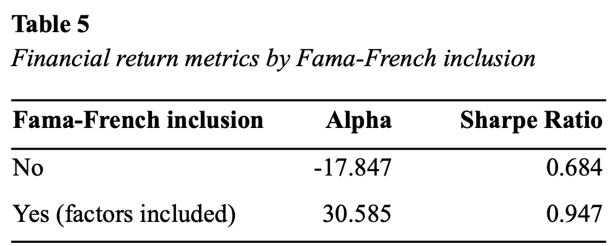
Main result: BIG Alpha Improvement
+45.26 pp average alpha with factors vs. technical‑only (p = 0.005) ​

Slide 16
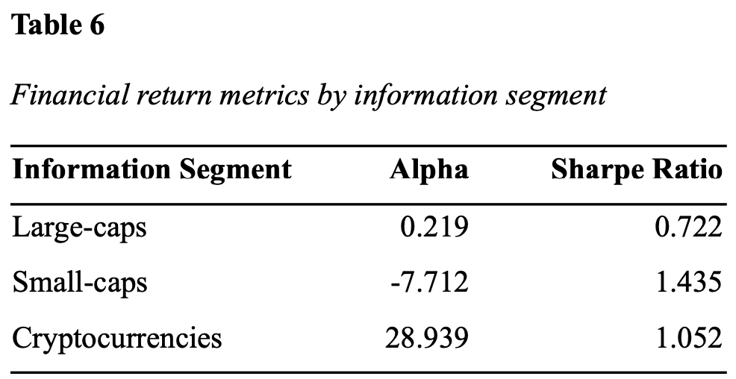
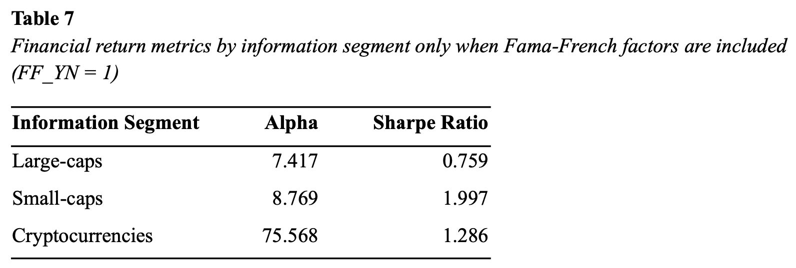
* note: crypto hard to replicate IRL; most exchanges don’t allow shorting

Slide 17
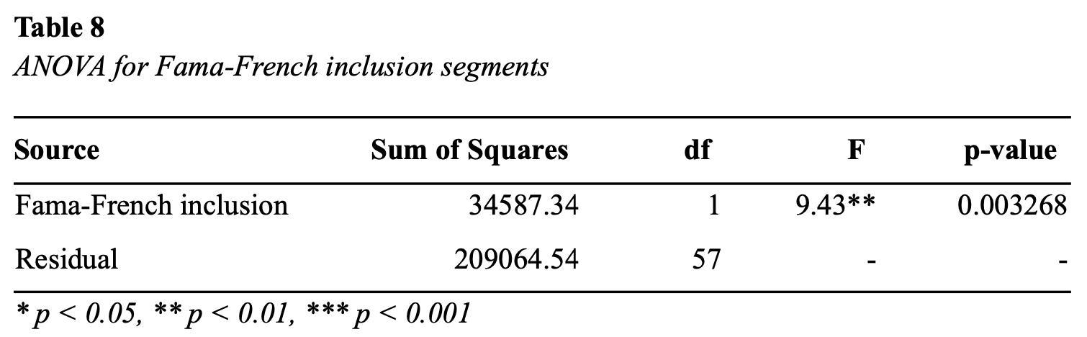
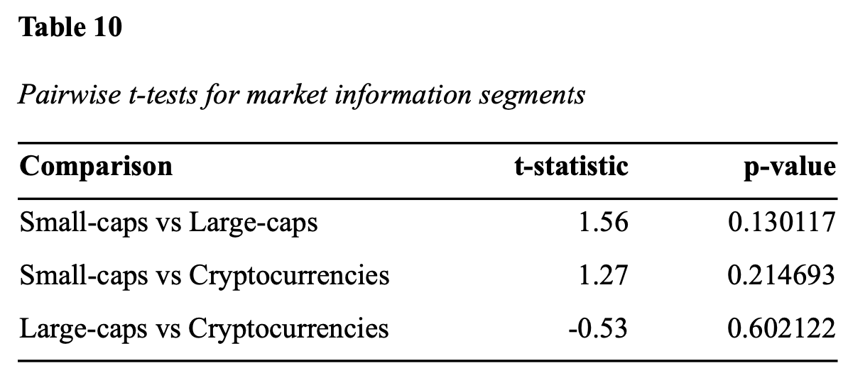
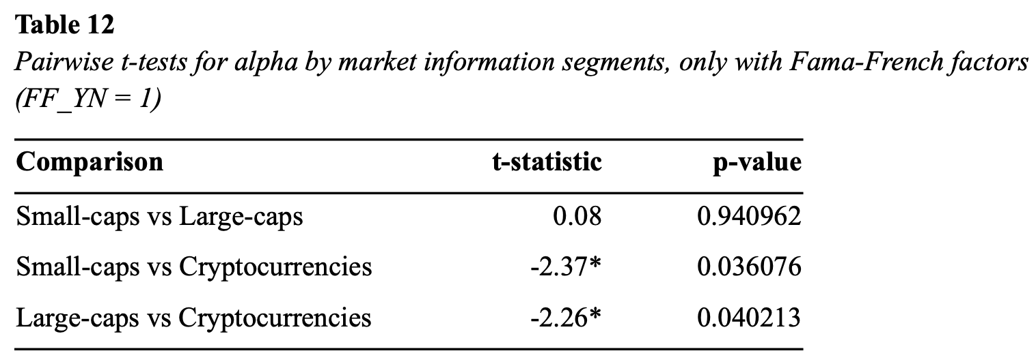
ANOVA and T-tests
F-statistic exceeds critical value (4.01) → reject null hypothesis
Statistically significant difference when including FF factors
Fail to reject null hypothesis
Statistically significant difference in means → reject null hypothesis
Still, no significance between stock categories

Slide 18
Implications and Limitations
Theoretical Implications
Markets are NOT uniformly efficient.
Public data CAN generate alpha → contradicts semi-strong and strong-form EMH.
LSTMs can find patterns in data → Random Walk doesn’t entirely hold.
Practical Implications
Low-info assets are more vulnerable to manipulation and speculation.
Lightweight ML tools can help generate alpha, especially with low-info.
LSTMs are a scalable, flexible alternative to traditional models.
Limitations
Sample size: 30 assets, 60 trials, 2-year testing window → more trials needed.
Computational constraints: time, RAM & VRAM, CPU & GPU capacity.
Black-box problem: AI models are too complex to fully understand.

Slide 19
Conclusion and Next Steps
MAIN TAKEAWAY: Inefficiencies DO exist, and neural net (AI) approaches can exploit them.
Financial market data helps!
NEXT STEPS:
Robustness tests in volatile timeframes (crashes, tariff wars, etc.).
Test if more input data helps.
Expand to more assets.
Test with real money…?

Slide 20

Thank you!
Q&A time?
For more info, full citations, etc., read my thesis on digitalcc.
Notes:
I’d like to shout out my advisor, Andrea Golfari, the only person whom I was able to talk with in the complete nonsensical jargon of this topic. I’d also like to thank my professors from the Econ department who got me interested in markets and efficiency in the first place.

