Slide 1
Image Recognition
Sean Fulbright
Alexji Gaston

Slide 2
Practical (learning problem)
Image Recognition and categorization of food

Slide 3
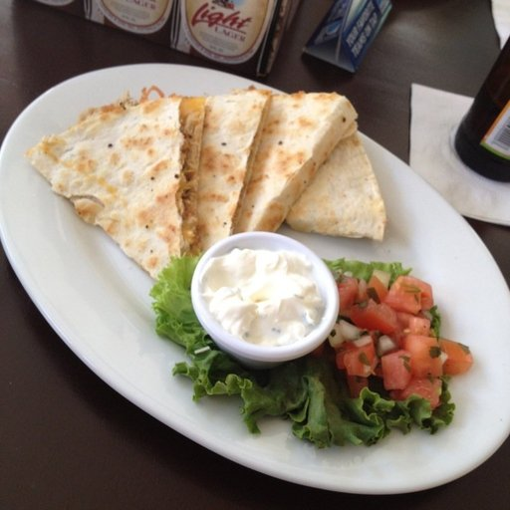
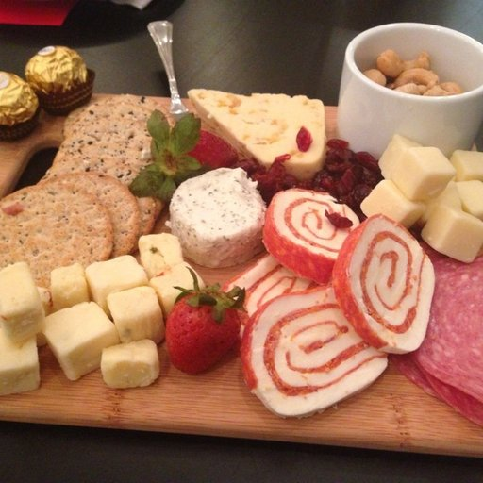
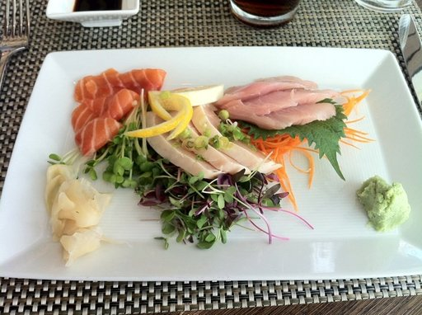
Dataset
Food 101 Dataset provided by Labelbox
Contains Images of Food Categorized as:
Soup
Dessert
Meat
Bread
Egg
Seafood
Fried Food
Noodles/Pasta
Dairy product
Fruit/Vegetable
Rice
Notes:
https://app.labelbox.com/catalog/dataset/clbwmz2ji10z608xp8jk5blf2?public=true&_r=https%3A%2F%2Fwww.google.com%2F%3Futm_source%3Dgoogle&utm_medium=paid-search&utm_campaign=20490370058&utm_keyword=deep%2520learning%2520in%2520machine%2520learning&gclid=CjwKCAjwv-2pBhB-EiwAtsQZFDjZ7b_X0MXsoUjSLBf1OJ9PXq2JAYMWOpHH9IOZcknnCKHsDZIuEBoCaBQQAvD_BwE&referrer_url=https%3A%2F%2Fwww.google.com%2F&search.query=NoXSA&search.sorting=NobwRAZglgpgNgEzALnNeTlgQQwC44BKA9gO4DCATjPjAgIJ5gA0YAbjJQEbEDOMAORwBbGCjBUaeOgAJGYAL6sEUagGM8UYgDtxAEQCiAZXIswogrgJG1ACxjCcASUzaArnDgKAukA

Slide 4

Machine Learning Method
Supervised
One vs all logistic regression
Neural Network (specifically resNet-50)
Libraries: TensorFlow(Keras)
Code for resNet model creation: https://github.com/ovh/ai-training-examples/blob/main/notebooks/computer-vision/image-classification/tensorflow/resnet50/notebook-resnet-transfer-learning-image-classification.ipynb
Notes:
https://www.tensorflow.org/

Slide 5
Experiment
Train the algorithm with some number of training data
Feed the set of training data into the trained program
Feed a test dataset into the trained program
Check the accuracy of the predictions
Repeat using different sizes of training data
Training set sizes are 50, 100, 250, 500, 1000, 5000, 9000
Compare accuracy of all sets of training data

Slide 6
Expected Results
As the program is trained with larger and larger training datasets, it will be more accurate at categorizing the images of foods into one of the eleven categories.

Slide 7
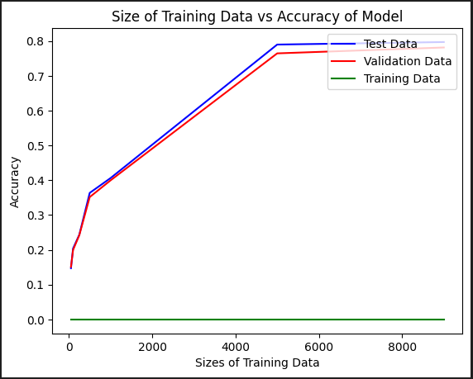
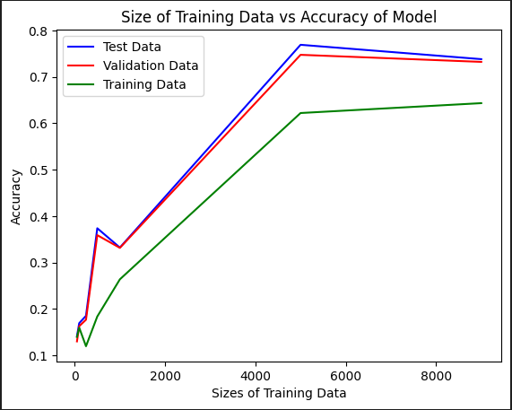
Actual Results
Results from a different run when trying to figure out resNet model (incomplete)
Through various passes, interesting results occurred:
Slight increase and decrease between 0 and 1000
The final result saw an overall increase in accuracy at 5000
Max Accuracy of 76.9% at a data size of 5000
Mostly underfitting, no overfitting
Model seems to correct overfitting automatically
Final results from complete resNet model

Slide 8
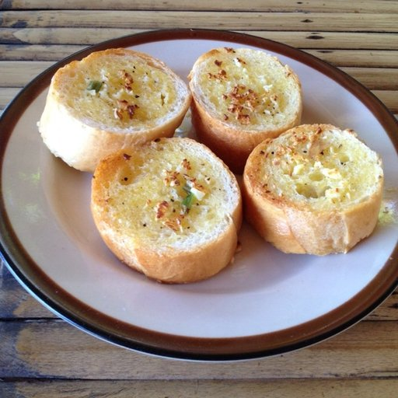
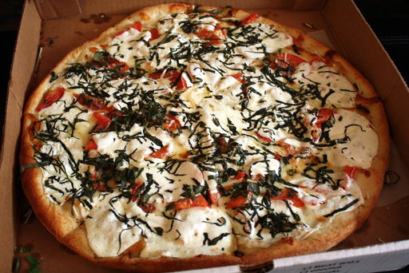
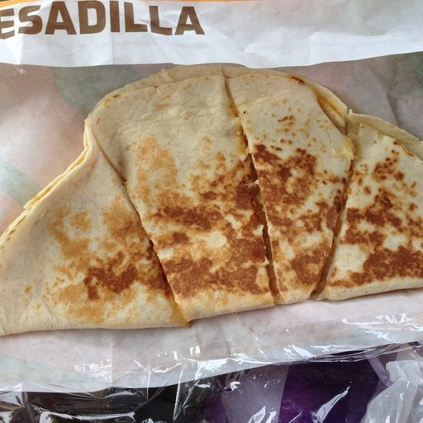
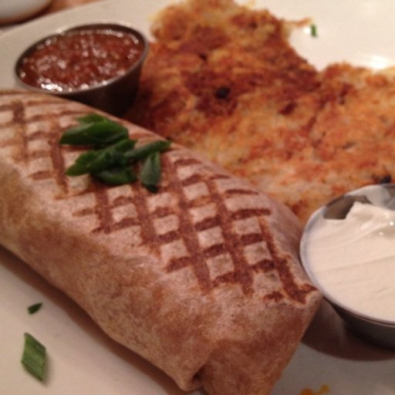
Possible Problems in Experiment
Dataset categories could be too vague and diverse
Ex. All images to the right are classified as bread
Based on one run due to time constraints

Slide 9
If Experiment was Repeated
Use training sizes between 1000 and 5000
Due to large jump from 33.2% accuracy to 76.9% accuracy
Use training sizes between 5000 and 9000
To determine more accurately the trend after 5000
Perform more runs to draw a conclusion from

Slide 10
Significance of results
Find an optimal training size from trendline, to avoid underfitting and overfitting
Find the max accuracy of the model with a dataset

Slide 11
References
Antonov, A. (2019, December 2). Food-11 Image Dataset. Food-11 image dataset. https://www.kaggle.com/datasets/trolukovich/food11-image-dataset
Bossard, Guillaumin, & Van Gool. (n.d.). Food-101. Labelbox. Retrieved October 27, 2023, from https://labelbox.com/datasets/food-101/

