Slide 1






Power Platform Back-End Cluster
Azure Storage
Azure SQL
Service Bus
Azure Key Vault
Azure Storage
Azure Cache
Azure SQL
Service Bus
Azure Key Vault
Azure Cache
API Management
Back-End Services
(private)
Gateway Service

Slide 2
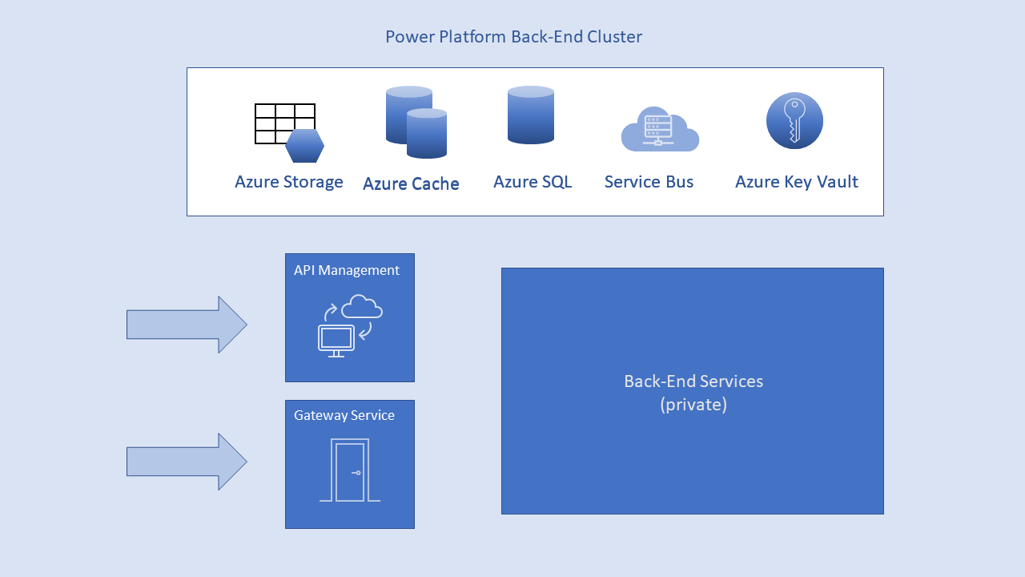
Azure Traffic Manager
Azure Active Directory
Power Platform Back-End Cluster
Browser
Web Front-End Cluster
Azure App Service Environment
ASP.NET
Azure CDN

Slide 3
Azure Traffic Manager
Azure Active Directory
1,2. DNS resolution
5. Redeem auth code for token
Power Platform Back-End Cluster
Browser
Web Front-End Cluster
2. Return WFE IP address
3. Redirect to sign-in page
Azure App Service Environment
8. Get data with token
4. Redirect with auth code
7. Load app page
ASP.NET
3,4. Sign in
5. Auth code
6. ID back-end cluster
Azure CDN
Global Back-End Service

