Slide 1
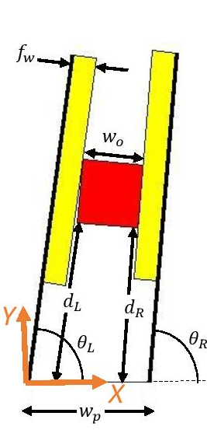
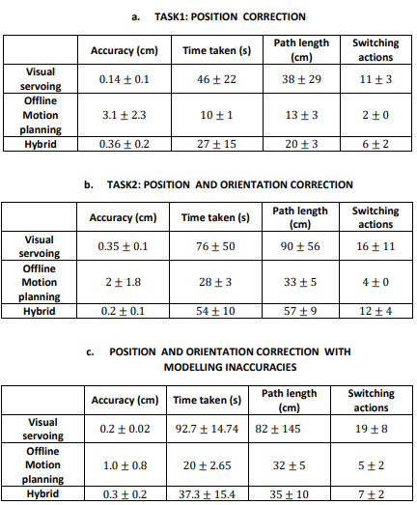
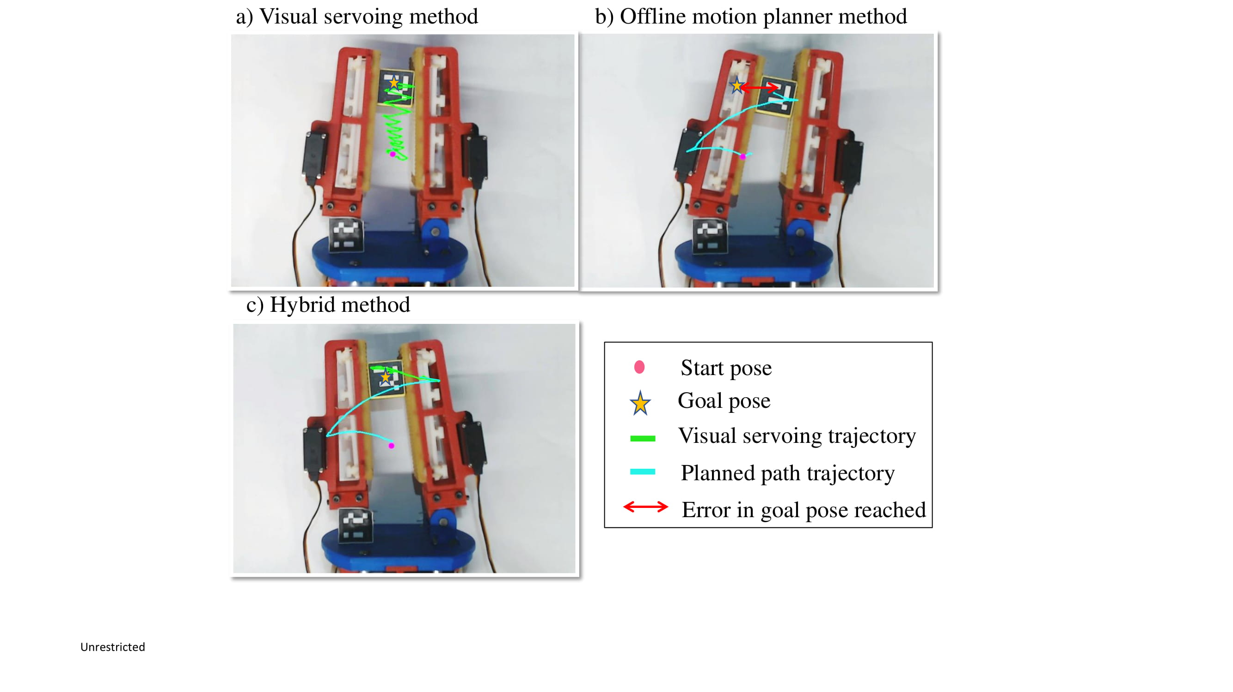
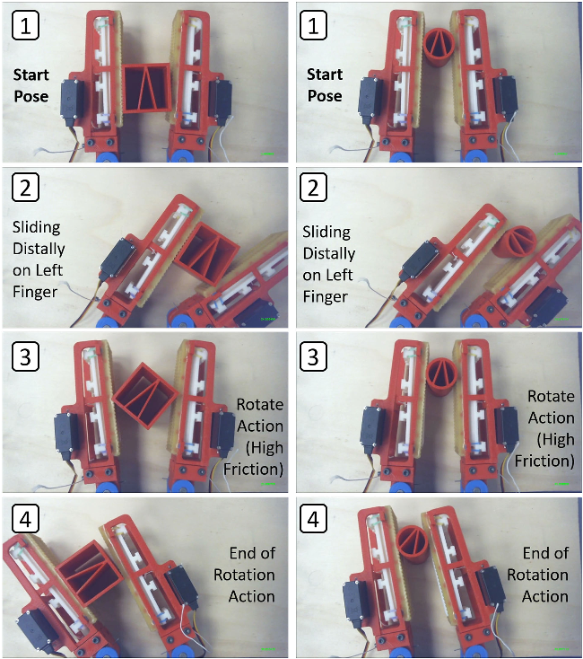
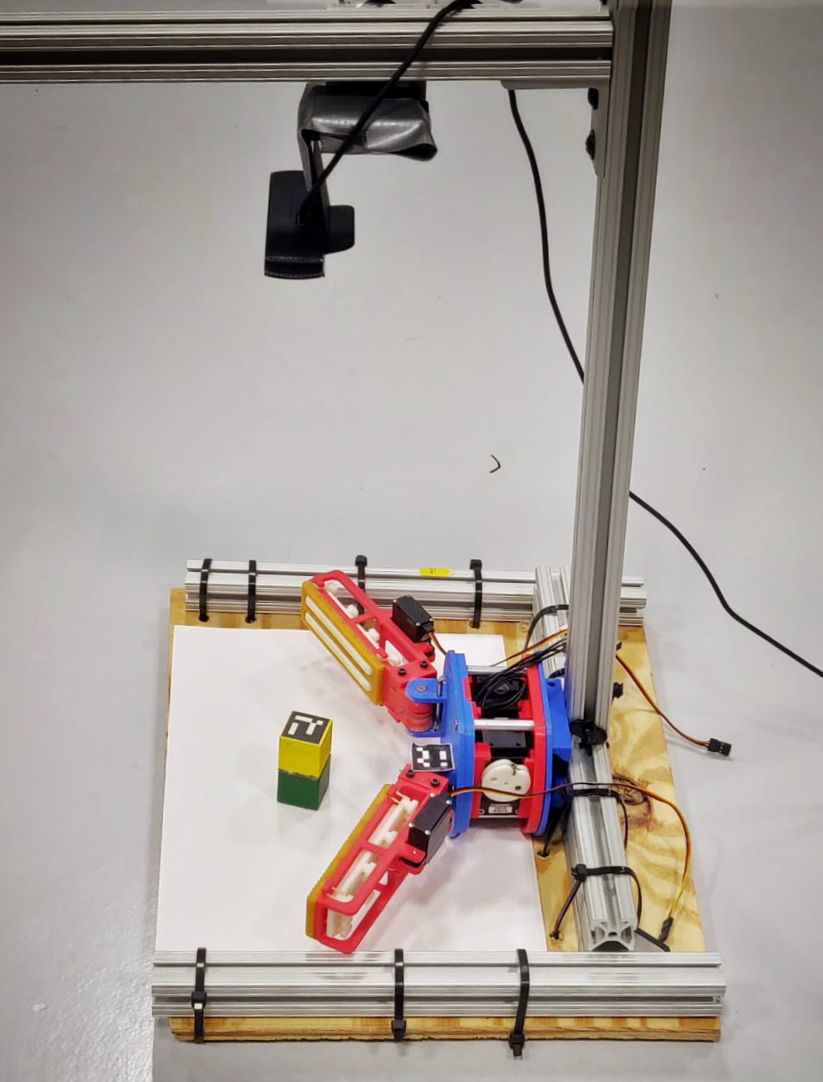
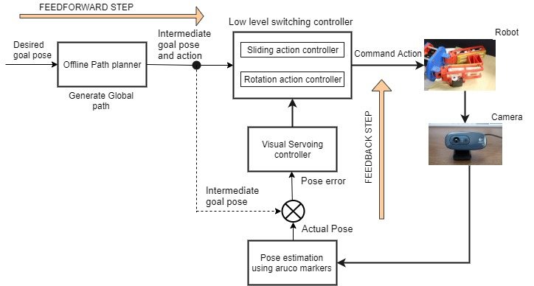

Within-hand Manipulation Planning and Control Approaches for Variable Friction Fingers
Gokul Narayanan(RBE), Joshua Amrith raj(RBE), Abhinav Gandhi(RBE), Aditya A.Gupte(RBE)
Advisors: Profs. Berk Calli, Adam J.Spiers
Abstract
Modelling
Results
The ability to conduct within-hand manipulation provides significant dexterity and flexibility advantages to robots operating in unstructured and constrained environments, as they can re-position and re-orient objects without regrasping. This is a challenging task even for an highly articulated robot. Here we propose different strategies to perform within hand manipulation of objects using Variable Friction(VF) Finger gripper system.
Visual Servoing:
$$v_{ref}=−λJ_{i}^{∗}e$$
$$\left[\begin{matrix}\dot{x} \\ \dot{y}\end{matrix}\right]=\left[\begin{matrix}−\left(d_{L}+\frac{w_{0}}{2}\right)\sin{θ_{L}+(\frac{w_{o}}{2}+ f_{w}})\cos{θ_{L}} \\ \left(d_{L}+\frac{w_{0}}{2}\right)\cos{θ_{L}}{−({\frac{w_{o}}{2}+f}_{w}})\sin{θ_{L}}\end{matrix}\right]\dot{θ_{L}}$$
Motion Planner:
Modified A* search
Cost Function Design:
$$f\left(s\right)=g\left(s\right)+αh\left(s\right)$$
$where α≥1$
$h\left(s\right)=βha(s)$
$$where$$
$ha\left(s\right)=h(s)position+h(s)orientatrion$
$β =$ $0<β<1, if a==Pa$
$1, otherwise$
$a →current action$
$Pa →Parent action$
Task Evaluation
Experimental Trajectory
Background
VF Finger Gripper is a 2-DOF robot gripper that can change the effective friction of its finger surfaces with a simple actuated mechanism. It is a non-holonomic switching system which can slide and rotate objects within hand by varying the friction surfaces and the finger angles.
Kinematic Modelling Parameters
f_{w} – Finger Width
W_{o} – Object dimension
θ_{L}, θ_{R} – Left and Right actuator angles
d_{L}, d_{R} – Object Position in left and right finger
w_{p} - Width of palm
Trajectory tracked by the object from start pose (7,7,0) to goal pose (12,12,0) for different methods a) Visual servoing b) Offline motion planning c) Hybrid method
Project Objectives
Develop methods to solve within hand manipulation task.
Evaluate the methods based on path smoothness, accuracy and efficiency by testing on VF Finger Gripper system.
Experiments
Conclusion and Future directions
Hybrid Method performs faster and gives smoother paths even with inaccurate models of the system as it combines the advantages of the pre-defined path from motion planner and online error correction from visual servoing.
In our future work, we propose to learn the policies to manipulate any object without modelling them explicitly.
Each method was tested on 3
different tasks and 5 different start and goal positions.
Tasks:
Perform only position correction.
Perform both position and orientation correction.
Perform Position and orientation correction with modelling inaccuracy.
Evaluation Metrics
Accuracy
Time taken
Path length
Path smoothness
Methodology
CAMERA
Develop an Offline Motion planner.
Develop an Online Visual Servoing method.
Develop an Hybrid method integrating offline and online approaches.
ORIGIN ARUCO MARKER
References
A. J. Spiers, B. Calli, and A. M. Dollar, “Variable-friction finger surfaces to enable within-hand manipulation via gripping and sliding,” IEEE Robotics and Automation Letters, vol. 3, no. 4,pp. 4116–4123, 2018.
B. J. Cohen, S. Chitta, and M. Likhachev, “Search-based planning for manipulation with motion primitives,” in IEEE IntConf on Robotics and Automation (ICRA), 2010, pp. 2902-908.
OBJECT ARUCO MARKER
OBJECT
VF SYSTEM
Operational Block Diagram
Experimental Setup

