Slide 1
PROJECT 1 — REVIEW 1
TENDON DRIVEN CONTINUUM ROBOT LINKAGE -BASED FLEXIBLE PIPE INSPECTION ROBOT
Six-Wheel Self-Adjusting Locomotion with Tendon-Driven Continuum Steering for Autonomous Pipeline Inspection
Presented by: ANJALI ULLAS (23BMH1064), HARSH VINOD BOPALIA (23BME1161), PARV KAPOOR (23BMV1026)
Project Guide: AROCKIA SELVAKUMAR, SMEC
Review 1 Date: 19 August 2026
1 / 16

Slide 2
OVERVIEW
Presentation Agenda
01
Need Analysis
Why intelligent pipeline inspection matters
Focus of Review 1
Literature survey & research gap
Objectives aligned to SDGs
Methodology & technical feasibility
Progress achieved so far
02
Literature Survey
Existing in-pipe robot technologies & gaps
03
Objectives & SDGs
Goals and sustainable development alignment
04
System & Methodology
Architecture, mechanism design, feasibility
05
Progress & Roadmap
Work completed and implementation plan
2 / 16

Slide 3
NEED ANALYSIS
Why Pipeline Inspection Needs a Smarter Robot
Industrial pipelines (6-8 inch) in oil & gas, chemical, water distribution, and power generation quietly age under corrosion, cracking, and weld degradation — yet most are only inspected manually, at great risk and cost.
1
2
3
4
Hazardous Access
Rigid Robot Limits
Undetected Defects
Costly Downtime
Confined, toxic, or high-pressure pipelines put inspection personnel at risk.
Conventional rigid in-pipe robots stall at elbows, bends, and vertical transitions.
Cracks, corrosion, dents & weld flaws often go unlocalized until failure occurs.
Unplanned leaks and shutdowns are far costlier than preventive inspection.
Need: An autonomous robot that self-adjusts to 6-8" diameter pipe, flexibly navigates elbows and vertical sections, inspects for defects, and maps their exact location for maintenance crews.
3 / 16

Slide 4
LITERATURE SURVEY
Classification of Existing In-Pipe Robots
In-pipe robots are broadly classified by locomotion and wall-contact form (Xie et al., 2021):
Type | Locomotion Principle | Key Limitation
Wheel type | Passive/active wheels roll along wall | Poor traction on inclines; limited adaptability
Wall-press type | 3 legs/wheels press wall, 120° apart | Not for rectangular ducts; resistance rises on uneven walls
Self-lock inchworm | Wedge locking via permanent magnets | Walks in one direction only unless extra actuator added
Screw-drive type | Continuous screw rotation against wall | Multiple actuators increase control complexity
Pneumatic peristaltic | Expandable chambers + coil spring | Needs a bulky compressed-gas supply line
Cam-Linkage Robot (CLR) | Single-motor cam + linkage, bidirectional creep | Rigid body — limited to near-constant-diameter straight pipe (360–400 mm)
Source: Xie Q, Liu S, Ma X. “Design of a novel inchworm in-pipe robot based on cam-linkage mechanism.” Advances in Mechanical Engineering, 2021.
4 / 16

Slide 5
LITERATURE SURVEY
Research Papers Referenced
Two literature streams inform this project: in-pipe locomotion, and tendon-driven continuum robotics.
Ref. | Authors (Year) | Title / Focus | Key Contribution Taken
[1] | Xie, Liu & Ma (2021) | Inchworm in-pipe robot based on cam-linkage mechanism | Benchmark for single-motor bidirectional in-pipe drive
[2] | Webster III & Jones (2010) | Design and kinematic modeling of constant curvature continuum robots | Constant-curvature (PCC) model for TDCR shape control
[3] | Rucker & Webster III (2011) | Statics and dynamics of continuum robots with general tendon routing | Cosserat-rod statics for bending under external wall load
[4] | Kato, Okumura, Song, Golby & Hata (2015) | Tendon-driven continuum robot: tension propagation model | Tendon friction / hysteresis along spacer-disk backbones
[5] | Burgner-Kahrs, Rucker & Choset (2015) | Continuum robots for medical applications: a survey | Design taxonomy and actuation trade-offs for continuum links
[6] | Perugini & Russo (2024) | Monolithic 3D-printed tendon-driven continuum robot designs | Single-piece TPU backbone; removes multi-part disk assembly
All references are peer-reviewed journal or conference publications.
5 / 16

Slide 6
LITERATURE SURVEY
Observations: How Our System Differs
Each reference solves one part of the problem; none combines wall traction with continuum steering for 6-8″ pipe.
Ref. | What Their System Does | How Our System Differs
[1] | Single stepper drives cam groups for bidirectional inchworm creep in 360-400 mm straight pipe. Rigid front and rear bodies. | We drive continuously on six powered wheels instead of creeping, and replace the rigid coupling with a bendable TDCR link for elbows.
[2] | Establishes constant-curvature kinematics for continuum arms mounted on a fixed base. | We apply the same model, but to a mobile inter-module steering joint rather than a fixed-base manipulator.
[3] | Models continuum statics under external loading, validated on a lab bench prototype. | Our external load is continuous pipe-wall contact, so this model sets our tendon-tension budget in a confined environment.
[4] | Quantifies tendon tension loss along spacer-disk backbones in a surgical endoscope. | We adopt the hysteresis insight and close the loop with onboard IMU feedback rather than open-loop tendon commands.
[5] | Surveys continuum designs for medical use: catheters, endoscopes, surgical arms. | Confirms TDCRs are unexplored for in-pipe locomotion, which is the gap our architecture addresses.
[6] | Prints a whole continuum segment as one TPU part instead of assembling dozens of vertebrae. | Directly informs our backbone fabrication route, keeping part count and cost inside our budget.
Observation: every reference addresses locomotion or continuum bending — none addresses both together.
6 / 16

Slide 7
NEED ANALYSIS
Research Gap & Motivation
What the Literature Shows
The Gap We Address
Rigid wall-press & wheel robots cannot pass elbows or vertical bends smoothly.
Self-lock inchworm robots are single-direction unless a second actuator is added, raising control complexity.
CLR proves a single motor can drive bidirectional inchworm creep — but its rigid crank-linkage body still cannot flex through bends.
Multi-DoF peristaltic/soft robots handle bends but need complex or pneumatic control (compressed air supply, many DoF).
No single-motor-class design combines active diameter-adaptive wheeled traction with true continuum (multi-bend) flexibility.
Few in-pipe robots integrate onboard vision-based defect detection with automatic digital path + defect mapping.
A hybrid ‘wheeled body + Tendon-Driven Continuum Robot (TDCR) link’ has not been explored for 6-8" pipelines in this literature.
7 / 16

Slide 8
OBJECTIVES
Project Objectives
O1
O2
O3
O4
Adaptive Locomotion
Continuum Steering
Defect Detection
Digital Path Mapping
Design a six-wheel self-adjusting mechanism maintaining continuous wall contact across 6-8" pipe diameters.
Integrate a Tendon-Driven Continuum Robot (TDCR) link for flexible navigation through elbows, bends & vertical sections.
Develop vision & sensing modules to detect cracks, corrosion, dents and weld irregularities in real time.
Generate an onboard digital map recording the traversal route and precise defect locations for maintenance planning.
Each objective is specific and measurable — validated in the Feasibility & Progress sections.
Expected impact: Improved inspection efficiency, reduced manual intervention in hazardous environments, and more reliable pipeline health monitoring across industries.
8 / 16

Slide 9
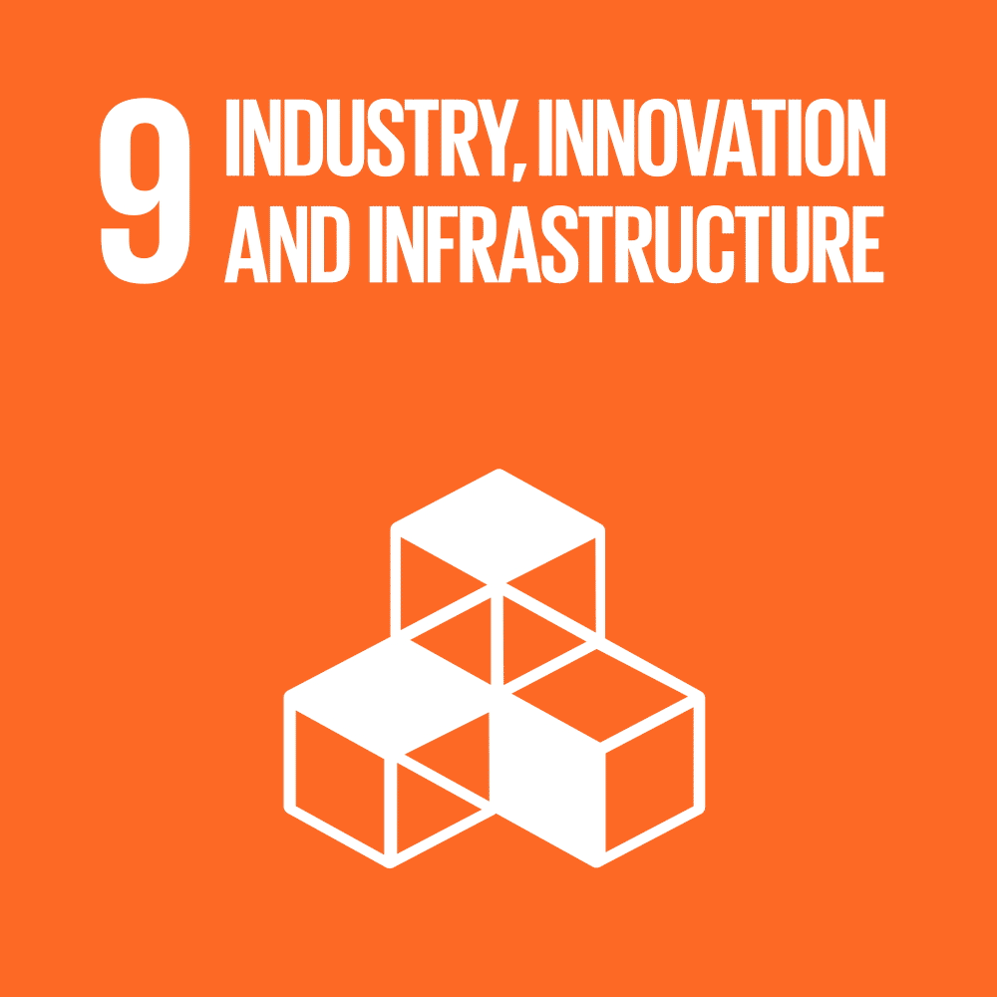




SUSTAINABLE DEVELOPMENT
Alignment with UN Sustainable Development Goals
SDG 9
SDG 6
SDG 7
SDG 3
SDG 12
Builds resilient, innovative technology for critical pipeline infrastructure.
Protects the integrity of water-distribution pipelines against leaks and contamination.
Improves reliability monitoring of oil, gas and power-generation pipelines.
Removes the need for personnel to enter hazardous, confined pipe environments.
Enables preventive maintenance, cutting resource loss from leaks and failures.
9 / 16

Slide 10
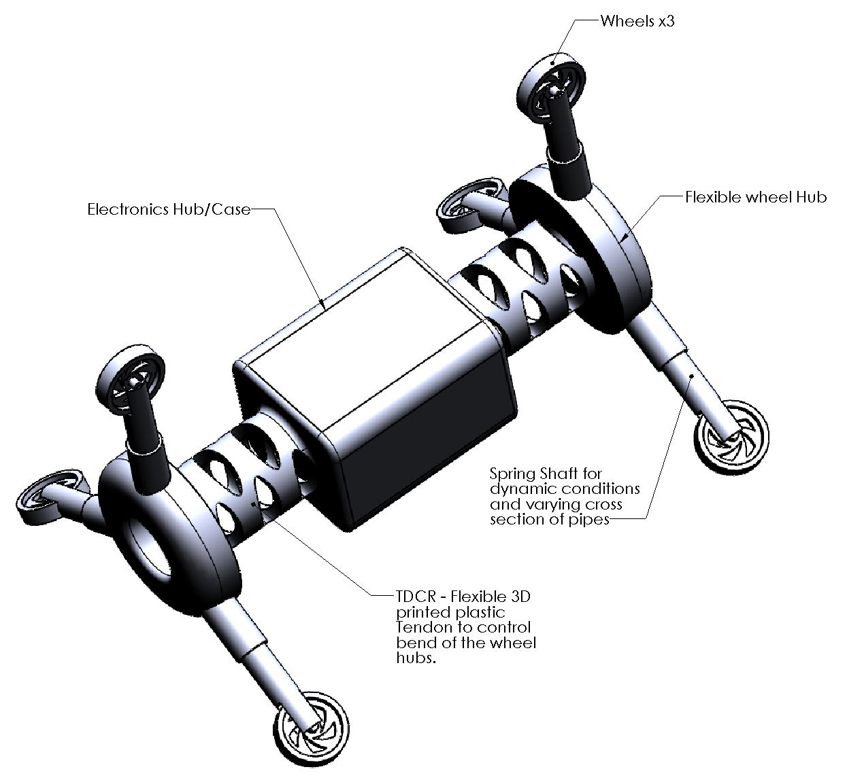
METHODOLOGY
Proposed System Overview
Two adaptive wheeled bodies (front & rear) connected by a flexible Tendon-Driven Continuum Robot (TDCR) link — combining stable traction with the articulation rigid inchworm robots lack.
Conceptual Rough CAD Model
1
Six-Wheel Self-Adjusting Body
Spring-biased wheel arms maintain continuous wall contact from 4– 6" diameter, front & rear.
2
TDCR Flexible Link
Tendon-actuated multi-DOF bending section enables smooth passage through elbows & vertical risers.
3
Vision & Sensing Payload
Onboard camera + proximity/IMU sensors scan for cracks, corrosion, dents & weld flaws.
4
Onboard Processing Unit
Logs traversal path and defect coordinates, generating a digital inspection map in real time.
10 / 16

Slide 11
METHODOLOGY
System Architecture
Adaptive Wheel
Mechanism
TDCR Steering
Module
Vision & Sensing
(Camera / IMU)
Design Rationale
Wheel + TDCR split keeps propulsion and steering functions independent — easier control, similar in spirit to CLR’s single-function modules.
Vision + sensing feed directly into the onboard unit, enabling real-time flagging rather than post-inspection review.
Digital map output mirrors the maintenance-ready format requested in the proposal (route + defect coordinates).
Onboard Control & Processing Unit
(Motor drive • Defect detection • Localization • Path logging)
Digital Path Map
+ Defect Location Report
11 / 16

Slide 12
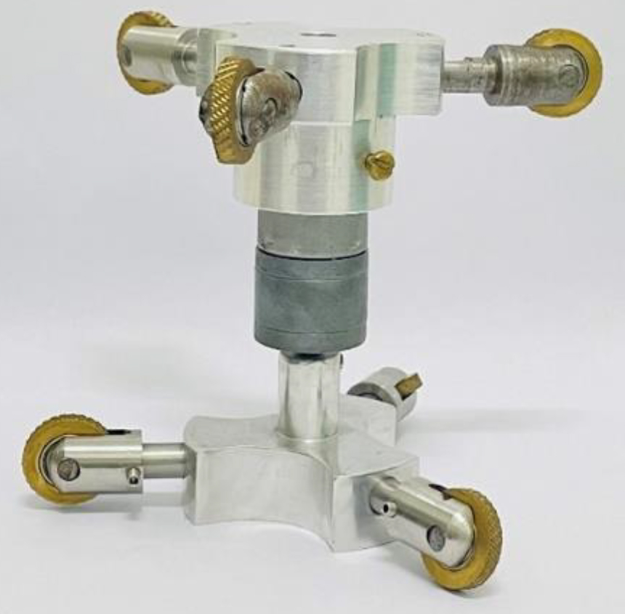
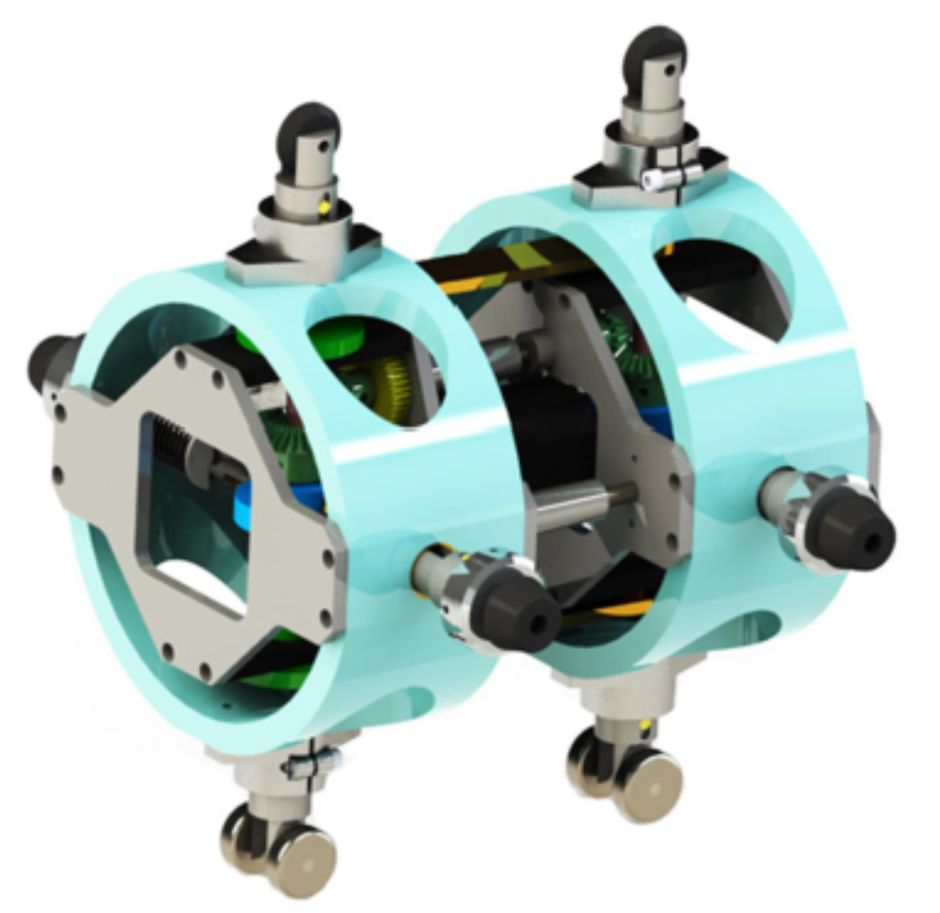
TECHNICAL DESIGN
Mechanism Design Comparison
Reference: Cam-Linkage Robot & In-pipe inspection robot
Proposed: Wheel + TDCR Hybrid
Single stepper motor drives symmetric cam groups + linkage for bidirectional inchworm creep.
Cam pressure angle reduced to ≈ 0° — avoids self-locking, keeps propulsion efficient.
No provision for elbows, bends or vertical transitions — rigid front/rear bodies only.
Six spring-loaded self-adjusting wheels per body give continuous traction across a 6-8" diameter range.
Tendon-Driven Continuum link adds multi-DOF bending — unlike CLR’s rigid crank, it flexes through elbows.
Adds onboard vision + sensing for defect capture, absent in the CLR reference design.
12/ 16

Slide 13
FEASIBILITY ANALYSIS
Technical, Economic & Operational Feasibility
Technical
Economic
Operational
Six-wheel adaptive mechanisms & TDCR continuum links are individually proven in literature.
Off-the-shelf steppers, tendon actuators, and machine-vision cameras meet payload/precision needs.
Integration is the novel step — mechanically compatible, feasible on a standard fabrication timeline.
Component set (motors, microcontroller, camera, sensors) is low-cost relative to industrial deployment value.
Prevents costly unplanned shutdowns & leak repairs — strong cost-avoidance case.
Reusable across multiple 6-8" pipeline assets, improving return on a single build.
Deployable via standard inspection access ports in oil & gas, water, chemical, and power plants.
Tetherless or tethered operation both compatible with the proposed control architecture.
Digital map output integrates directly into existing maintenance workflows.
13 / 16

Slide 14
IMPLEMENTATION
Progress Achieved So Far
Literature Review
Completed
Surveyed wheel, wall-press, screw, inchworm & pneumatic in-pipe robots; benchmarked against CLR.
Next Steps
Finalize wheel-arm & TDCR CAD
Fabricate prototype
Develop control firmware
Test in mock pipeline rig
Validate defect detection accuracy
Concept & Need Analysis
Completed
Defined problem statement, research gap and SDG-aligned objectives.
Six-Wheel Mechanism CAD
In Progress
Conceptual layout of spring-loaded self-adjusting wheel arms underway.
TDCR Kinematic Modeling
Initiated
Tendon routing and bending-section kinematics being formulated.
Sensor & Vision Selection
In Progress
Shortlisting camera and proximity/IMU sensors for defect detection.
14 / 16

Slide 15
EXPECTED OUTCOMES
What the Final Prototype Will Deliver
6-8"
2-Way
Real-Time
Digital
Adaptive pipe
diameter range
Bidirectional
traversal
Defect detection
& logging
Path + defect
map output
Outcome Summary
A working prototype that autonomously navigates straight sections, elbows and vertical transitions in 6-8" pipe.
Onboard vision system flags cracks, corrosion, dents and weld irregularities during traversal.
A digital inspection map that pinpoints defect locations along the travelled route for maintenance crews.
Reduced manual intervention and improved inspection efficiency across oil & gas, water, chemical and power sectors.
15 / 16

Slide 16
Thank You
Intelligent Pipe Inspection Robot — Project 1, Review 1
16 / 16

