Slide 1

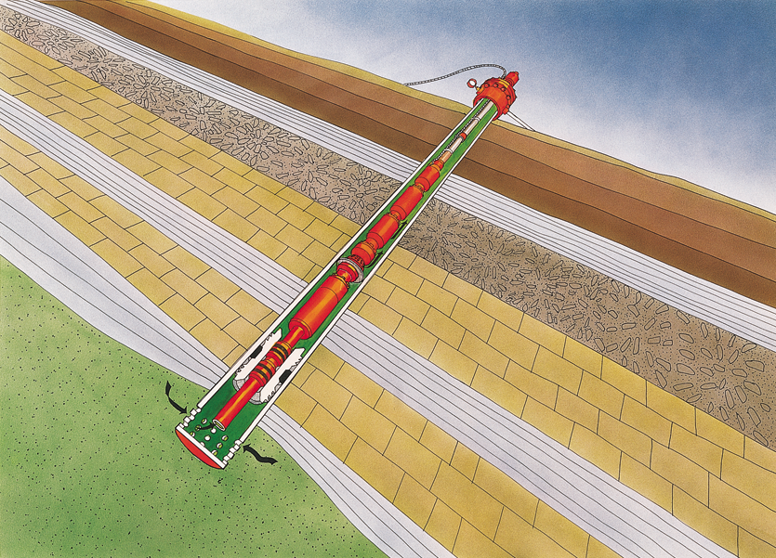
Electric Submersible Pumps – design with pressure gradient curves

Slide 2

Total Dynamic Head – What I am not going to talk about !
Wellhead Pressure
Wellhead
3
Ground Level
Flow
1
2
Net Vertical Lift
Total Friction Loss
Producing Fluid Level
Pump Set Depth
Flow
Flow

Slide 3
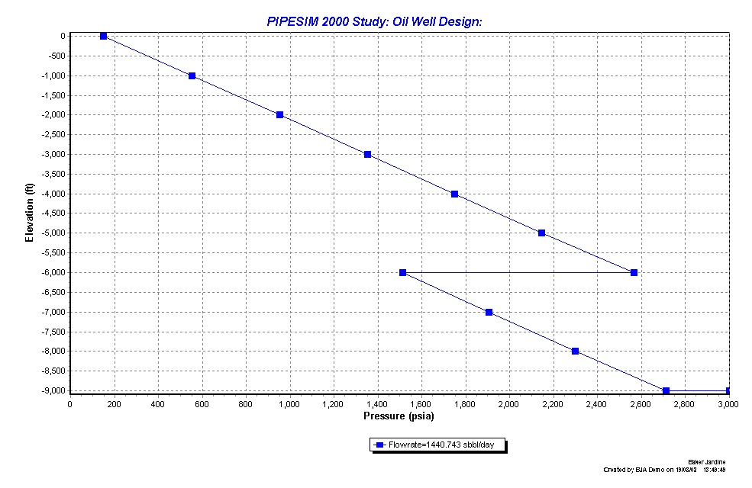
Pressure gradient curve
P_{wh}
Pump setting depth
PIP
Pump dP
PDP
P_{wf}
P_{R}
Notes:
The pump cannot flow at this rate naturally as the required Pwf seen by the extrapolated gradient line is > reservoir pressure

Slide 4
Pump curves
The two main pump design parameters are:
  The pump delta P converted to head by fluid density.
  The pump flow rate in rb/d
Notes:
The pump operates by lifting a volume of liquid out of the well with every stroke – like using a bucket in a water well

Slide 5
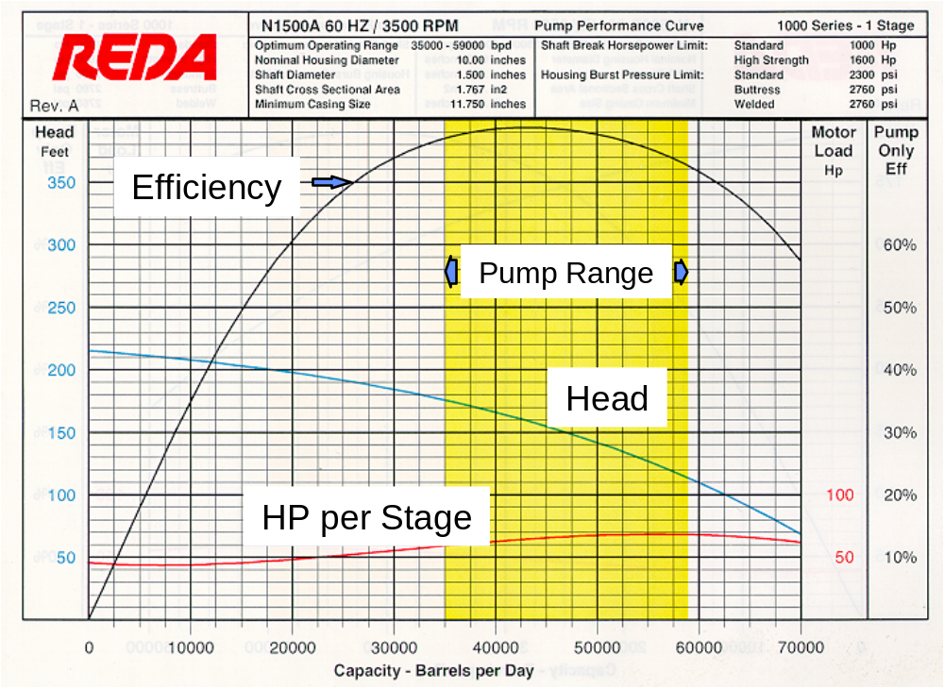
Pump curves
Notes:
By examining the curve above we can see that at 38000BPD the N1500A pump stage will produce 140’ of lift or head. It does not matter to the pump what the specific gravity of the pumped fluid is, for that condition it will always produce 140’ of lift. This is very useful for producing pump curves but not very practical in the real world as we are not very often producing liquid straight out of the pump to atmosphere. More often head needs to be converted to pressure, in the ‘imperial oil field’ this is almost always Pounds per square Inch. The conversion is relatively straightforward
PSI=(Head in feet)x(Weight in pounds of one square inch of fluid 1’ high)
This suggests that you know the weight by volume of your fluid, which is not usually the case. However a 1’ high column of water will exert a pressure of 0.433pounds of pressure over a 1” square, so if you know the s.g. of the pumped fluid it is easy to work out the head in PSI.
PSI=(Head in feet)x(0.433)x(S.g. of pumped fluid)
Horsepower per stage
In the same way that the lift per stage can be read for each flow rate, the HP required to ‘turn’ the stage can also be calculated. For the 48000BPD case each stage will use approximately 68HP.
Recommended Operating Range (ROR)
The recommended operating range of is determined and used for a number of different factors and for a number of different reasons.
Api Testing-Pumps must fall within +/- 5% on head and flow, less than 8% on horsepower and +/-10% on efficiency within the ROR. Not all pumps match the performance curves, Schlumberger curves will match to within API RP within the ROR. The further away from the ROR the pump is operated at the larger the percentage difference can become.
Efficiency-The ROR is set around the best efficiency point(BEP) of the pump stage operating outside of this range will undoubtedly require a larger pump and motor to be purchased as well as more electricity to operate it.
Thrust-Each pump stage will be exposed to various forces in its normal operating life. These are
❖ Gravity acting on the bouyed mass of the impeller. This force will always act downwards, this will not always be in the direction of the shaft, remember deviated wells.
❖ The net force resulting from the differential pressure in the stage. Unless there is a wide open flow condition the stage will always develop head hence the ‘topside’ will always be greater than the ‘downside’, hence this force is always downwards.
❖ The force from the momentum of the fluid coming into the stage.This will always be upwards unless there is a no flow condition, in which case it will be zero.
Depending on whether the resultant force is positive or negative determines whether the pump stage is in downthrust or upthrust, it is practically improbable that the forces will be in equilibrium. As a general rule of thumb, pump operation to the left of the ROR will mean the stage is in downthrust (the differential pressure at lower flows out weighs the force of the fluid momentum). To the right of the ROR the stage is generally considered to be in upthrust.
In upthrust, the topside of the impeller will need to handle the force created against the underside of the top diffuser stage. In downthrust this force will need to be handled on the underside of the impeller stage.
Downthrust can be handled in every stage or by transfer to a suitable location within the pump string, it all depends on construction of the unit.

Slide 6
Systematic Pressure Analysis
Above the pump:
  P _{discharge} = WHP + ΔP_{gravity} + ΔP_{friction} (wellhead to pump)
    Validates : oil density, water cut, pressures and depths)
Across the pump:
  P _{intake} = P_{discharge} - ΔP_{pump}
    Where ΔP_{pump} = Head (ft) x Density (psi/ft)
    Validates : pump performance, flowrate, effect of wear/viscosity/gas)

Slide 7
Systematic Pressure Analysis
Below the pump:
  P _{wf} = P _{intake} + ΔP_{gravity} + ΔP_{friction} (pump to reservoir)
In the reservoir:
  PI = Q / (P_{R} – P_{wf} ) (reservoir inflow performance)
    Validates : IPR, flowrate, PI, P_{R}
  Downhole flowrate (rb/d) = Q_{oil}(stbo/d) x B_{o} + Q_{water} (stbw/d)

Slide 8
ESP Head/Pressure Calculations
ESP generates head by movement of fluids through the impeller and diffuser changing kinetic energy (movement) into potential energy (head)
Head is dependent on
  Speed of rotation of impeller
  Flow rate through the impeller
  Size and shape of impellers (flow types)
  Viscosity of fluids
  Amount of gas
  Mechanical factors such as wear

Slide 9
ESP Head/Pressure Calculations
Head (ft) = ΔP_{pump} (psi) / pressure gradient of well fluids (psi/ft)
    remember pressure gradient (psi/ft) = S.G. / 2.31
Questions:
  For a pump generating 2500 feet of head and pumping seawater, what is ΔP ?
  For the same pump which is now pumping 34°API oil what is ΔP ?
  What would this scenario be typical of ?
Notes:
2500*0.45 = 1125 psi
2500 * 0.37 = 925 psi
Unloading a well after completion

Slide 10
ESP Head/Pressure Calculations
Fluid level above the pump
Wellhead
Flow
Ground Level
Producing Fluid Level
Pump Set Depth
Flow
Flow
Given : pump set depth = 6000 ft, top of perforations = 6750 ft, the measured P_{intake} = 600 psi and zero casing pressure in the well producing 100% 34°API oil , what is the fluid level above the pump ?
Notes:
600/0.37 = 1621 ft

Slide 11
ESP Head/Pressure Calculations
For the case of this well with no measurement of P_{intake} but with 40% water cut and a measured fluid level= 4379 ft, what would be the Pwf ?
Oil ??
Downhole measurement will reduce uncertainty
Produced Fluid
Notes:
Assume oil above the pump and mixture below:
Pintake = 600 psi
Pwf= 600 + 0.6*0.37*750 + 0.4*0.43*750=895 psi
If I assume a mixture from 4379ft down I get Pwf = (0.6*0.37+0.4*0.43)*2371 = 934 psi !

Slide 12
Measurements for ESP systems
What’s measured | What it can help with
Pump discharge pressure | Water cut, tubing GOR estimation and well shut in protection
Well head pressure | Water cut and tubing GOR
Pump intake pressure | Gas locking (P_{b} and free gas volumes), reservoir drawdown, sand control, coning
ΔP_{pump} | Upthrust and downthrust protection; flow estimation, pump performance (wear, viscosity,materials)
Motor temperature | Overheating
Motor amps | Overload/underload protection
Current leakage | Overheating – insulation breakdown
Vibration | Fatigue, loading

Slide 13
ESP design process (manual)
Assume design conditions: flow rate, water cut, WHP, pump setting depth and IPR
Determine P_{wf} from IPR
Calculate upwards to find PIP using a flow correlation or simplifying assumptions
Determine gas entering pump after gas separation (if any)
Calculate downwards from WHP to find PDP using a flow correlation or simplifying assumptions
Find pump head requirement: Head (ft) = ΔP_{pump} (psi) / pressure gradient of well fluids (psi/ft)
  Total dynamic head (TDH)
Find average flow rate Q_{pump} in pump (rb/day)

Slide 14
ESP design process (manual)
Select pump size from casing ID and pump operating range
From pump curves read head per stage for Q_{pump}
Calculate number of stages required = TDH / head per stage
From pump curves read power required per stage at Q_{pump}
Calculate total motor horsepower required =
    power per stage x no. of stages x S.G. of fluid
Select voltage/amps combination for selected motor size
Select cable size from amps required
Run sensitivities that consider changing well conditions

Slide 15
ESP design and analysis exercises
Exercise 1 : manual pump design
Exercise 2 : using PIPESIM for pump design
Exercise 3 : using PIPESIM for pump diagnostics

Slide 16
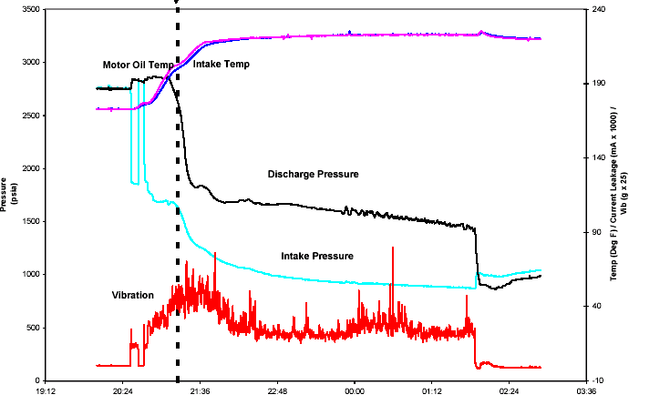
ESP diagnostics examples

Slide 17
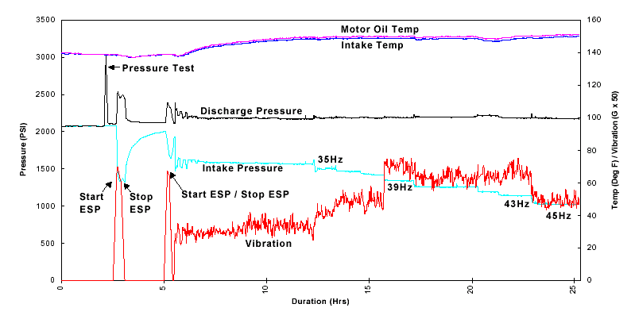
ESP Diagnostic Examples

Slide 18
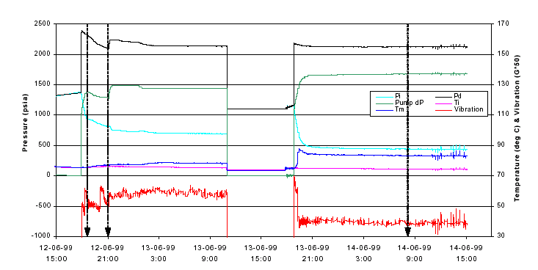
ESP diagnostics and Time slice analysis

Slide 19
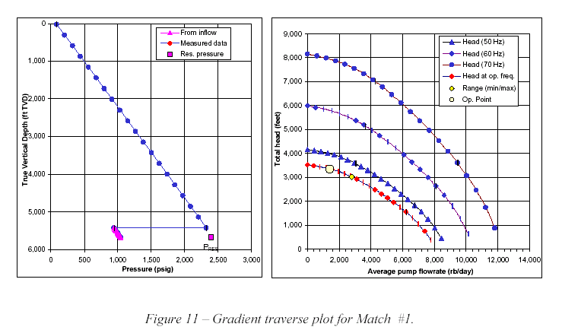
ESP diagnostics and Time slice analysis

