Slide 1
Formalization and implementation of BFO 2 with a focus on the OWL implementation
With an introduction to some of the underlying technologies
Alan Ruttenberg, University at Buffalo, 2012-08-18

Slide 2
Goals of this session
Discuss the implementation of BFO 2 in a computational setting, in particular the Semantic Web
Explain the role of the BFO2 Reference, informal first order logic (FOL), FOL implementation, and OWL implementation
Give an introduction to OWL 2, the Web Ontology Language
Show what constructs are available
Explain the role of reasoner and standard reasoning tasks
Go into detail about the BFO 2 OWL 2 implementation
Review design, classes, properties
Explain approach to temporal representation
Review open issues
Give some pointers to additional resources

Slide 3
How is BFO made
Historically, Barry Smith developed BFO
Because BFO will be part of the OBO Foundry, it will now be developed collaboratively
There is a group of about 10 individuals who have actively worked on the current version
The output of this process are: The BFO2 Reference, informal first order logic (FOL), FOL implementation, and OWL 2 implementation
There is overlap of the people involved in developing each of these artifacts.
It should be understood that BFO is not yet finalized
You should understand phrases such as “BFO has X, or BFO doesn’t X”, until this development cycle of BFO is finished, as “in my opinion BFO has X” or “the current BFO document has X”

Slide 4
Role of BFO 2 development artifacts
The Reference tells you how to think about BFO 2, as well as explicating the skeleton of the formal expression
The informal FOL, part of the Reference, is a guideline for developing the FOL expression of BFO
The FOL expression of BFO should be the arbiter of decision making regarding which statements are true according to BFO
The OWL 2 implementation of BFO 2 is mean to be used for computing with knowledge structured according to the principles developed in BFO 2 Reference

Slide 5
Example of informal FOL – realizes relation
Reference: To say that b is a realizable entity is to say that b is a specifically dependent continuant that inheres in some independent continuant which is not a spatial region and is of a type instances of which are realized in processes of a correlated type.
First order logic(ish): to say that b realizes c at t is to assert that there is some material entity d & b is a process which has participant d at t & c is a disposition or role of which d is bearer_of at t & the type instantiated by b is correlated with the type instantiated by c.

Slide 6
Example of FOL – realizes relation
(forall (x y t)
(if (and (hasParticipantAt x y t)
(SpecificallyDependentContinuant y))
(exists (z)
(and (IndependentContinuant z)
(not (SpatialRegion z))
(specificallyDependsOnAt x z t)
(specificallyDependsOnAt y z t)))))
FOL is written as documentation, as well as in a computational format called Common Logic Interchange Format (CLIF)

Slide 7
Example of OWL – realizes relation
Domain: process
Range: ‘realizable entity’
realizes o 'inheres in at all times’ -> ‘has participant at some time’
The owl is sometimes simpler that FOL in some ways, and more complicated in other ways. Strictly speaking OWL is a fragment of FOL, with a syntax that differs from standard FOL syntax

Slide 8
An introduction to Web Ontology Language aka OWL
Because it might be hard to explain the BFO 2 OWL implementation if you don’t know what OWL is

Slide 9
Goals of this section
Introduce the idea of the semantic web of which OWL technology is a part
Explain what OWL is intended to do, and not
Introduce you to the elements that OWL lets you work with
Explain the role of reasoner and standard reasoning tasks
Expose some common sources of error
Show some examples of uses of OWL
Give pointers to related tools and online resources

Slide 10
The semantic web in a nutshell
Adds to web standards and practices encouraging
Unambiguous names for things, classes, and relationships
Well organized and documented in ontologies
With data expressed using uniform knowledge representation languages
To enable computationally assisted exploitation of information
That can be easily integrated from different sources
Both within and across public and organizational boundaries

Slide 11
Some elements of a future web hoped for by semantic web researchers
A web where you can make precise scientific queries on a scale that google now makes available less precise queries
A web with autonomous agents that you can trust to do tasks for you
The same cut and paste fluidity with which we can build web pages, but for scientific analysis and visualization
Increased scientific productivity because of the availability of knowledge to people with many different skills

Slide 12
Allen Brain Atlas & copy/paste
A remarkable scientific achievement. Mouse brains sectioned and stained for the presence of gene expression.
20,000 genes, 400000 images at high resolution.
At the time available only through an HTML interface.
Extract the information, convert to RDF (Now there is XML) to enable search by ontology tools

Slide 13
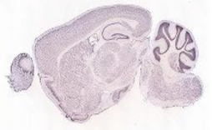
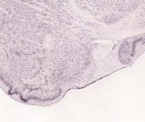
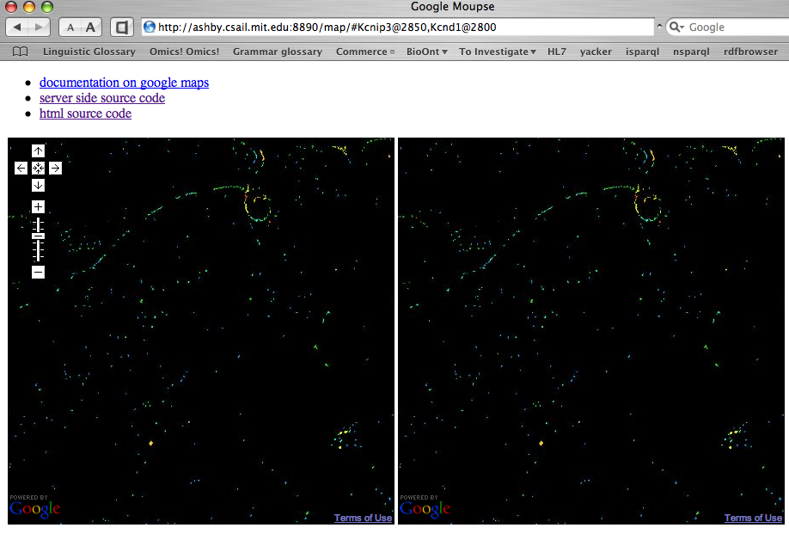
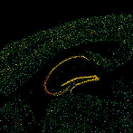
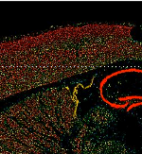
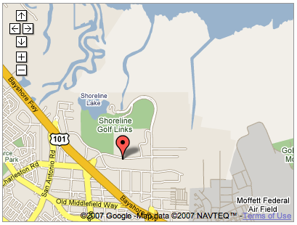
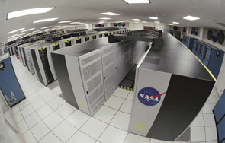
Copy/Paste on the Semantic Web for Science
Allen Brain Institute Servers
Javascript
http://www.brainmap.org://….0205032816_B.aff/TileGroup3/1-0-1.jpg
SPARQL AJAX
Query
URL
Google Maps API
Neurocommons Servers
Notes:
http://hcls1/map/#Kcnip3@2850,Kcnd1@2800

Slide 14
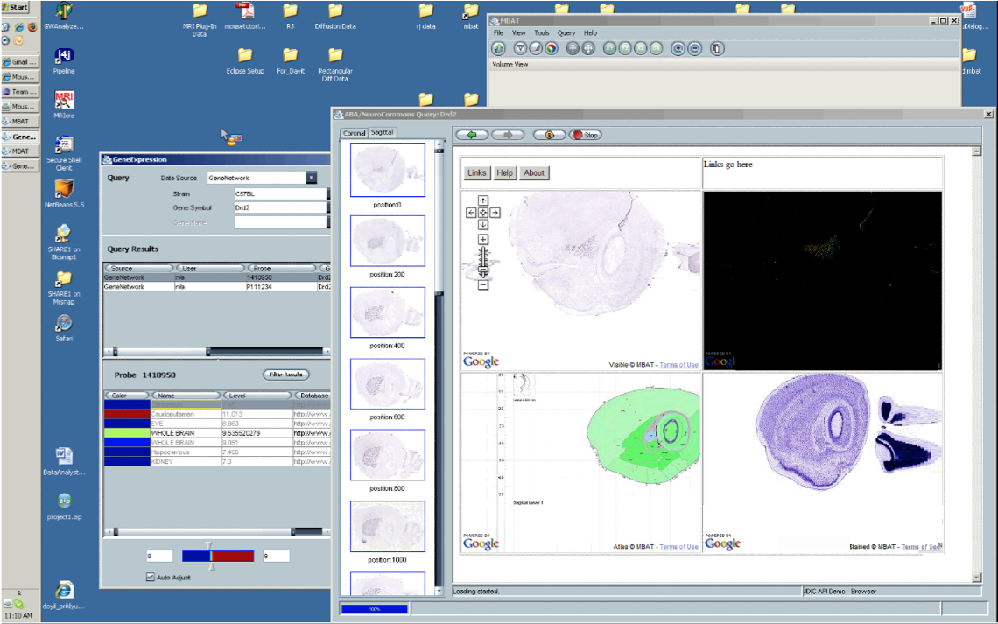
BIRN: “viewed source”, use our code in their own applications

Slide 15
We are always asking questions
For what neurological disorders are cell lines available?
For Parkinsons disease, what tissue and cell lines are available?
Give me information on the receptors and channels expressed in cortical neurons
What chemical agents can be used visualizing the nervous system?
A question I was asked
Create a system that will let us prioritize an expected 2000 siRNA hits according to whether there is chemical matter for studying them, e.g. validated antibodies, since we can only follow up on 600.
We know how to use Semantic Web technology to answer these kinds of questions (but there is no free lunch)
We build BFO 2 and ontologies based on it to make it possible to answer questions such as this

Slide 16

What is OWL?
Web Ontology Language (acronym inspired by Winnie the Pooh)
A computer language in which you can express, communicate about and reason over some kinds of ontologies
One element in a set of interoperable standards and protocols collectively known as “semantic web”
One of a set of such semantic web languages with varying capabilities – RDF, RDFS, RIF
A family of languages – OWL-[Full, DL, EL, RL, QL]. In this presentation we focus on OWL-DL
A fragment of first (and a bit of second) order logic

Slide 17
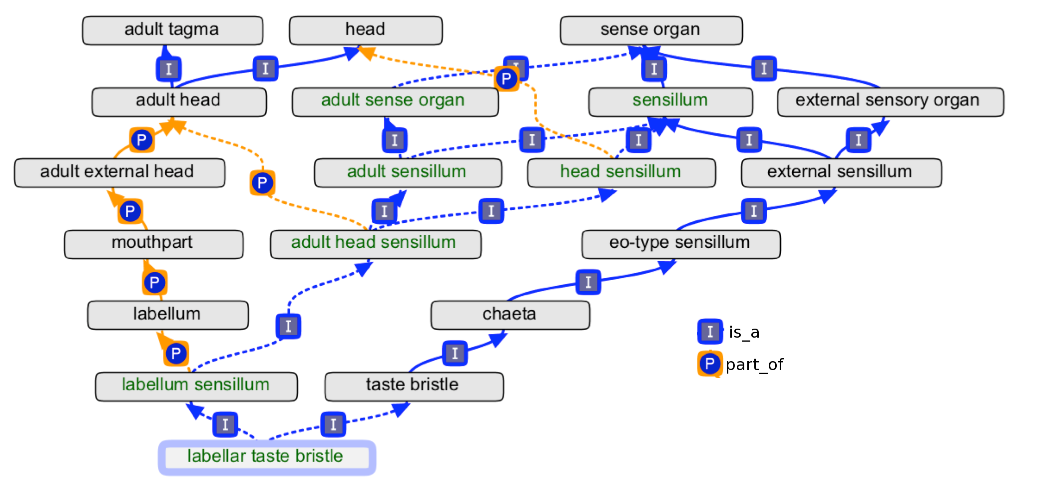
Manually maintaining an ontology with multiple classification schemes is hard…
Here the desire is to classify by part, by function, and by stage of life
…so automate what you can.

Slide 18
How OWL helps us move in that direction
Historically, much work done in ontology and representation, but with many different, incompatible, systems
OWL standardization helps make it easier to share, deploy, and build on others work.
In many cases these projects did not use very much reasoning, or used imprecise rules of inference
OWL has a clear semantics and there are and open source reasoners that perform adequately and yield complete, correct results
Even now, a major repository of biomedical ontologies, the NCBO Bioportal, contains a number of inconsistent ontologies

Slide 19
What is OWL not?
OWL is not a philosophical theory, it is a computational tool
Don’t confuse OWL Classes with Universals
Don’t confuse OWL Individuals with Particulars
(even though we often use the former to represent the latter)
Using OWL doesn’t mean your ontology will automatically be good, any more than using words means you will write a good story
There are lots of things that OWL’s reasoning can’t do, some very important, like reasoning about how events relate in time.

Slide 20

Building blocks of OWL

Slide 21
Building block: Individual
Individuals are singular entities.
They can be the subject and object of relations
They can be named or un-named
Often, but not always, OWL individuals are used to represent particulars.
In subsequent text I will sometimes use a blue color for text descriptions of individuals

Slide 22
Building block: Class
A class is a set of individuals, but is not determined by them.
Class expressions describe conditions under which an individual is a member of that set
OWL Classes are often used to represent universals, groups, or attributed classes.
In subsequent text I will sometimes use a green or orange for text descriptions of classes

Slide 23
Building block: Datatype and Values
Data values are singular entities.
They can be the object of relations, but not subject
Datatypes are sets of data values along with built-in relations between the values
Every data value is associated with a datatype
Example values: 2.7^^float, 3^^integer, “hello”
Example built-in relations: > (for numbers), length (for strings)

Slide 24
Building block: Property
Properties can be thought of as sets of pairings of individuals with either other individuals or data values. As with classes, the set does not determine the property.
Often, but not always, OWL properties are used to represent relations.
In subsequent text I will sometimes use bold face for text descriptions of properties
Example: An OWL property inheres_in (at a time)
A set of pairs of dependent continuants and the independent continuants they inhere in
e.g (this dark blue color, this screen)

Slide 25
Building blocks: statements about properties
Property domain and range, let you express what the class of any subject or object of a property is
Property characteristics: transitive, symmetric, reflexive, functional …
Cause there to be additional inferences to be made based on a property assertion

Slide 26
Building block: Quantified Statements
subClassOf, subPropertyOf
All-some
ALL things related to SOME thing of a type.
Person: has part some head
All-only
ALL things related to ONLY things of a type.
PumpingFunction: realized in only Pumping
Composition of properties.
realizes o inheres_in => has_participant
English: for ANY function and ANY processs, if there EXISTs a thing such that function of thing is realized in process, THEN thing participates in process.

Slide 27
Different ways of writing OWL
Encoding the statement “John is an instance of Person”
DL Syntax
John ∈ Person
RDF/XML
Manchester syntax
<owl:Class rdf:about="http://example.org/1/person">
<rdfs:label>person</rdfs:label>
</owl:Class>
<owl:NamedIndividual rdf:about="http://example.org/1/john">
<rdf:type rdf:resource="http://example.org/1/person"/>
<rdfs:label>john</rdfs:label>
</owl:NamedIndividual>
Prefix: : <http://example.org/1/>
Class: :person
Annotations:
rdfs:label "person”@
Individual: :john
Annotations:
rdfs:label "john"@
Types:
:person
Functional style syntax
Prefix(:=<http://example.org/1/>)
Declaration(Class(:person))
AnnotationAssertion(rdfs:label :person "person")
Declaration(NamedIndividual(:john))
AnnotationAssertion(rdfs:label :john "john")
ClassAssertion(:person :john))
Turtle
:john rdf:type :person
:john rdfs:label “john”
:person rdf:type owl:Class
:person rdfs:label “person”

Slide 28
Jargon: triples
:john rdf:type :person
:john rdfs:label “john”
:person rdf:type owl:Class
:person rdfs:label “person”
Each line has three parts
Subject
Predicate
Object
This representation originates with RDF

Slide 29
Reasoning and OWL

Slide 30
What is reasoning?
Reasoning is a mechanism to leverage what you have said in OWL to do more for you
Typical OWL reasoners perform several tasks
Check whether everything you said makes sense together
Are all the classes satisfiable?
Is the ontology consistent?
Determing which classes subsume each other
Infer relationships that are implied, but not stated explicitly
Determine what types an instance is
Answer a variety of queries, based on what you have stated
Protégé provides access to Pellet, Hermit and FaCT++
Beware: Reasoners are built by people and therefore sometimes have bugs.

Slide 31
Reasoning: a subsumption
Given
An antihypertensive drug is any drug that treats hypertension
A calcium channel blocking antihypertensive is any drug that treats hypertension AND has a calcium channel blocker as active ingredient
An owl reasoner would infer that
antihypertensive drug subsumes calcium channel blocking antihypertensive
calcium channel blocking antihypertensive is a subclass of antihypertensive drug
Every calcium channel blocking antihypertensive is an antihypertensive drug
( These three statements mean the same thing )

Slide 32
Reasoning: an unsatisfiable class
Given
Every antidepressant drug has at least one side effect
Dr. Palaasa’s recommended drugs are any antidepressant drug that has no side effects
An OWL reasoner would infer that
The class Dr. Palaasa’s recommended drugs is unsatisfiable
The class Dr. Palaasa’s recommended drugs can not have any members
( These three statements mean the same thing )

Slide 33
Reasoning: an inconsistency
Given
John was only treated with analgesics
John was treated with some coumarin
No coumarin is an analgesic (or coumarin and analgesic are disjoint)
An OWL reasoner would infer that
There is an inconsistency
( If john was only treated with analgesics and he was treated with coumarin, then coumarin is an analgesic. But we said coumarin is not an analgesic )

Slide 34
Reasoning: determing type
Given
John was treated with some coumarin
Anyone who is treated with something is a patient
An OWL reasoner would infer that
John is an instance of patient
John has type patient
( These mean the same thing )

Slide 35
Reasoning: an inferred relation
John’s hand is part of John’s body
John’s finger is part of John’s hand
The is part of relation is transitive
An OWL reasoner would infer that
John’s finger is part of John’s body
( even though you didn’t explicitly say that )

Slide 36
Reasoning: answering queries
OWL reasoners can answer queries posed as class descriptions, using previously described reasoning
Using subsumption, one can retrieve superclasses or subclasses of the described class
Using the ability to determine type one can retrieve instances that satisfy the class description

Slide 37
Reasoning: answering a query
Given
John has a temperature of 98.6
Mary has a temperature of 99.2
Sam has a temperature of 96.2
Elise has a temperature of 101.1
Suppose you want to query “which people have a temperature of 99 or above” you would create the class expression
Any thing that has a temperature of > 99 (imagine this class is called ‘q’)
Then ask which instances have type q. We describe that kind of reasoning on the slide “reasoning: determining type”

Slide 38
How does a reasoner work?
Recall
Everything is grounded in individuals
Classes have extensions = the individuals that are members
Properties have extensions = the pairs of individuals that are so-related.
OWL Reasoners work by trying to prove all models satisfy the constraints of what you have stated in your ontology. They do that by trying to find a model that satisfies the negation, and if they find it they are done.
A models is (to a first approximation) a choice of these extensions

Slide 39
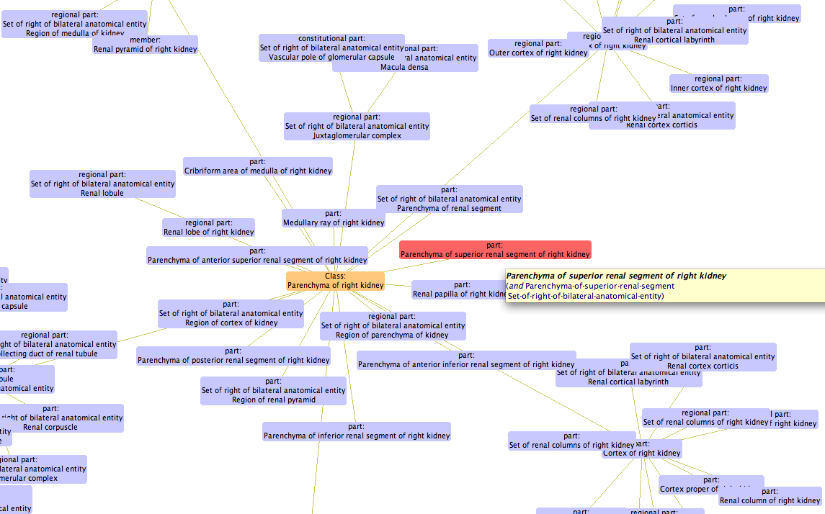
One visualization of a model
Be happy: reasoners check lots of details, saving you the effort!
Caveat: There are two important assumptions OWL reasoners make

Slide 40
The open world assumption
What you don’t say, isn’t known
Consider a drug formulary listing drugs whose cost will be reimbursed by insurance
If a drug is not listed in the formulary, then it won’t be reimbursed.
This demonstrates the closed world assumption: If something isn’t said, it is considered to be false
Consider a taxonomy of species
If a species is not in the taxonomy, the author simply didn’t know about it.
The open world assumption is well suited for working in science, where what we don’t know is much more than what we know

Slide 41
Things can have more than one name
We say OWL lacks the unique name assumption
Consider the bar code on blood sample tube
Some bar codes are assigned with the intention that they are not reused
We can safely assume that if we are given two different bar codes, there are two different tubes
Therefore, we can use the unique name assumption when dealing with bar codes on blood samples
Consider instead the different names for a chemical
Aside from different communities giving chemical different names, there are names for the same thing in many different languages
We can’t assume that if two things have different names they are different things.
Because OWL was built for the world wide web, it doesn’t make the unique name assumption.

Slide 42
Beware
Forgetting about these two assumptions is a cause for much confusion about how OWL behaves
Most commonly people are surprise because they expect different results than they get
I will give examples of some cases of this

Slide 43
A typical open world surprise
Given
John has son Mark
John has son Sam
Describe the class
Person that has 2 sons
Surprise! – John is not determined to be an instance of this class
Why?
John might have another son – we didn’t say these were his only sons
In OWL you can say, if appropriate, that Mark and Sam are different individuals

Slide 44
Another typical open world surprise
Given
The domain of property has son is an organism
my corolla is a car
my corolla has son my bicycle
We’ve made a mistake!
Why doesn’t the reasoner complain?
my corolla is inferred to be both a car and an organism, but we didn’t say that nothing can be both a car and an organism
In OWL we need to say that car and organism are disjoint classes

Slide 45
A typical (lack of) unique name assumption surprise
Given
John has son Mark
John has son Sam
Create the class
Person that has at least 2 sons
Surprise – John is not determined to be an instance of this class
Why?
Mark and Sam might be names for the same person. The fix: Assert that Mark and Sam are different individuals

Slide 46
OWL 2 added a number of capabilities to OWL
Annotations everywhere
No separated vocabulary
New property types
Qualified cardinality
Property chain
Datatypes
Profiles

Slide 47
Annotations
Annotations (e.g. string to display in user interface) have no model theoretic semantics
OWL 2 lets you annotates more entities. OWL 1: Entities. Now also: Axioms, PropertyAssertions, Annotations themselves.
AnnotationAssertion( obo:OBI_0000255 Annotation( obi:forCommunity “CDISC” ) obi:alternativeLabel ”Investigation Site”)
PropertyDomain( Annotation(obi:editor_note “Needs more tightly controlled domain restrictions”)
ro:part_of snap:Continuant)

Slide 48
No more separated vocabulary
In OWL 1 DL, an name could not denote more than one of class, object property, datatype property, individual
In OWL 2 DL this restriction is removed. One can say:
ClassAssertion( a:Dog a:Brian) Brian instance of dog.
ClassAssertion( a:Species a:Dog ) Dog instance of species.
However, inference is limited:
SameIndividal( a:Dog a:Canine) does not entail
ClassAssertion( a:Canine a:Brian)

Slide 49
Property types
OWL 1 had: Functional, InverseFunctional, Transitive, Symmetric
OWL 2 adds: Asymmetric, Reflexive, Irreflexive
Nobody can be their own spouse ObjectProperty(spouseOf Irreflexive)
If A is B's parent, then B is not A's parent ObjectProperty(biologicalParent ASymmetric)
Unfortunately, transitivity can’t be combined with asymmetry so this can’t be used to check partonomies for cycles.

Slide 50
Qualified Cardinality Restrictions
In OWL 1 there were cardinality constraints that constrained the total number of values that a property could have. In OWL 2 we can qualify cardinality with a type.
A safe drug regimen must not contain more than one central nervous system depressant
ClassAssertion( MaxCardinality( 1 CNS-Depressant) SafeDrugRegimen )

Slide 51
Property chains
Gives ability to compose relations.
Caveat: There are complex side conditions that rule out certain combinations of axioms
Owning something means owning all of its parts
SubPropertyOf( PropertyChain( owns has_part ) owns )

Slide 52
More expressive datatypes
Teenagers have an age between 13 and 19
SubClassOf ( SomeValuesFrom( a:hasAge DatatypeRestriction( xsd:integer xsd:minInclusive "13"^^xsd:integer xsd:maxInclusive "19"^^xsd:integer) ) a:Teenager)
An experimental extension – linear equations. A set datatype properties are constrained to be solutions of a set of linear equations.
http://www.w3.org/2007/OWL/wiki/Data_Range_Extension:_Linear_Equations

Slide 53
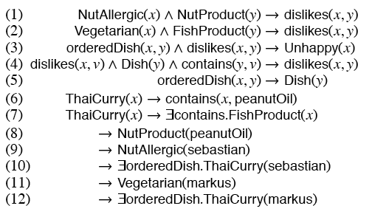
Property chains
Property chains can be used to implement decidable rules on OWL:
http://korrekt.org/papers/KroetzschRudolphHitzler_ELP_TR_2008.pdf

Slide 54
More expressive datatypes
OWL 1 had strings and integers at least, and poorly defined behavior for additional datatypes
OWL 2 has a wider variety of types with well defined behavior: floats, doubles, dates, decimal, real, rational
OWL 2 allows extension, by restriction, of datatypes, e.g. integers < 3, strings that match regular expresion “OBI_.*”.

Slide 55
Profiles
Profiles are subsets of the language with different computational properties
OWL EL – Drops disjunction, negation, universal quantification (+ some more). Gains polynomical classification time.
OWL QL – Drops disjunction, universal quantification, enumerated classes. Restricts where existentials and negation can occur (+ some more). Gains ability to work with instance data stored natively in a relational database by translation of main operations to SQL

Slide 56
Profiles
OWL-RL: Restricts expressiveness so that individuals not explicitly in the ontology can not be inferred. Gains the ability to compute ground entailments (those involving only individuals) by using a forward chaining rule system (but caveat datatype).
The rules applied to unconstrained RDF graphs give correct, but incomplete, results.

Slide 57
Some things OWL can’t compute
Cycles
Temporal Reasoning
Query (other than querying instances of a class)

Slide 58
Cycles
Can’t express that there are only 3 entities connected in a cycle. Can’t differentially classify cycle from open.

Slide 59
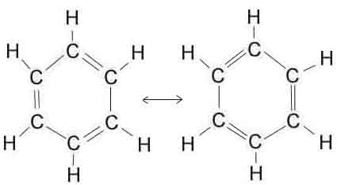
Cycles
Can’t write a defined class expression that classifies these as rings

Slide 60
Temporal Expression
We can express time in many ways. For example, using annotations.
PropertyAssertion( Annotation(during interval1) part_of A B)
But the annotation carries no semantics. If we have
PropertyAssertion( Annotation(during interval2) part_of B C)
Reasoner will conclude that A part_of C even if interval1 and interval2 don’t overlap

Slide 61
Temporal Reasoning
What do we want to say? (relevant for biology)
1) something exists only during an interval
2) If A exists between t1, t2, and B exists between t3, t4, and we say there is some time that A part_of B, can we find an inconsistency if {t1, t2} doesn’t overlap {t3,t4}?

Slide 62
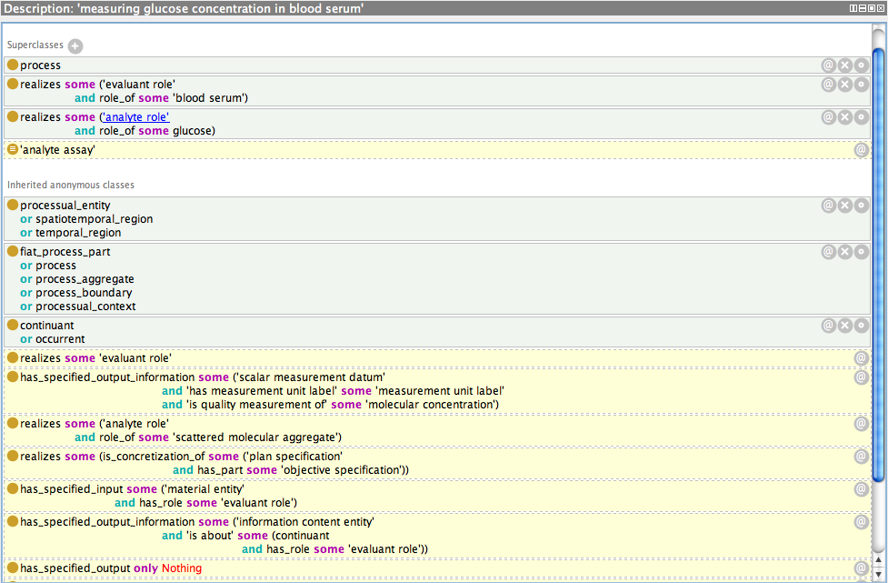

Slide 63
From English to OWL: Words mix up functions and objects
Ligand
Neurotransmitter
Hormone
Peptide
Looking for peptides?

Slide 64
Connect words to their corresponding entities in the world
PeptideReceptorLigand - A peptide that has a function which makes it able to bind to a receptor
PeptideNeurotransmitter - A peptide expressed in a neuron that has a function which makes it able to regulate another neuron
PeptideHormone - A peptide that produced in one organ and having an regulatory effect in another.
Peptide - A “short” polymer of amino acids
Looking for peptides?

Slide 65
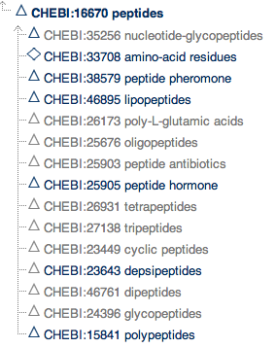
Peptides from CHEBI Chemical Entities of Biological Interest

Slide 66
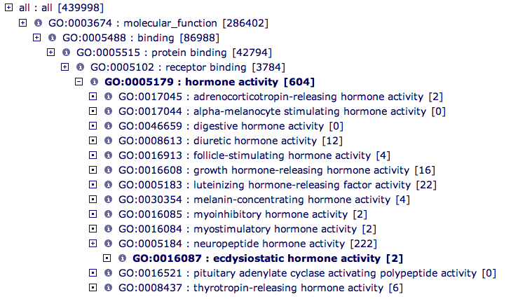
Hormone Activity from GO Molecular Function

Slide 67
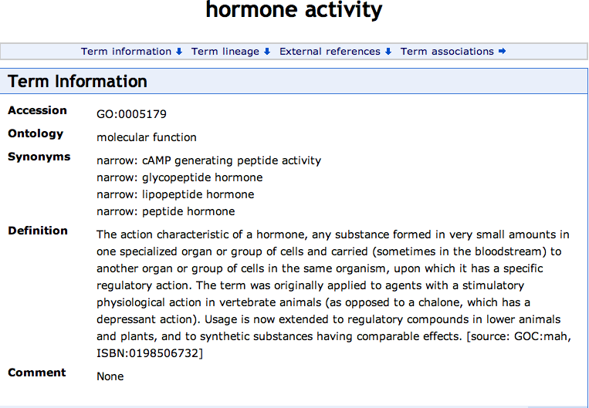

Slide 68
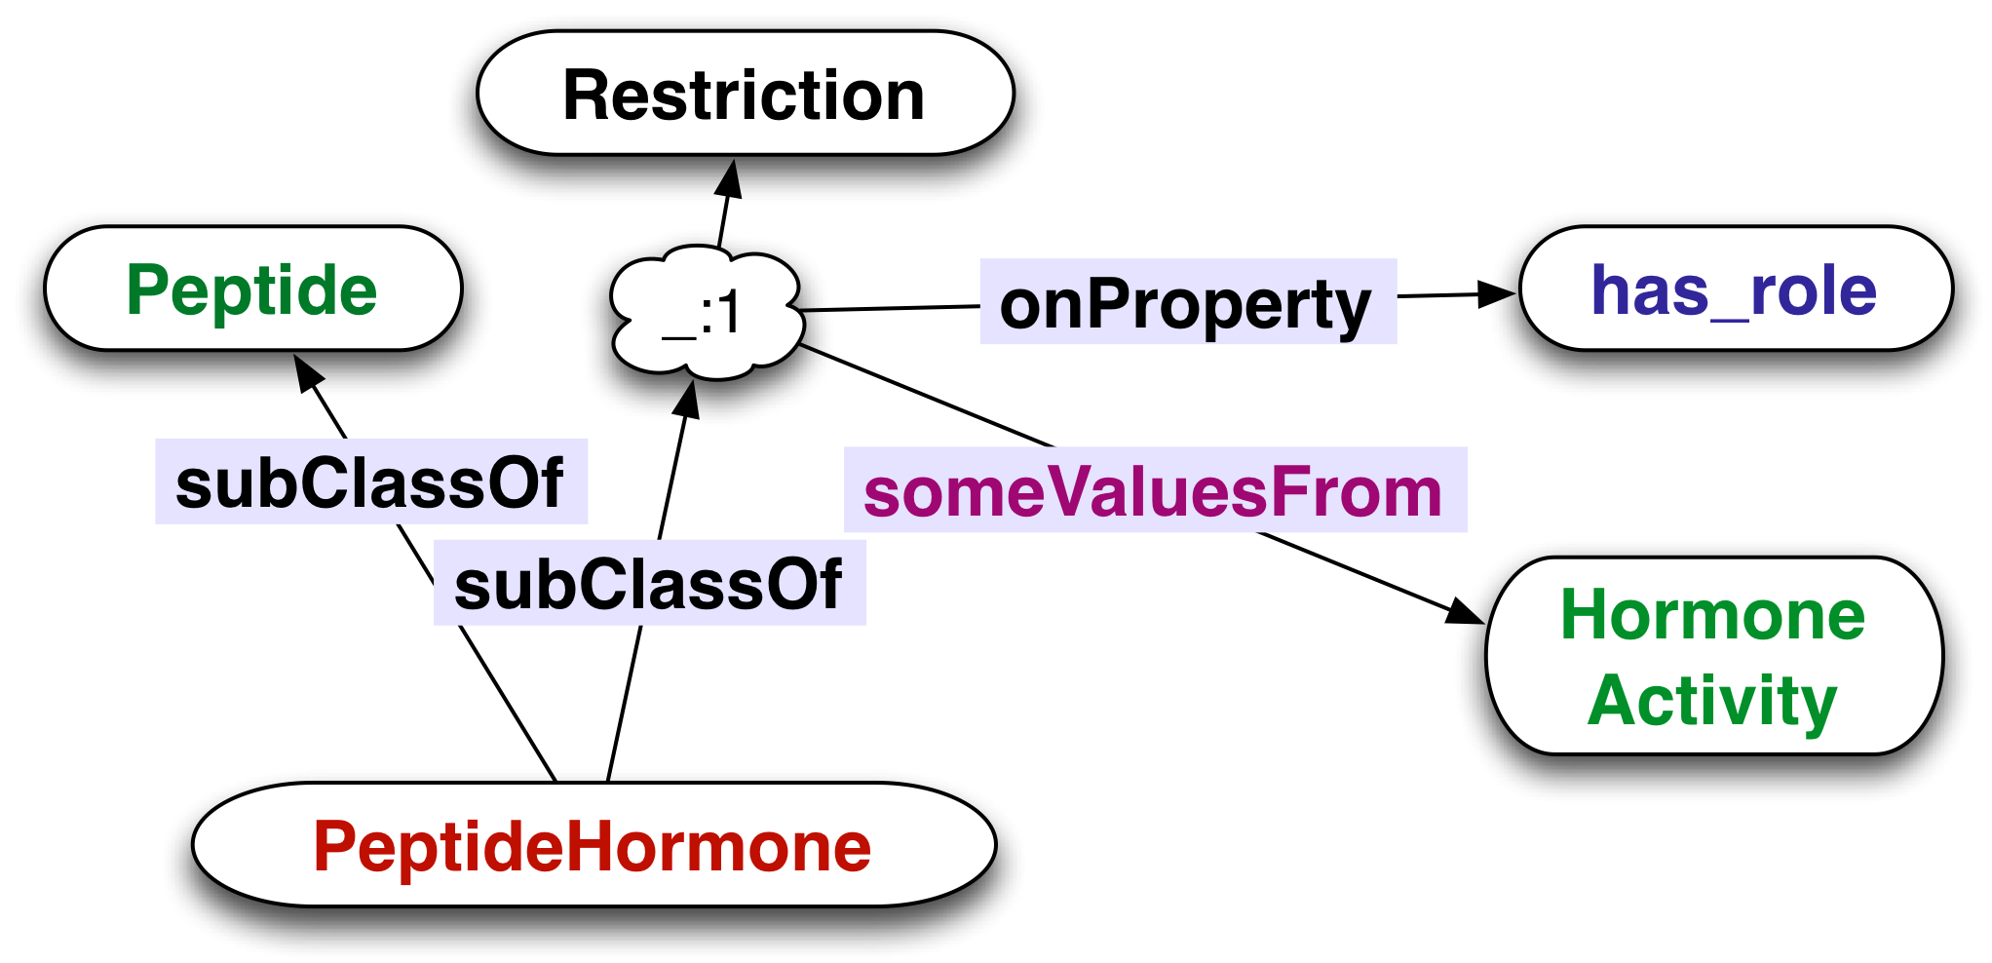
From English to OWL
ALL instances of PeptideHormone are an instance of Peptide that has_role SOME instance of HormoneActivity

Slide 69
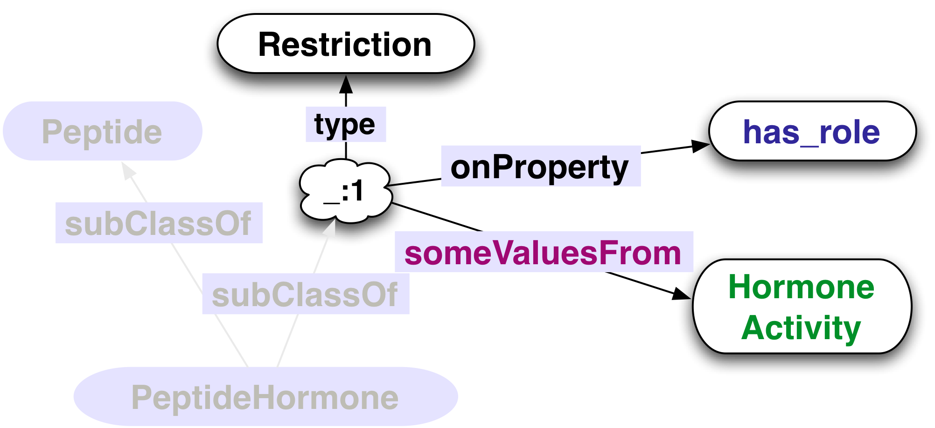
Restrictions - Classes Described by Phrases
Things
ALL instances of PeptideHormone are an instance of Peptide that has_role SOME instance of HormoneActivity

Slide 70
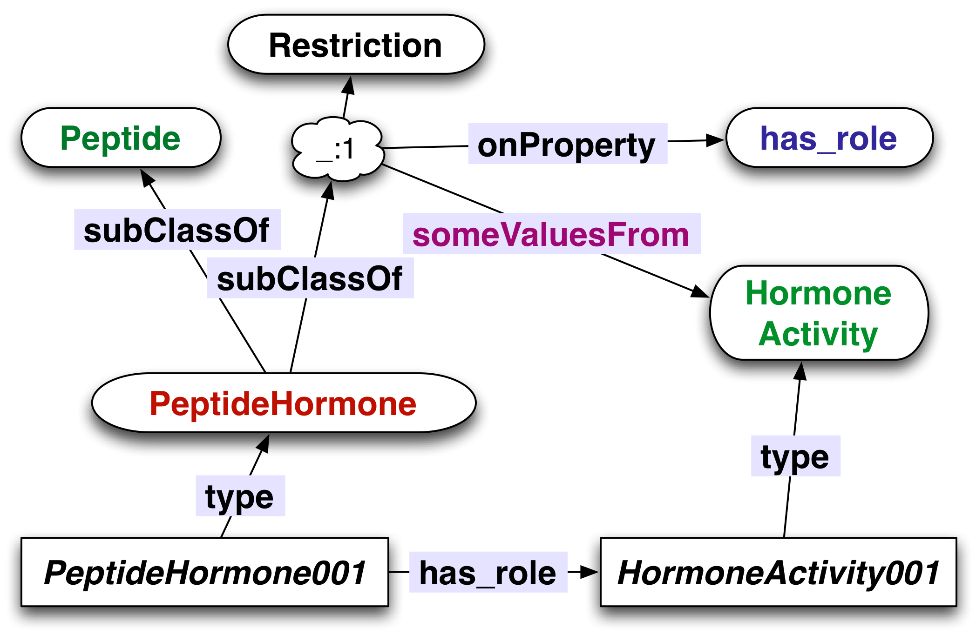
Representing Individuals
( Those individuals would represent individual molecules )

Slide 71
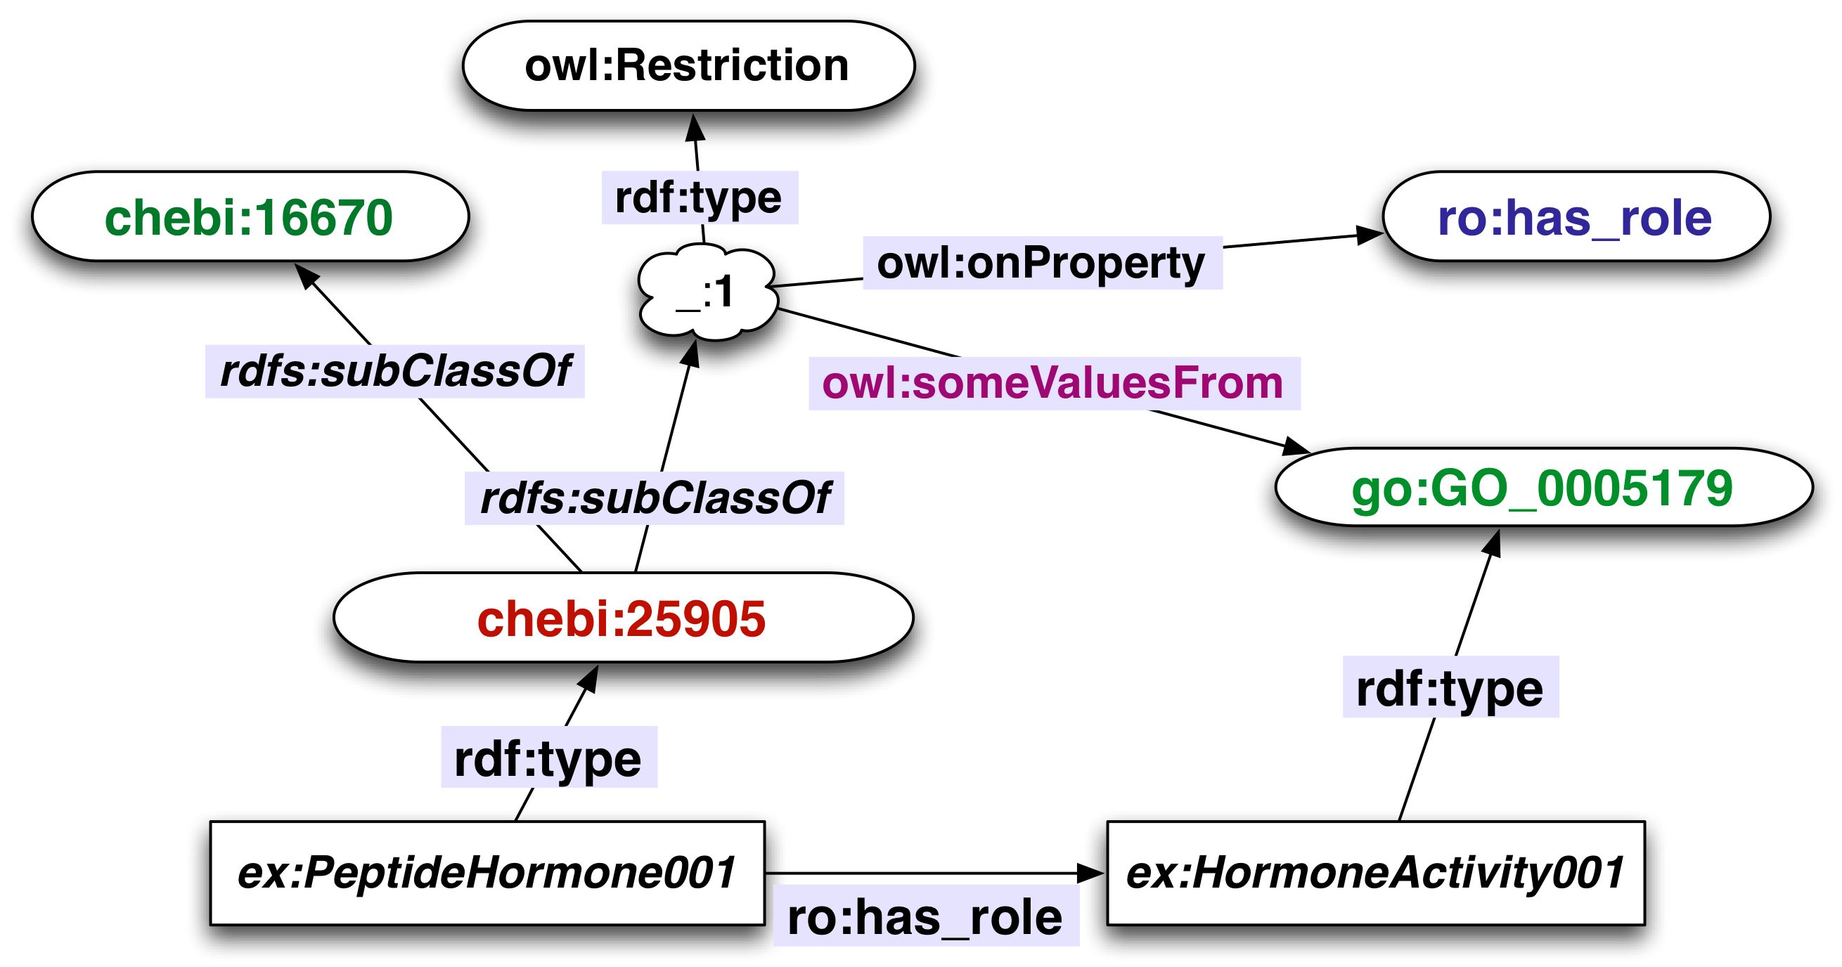
URIs, the Words of the Semantic Web
chebi:25905 = <http://purl.org/obo/owl/CHEBI#CHEBI_25905>

Slide 72

From Graph to Triples
4
5
1
2
6
6
7
3
8
1
chebi:25905 rdfs:subClassOf chebi:16670.
2
chebi:25905 rdfs:subClassOf _:1.
6
_:1 owl:onProperty ro:hasRole.
_:1 owl:someValuesFrom go:GO_00179.
…
5

Slide 73
SPARQL: Matching Patterns of Triples
1
chebi:25905 rdfs:subClassOf chebi:16670.
2
chebi:25905 rdfs:subClassOf _:1.
6
_:1 owl:onProperty ro:hasRole.
5
_:1 owl:someValuesFrom go:GO_00179.
select ?moleculeClass
where {
?moleculeClass rdfs:subClassOf chebi:16670.
?moleculeClass rdfs:subClassOf ?res.
?res owl:onProperty ro:hasRole.
?res owl:someValuesFrom go:GO_00179.
}
The match allows us to bind the variable
?moleculeClass = chebi:25905

Slide 74
Looking forward
“It’s the standard, stupid” More reasoning services are being standardized, which means more use and development. Standardization is good!
The OWL 2 standard is recently finished and there is active work on implementations on many fronts
Standard ontology languages are still only weakly expressive, particularly in the realm of mathematics. Expect hybrid systems to be developed
Look towards combinations of DL, rule systems, spatial reasoners, probabilistic reasoning, symbolic mathematics, as well as approximate reasoning
Scaling – look to more expressivity at larger scale. SPARQL, no reasoning 10^10 triples, SPARQL, some reasoning 10^9 triples.

Slide 75
Tools of the trade: Graphical Editors
Protégé 3, 4
Protégé 3, OWL 1, Legacy, Stable (but obsolete for OWL development)
Protégé 4, Written for OWL 2, maturing (still a bit to go, but it’s what I usually use)
OBO edit
Neon OWL editor
Topbraid Composer

Slide 76
Tools of the trade: Programmer APIs
OWLAPI – Java (http://owlapi.sourceforge.net/)
Common access to a growing number of reasoners
Provide constructors, reasoner invocation, Class expression query, extraction of inferred results
Jena – Java (http://jena.sourceforge.net/)
Semantic Web oriented. RDF more than OWL.
Provides some constructors, SPARQL implementation, serialization to/from variety of formats
Fuxi – Python (http://code.google.com/p/fuxi/)
Infix syntax for OWL
Reasoner for subset of OWL
LSW 2 – Common lisp
What I use for my development
Base on OWLAPI, Hermit, Fact++, Pellet
Constructors, reasoning services, graphical view

Slide 77
Tools of the trade: Databases for OWL/RDF content
Openlink Virtuoso: Triple store with small amount of reasoning capability but large capacity. What Neurocommons uses.
Oracle 11g: Triple store supports OWL-RL, rule additions.
Pellet, Stardog
OWLIM: Subset of OWL reasoning over large store
Sesame: Liked API, smaller data sets.

Slide 78
Tools of the trade: Query Languages
SPARQL
RDF-based, reasoning agnostic, works with large stores. Active working group specifying new version. SPARQL-update extension adds update capability. http based protocol.
“DL query”
Accept class expressions as queries – return subclasss, superclasses, instances, consistency. OWLapi, DL-Tab in Protégé, OWLink
SPARQL-DL
Proposed extension to SPARQL to be OWL aware. Implemented as part of Pellet

Slide 79
Tools of the trade: Flavors of reasoning
First order and higher order logic systems. E.g. Isabelle, Prover9. Suitable for very expressive, small systems.
Rule based. Production systems. RIF, SWRL, Answer-Set (DLV)
Description logics – OWL effective, expressive, reasoning
OWL-DL Most expressive. Most expensive to reason about
OWL-RL Suitable for implementation using rule based technology
OWL-EL Tractable reasoning for large numbers of classes
OWL-QL Reasoning on large numbers of instances in relational databases

Slide 80
Introduction to BFO 2 OWL Implementation
Choices, Issues, Resolutions

Slide 81
Quick start
Get Protégé 4.2 latest version
Open http://purl.obolibrary.org/obo/bfo.owl
Follow along

Slide 82
Goals of this section
Say a few words about BFO
Describe the BFO 2 OWL design principles
Make clear the status of BFO 2 OWL
Discuss contents of BFO 2 OWL
Review changes relative to BFO 1
Give guidelines for migrating from BFO 1 to BFO 2
Discuss selected aspects of the implementation
Strategy for time-indexed properties
Review selected open issues
Answer your questions

Slide 83
Status of BFO 2 2012-07-20 “Graz” Release
This version of BFO represents a major update to BFO and is not backwards compatible with BFO 1.1. The previous version of BFO, version 1.1.1 will remain available at http://ifomis.org/bfo/1.1 and will no longer be updated. We expect to provide automated support for migrating from BFO 1.1 to BFO 2 at some point in the future.
This version is a draft release for public comments. As such we expect it to generate a lively discussion rather than be a stable ground for building application ontologies. The release is the product of intensive discussions and a series of prototypes which kicked off with a November 2011 workshop held in Buffalo.
While we have attempted to produce a file reflecting the current BFO2 specification document, there remain issues and bugs that will be fixed in subsequent releases. Our expectation is that IDs in this version, going forward, will not disappear and we will follow the GO/OBI deprecation policy. In addition, not all elements of the reference itself are stable and there may be (even substantial) changes to the reference before we have the first release candidate.

Slide 84
OWL 2
We make use of the full range of OWL 2 using the direct semantics.
We may release weakened versions (e.g. dropping axioms that are outside the EL profile) if there is demand
Features of OWL 2 that are useful for us
Property chains
Ability to annotate anything (for documentation purposes)
Availability of free computational tools for reasoning
Built to live on the web, which makes for easy uptake
ObjectHasSelf, which allows for local reflexivity
Problems
Running into issues related to the OWL 2 global constraints, for example wanting to use transitive properties in role chains, or make properties disjoint with self-linking properties

Slide 85
Selected design principles
1. A clear reading of the OWL version in terms of BFO reference. A translation is a mapping from the OWL model - axioms, entities, relations, etc. To the formal language used in the reference, currently FOL. A reading can be considered a data transformation that takes asserted and inferred axioms and results in FOL using types defined in BFO 2 reference. This translation should be complete - no assertions in the OWL file can be left untranslated.
5. Make maximal use of reasoning to ensure quality/correctness. It is easy to make mistakes when ontologies have no automated procedure to test them. By adding as many constraining axioms which correspond to textual descriptions in BFO 2 Reference, we have he best chance of finding conceptual errors. We will aim to make clear the relation between the FOL and the OWL, independently of the reference. We will examine the reference with a mind to ensuring axioms that are not so labeled are marked explicitly as axioms.

Slide 86
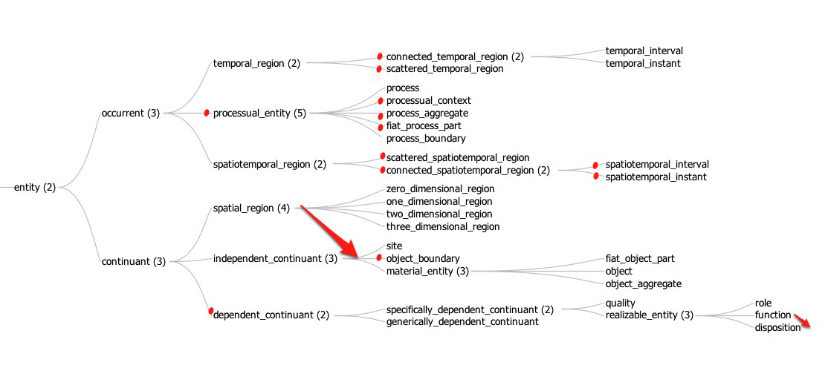
BFO 1.1 Classes
deprecated
moved

Slide 87
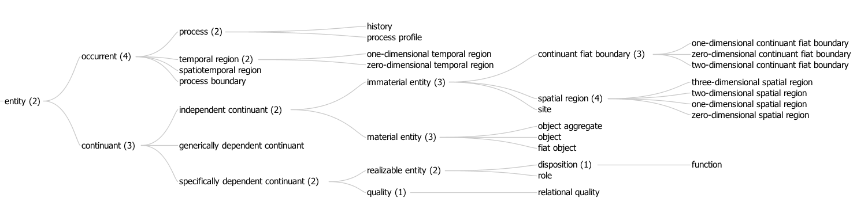
BFO 2 Classes
The tree was too wide
Added

Slide 88
Relations in BFO 2
has material basis (disposition -> material entity)
has history (material entity<-> process, 1:1)
continuant part of ( continuant -> continuant)
member part of (object <-> object aggregate)
continuant proper part of
occurrent part of ( occurrent -> occurrent )
concretizes (sdc -> gdc)
exists at (entity -> temporal region)
specifically/generically depends on (sdc, gdc -> site or material entity)
specifically depends on (many possibilities)
occupies spatial region (continuant -> spatial region)
occupies spatiotemporal,temporal region
( occurrent -> spatiotemporal, temporal region)
occurs in (process -> material entity or site)
located in (material entity or site -> material entity or site)
has participant (process -> continuant)
sdc = specifically dependent continuant gdc = generically dependent continuant

Slide 89
No closure axioms in BFO 2
OWL 1 had closure axioms – axioms that said that at each level the subclasses of a class were the only subclasses.
These are no longer present in BFO 2
Example: We don’t close specifically dependent continuants because we’re pretty sure there are more
Example: We don’t close continuant fiat boundary because the subclasses don’t include the case of a sum of non-intersecting zero-dimensional (point) and one-dimensional (line) continuant fiat boundary.

Slide 90
Siblings disjoint except between material entity children
A paradigm case: not ruling out granularity
A molecule is, at the same time, an object aggregate (of atoms) and an object (for example as constituent of a crystal)
In different granular contexts the same physically identifiable thing can justifiably classified as different types
If we made the children of material entity be disjoint, we would make it hard to extend BFO to deal with granularity effectively.
So we don’t

Slide 91
Importing BFO into your Ontology
Use the OWL imports functionality that your editing tool provides
Give the import URI as
http://purl.obolibrary.org/obo/bfo/2012-07-20/bfo.owl if you want to make sure you get today’s version
http://purl.obolibrary.org/obo/bfo.owl if you want to import whatever the most recent version of BFO is.
Both URIs currently retrieve the same document, however that will change as soon as there is a new version released

Slide 92
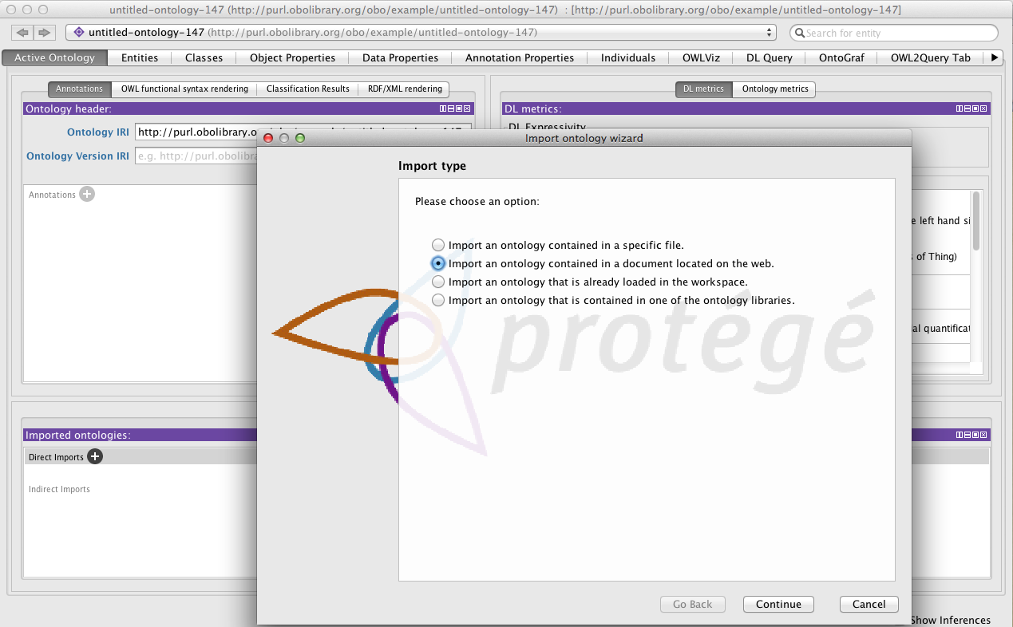

Slide 93
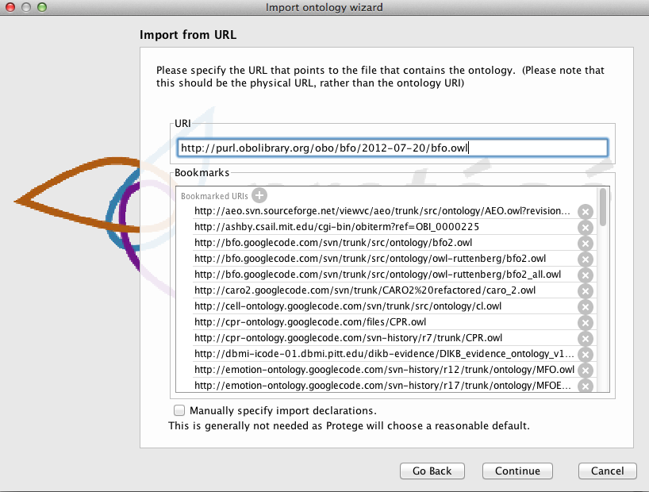
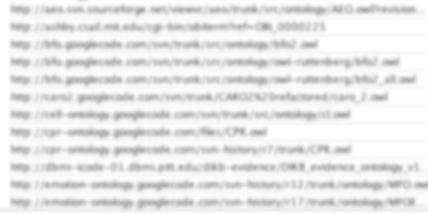

Slide 94
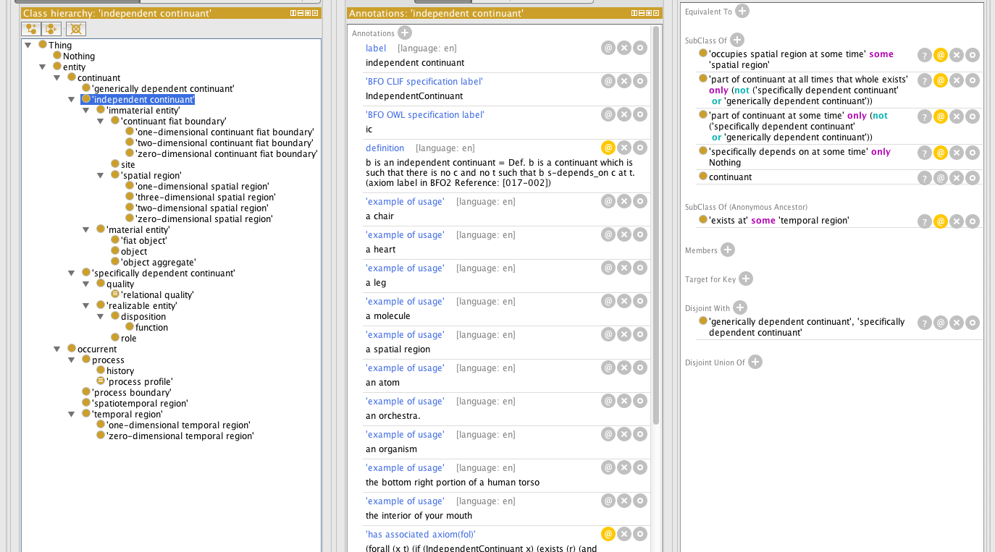
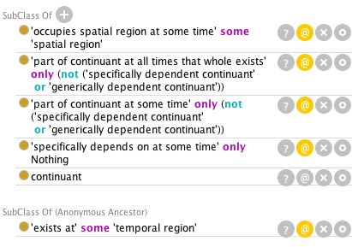

http://protege.stanford.edu/download/download.html Get the latest version of Protégé 4.2

Slide 95
Migrating classes from BFO 1.1 to BFO 2
Note deprecated classes –
Specifically dependent continuant
Process X classes
Scattered/Connected X
Attend to classes that are similar to earlier classes
object boundary, continuant fiat boundary
Function now subclass of disposition
Look for applicability of new classes
history, relational quality
Learn the relations that are now in BFO and apply them.
Migrate use of RO to BFO, new RO

Slide 96
Migrating relations to BFO 2
Properties redesigned to not overload names as in BFO 1.
part_of (class, class)
part_of (continuant, continuant, t)
part_of (occurrent, occurrent)
Strategies to remove overloading
Drop class/class relations
Name properties according to type
Use “at-some-time”, “at-all-times” relations to acknowledge temporal indexing. (maybe –during-process relations coming)
How to migrate
Attend to part relations which have split continuant/occurrent/at some times/at all times – If you use part relations a lot this will be the biggest work
Attend to other temporally indexed relations
Learn and use new relations
material basis
history of
specifically/generically depends on
concretizes
realizes

Slide 97
Why time indexing is important (even in BFO OWL)
Documentation of BFO has always had time indexed relations, for example parthood between continuant instances is written as part_of(c1,c2,t)
Our first design principle is that the the OWL file have a BFO reading
In the prior Relation Ontology OWL implementation the part of relations were binary, and were not given any BFO reading.
Since BFO defines the meaning of the relations, we have no basis for formally understanding relations if there is not a BFO reading
We (OBO community) is moving more towards representation of instances. Prior to this only “class level” relations were used, which were not time dependent. However OWL only provides for making quantified sentences over individuals rather than reifying classes.

Slide 98
Understanding the time-indexing approach
The problem: OWL provides only binary relations
Time indexed relations are ternary
Solution: Move quantification over time into the instance-level relation
For part_of(c1,c2,t) define:
part-of-at-some-time(c1,c2) =def
forsome(t) exists_at(c1,t) & exists_at(c2,t) & part_of(c1,c2,t)
part-of-at-all-times(c1,c2) =def
forall(t) exists_at(c1,t) -> exists_at(c2,t) & part_of(c1,c2,t)
Note: only part-of-at-all-times is transitive Note: part-of-at-all-times is not the inverse of has-part-at-all-times Note: part-of-at-all-times-that-whole-exists can be defined so as to be the inverse of has-part-at-all-times
part-of-at-all-times-that-whole-exists(c1,c2) =def
forall(t) exists_at(c2,t) -> exists_at(c1,t) & part_of(c1,c2,t)

Slide 99
Known issues in BFO 2
No proper way to represent non-rigid universals (professor, fetus) yet
process profile not well liked by part working group
Acceptability of time-indexing? How to extend it.
Material basis only for dispositions (what about qualities, and what about qualitative basis?)
Alan doesn’t like specific dependence of processes on material entities
Additional requested relations – begins/ceases to exist during (continuant -> process)
BFO 2, OBO Format, and bfo-ruttenberg.owl (vintage 2010-05)
Are some definitions too formal? (see def. of process, process profile)
Change in definition of process boundary (now only temporal)

Slide 100
Known issues in BFO 2
Permanent generic parthood, and similar. Can’t say, currently, that at all times every independent continuant is located in some spatial region (different ones at different times)
Support for granularity (what to do about has grain relation in use in some ontologies)
Stages (temporal parts of history). Need to axiomitizing that they map uniquely to the material entity the history is of.
Review of reference and completion of adding axioms. Feedback from OWL implementation back into reference.
Only relation relating site to host is continuant part of
How to relate process profile to, e.g. qualities they profile

Slide 101
Resources
Release notes (start here)
http://purl.obolibrary.org/obo/bfo/2012-07-20/ReleaseNotes
Reference document
http://purl.obolibrary.org/obo/bfo/2012-07-20/Reference
http://purl.obolibrary.org/obo/bfo/2012-07-20/Reference.htm
OWL Document
http://purl.obolibrary.org/obo/bfo/2012-07-20/bfo.owl
First order logic formulation
http://purl.obolibrary.org/obo/bfo/2012-07-20/fol.pdf
Discussion list
http://groups.google.com/d/forum/bfo-owl-devel
Tracker/Issues list
http://code.google.com/p/bfo/issues/list

Slide 102
Acknowledgements
Recent contributors: Mauricio Almeida, Thomas Bittner, Jonathan Bona, Mathias Brochhausen, Werner Ceusters, Mélanie Courtot, Randall Dipert, Bill Duncan, Janna Hastings, Albert Goldfain, Leonard Jacuzzo, Ludger Jansen, Pierre Grenon, Larry Hunter, Chris Mungall, Fabian Neuhaus, David Osumi-Sutherland, Bjoern Peters, Mark Ressler, Robert Rovetto, Ron Rudnicki, Alan Ruttenberg, Stefan Schulz, Barry Smith.
Special thanks to Stefan Schulz, Janna Hastings, Melanie Courtot for review of the OWL document, and Mathias Brochhausen for ideas for this presentation.

