Slide 1
BFO 2.0
Tutorial, Graz, July 23, 2012
Barry Smith and Alan Ruttenberg

Slide 2
BFO
A simple, small top-level ontology to support information integration in scientific research
No abstracta (numbers, propositions, …)
No overlap with domain ontologies (for society, for information, for biology…)

Slide 3
Three Fundamental Dichotomies
Continuant vs. occurrent
Dependent vs. independent
Universal/Type vs. instance
http://ontology.buffalo.edu/bfo/

Slide 4
Continuant
thing, quality …
Occurrent
process, event

Slide 5
depends_on
Continuant
Occurrent
process, event
Independent
Continuant
thing
Dependent
Continuant
quality
quality depends
on bearer

Slide 6
depends_on
Continuant
Occurrent
process, event
Independent
Continuant
thing
Dependent
Continuant
quality, …
event depends
on participant

Slide 7
instance_of
types
Continuant
Occurrent
process, event
Independent
Continuant
thing
Dependent
Continuant
quality
.... ..... .......
instances

Slide 8
depends_on
Continuant
Occurrent
process
Independent
Continuant
thing
Dependent
Continuant
quality
temperature depends
on bearer
.... ..... .......

Slide 9
Blinding Flash of the Obvious
Continuant
Occurrent
(Process, Event)
Independent
Continuant
Dependent
Continuant
How to create an ontology from the top down

Slide 10
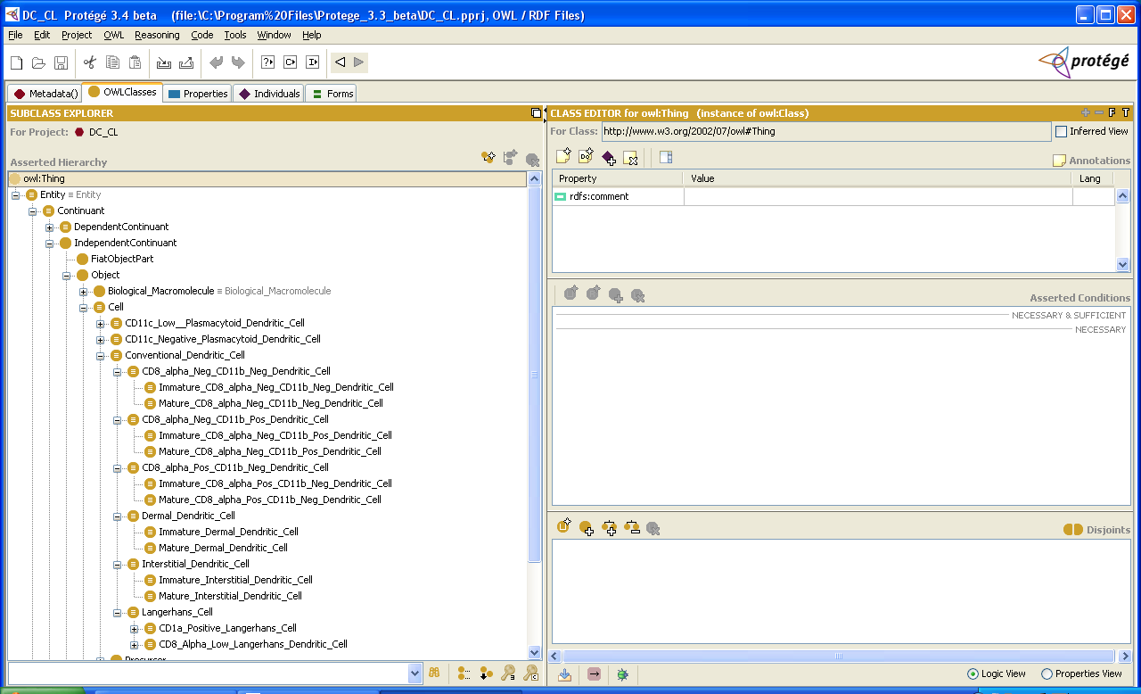
Example: The Cell Ontology

Slide 11
Basic Formal Ontology
Continuant
Occurrent
(Process, Event)
Independent
Continuant
Dependent
Continuant
http://ifomis.uni-saarland.de/bfo/

Slide 12
Benefits of coordination
No need to reinvent the wheel
Can profit from lessons learned through mistakes made by others
Can more easily reuse what is made by others
Can more easily inspect and criticize results of others’ work (PATO)
Leads to innovations (e.g. Mireot) in strategies for combining ontologies

Slide 13
Users of BFO
OBO Foundry
NIF Standard
eagle-I / VIVO / CTSAconnect
IDO Consortium

Slide 14
The OBO Foundry
  GO Gene Ontology
  CL Cell Ontology
  ChEBI Chemical Ontology
  PRO Protein Ontology
  PATO Phenotype (Quality) Ontology
  IDO Infectious Disease Ontology
  PO Plant Ontology
  OBI Ontology for Biomedical Investigations
  OGMS Ontology for General Medical Science
  SO Sequence Ontology
  FMA Foundational Model of Anatomy
  CARO Common Anatomy Reference Ontology
  EnvO Environment Ontology
  Disease Ontology

Slide 15
IDO Consortium
MITRE, Mount Sinai, UTSouthwestern, University at Buffalo – Influenza
IMBB/VectorBase – Vector borne diseases / IDO Mal (A. gambiae, A. aegypti, I. scapularis, C. pipiens, P. humanus)
Colorado State University – Dengue Fever
University of Michigan – Brucellosis

Slide 16
Other
Neurological Disease Ontologies (ND)
Interdisciplinary Prostate Ontology (IPO)
Nanoparticle Ontology (NPO): Ontology for Cancer Nanotechnology Research
Neural Electromagnetic Ontologies (NEMO)
ChemAxiom – Ontology for Chemistry
Ontology for Risks Against Patient Safety (RAPS/REMINE) (EU FP7)
…
See list of > 100 projects here: http://www.ifomis.org/bfo/users/

Slide 17
maintained by
Werner Ceusters, Buffalo
Pierre Grenon, Open University
Chris Mungall, Berkeley
Fabian Neuhaus, NIST
Holger Stenzhorn, IFOMIS, Saarland University
Alan Ruttenberg, Science Commons
plus 103 other members of BFO Discussion Group:
http://groups.google.com/group/bfo-discuss?

Slide 18
inspired by
Aristotle
Husserl
Roman Ingarden
Ingvar Johansson
Kevin Mulligan, University of Geneva
Cornelius Rosse
Peter Simons, Trinity College, Dublin
Wittgenstein’s Tractatus (picture theory of language)
Wolfgang Degen, Nicola Guarino, Patrick Hayes

Slide 19
some important users
Bjoern Peters, University of California, San Diego
Mathias Brochausen, IFOMIS
Lindsay Cowell, Duke University Medical Center
Albert Goldfain, University at Buffalo/Blue Highway
William Hogan, University of Pittsburgh
Stephan Schulz, Freiburg University
Kent Spackman, SNOMED / IHTSDO
Jean Marie Rodrigues
Janna Hastings

Slide 20
RELATION TO TIME GRANULARITY | CONTINUANT |  |  |  | OCCURRENT
 | INDEPENDENT |  | DEPENDENT
ORGAN AND ORGANISM | Organism (NCBI Taxonomy) | Anatomical Entity (FMA, CARO) | Organ Function (FMP, CPRO) | Phenotypic Quality (PaTO) | Biological Process (GO)
CELL AND CELLULAR COMPONENT | Cell (CL) | Cellular Component (FMA, GO) | Cellular Function (GO)
MOLECULE | Molecule (ChEBI, SO, RnaO, PrO) |  | Molecular Function (GO) |  | Molecular Process (GO)
The Open Biomedical Ontologies (OBO) Foundry

Slide 21
 | CONTINUANT |  |  |  | OCCURRENT
 | INDEPENDENT |  | DEPENDENT
ORGAN AND ORGANISM | Organism (NCBI Taxonomy) | Anatomical Entity (FMA, CARO) | Organ Function (FMP, CPRO) | Phenotypic Quality (PaTO) | Organism-Level Process (GO)
CELL AND CELLULAR COMPONENT | Cell (CL) | Cellular Component (FMA, GO) | Cellular Function (GO) |  | Cellular Process (GO)
MOLECULE | Molecule (ChEBI, SO, RNAO, PRO) |  | Molecular Function (GO) |  | Molecular Process (GO)
RELATION TO TIME
GRANULARITY
rationale of OBO Foundry coverage (homesteading principle)

Slide 22
BFO and the 3 Gene Ontologies (GO)
Continuant
Occurrent
biological process
Independent
Continuant
Dependent
Continuant
cell component
molecular function
Kumar A., Smith B, Borgelt C. Dependence relationships between Gene Ontology terms based on TIGR gene product annotations. CompuTerm 2004, 31-38.
Bada M, Hunter L. Enrichment of OBO Ontologies. J Biomed Inform. 2006 Jul 26

Slide 23
OBO Foundry organized in terms of Basic Formal Ontology
Each Foundry ontology can be seen as an extension of a single upper level ontology (BFO)
either post hoc, as in the case of the GO
or in virtue of creation ab initio via downward population from BFO

Slide 24
Example: The Cell Ontology

Slide 25
Continuant
Independent
Continuant
Specifically
Dependent
Continuant
Non-realizable
Dependent
Continuant
(quality)
Realizable
Dependent
Continuant
(function, role,
disposition)
..... .....

Slide 26
Continuant
Independent
Continuant
Specifically
Dependent
Continuant
Non-realizable
Dependent
Continuant
(quality)
Realizable
Dependent
Continuant
(function, role,
disposition)
..... .....

Slide 27
realization depends_on realizable
Continuant
Occurrent
Independent
Continuant
bearer
Dependent
Continuant
disposition
Process of
realization
.... ..... .......

Slide 28
Specific Dependence
on the instance level
a depends_on b =def. a is necessarily such that if b ceases to exist than a ceases to exist
on the type level
A specifically_depends_on B =def. for every instance a of A, there is some instance b of B such that a depends_on b.

Slide 29
specifically_depends_on
Continuant
Occurrent
process, event
Independent
Continuant
thing
Dependent
Continuant
quality
temperature depends
on bearer
.... ..... .......

Slide 30
Specifically dependent continuants
the quality of whiteness of this cheese
your role as lecturer
the disposition of this patient to experience diarrhea

Slide 31
the universal red
the universal eye
instantiates
instantiates
the particular case of redness (of a particular fly eye)
an instance of an eye (in a particular fly)
depends_on

Slide 32
color
anatomical structure
is_a
is_a
red
eye
instantiates
instantiates
the particular case of redness (of a particular fly eye)
an instance of an eye (in a particular fly)
depends on

Slide 33
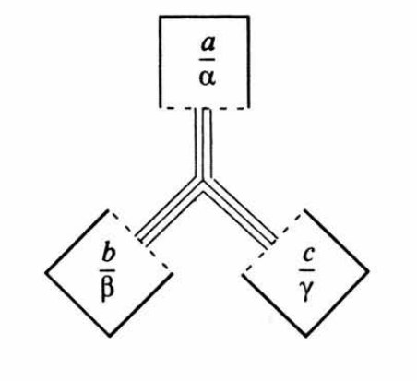
New to BFO 2.0: Introduction of reciprocal dependence
some specifically dependent continuants (SDCs) are reciprocally dependent on each other, for example between color hue, saturation and brightness

Slide 34
specifically_depends_on
Continuant
Occurrent
process
Independent
Continuant
thing
Dependent
Continuant
quality
temperature depends
on bearer
.... ..... .......

Slide 35
Realizable dependent continuants
Role: nurse role, pathogen role, food role
Disposition: fragility, virulence, susceptibility, genetic disposition to disease X
Function: to pump (of the heart), to unlock (of the key)

Slide 36
Realizable dependent continuants
plan
function
role
disposition
capability
tendency
continuants

Slide 37
Their realizations
execution
expression
exercise
realization
application
course
occurrents

Slide 38
Defining ‘Student’
Student(x, t) =def. x is a student who is bearer at t of a student role
Student role is_a role
(Role universals are rigid universals)
If role(y) at t, then role(y) at all times at which y exists.

Slide 39
Role (externally-grounded realizable entity)
role =def. a realizable entity
which exists because the bearer is in some special physical, social, or institutional set of circumstances in which the bearer does not have to be, and
is not such that, if it ceases to exist, then the physical make-up of the bearer is thereby changed.

Slide 40
Disposition (an internally-grounded realizable entity)
disposition =def.
a realizable entity which if it ceases to exist, then its bearer is physically changed, and
whose realization occurs when this bearer is in some special physical circumstances, in virtue of the bearer’s physical make-up

Slide 41
Function (a disposition designed or selected for)
function =def.
a disposition that
exists in virtue of the bearer’s physical make-up,, and
this physical make-up is something the bearer possesses because it came into being, either through evolution (in the case of natural biological entities) or through intentional design (in the case of artifacts), in order to realize processes of a certain kind.

Slide 42
Changes in BFO 2.0
Elucidation vs. Definition
Users Guide and Specification
BFO 2.0 OWL
BFO 2.0 FOL / CLIF
Scripting support for transition from 1.1 to 2.0

Slide 43
New Treatment of Relations
New treatment of relations
Relations now divided into two families
strictly formal relations, such as is_a and part_of are incorporated into BFO to make BFO inferentially complete
other relations, such as is_membrane_part_of – which will be collected, reviewed and made available in a public forum

Slide 44
3 kinds of (binary) relations
Between types
  human is_a mammal
  human heart part_of human
Between an instance and a type
  this human instance_of the type human
  this human allergic_to the type tamiflu
Between instances
  Mary’s heart part_of Mary
  Mary’s aorta connected_to Mary’s heart
Notes:
In the following discussion:
Classes are in upper case
‘A’ is the class
Instances are in lower case
‘a’ is a particular instance

Slide 45
Type-level relations presuppose the underlying instance-level relations
A part_of B =def. All instances of A are instance-level-parts-of some instance of B
e.g. human heart part_of human
A has_participant B =def. All instances of A have an instance of B as instance-level participant
e.g. cell binding has_participant cell

Slide 46
In BFO 2.0
we quantify only over instances and use labels only for instance-level relations
Thus we say
  for all x (human_heart(x) → there is some y, human(y) & x part_of y)
Not
  human_heart part_of human

Slide 47
Other changes in treatment of relations
New relation exists_at t added
‘t’, here and elsewhere, ranges of temporal regions (= both instant and intervals)
Relation of containment deprecated
We provide a generalization of the located_in relation as compared to earlier versions of BFO
Relations of parthood disambiguated
Hitherto BFO has distinguished parthood between continuants and occurrents by means of the at t suffix used for the former; henceforth we will use the explicit distinction between continuant_part_of and occurrent_part_of (still using the at t suffix for the former)

Slide 48
Specifically Dependent Continuants
Specifically
Dependent
Continuant
if the bearer ceases to exist, then its quality, function, role ceases to exist
the color of my skin
the function of my heart to pump blood
my weight
Quality,
Pattern
Realizable
Dependent
Continuant

Slide 49
Generically Dependent Continuants
if one bearer ceases to exist, then the entity can survive, because there are other bearers
(copyability)
the pdf file on my laptop
the DNA (sequence) in this chromosome
Generically
Dependent
Continuant
Information
Object
Gene
Sequence

Slide 50
Relation of Concretization
GDC: plan specification
SDC: concretization of this plan specification in the patterns of ink in this printed document
SDC: concretization of this plan specification in your head (your plan)

Slide 51
Music
Beethoven’s 9th Symphony, a certain abstract pattern (generically dependent continuant), which we shall call #9
#9 instance_of symphony
symphony is_a musical work.
#9 instance_of musical work
#9 concretized_in specifically dependent continuant pattern of ink marks borne by this printed copy of the score #10
#9 concretized_in specifically dependent continuant pattern of grooves in this vinyl disk.

Slide 52
Music
#10 instance_of generically dependent continuant type OBI:plan specification
#10 specifies how to create performance of #9.
#10 is concretized_in this network of subplan (complex realizable SDC) distributed across the minds of the conductor and members of this orchestra #11
#11 realized_in this performance #12
#12 copied_in what you hear (a process inside your head)

Slide 53
Protocol
#1 protocol (GDC) instance_of OBI: type plan specification.
#1 concretized_in #2 (= plan in mind of leader of research team, a realizable SDC to carry out some experiment.
realization of #2 starts with the creation of a series of sub-protocols, which are plan specifications for each team member.
The experiment itself is the sum of the realizations of these plans, having outputs further GDCs such as publications, databases …

Slide 54
Continuant
Occurrent
Independent
Continuant
Specifically
Dependent
Continuant
Generically
Dependent
Continuant
Functioning
Quality
Realizable
Information
Artifact
Sequence…
Role
Disposition
Function

Slide 55
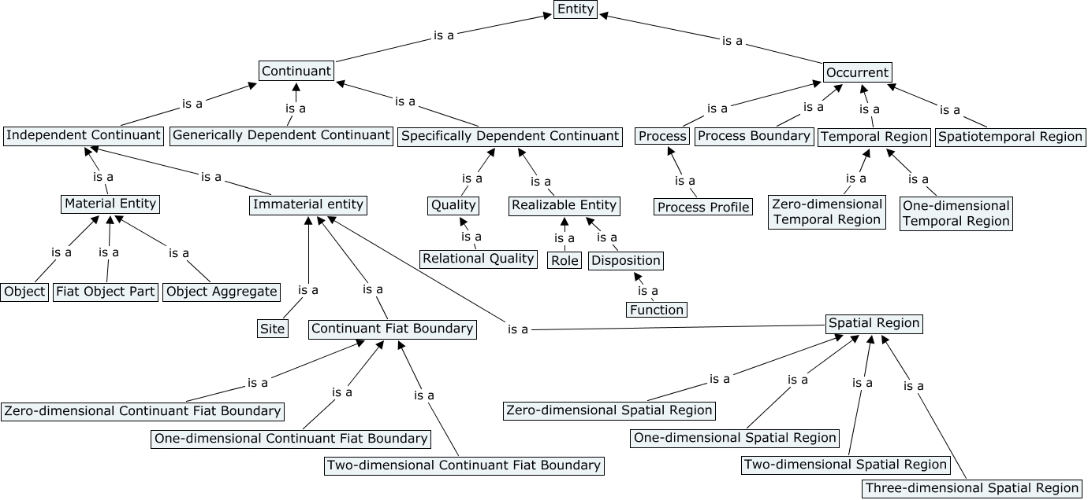

Slide 56
New treatment of boundaries

Slide 57
All boundaries in BFO 2.0 are fiat
FMA Examples: Anatomical plane
Anchored anatomical plane
Craniocervical plane
Cervicothoracic plane
Plane of oral orifice
Anterior plane of oral orifice
Posterior plane of oral orifice
Midplane of oral orifice
Thoraco-abdominal plane
Occipital plane
Interspinous plane
Plane of anatomical orifice
Anatomical transverse plane
Plane of anatomical junction
Sagittal midplane of body

Slide 58
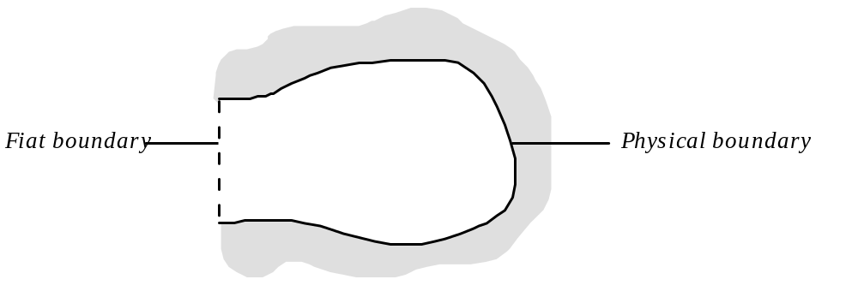
The mouth of a cave

Slide 59
Boundaries go together with sites

Slide 60
A cave (site)

Slide 61
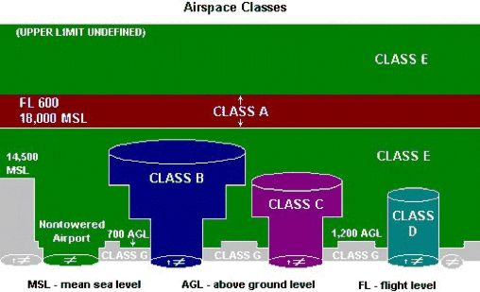
ELUCIDATION: a is a site means: a is a three-dimensional immaterial entity that is (partially or wholly) bounded by a material entity or it is a three-dimensional immaterial part thereof.
Controlled Airspace Classes

Slide 62
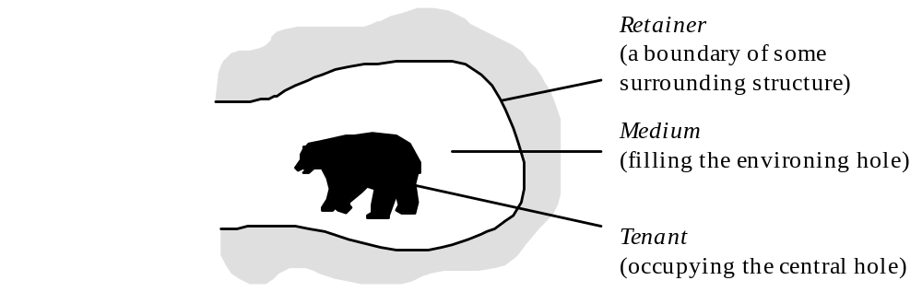
Double Hole Structure

Slide 63
Ambiguity of ‘Manhattan’
Manhattan as material entity (a collection of bricks and rock and other solid matter)
Manhattan as a complex site (the place where people actually live and move)
Extended Manhattan = the sum of the above
analogously for cave, mouth, nostril, your car, your lab, your bed (getting into bed …)

Slide 64
Continuant boundaries go together with sites

Slide 65
Why are sites needed in addition to 3-D spatial regions?
Because a site, e.g. the hull of a ship, can move through space (and thus occupy successively different spatial regions)
Sites are in this respect, too, analogous to material entities.

Slide 66
In BFO 2.0 focus is on fiat boundaries
when we talk about e.g. 2-dimensional surfaces of material objects, then we are talking about fiat boundaries
= boundaries for which there is no assumption that they coincide with physical discontinuities.

Slide 67
Continuant boundaries go together with (0-,1-, and 2-D) spatial regions

Slide 68
as sites go together with 3-D spatial regions

Slide 69
and material entities go together with 3-D spatial regions

Slide 70
just as process boundaries go together with temporal instants

Slide 71
so processes go together with temporal intervals

Slide 72
Future work needed on boundaries and spatial and temporal regions
Boundary dependence is not a type of specific dependence. Needs defining.
Bona fide boundaries?
Frame-dependence of spatial and temporal regions (work on BFO-Physics on-going)

Slide 73
BFO:material_entity

Slide 74
BFO:object (& its siblings)

Slide 75
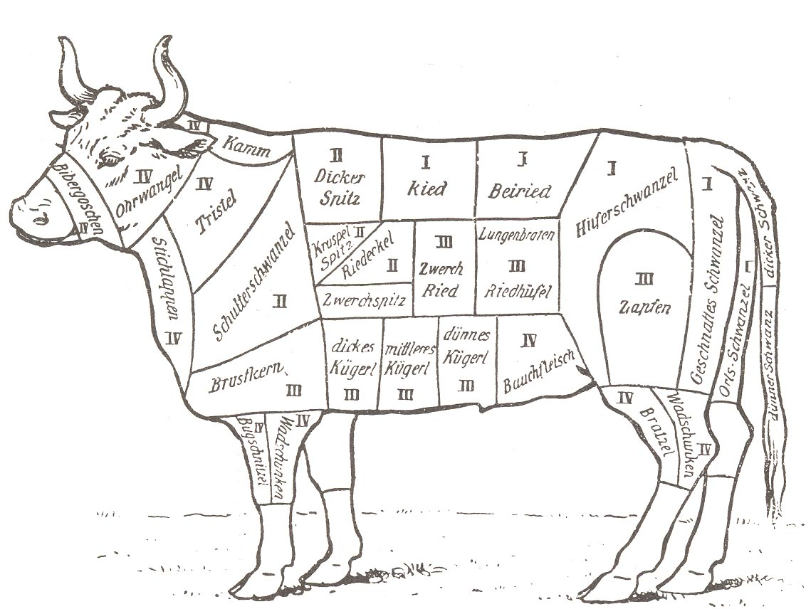
BFO: fiat_object
For BFO 2.O Object, Fiat Object Part and Object Aggregate are not intended to be exhaustive of Material Entity (see Lars Vogt)

Slide 76
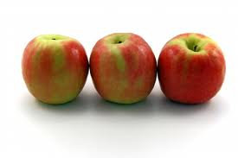
BFO:object_aggregate
not a sum of objects, but something like a set:

Slide 77
BFO:object_aggregate
which can however change its members over time
(e.g. the aggregate of members of the International Association for Ontology and Its Applications)
examples: populations, families, tribes, species, planetary systems – anything associated with a count, a registry, an inventory, a census

Slide 78
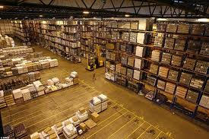
inventory

Slide 79
member_part_of
a member_part_of b at t =Def. a is an object at t
& there is at t a mutually exhaustive and pairwise disjoint partition of b into objects x₁, …, x_{n} with a = x_{i} for some natural number i.
Use this as basis for a theory of groups, organizations and other social objects

Slide 80
BFO:object (& its siblings)
For BFO 2.O Object, Fiat Object Part and Object Aggregate are not intended to be exhaustive of Material Entity (see Lars Vogt)

Slide 81
Clarification of BFO:object
We provide a more extensive account of what ‘Object’ means (roughly: an object is a maximal causally unified material entity); it describes three main groups of examples of causal unity:
  cells, organs, organisms
  solid portions of matter (rocks, planets)
  engineered artifacts (tennis balls, billiard balls)

Slide 82
Non-rigid universals
= universals which (may) hold of a continuant only for a certain time in the life of the continuant
human
in nature, no sharp boundaries here
embryo
fetus
neonate
infant
child
adult
instantiates at t₁
instantiates at t₂
instantiates at t₃
instantiates at t₄
instantiates at t₅
instantiates at t₆
John

Slide 83
portion of water
Phase transitions
portion of ice
portion of liquid water
portion of gas
instantiates at t₁
instantiates at t₂
instantiates at t₃
this portion of H₂0

Slide 84
Determinable and determinate qualities
temperature
rigid
non-rigid
37ºC
37.1ºC
37.2ºC
37.3ºC
37.4ºC
37.5ºC
instantiates at t₁
instantiates at t₂
instantiates at t₃
instantiates at t₄
instantiates at t₅
instantiates at t₆
John’s temperature (a quality instance)

Slide 85
Determinable and determinate qualities
temperature
in nature, no sharp boundaries here
in nature, no sharp boundaries here
37ºC
37.1ºC
37.2ºC
37.3ºC
37.4ºC
37.5ºC
instantiates at t₁
instantiates at t₂
instantiates at t₃
instantiates at t₄
instantiates at t₅
instantiates at t₆
John’s temperature

Slide 86
Histories
history of a material entity m = sum of processes taking place in the spatiotemporal region occupied by m, including processes on the surface of the entity or within the cavities to which it serves as host.

Slide 87
Histories
The relation between a material entity and its history is one-to-one:
for any material entity a, there is exactly one process which is the history of a,
for every history h, there is exactly one material entity which h is the history of.
Histories are additive. Thus for any two material entities a and b, the history of the sum of a and b is the sum of their histories.

Slide 88
Lives (for OGMS)
The life of an organism is the history of the corresponding OGMS:extended organism

Slide 89
Process Profiles
Addressing the main complaint as concerns BFO 1.1 = its lack of the ability to annotate process measurement data (e.g. data about heart rates)

Slide 90
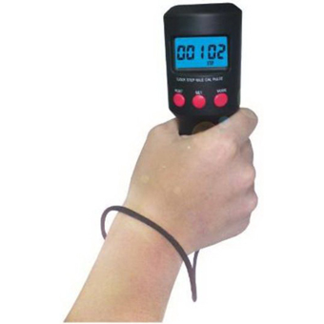
is_about
IAO:measurement datum
concretized_by
process: John’s heart beating
has_specified
_output
quality: ‘120 bpm’-shaped pattern
has_participant
OBI process:
this specific assay
has_participant
inheres_in
device
screen
has_part
has_participant
Beat Measurement
John
Notes:
http://www.123rf.com/photo_9665076_diabetes-patient-measuring-glucose-level-blood-test-using-ultra-mini-glucometer-and-small-drop-of-bl.html

Slide 91
The problem of process qualities
heart beating at constant rate:
the heart (object)
the process of beating
the temporal region occupied by this process
the spatiotemporal region that is occupied by this process (trajectory of the beating process)
the rate, referred to by means of
an expression (information artifact, thus a BFO:generically dependent continuant) such as ‘63 beats/minute’.

Slide 92
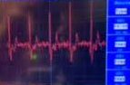
is_about
IAO:measurement datum
concretized_by
process: John’s heart beating
has_specified
_output
quality: ‘120 bpm’-shaped pattern
has_participant
OBI process:
this specific assay
has_participant
inheres_in
device
screen
has_part
has_participant
Beat Measurement
John
Notes:
http://www.123rf.com/photo_9665076_diabetes-patient-measuring-glucose-level-blood-test-using-ultra-mini-glucometer-and-small-drop-of-bl.html

Slide 93
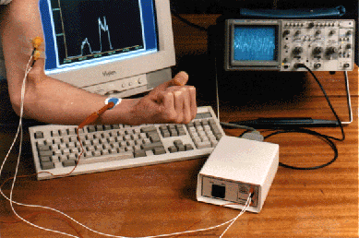

Notes:
http://ej.iop.org/images/0031-9120/32/5/005/img2.gif

Slide 94
The device
The device is in each case a reliable means of arriving at information of the relevant sort
This means:
1. it has been built according to a specified process
2. it matches the other instances of the same device type produced as outputs of this process
3. the information produced as output by other instances of this device type has been positively tested for accuracy

Slide 95
Objects have qualities which can be accepted as first class entities
Why?
Because objects can gain and lose qualities – as you can gain and lose a suntan
Processes do not have qualities which can be accepted as first class entities
Why not?
Because processes cannot change.
a beating process p goes from 63 to 65bpm= p (unchangingly) has two temporal parts, the first of which is a 63bpm segment, the second a 65bpm segment

Slide 96
Intuition:
if you have 3 apples in a box, then you do not have 4 first-class entities: the 3 apples, plus the number 3.
Analogously:
if you have a process that is a 63bpm-process, then you do not have 2 first-class entities: the process, plus the 63bpm.

Slide 97
to predicate ‘has rate 63 bpm’ of a certain regular 3 minute long heart beating process
is not to assert that the process has a special quality (which the same process, in another scenario, could conceivably have lacked)
it is to assert that the process is of a certain determinate type.
process p has rate r is analogous not to:
rabbit r has weight w
but rather to:
rabbit r instance_of universal: rabbit

Slide 98
Typically, processes are very complicated
a single running process p might be an instance of multiple universals such as
  3.12 m/s motion process,
  9.2 calories per minute energy burning process,
  30.12 liters per kilometer oxygen utilizing process,
  cardiovascular exercise process of type #16
  and so on.
  How develop mathematical models of such complex entities?

Slide 99
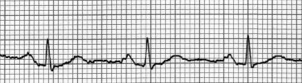
Solution
focus not on ‘thick’ processes, such as runnings or hearts’ beating
but on ‘thin’ structural parts of processes
  called ‘process profiles’
    (event patterns, …)

Slide 100
The problem of process qualities
heart beating at constant rate, elements of an ontological analysis:
the heart (object)
the process of beating
the temporal region occupied by this process
the spatiotemporal region that is occupied by this process (trajectory of the beating process)
the heart beating, referred to by means of
a time series graph (information artifact, thus a BFO:generically dependent continuant) such as:

Slide 101
Process profile ≅ that which the output of a correct device would represent
= that which a correct time-series graph would represent
Notes:
http://www.fitnessmantra.info/fitness/wp-content/uploads/2007/09/ECG%20-%20Electro%20Cardio%20Graph.png

Slide 102
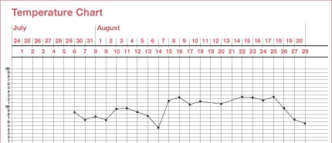
A simpler case
Call the process represented by this graph a (temperature) quality process profile

Slide 103
The graph picks out just one dimension of qualitative change within a much larger conglomerate of processes
Hence ‘quality process profile’

Slide 104
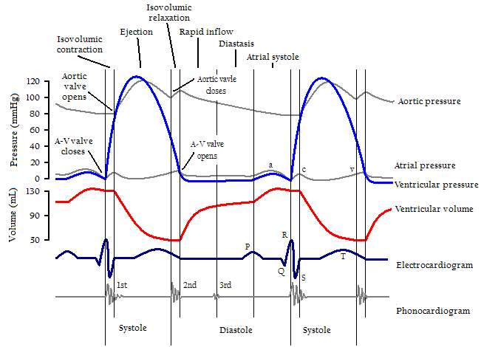
Cardiac Cycle, Left Ventricle
Notes:
http://en.wikipedia.org/wiki/Cardiac_cycle

Slide 105
Some processes can incorporate multiple quality process profiles
Cardiac Cycle, Left Ventricle
Notes:
http://en.wikipedia.org/wiki/Cardiac_cycle

Slide 106
compare inseparable parts of qualities e.g. hue, saturation and brightness of a color quality
the corresponding quality process profiles will stand in analogous relations to each other

Slide 107
just as hue, saturation, brightness are mutually dependent proper parts of a color instance
so process profiles are mutually dependent proper parts of some larger process

Slide 108
multi-quality process profile
Cardiac Cycle, Left Ventricle
Notes:
http://en.wikipedia.org/wiki/Cardiac_cycle

Slide 109
Single quality process profile
a process of the sort that can be represented by a chart plotting quality measurement results on a single dimension against a time axis
a quality process profile is a truthmaker for a time series graph of this sort

Slide 110
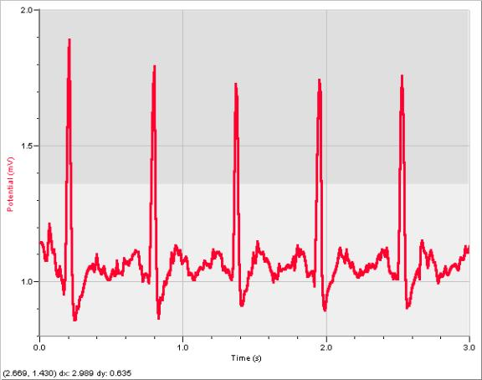
Many putative process qualities (e.g. amplitude) may better be conceived as qualities of such time series graphs
Notes:
http://tg016.k12.sd.us/inquiry_project____________cardi.htm

Slide 111
Elucidation
a process_profile_of b holds when
a proper_occurrent_part_of b
& there is some proper_occurrent_part c of b which
has no parts in common with a
& is mutually dependent on a
& is such that a, b and c occupy the same temporal region

Slide 112
mutual dependence
a
b
c
husband role ←→ wife role

Slide 113
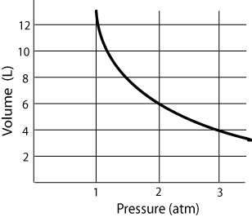
Boyle’s Law

Slide 114
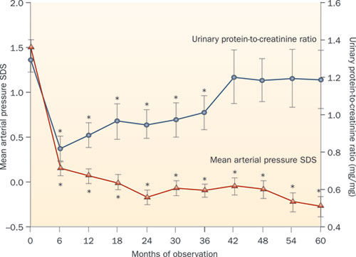
simultaneous causality

Slide 115
causal models for Virtual Physiological Human

Slide 116
Physiological models
kinetic, hydraulic, electrical or chemical …
sets of differential equations …
how to integrate these models?

Slide 117
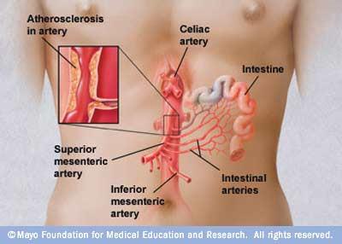

Slide 118
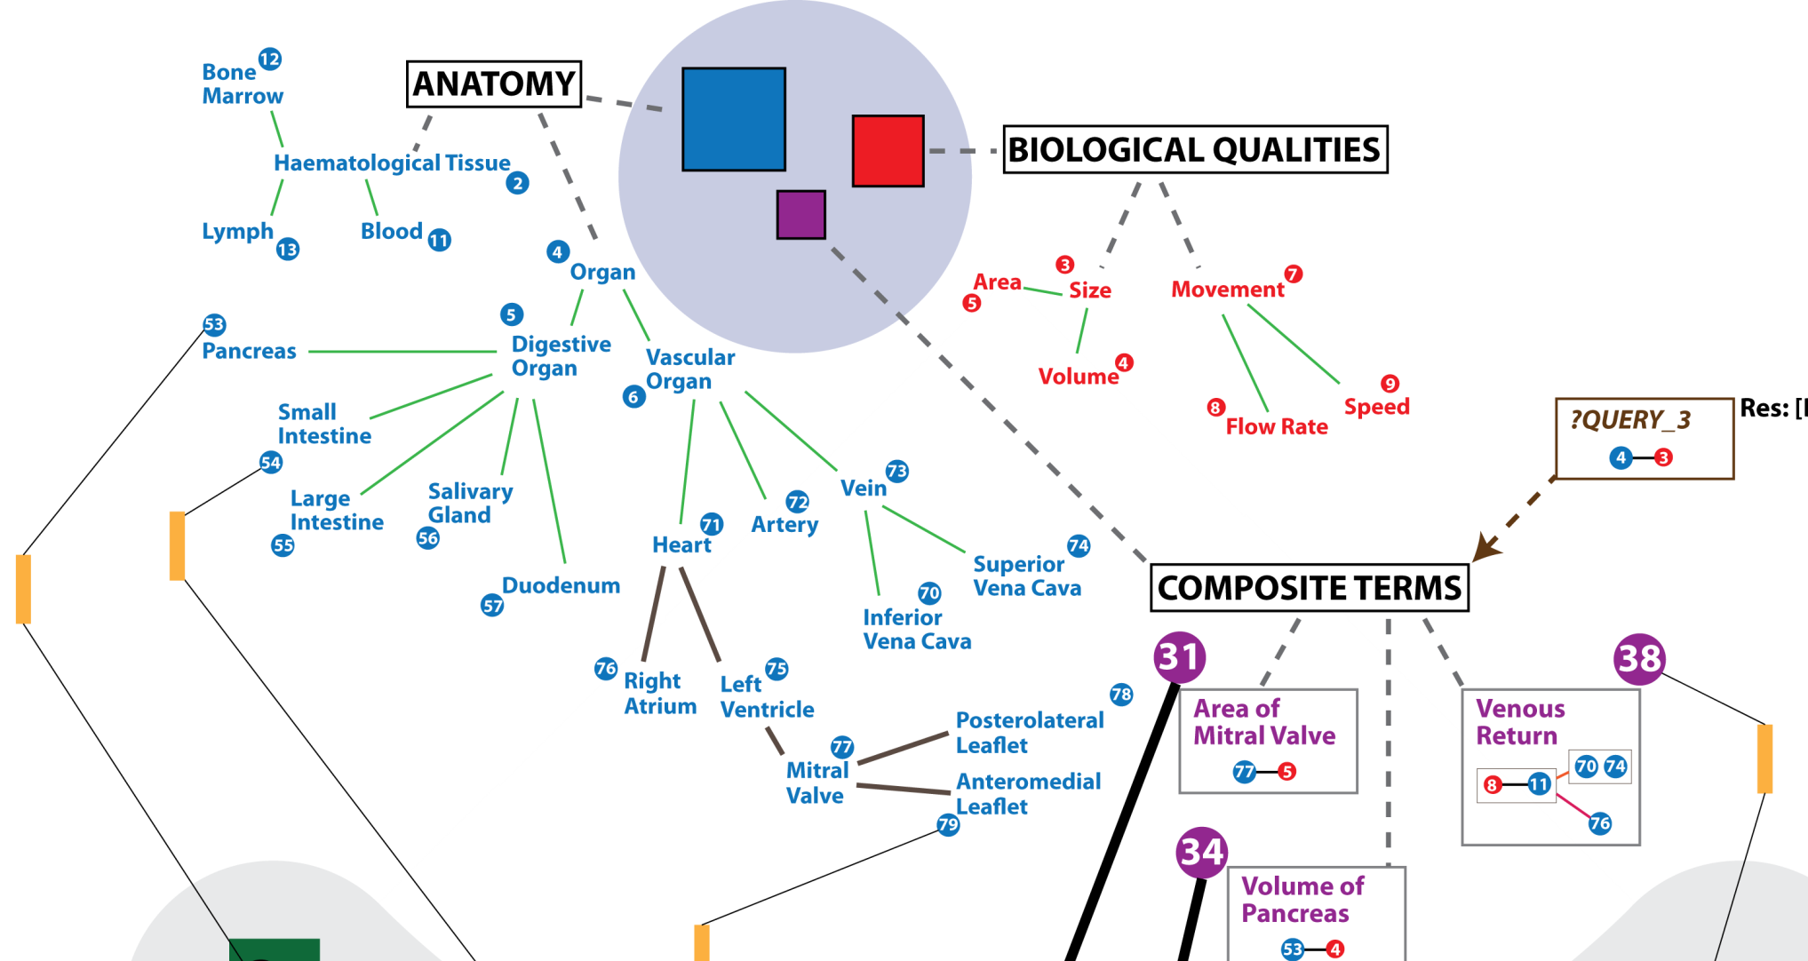
Virtual Physiological Human Ontologies
Bernard de Bono, ICBO 2011

Slide 119
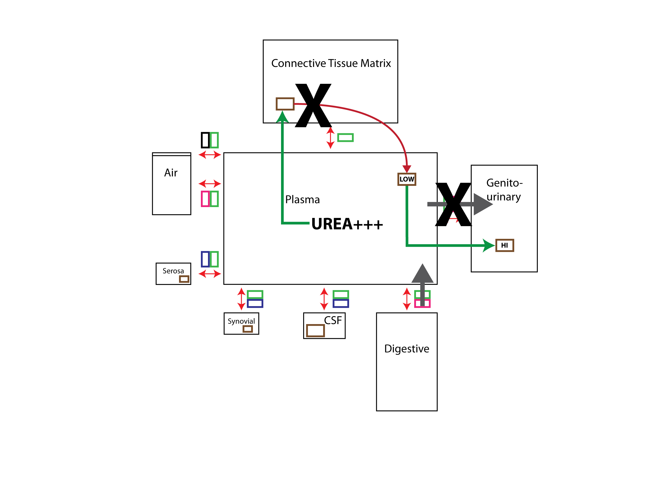
Compartments
Bernard de Bono, ICBO 2011

Slide 120
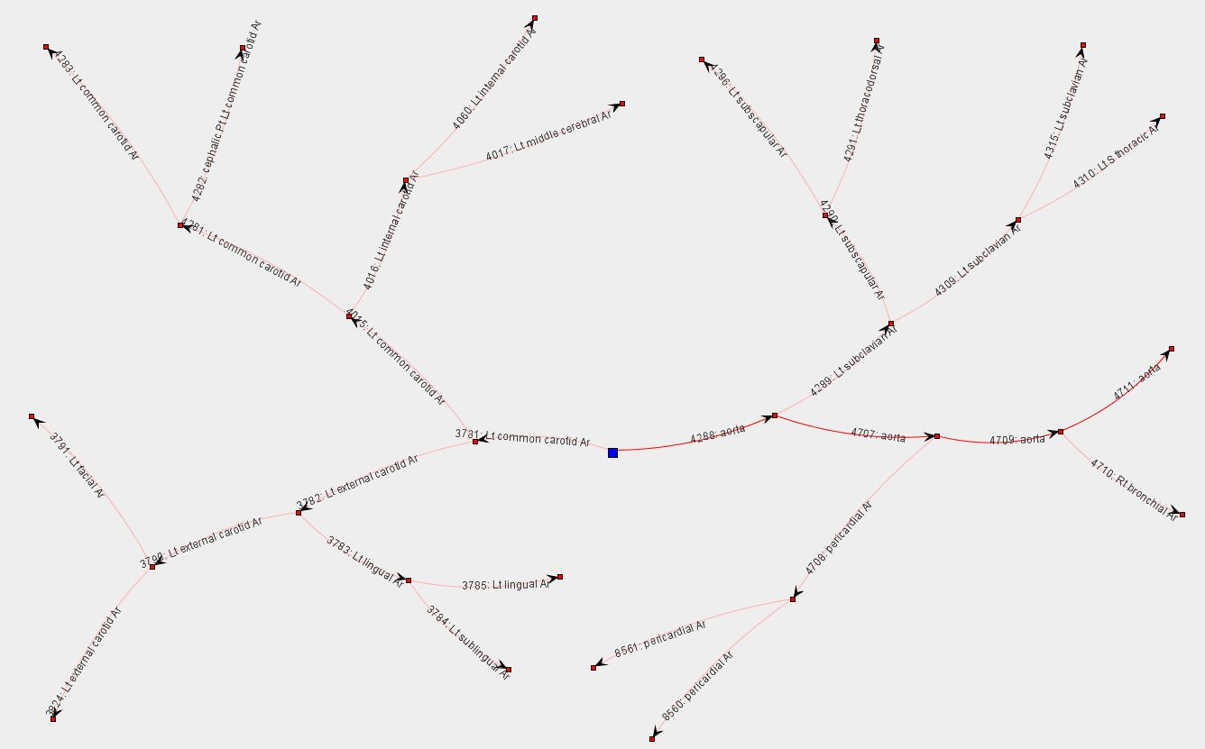
Connections
Bernard de Bono, ICBO 2011

Slide 121
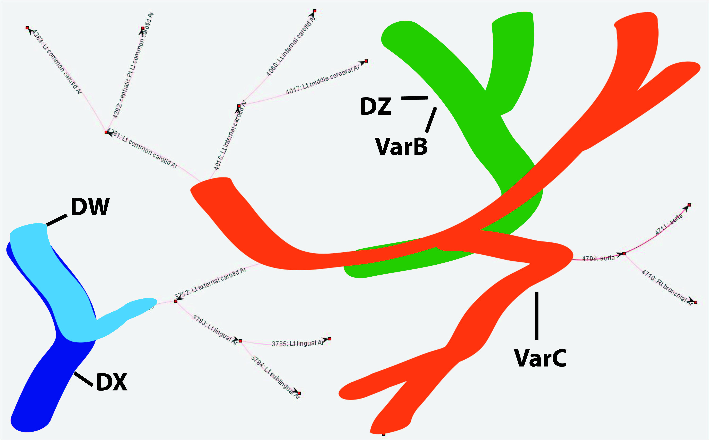
Differential equations
Bernard de Bono, ICBO 2011

Slide 122
Differential equations
Bernard de Bono, ICBO 2011

Slide 123
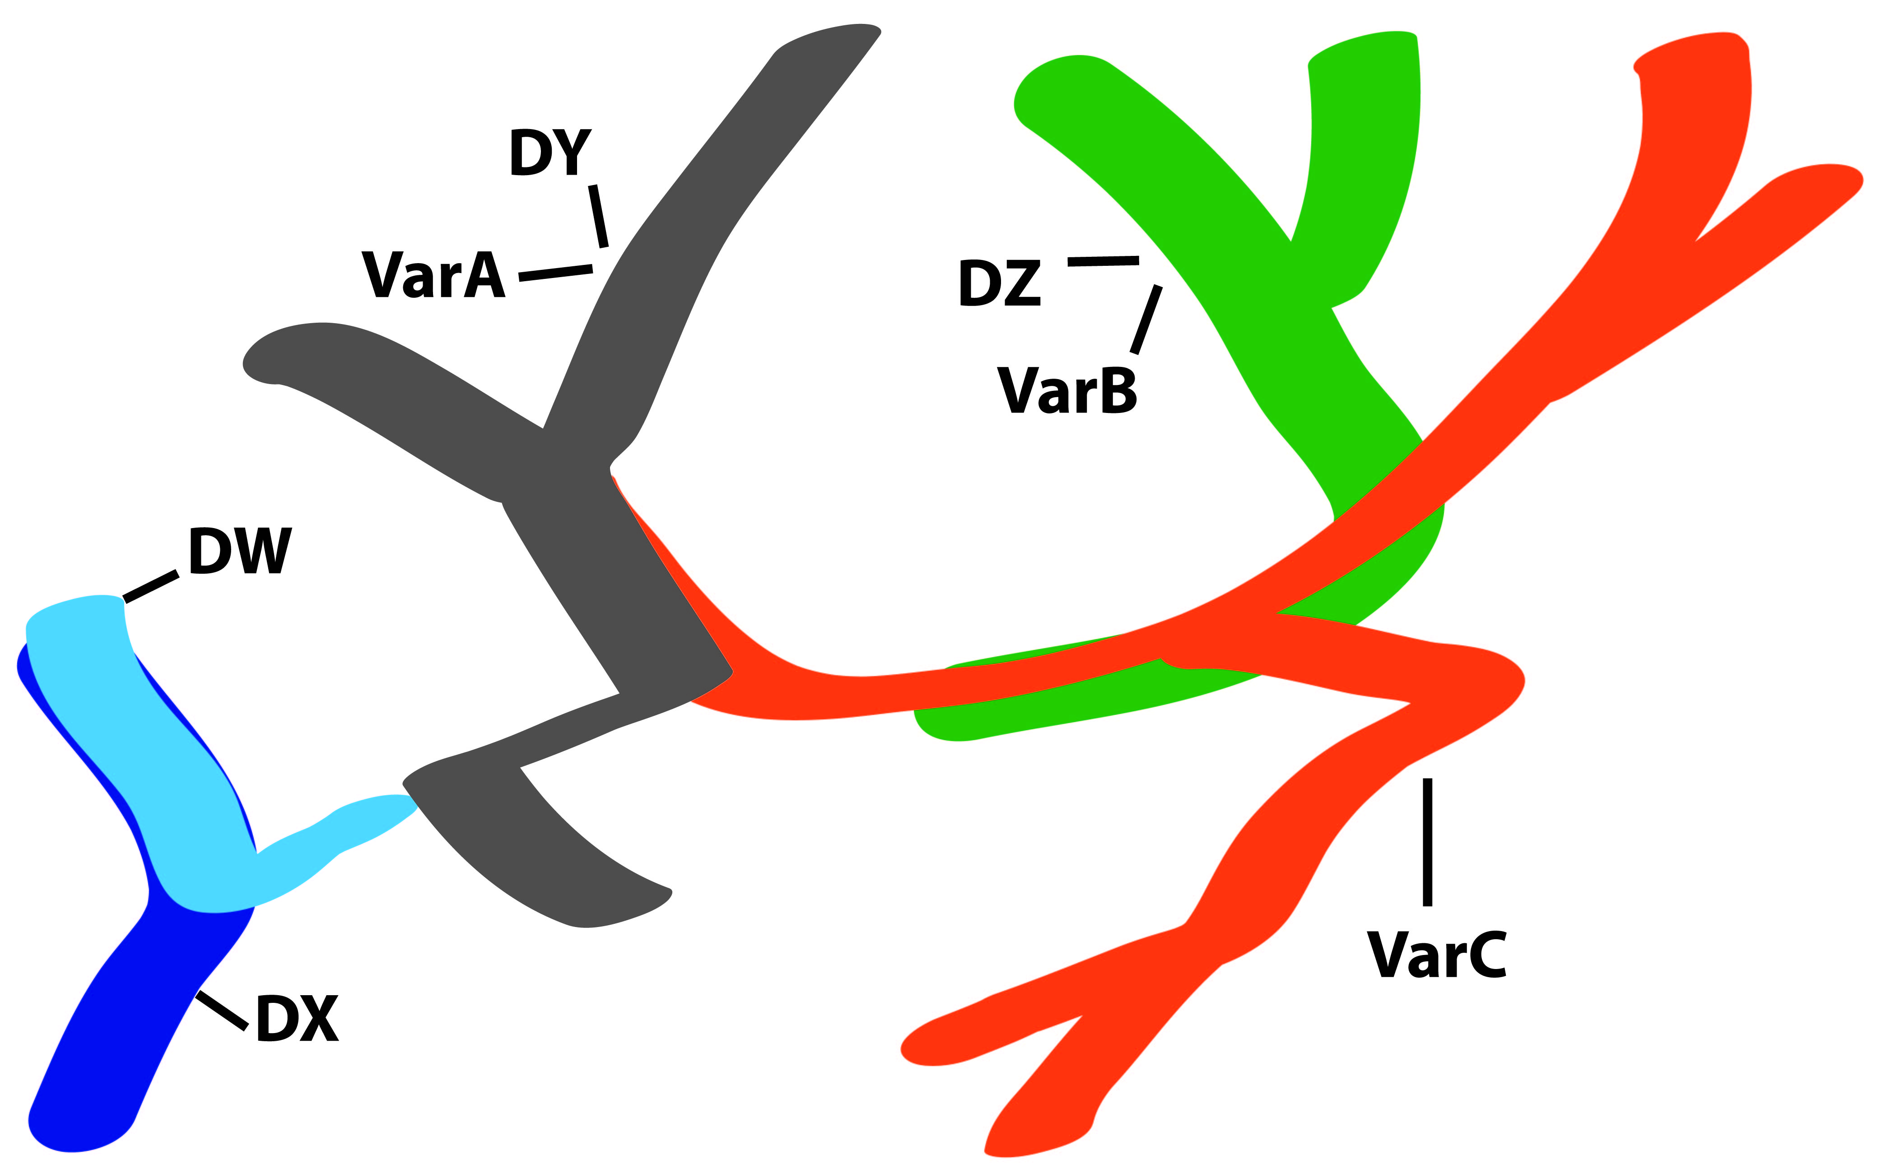
Differential equations
Bernard de Bono, ICBO 2011

Slide 124
Hypothesis
Multi-quality process profiles are the sorts of things that can be represented by corresponding differential equations; i.e. they are multiple interrelated thin slices within processes

Slide 125

Determinable and determinate qualities
temperature
37ºC
37.1ºC
37.2ºC
37.3ºC
37.4ºC
37.5ºC
instantiates at t₁
instantiates at t₂
instantiates at t₃
instantiates at t₄
instantiates at t₅
instantiates at t₆
John’s temperature (a quality instance)

Slide 126
Determinable and determinate quality universals
length
  6 cm length
  7 cm length
weight
  1 kg weight
  2 kg weight
temperature
  62 degree C temperature
  63 degree C temperature

Slide 127
Determinable and determinate process profile universals
speed profile
constant speed profile
  2 mph constant speed profile
  3 mph constant speed profile
variable speed profile
  acceleration profile
    constant acceleration profile
      0 ft/s² constant acceleration profile
      32ft/s² constant acceleration profile
      33 ft/s² constant acceleration profile
  variable acceleration profile
        increasing acceleration profile

Slide 128
Process predications
To assert that a process has process profile type F with magnitude n as measured in unit u is to assert:
measuring technology for measuring process profiles of determinable type F in units u would yield output: n when applied under ideal conditions to this process

Slide 129
Heart beat process profile (across an interval)
Notes:
http://www.fitnessmantra.info/fitness/wp-content/uploads/2007/09/ECG%20-%20Electro%20Cardio%20Graph.png

Slide 130
How to understand: heart beat at t ?
in terms of this diagram? In first approximation, the ration of numbers of beats to time in a sufficiently large segment of the heart beating process which includes t in its interior
Notes:
http://www.fitnessmantra.info/fitness/wp-content/uploads/2007/09/ECG%20-%20Electro%20Cardio%20Graph.png

Slide 131
How to understand: heart beat at t
in terms of this diagram? In first approximation, the ratio of number of cycles to time in a sufficiently large segment of the heart beating process which includes t in its interior (say: 2 cycles / 1.8 seconds)
t
Notes:
http://www.fitnessmantra.info/fitness/wp-content/uploads/2007/09/ECG%20-%20Electro%20Cardio%20Graph.png

Slide 132
Compare: John is moving with speed v at time instant t
roughly: there is some temporal interval (t₁, t₂), including t in its interior, in which the constant speed v process profile is instantiated
more precisely: Given any ε, however small, we can find some interval (t₁, t₂), including t in its interior, which is such that the ratio of d (the distance traveled) to |t₂-t₁| differs from v by less than ε.

Slide 133
Note the difference between
this moving m has speed v at time instant t
this person j has temperature 63°C at time t
j might have had a different temperature at t
m could not have had a different speed at t
m could not have been different in any way

Slide 134
Process predications
‘p has F of value n as measured in unit u’
abbreviates:
there is some process profile p_{o} such that
p_{o} process_profile_of p
& p_{o} instance_of the determinate process profile type: F with magnitude n as measured in unit u.

Slide 135
Relative process predications
Every process is embedded within a series of larger process wholes, each nested within yet larger process wholes.
When a billiard ball is moving across a table, we can focus
  on the ball’s motion relative to the table,
  on the larger process which is the motion of the body-table system relative to the motion of the earth,
  on the motion of the body-table-earth system relative to the movement of the sun

Slide 136
Relative physiological process predications
When studying the kidney physiologists may investigate
  processes within the interior of the kidney, interactions between the kidney and other parts of the urogenital system,
  interactions between this system and other bodily systems
  and so on.

Slide 137
Relative physiological process predications
A physiologist may be interested in
processes in a single organism,
processes in this single organism as part of a larger whole which includes an entire population of organisms of a relevant similar type (all humans, all human babies of a given birthweight, all athletes, …).
Normal processes are defined for this larger population, and deviations from this norm are defined for the single organism relative thereto.

Slide 138
Relative physiological process predications
The physiologist may study kinetic, hydraulic, electrical or chemical processes extending across smaller and larger wholes, for example when investigating pharmacokinetic interactions between the kidney and drug molecules within its compartments, or when investigating photodermatological interactions which occur when the epidermis is exposed to sunlight.

Slide 139
Relative physical process predications
Predications of processes are always relative to the entirety of spacetime
(relative to frames?)

Slide 140
Most process predications look like this
They do not look like this (which would make them analogous to qualities):
Should we recognize States as Static Process Profiles?

Slide 141
Spinoza: States of motion and rest
4 m/s speed profile
0 m/s speed profile
state of pregnancy

Slide 142
Process profiles are additive
If p₁ and p₂ are process profiles that do not overlap in their temporal extent, then the mereological sum of p₁ and is also a process profile
May not be true for multi-quality process profiles

Slide 143
VPH Process profiles ?
Pump has certain settings
  realization of function will provide equation
    equation has parameters and variables
    target thresholds for disorders
  with parameters, e.g. the heart pumping with different parameters as you age, different inputs (clots …)
  qualities of the curve which is the realization are qualities of the function

Slide 144
Many putative process qualities (e.g. amplitude) may better be conceived as qualities of such time series graphs
Notes:
http://tg016.k12.sd.us/inquiry_project____________cardi.htm

Slide 145
Needed for the future
Treatment of boundary_of and is_bounded_by relations
Treatment of relations between universals; rules for quantifying over universals.
Relations of dependence of objects on qualities (e.g. of you on your mass)
More detailed treatment of two kinds of causal relations:
(1) causal dependence, for example the reciprocal causal dependence between the pressure and temperature of a portion of gas; the causal unity of objects fits here
(2) causal triggering, where a process is the trigger for a second process which is the realization of a disposition.

