Slide 1
Case study: Classification of advertisement response
Jalal Alizadeh
Thursday, 25 March 2021

Slide 2
Motivation
Advertising can increase costumers’ knowledge about the benefits of a product
Advertising influences costumers’ attitude by building a desire for the product
The goal of advertising is to define the target group to increase the number of potential costumers
Machine learning can help companies in two directions:
To boost their business
To expand the activity
Machine learning can deliver benefits such as discovering patterns, costumer segmentation and to increase business’s market position.

Slide 3
Introduction
A machine learning (ML) classification task requires data as an input to make a prediction
The data under the investigation represents the population’s reaction to a direct mailing advertisement
As of classification task, the data must contain label (reaction):
Response
No response
The data is composed of nine features from 10000 individuals as follows:
Name, age, lifestyle, zip code, family status, car, sports, earnings and living area
Task is about to build a binary classification model to predict whether a person will respond to the advertisement or not

Slide 4
How classification models work
A computational method that extracts information from data
Classification task is about to predict class (an equivalent term to label) based on provided features
A classifier is an algorithm to map the data to a specific class
To fulfill a classification task, the data should be divided in two parts:
Training set: to understand the relationship of input variables to the class
Test set: to measure the accuracy of the trained model
Available data
Training set
Test set

Slide 5
Features and classifiers
The values of the “Name” feature are specific across all samples
It has been removed since it contains (provides) no information
“Zip code” feature has ~ 94% distinct values
Two other features with considerably less number of values can be extracted from zip code:
Broad area index: using the first digit of zip code
County index: using the first three digits of zip code
“Sports” feature has 15% missing values, hence, are grouped as “other” value
The models were evaluated using five different algorithms:
Logistic regression (GLM), support vector machine (SVM), decision tree (DT), gradient boosting method (GBM), random forest (RF)

Slide 6
Evaluation
Two performance measures are evaluated among on all models to select the best model in prediction of mailing response:
Areal under the curve (AUC): ability of a model to distinguish two classes:
Mitigate the imbalance number of observation among the classes
0.5 means no distinguishing or based on chance
Higher the AUC, better the prediction power

Slide 7
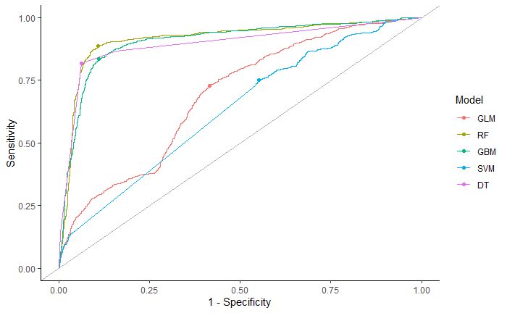
Results: best model
The bullet point on each curve determines the efficiency of the model
The closer bullet point to top-left, the higher prediction reliability
AUC shows that DT, RF and GBM performed more accurate compared to SVM and GLM

Slide 8
Best model
DT, RF and GBM similarly performed better than two others.
AUC is achieved ~ 83% for DT, RF and GBM
Continue with DT because:
DT uses an architecture that simplifies the model interpretation
DT is computationally less expensive than RF and GBM

Slide 9
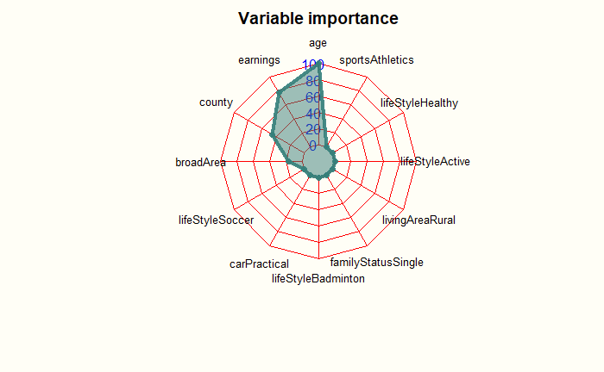
Important features
Top 3 features with more than 45% importance in prediction are :
Age, earnings and county information

Slide 10
Final model
Final model uses the whole data regardless of training and test split
A decision tree algorithm is trained on data with all samples:
To discover the relation between variables and label
To improve the performance by observing a higher number of the samples
The final model is accurately able to predict a person willingness to respond an advertisement

Slide 11
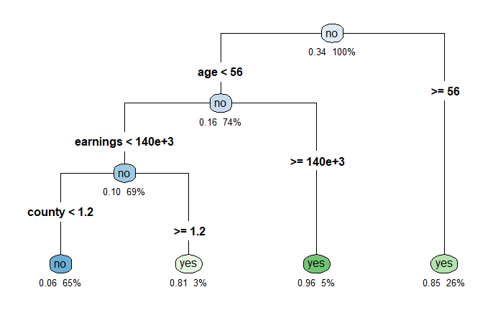
Final model architecture
Each node shows:
Predicted class (yes: response, no: no response)
The predicted probability of response class (ranges from 0 to 1)
The percentage of observations to make a decision

Slide 12
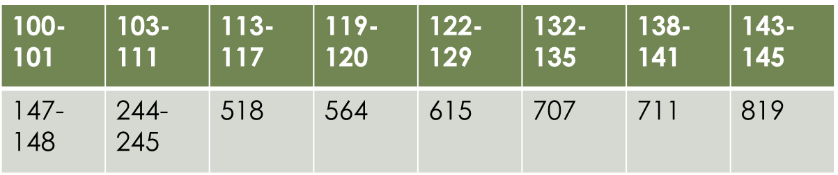
County information
County >= 1.2 narrows counties down to those:
Whose zip code starts with the first three digits as:
These counties can be visualized on a country map (next slide)

Slide 13
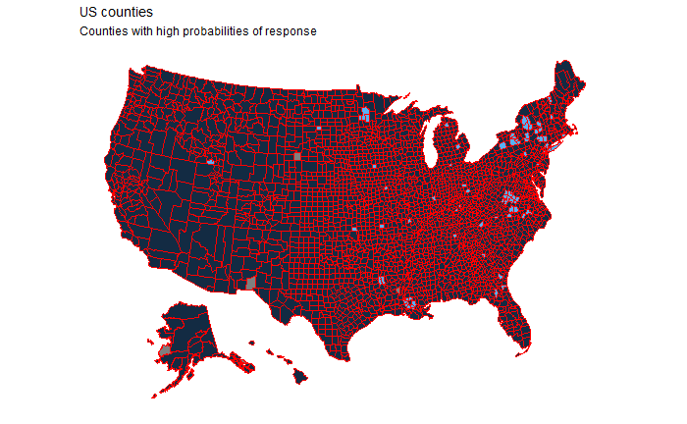
County information
If data belong to USA
The blue area: higher probability of respond

Slide 14
Conclusion
A decision tree model can reliably tag a person whether he/she reacts to an advertisement mail
A 56 or older person with an income of above 140000(currency), and living area with the zip code (first three digits) as shown in the table below is most likel to respond
Mailing the advertisement to the ideal residents (highly prone to respond) will optimize companies‘ spent budget in an efficient time
100-101 | 103-111 | 113-117 | 119-120 | 122-129 | 132-135 | 138-141 | 143-145
147-148 | 244-245 | 518 | 564 | 615 | 707 | 711 | 819

Slide 15
Future work/suggestions
If advertisement is focused on sports:
Instead of groupping the missing values of sports to „other“, an imputation procedure could be implemented to estimate the missing values the from other variables
If there was any information about country:
A better visualization of county could be prepared
A more specified rules (also more number of rules) could be investigated using random forest model

Slide 16
Many thanks for your listening!
Question and comments are welcome
Jalal Alizadeh
Reach me at: j.alizadeh.sh@gmail.com

