Slide 1
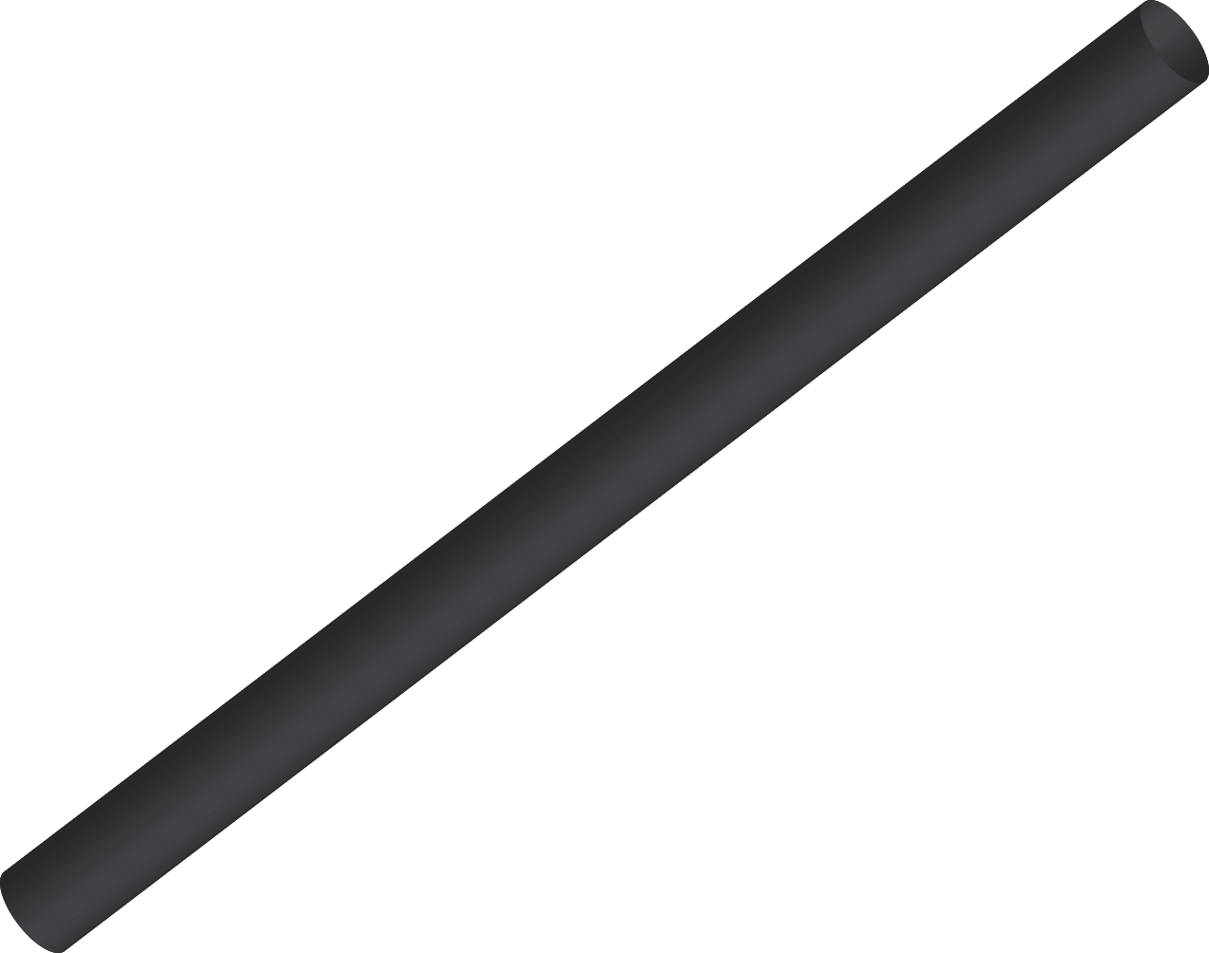


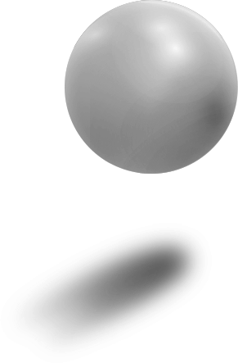
THREE JS Basic Scene
Guide for Beginners

Slide 2

AGENDA
Scene
1
2
Objects
Camera
3
4
Renderer

Slide 3
1
Scene

Slide 4
INTRODUCTION
The scene is like a container. You place your objects, models, particles, lights, etc. in it, and at some point, you ask Three.js to render that scene.

Slide 5
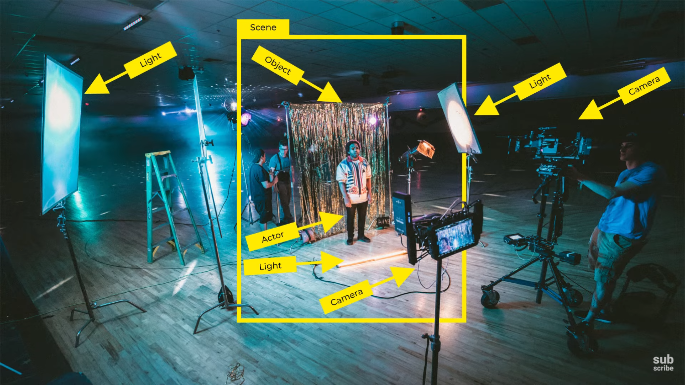
const scene = new THREE.Scene()
Scene.add(element)

Slide 6
2
Objects

Slide 7
INTRODUCTION
Objects can be many things. You can have primitive geometries, imported models, particles, lights, and so on

Slide 8
Objects
We will start with a simple red cube.
To create that red cube, we need to create a type of object named Mesh. A Mesh is the combination of a geometry (the shape) and a material (how it looks).
To create the geometry, we use the BoxGeometry class with the first 3 parameters that correspond to the box's size.
To create the material, we use the MeshBasicMaterial
const geometry = new THREE.BoxGeometry(1, 1, 1)
const material = new THREE.MeshBasicMaterial({ color: 0xff0000 })
const mesh = new THREE.Mesh(geometry, material)
scene.add(mesh)

Slide 9
3
Camera

Slide 10
INTRODUCTION
The camera is not visible. It's more like a theoretical point of view. When we will do a render of your scene, it will be from that camera's point of view.
For Now we use perspective camera

Slide 11

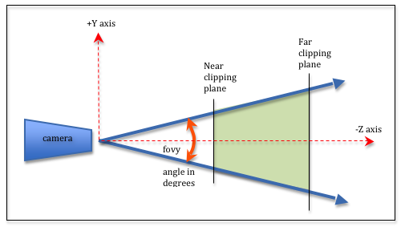

Perspective camera
To create the camera, we use the PerspectiveCamera class.
There are two essential parameters we need to provide.
The field of view
The aspect ratio
The field of view is how large your vision angle is.
The aspect ratio is canvas width / canvas height
const camera = new THREE.PerspectiveCamera(75,
sizes.width / sizes.height);
scene.add(camera)
Notes:
the maximum area that the device can capture.

Slide 12
4
renderer

Slide 13
INTRODUCTION
The renderer's job is to do the render. In this we use webGLRenderer. The WebGL renderer displays your beautifully crafted scenes using WebGL.
const renderer = new THREE.WebGLRenderer({
canvas:document.getElementById(“myCanvas");
})
renderer.setSize(sizes.width, sizes.height)

Slide 14
First render
renderer.render ( scene : Object3D, camera : Camera )
Render a scene or another type of object using a camera.
It's time to work on our first render. Call the render(...) method on the renderer and send it the scene and the camera as parameters.
renderer.render(scene, camera)

Slide 15

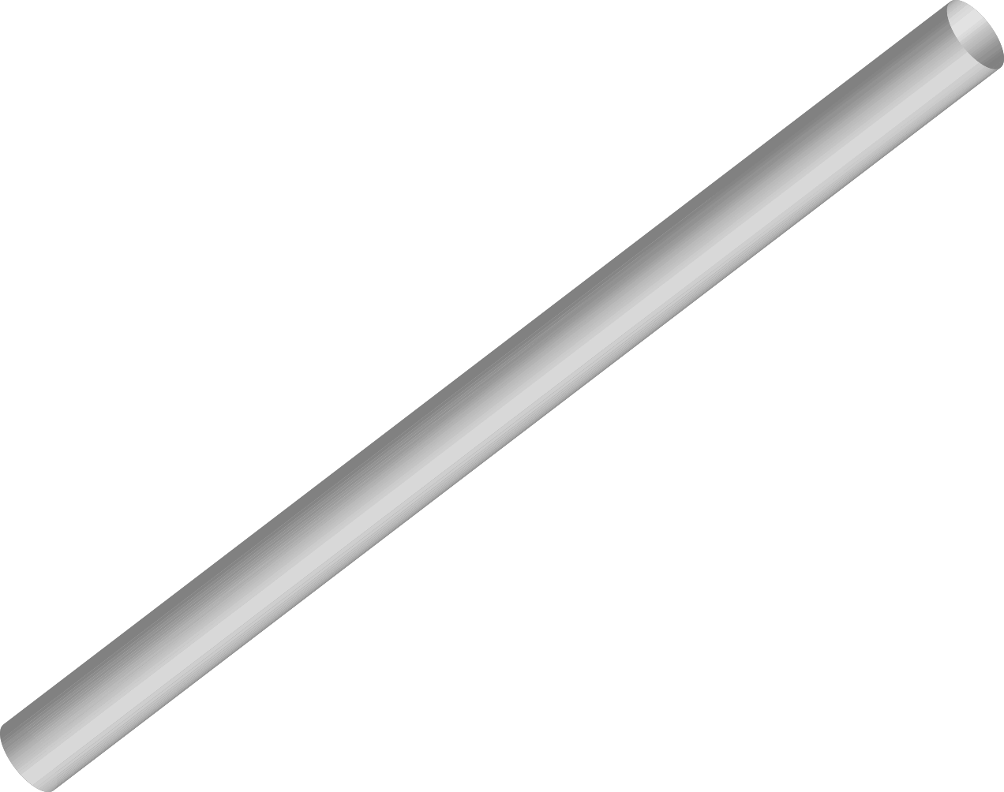
THANKS!
Does anyone have any questions?
anasm8931@gmail.com
Please keep this slide for attribution

