Slide 1
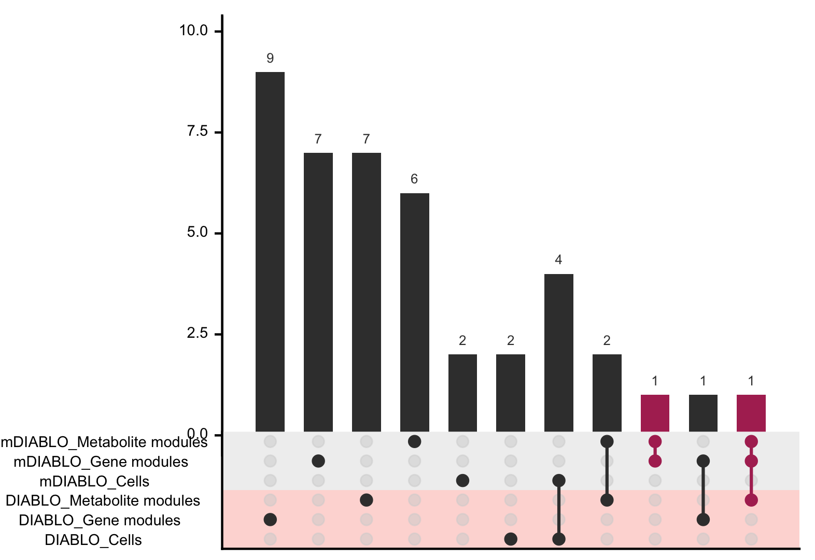
A
Variance decomposition
B
C
mRNA
Gene modules
Pre
vs
Post
Cells
Metabolites
Metabolite modules
D
E
F

