Slide 1
Odoo Functional Workflow
Functions, Uses & Practical Screenshots
Sales • CRM • Purchase • Inventory • Accounting • HR • Contacts
Practical demonstration based on the provided Odoo records
Prepared by: Ajay Thakur
Odoo Functional Assessment

Slide 2
ODOO FUNCTIONAL ASSESSMENT
Overview
What this presentation demonstrates
01
Master Data
Company, contacts, product categories, products and employees
02
Sales & CRM
Lead → opportunity → quotation → sales outcome
03
Purchase
RFQ, purchase order and supplier transactions
04
Inventory
Product movement and delivery validation
05
Accounting
Customer invoices, payments, vendor bills, credit notes and payments
06
Business Value
Centralized data, traceability, automation and integrated workflows
Prepared for Odoo Functional Learning & Practical Assessment • Slide 2

Slide 3
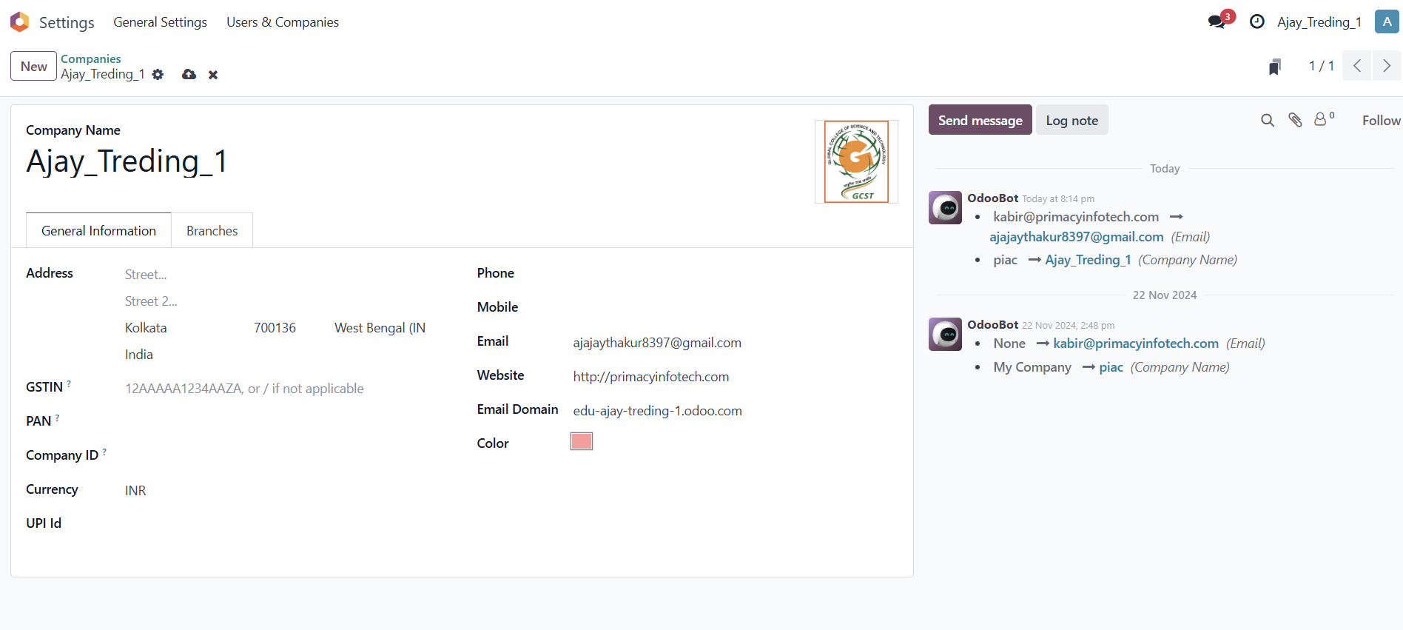
ODOO FUNCTIONAL ASSESSMENT
Company Setup & General Settings
01. Company Setup & General Settings
FUNCTION
Function: Configure the company profile, address, GSTIN, currency, email domain and company branding.
BUSINESS USE
Use: Establishes the organization master data used across Sales, Purchase, Accounting and other Odoo apps.
Prepared for Odoo Functional Learning & Practical Assessment • Slide 3

Slide 4
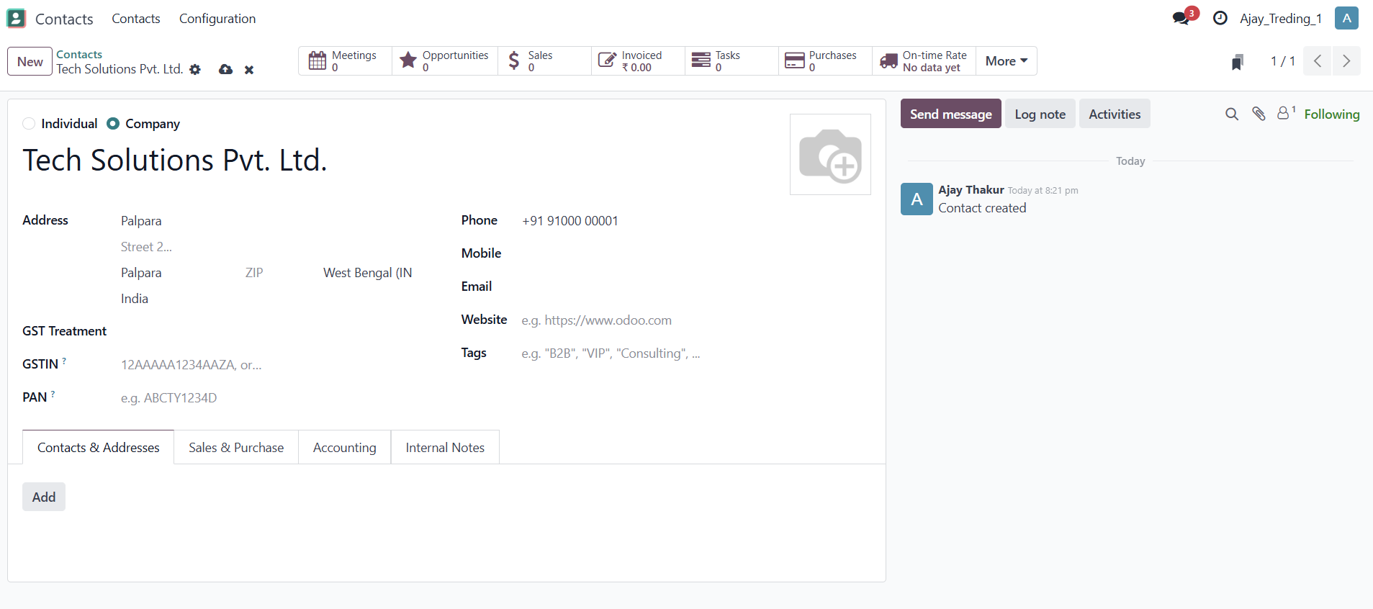
ODOO FUNCTIONAL ASSESSMENT
Customer / Contact Creation – Tech Solutions
02. Customer / Contact Creation – Tech Solutions
FUNCTION
Function: Create a company contact with address, phone, email and GST-related information.
BUSINESS USE
Use: Maintains customer master data and provides a single contact record for CRM, Sales and Accounting.
Prepared for Odoo Functional Learning & Practical Assessment • Slide 4

Slide 5
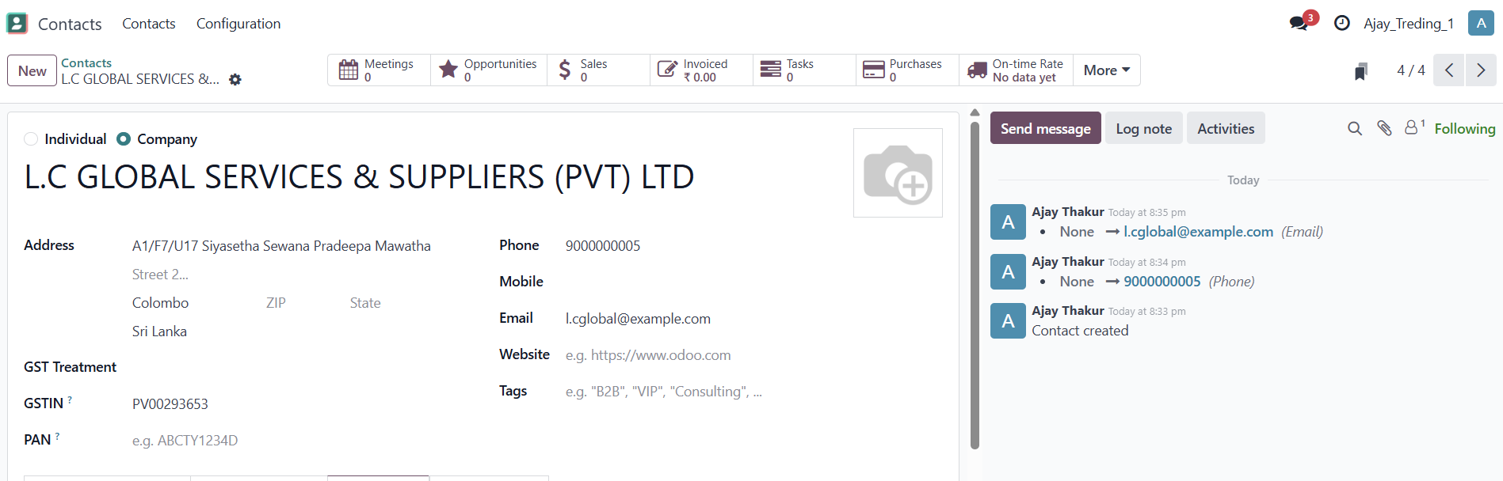
ODOO FUNCTIONAL ASSESSMENT
Vendor / Contact Creation – L.C Global Services
03. Vendor / Contact Creation – L.C Global Services
FUNCTION
Function: Store supplier information such as address, phone, email and GST details.
BUSINESS USE
Use: Provides vendor master data for RFQs, purchase orders, bills and vendor payments.
Prepared for Odoo Functional Learning & Practical Assessment • Slide 5

Slide 6
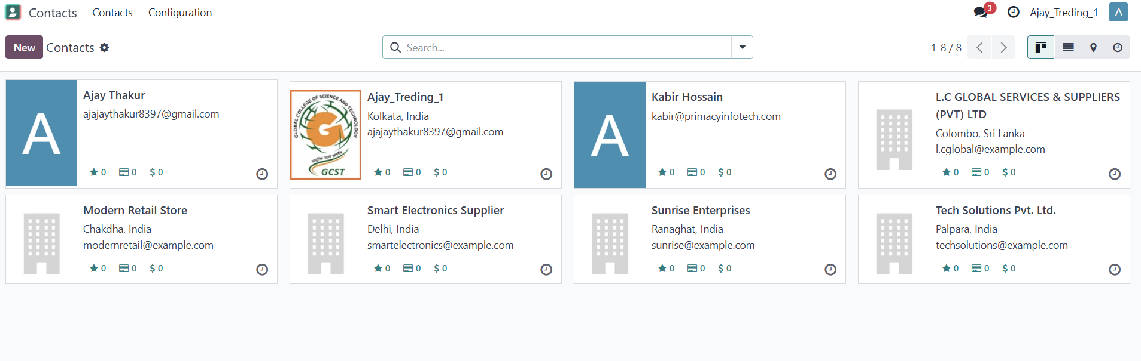
ODOO FUNCTIONAL ASSESSMENT
Contacts Directory
04. Contacts Directory
FUNCTION
Function: View and manage all customers, vendors and other contacts in one place.
BUSINESS USE
Use: Quickly search, open and maintain business partners used by multiple Odoo modules.
Prepared for Odoo Functional Learning & Practical Assessment • Slide 6

Slide 7
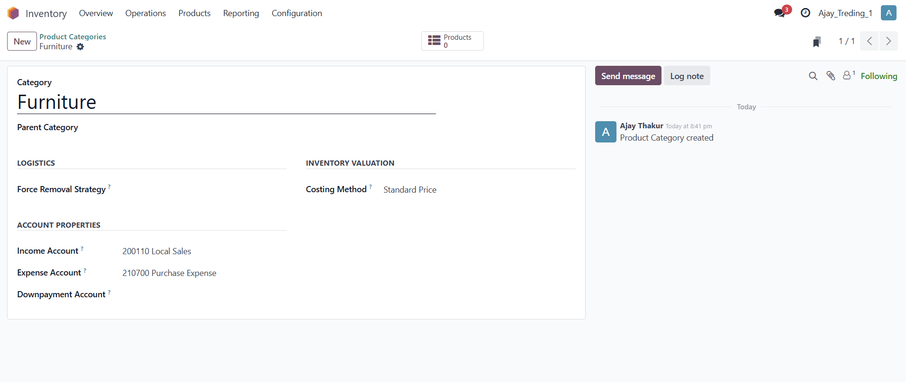
ODOO FUNCTIONAL ASSESSMENT
Product Category – Furniture
05. Product Category – Furniture
FUNCTION
Function: Create a product category and configure logistics, costing and account properties.
BUSINESS USE
Use: Groups products and helps apply consistent inventory valuation and accounting settings.
Prepared for Odoo Functional Learning & Practical Assessment • Slide 7

Slide 8
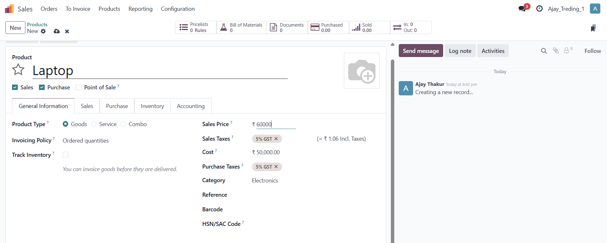
ODOO FUNCTIONAL ASSESSMENT
Product Master – Laptop
06. Product Master – Laptop
FUNCTION
Function: Define a sellable/purchasable product, price, cost, taxes and category.
BUSINESS USE
Use: Creates the product master used in quotations, sales orders, invoices, inventory and purchasing.
Prepared for Odoo Functional Learning & Practical Assessment • Slide 8

Slide 9
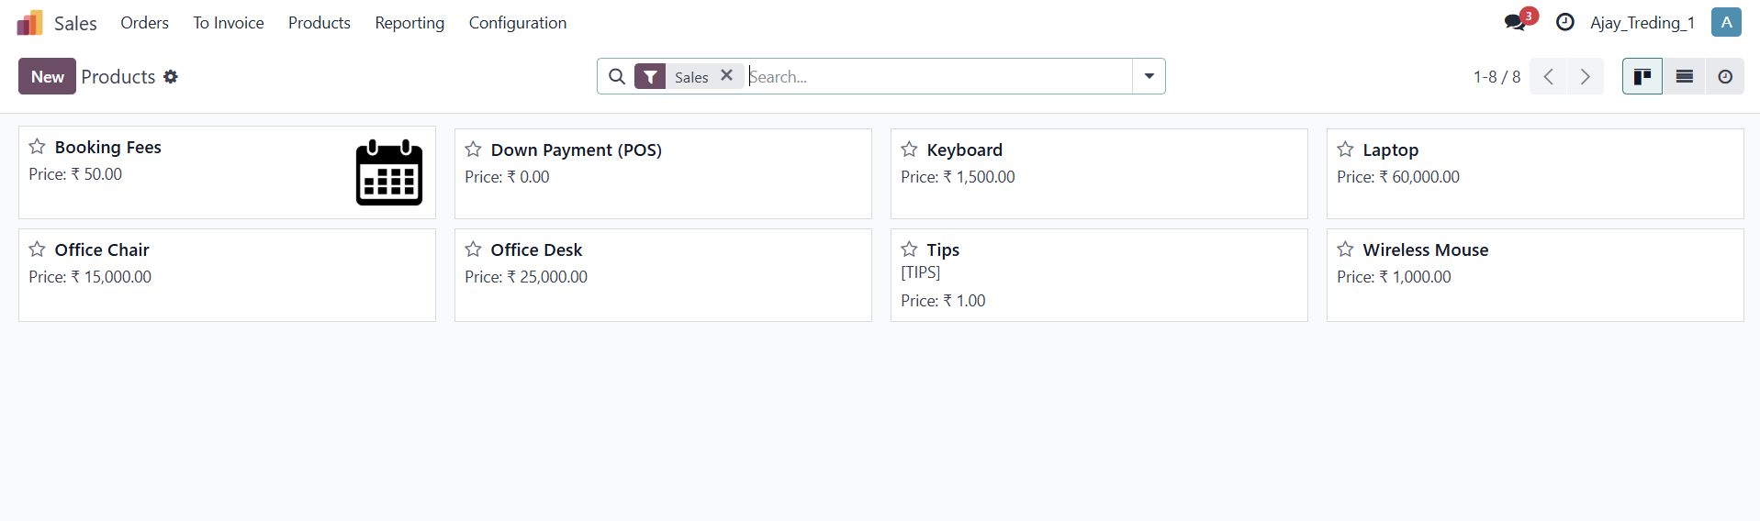
ODOO FUNCTIONAL ASSESSMENT
Product List
07. Product List
FUNCTION
Function: View products in a searchable list/kanban-style screen with prices.
BUSINESS USE
Use: Gives users a quick overview of available products and supports faster product selection.
Prepared for Odoo Functional Learning & Practical Assessment • Slide 9

Slide 10
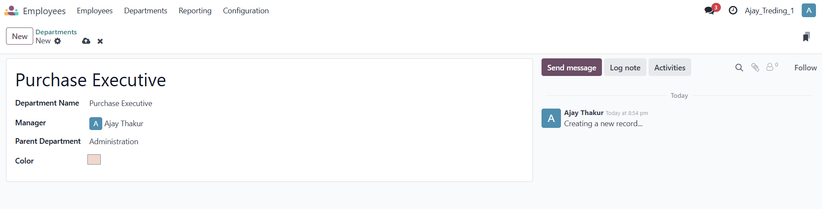
ODOO FUNCTIONAL ASSESSMENT
Purchase – Request for Quotation
08. Purchase – Request for Quotation
FUNCTION
Function: Create an RFQ for a supplier with products, quantities, prices and purchase taxes.
BUSINESS USE
Use: Starts the procure-to-pay process and can be confirmed into a Purchase Order.
Prepared for Odoo Functional Learning & Practical Assessment • Slide 10

Slide 11
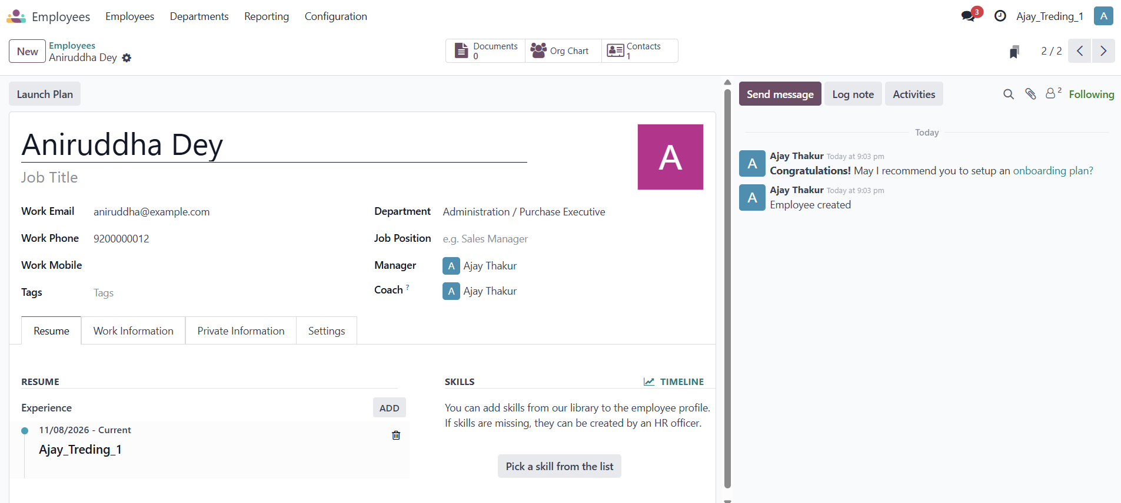
ODOO FUNCTIONAL ASSESSMENT
Employee Master
09. Employee Master
FUNCTION
Function: Create an employee profile with work email, phone, department, manager and job information.
BUSINESS USE
Use: Centralizes employee records and supports HR organization, reporting and employee workflows.
Prepared for Odoo Functional Learning & Practical Assessment • Slide 11

Slide 12
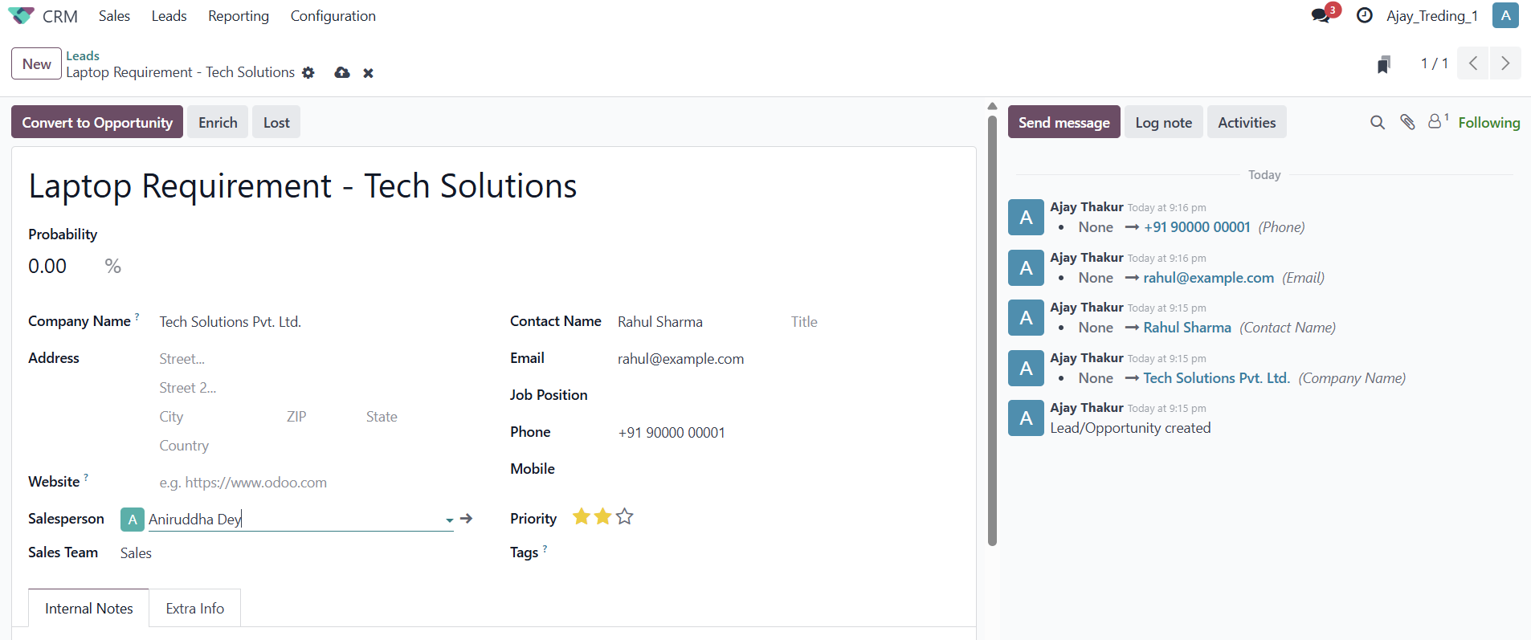
ODOO FUNCTIONAL ASSESSMENT
CRM – Lead Creation
10. CRM – Lead Creation
FUNCTION
Function: Capture a sales lead with company, contact, email, phone, salesperson and priority.
BUSINESS USE
Use: Records a potential customer requirement before it becomes a qualified opportunity.
Prepared for Odoo Functional Learning & Practical Assessment • Slide 12

Slide 13
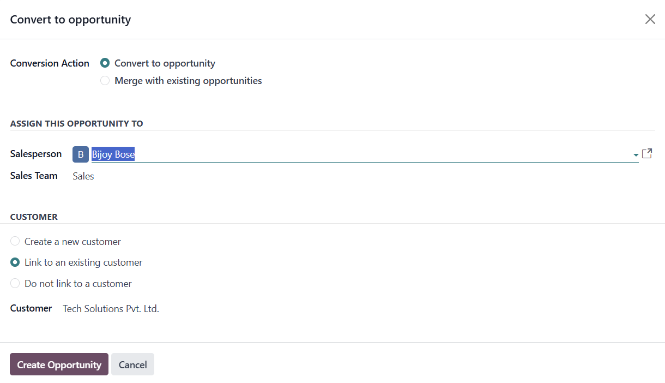
ODOO FUNCTIONAL ASSESSMENT
CRM – Convert Lead to Opportunity
11. CRM – Convert Lead to Opportunity
FUNCTION
Function: Convert a lead into an opportunity and assign the salesperson/team.
BUSINESS USE
Use: Moves a potential requirement into the sales pipeline for qualification and follow-up.
Prepared for Odoo Functional Learning & Practical Assessment • Slide 13

Slide 14
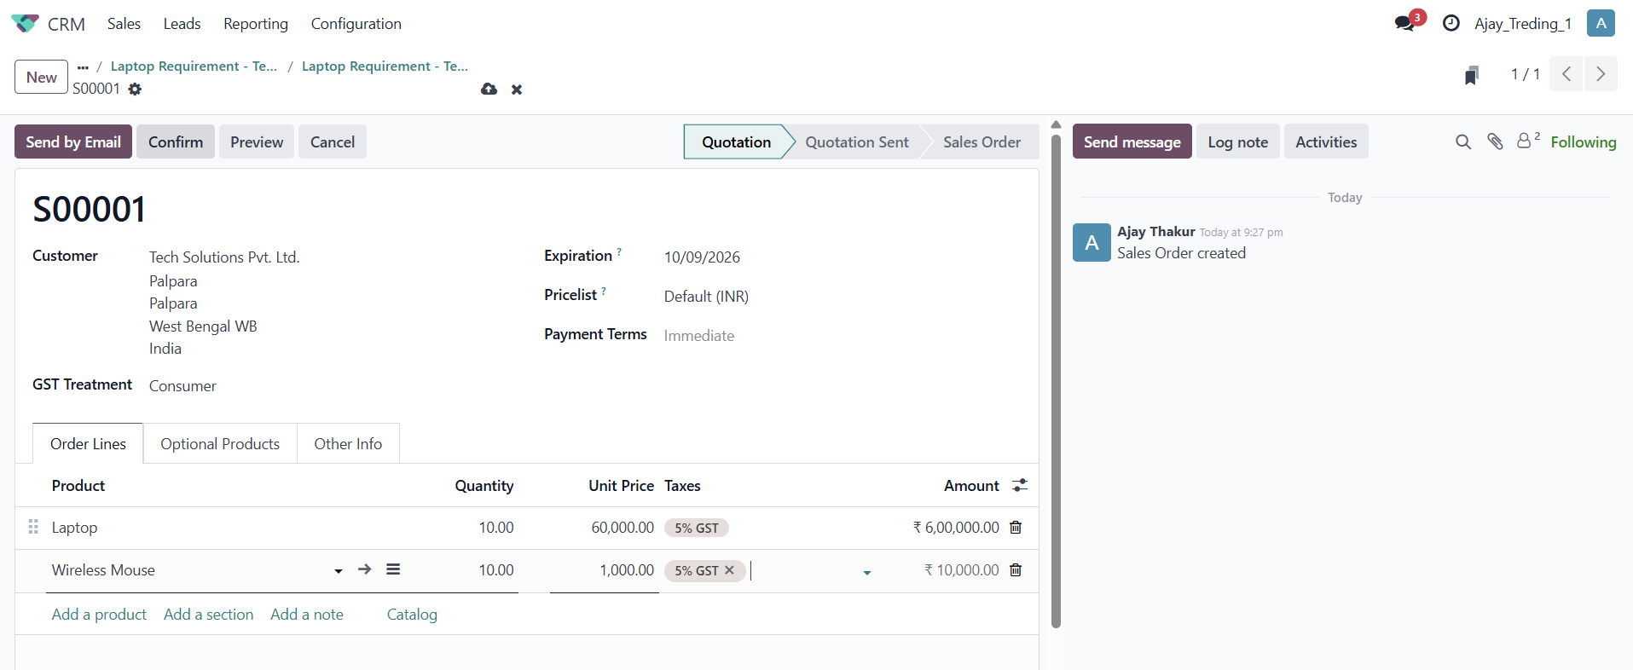
ODOO FUNCTIONAL ASSESSMENT
Sales – Quotation
12. Sales – Quotation
FUNCTION
Function: Create a quotation with customer, products, quantities, prices, taxes and payment terms.
BUSINESS USE
Use: Sends a formal commercial offer that can be confirmed as a Sales Order.
Prepared for Odoo Functional Learning & Practical Assessment • Slide 14

Slide 15
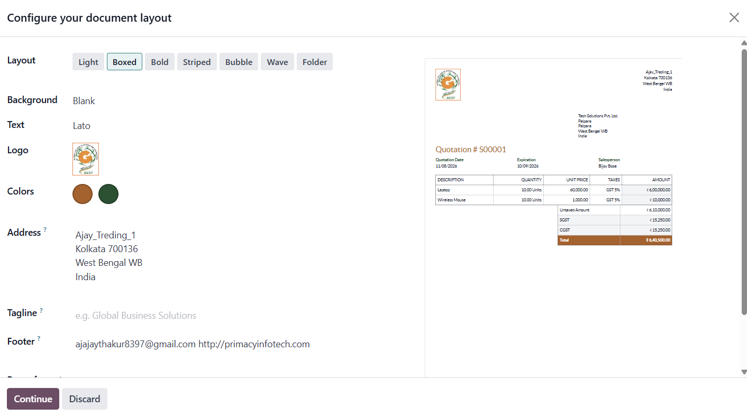
ODOO FUNCTIONAL ASSESSMENT
Quotation Document Layout
13. Quotation Document Layout
FUNCTION
Function: Configure the quotation report layout, logo, address, colors, tagline and footer.
BUSINESS USE
Use: Produces professional customer-facing PDF documents with company branding.
Prepared for Odoo Functional Learning & Practical Assessment • Slide 15

Slide 16
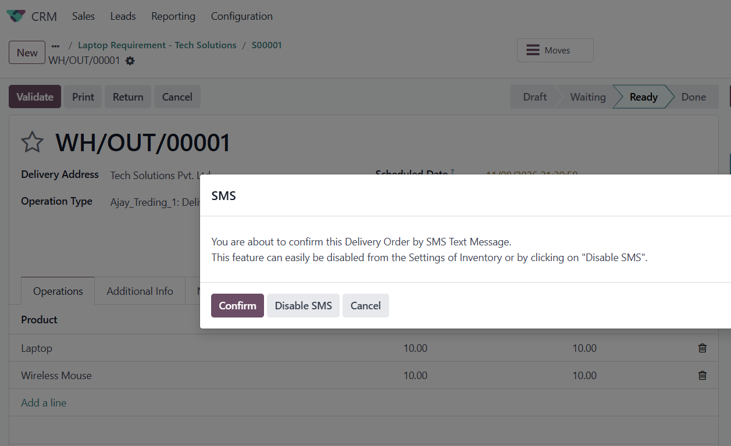
ODOO FUNCTIONAL ASSESSMENT
Inventory – Delivery Validation & SMS
14. Inventory – Delivery Validation & SMS
FUNCTION
Function: Validate an outgoing delivery and manage the SMS confirmation prompt.
BUSINESS USE
Use: Confirms that products are ready to be delivered and records the delivery operation in inventory.
Prepared for Odoo Functional Learning & Practical Assessment • Slide 16

Slide 17
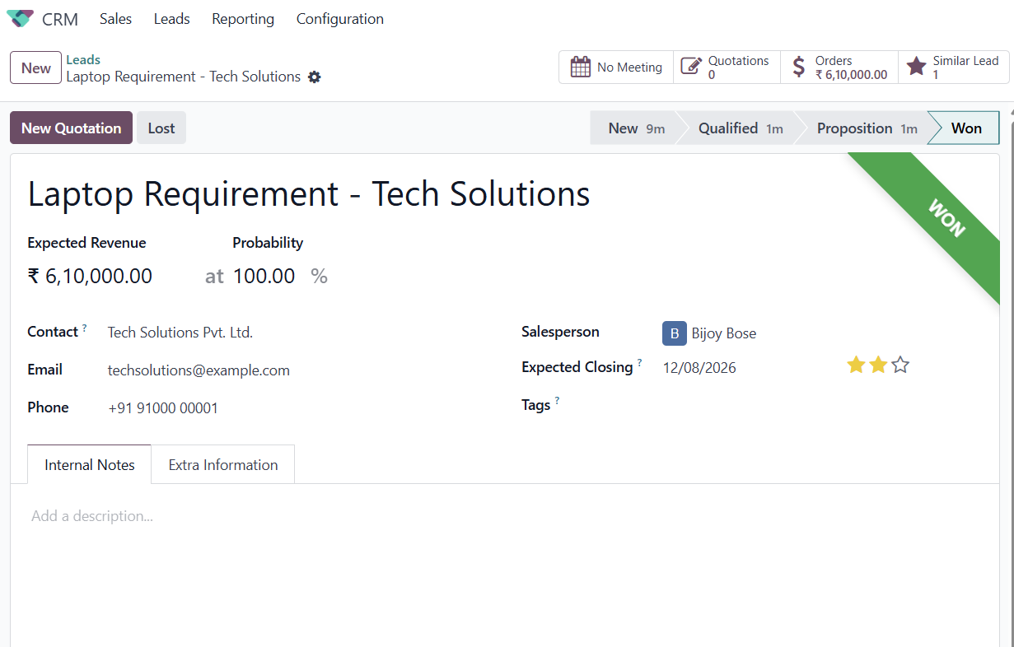
ODOO FUNCTIONAL ASSESSMENT
CRM – Won Opportunity
15. CRM – Won Opportunity
FUNCTION
Function: Track the opportunity after successful conversion, with expected revenue and 100% probability.
BUSINESS USE
Use: Marks a successful sales pipeline outcome and links the opportunity to the customer.
Prepared for Odoo Functional Learning & Practical Assessment • Slide 17

Slide 18
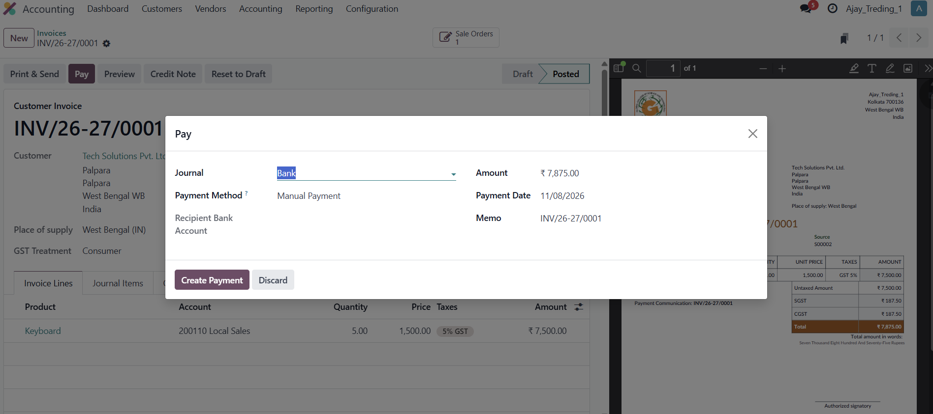
ODOO FUNCTIONAL ASSESSMENT
Accounting – Customer Invoice Payment
16. Accounting – Customer Invoice Payment
FUNCTION
Function: Register a payment against a posted customer invoice using a selected journal and payment method.
BUSINESS USE
Use: Records money received and changes the invoice/payment status to reflect settlement.
Prepared for Odoo Functional Learning & Practical Assessment • Slide 18

Slide 19
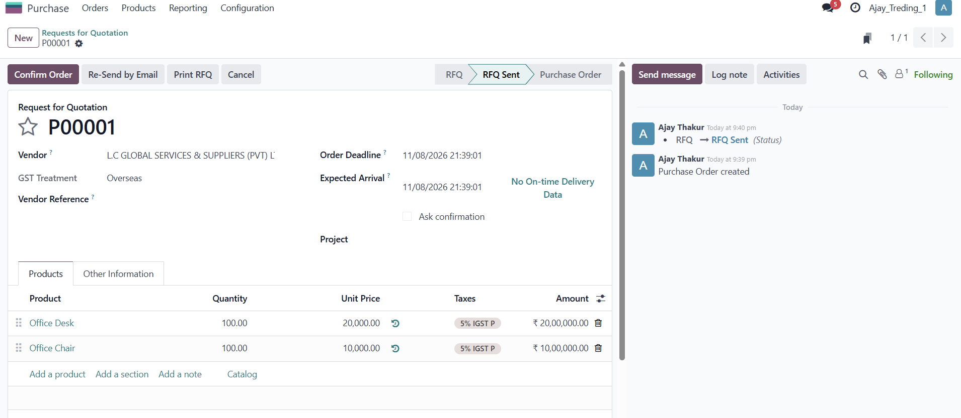
ODOO FUNCTIONAL ASSESSMENT
Accounting – Vendor Credit Note
17. Accounting – Vendor Credit Note
FUNCTION
Function: Create/post a vendor credit note or reversal related to a supplier bill.
BUSINESS USE
Use: Corrects supplier billing transactions and creates the accounting trail for refunds/reversals.
Prepared for Odoo Functional Learning & Practical Assessment • Slide 19

Slide 20
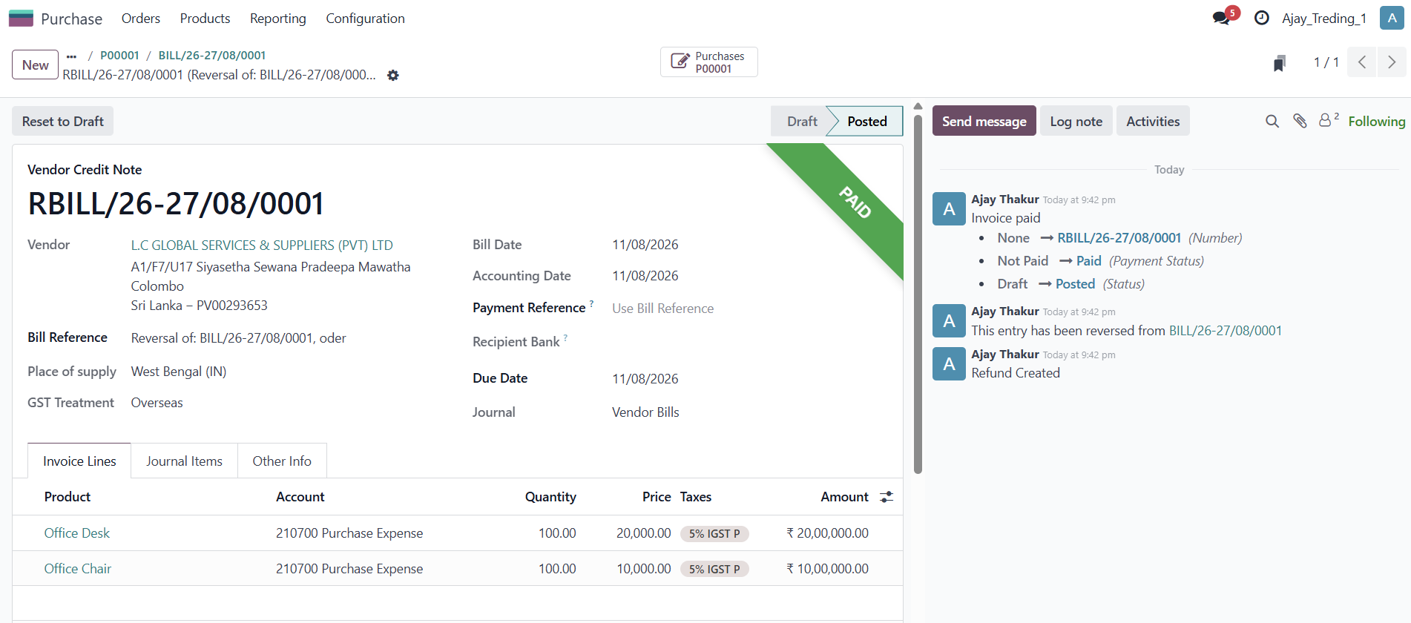
ODOO FUNCTIONAL ASSESSMENT
Accounting – Vendor Payment
18. Accounting – Vendor Payment
FUNCTION
Function: Record a vendor payment with journal, payment method, amount, date and memo.
BUSINESS USE
Use: Records money paid to a supplier and updates the bill/payment status.
Prepared for Odoo Functional Learning & Practical Assessment • Slide 20

Slide 21
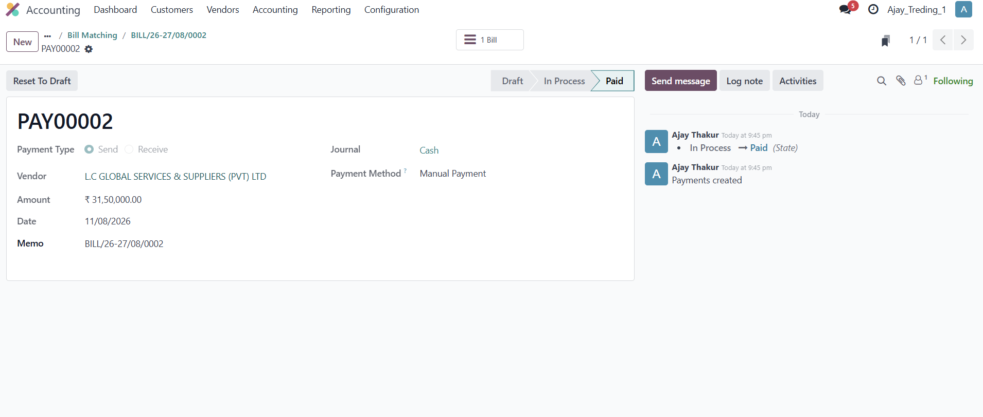
ODOO FUNCTIONAL ASSESSMENT
Vendor Payment Record – PAY00002
19. Vendor Payment Record – PAY00002
FUNCTION
Function: View a completed vendor payment with supplier, amount, date, journal and payment method.
BUSINESS USE
Use: Provides an auditable payment record linked to the vendor bill.
Prepared for Odoo Functional Learning & Practical Assessment • Slide 21

Slide 22
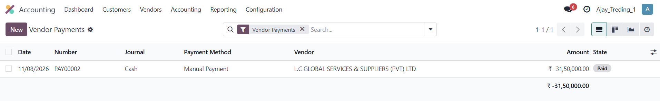
ODOO FUNCTIONAL ASSESSMENT
Vendor Payments List
20. Vendor Payments List
FUNCTION
Function: View vendor payments in a list with date, number, journal, vendor, amount and state.
BUSINESS USE
Use: Supports payment tracking, reconciliation and accounting review.
Prepared for Odoo Functional Learning & Practical Assessment • Slide 22

Slide 23
SUMMARY
End-to-End Workflow
How the Odoo functions connect
Master Data
→
CRM Lead
→
Opportunity
→
Quotation / Sales Order
Delivery
→
Customer Invoice
→
Payment
→
Purchase / Vendor
Vendor Bill & Payment
Key takeaway: Odoo integrates customer, product, sales, inventory, purchasing, HR and accounting data so that one business transaction can be traced across the complete process.
Prepared for Odoo Functional Learning & Practical Assessment • Slide 23

