Slide 1
ST. Mary’s Food Finder Flutter App
Generated for TADHack-mini Phoenix 2020
By Allan Jackson

Slide 2
St. Mary’s App is intended to augment existing NPO Web Site
Free Cell Phones Voice & Text are available for qualified Low-Income households and individuals in Arizona (AZ).
These phones include a baseline service package from Assurance Wireless.
May be used for personal and business purposes. New guidelines allow for separate users that live at the same address to be eligible including residents of homeless shelters and nursing homes.
Author has seen that baseline data plans also exist for LIH & I
This Flutter app has been tested on Android devices on 2/1/2020
App will be side-loaded and tested on Assurance wireless 2/2

Slide 3
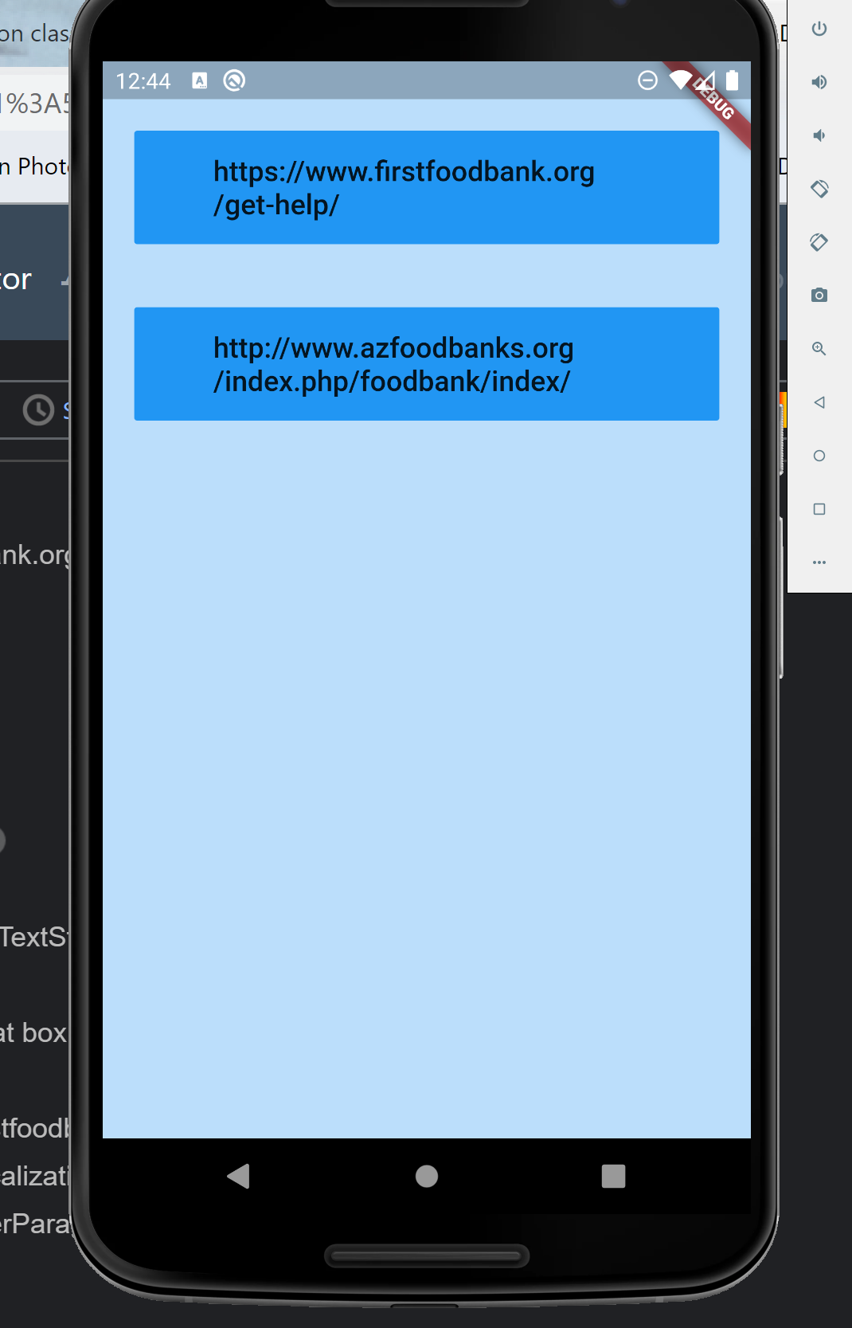
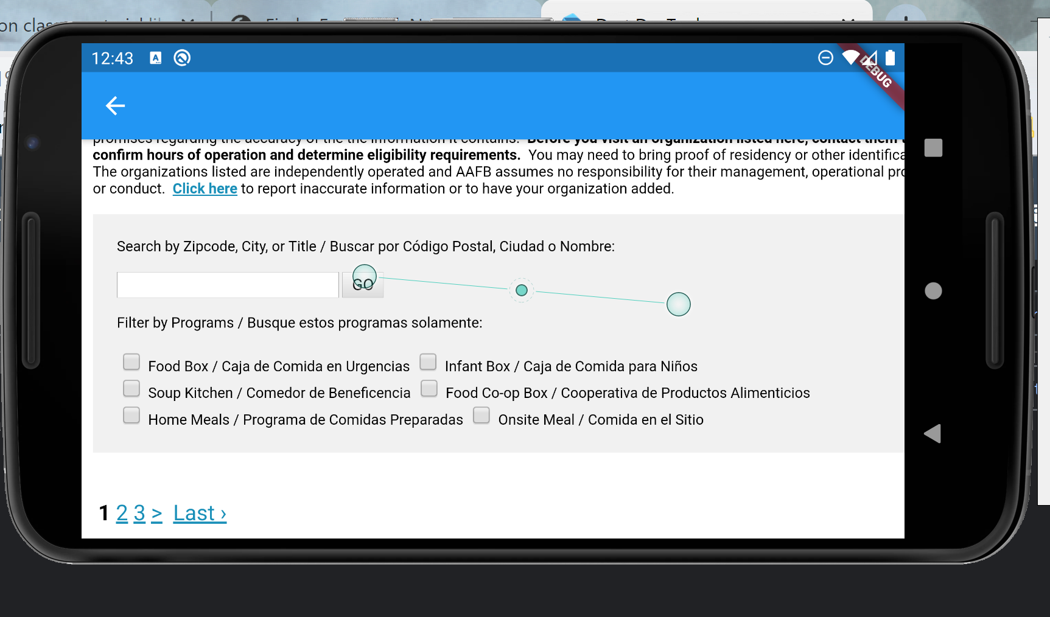
App s/b compatible with both Android and iPhones
Flutter is google’s mobile cross-platform development language
Development IDEs are Android Studio and VS Code
Android emulation has been successful

Slide 4
App capabilities
St. Mary’s Food Finder allows access to ALL the functionality of the NPO Web Site which includes:
Locate Food Resources by Postal ZIP code
Map route to Food Resources though out Arizona
Register for all NPO Resources on the website
This app is NOT a Web Browser
It only navigates to relative/linked resources of St. Mary’s and Arizona food banks

Slide 5
Future development/upgrades
Progress bar (rotator) should be added during web navigation
Splash Screen should be added with NPO information
NPO logos should be incorporated as application ICONS
NPO logos and artwork should be added
Mobile device orientation (landscape) should be focused
Testing should be verified on iPhones
Audience Questions:

Slide 6
App Resources
The application can be found/cloned at the following GitHub repository:
https://github.com/AJAX6255/st_marys_food_finder.git
Team Email:
allan.jackson6255@gmail.com
Cell Phone:
1(828)595-0825

