Slide 1

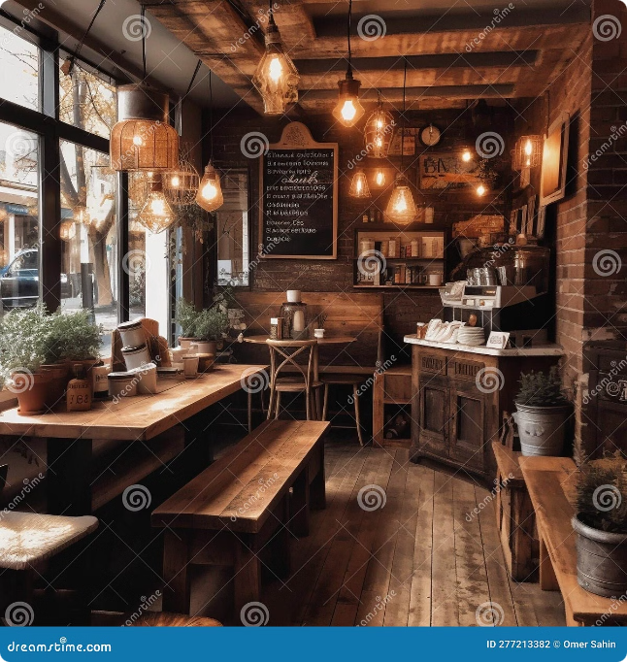
Arora Coffee Shop
Arora Coffee Shop provides a comfortable and inviting atmosphere for customers to enjoy delicious beverages and snacks. The shop is designed to offer a welcoming environment for relaxation and socialization.

Slide 2
Order Entry
Beverage Selection
Snack Options
Order Confirmation
The system allows customers to select from a wide variety of beverages, including classic coffees, teas, and specialty drinks.
Customers can choose from a variety of pastries, sandwiches, and other snacks to complement their beverages.
The system confirms the order details with the customer before proceeding to the billing stage.

Slide 3

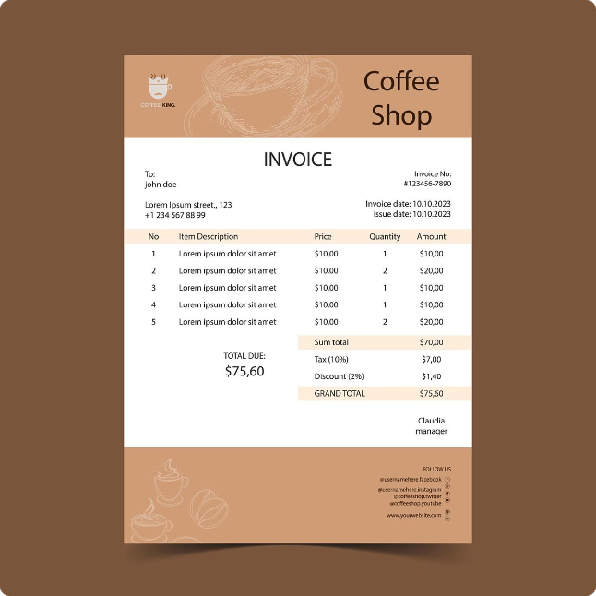
Bill Generation
Item
Price
Quantity
Total
Cappuccino
$4.50
1
$4.50
Croissant
$3.00
1
$3.00
GST (5%)
N/A
N/A
$0.38
Total
N/A
N/A
$7.88

Slide 4

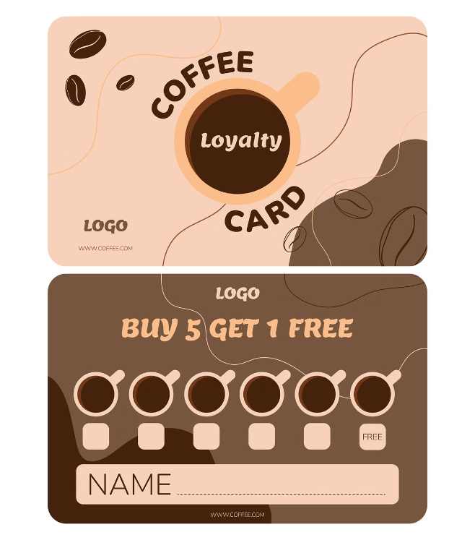



Customer Loyalty Program
Rewards Points
Customers earn points for every purchase they make at the shop, allowing them to redeem rewards such as discounts or free drinks.
Tiered System
The loyalty program can have tiered levels, offering greater rewards for customers who make more frequent purchases.
Exclusive Offers
Customers can receive exclusive discounts and promotions through the loyalty program, encouraging repeat visits.

Slide 5

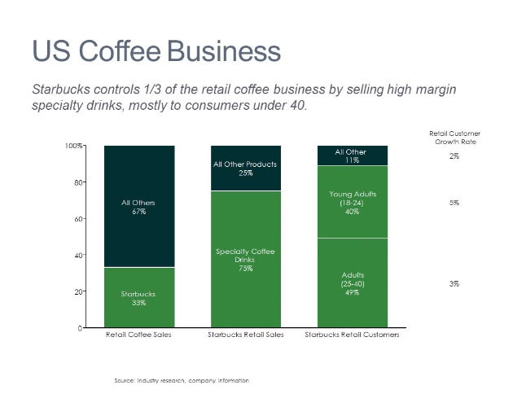
Daily Sales Report
1
Total Revenue
2
Item-wise Sales
The report displays the total revenue generated for the day, including sales of beverages, snacks, and any other items sold at the shop.
The report breaks down sales by individual items, providing insights into the most popular products and identifying potential areas for improvement.
3
Customer Activity
The report can include data on customer visits, average spending, and loyalty program engagement, providing valuable information for customer insights and marketing strategies.

Slide 6

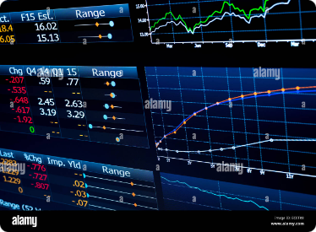
Data Setup Configuration
1
2
3
Customer Database
Item Catalog
Price Management
The system includes a database to store customer information, such as names, contact details, and loyalty program points.
A comprehensive catalog of all items sold at the shop, including beverages, snacks, and other goods, with their respective prices and GST information.
The system allows for easy price updates and adjustments for individual items, catering to fluctuations in costs and market trends.

Slide 7

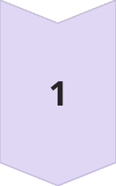
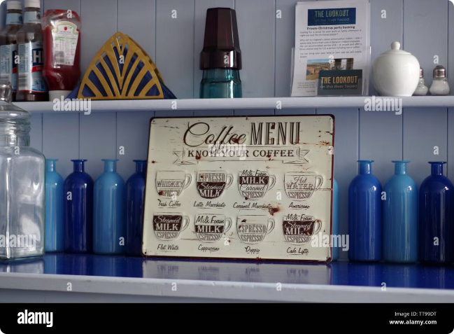
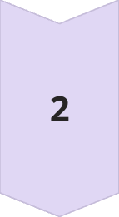
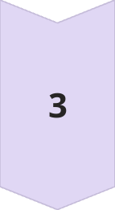

Inventory Management
Stock Tracking
The system tracks inventory levels of all items, ensuring that the shop is adequately stocked to meet customer demand.
Order Placement
Automatic alerts are generated when stock levels fall below pre-defined thresholds, facilitating timely re-ordering of necessary items.
Supplier Management
The system can be integrated with supplier information to streamline the ordering process and manage supplier relationships effectively.

