Slide 1
Strategic Retail Insights Using Advanced SQL
Welcome, everyone. I'm Ajay Priyakar M, and I'll be guiding you through a comprehensive analysis leveraging advanced SQL techniques to uncover strategic insights from our retail datasets. This project utilizes five key datasets: Product, Customer, Sales, Inventory, and Promotion, each playing a crucial role in our analysis. Our aim is to provide actionable intelligence that supports informed decision-making across sales, marketing, and inventory management, driving efficiency and profitability.
AP
by AJAY PRIYAKAR M

Slide 2
Top 3 Best-Selling Products
Identifying our best-selling products is vital for optimizing inventory and marketing strategies. This query ranks products by total quantity sold.
SQL Query
Solution Table
WITH ProductSales AS (
SELECT ProductID, SUM(Quantity) AS TotalQty
FROM Sales
GROUP BY ProductID
)
SELECT p.ProductName, ps.TotalQty
FROM ProductSales ps
JOIN Product p ON ps.ProductID = p.ProductID
ORDER BY ps.TotalQty DESC
FETCH FIRST 3 ROWS ONLY;
ProductName
TotalQty
iPhone 14
8763
Samsung Galaxy S22
7944
Nike Air Max
6532
The iPhone 14, Galaxy S22, and Nike Air Max are our top performers.

Slide 3
Customer Lifetime Value (CLV) Analysis
Understanding CLV helps us identify and reward our most valuable customers, leading to better retention strategies.
SQL Query
Solution Table
SELECT c.CustomerID, c.Name, SUM(s.TotalPrice) AS CLV
FROM Customer c
JOIN Sales s ON c.CustomerID = s.CustomerID
GROUP BY c.CustomerID, c.Name
ORDER BY CLV DESC;
CustomerID
Name
CLV
234
Ava Johnson
15678.90
567
Ethan Smith
14322.50
890
Mia Brown
13987.25
Ava Johnson, Ethan Smith, and Mia Brown are our most valuable customers based on lifetime spend.

Slide 4

Products with Low Inventory
Monitoring inventory levels ensures we avoid stockouts and maintain optimal product availability for our customers.
SQL Query
Solution Table
SELECT p.ProductName, i.StockLevel
FROM Inventory i
JOIN Product p ON i.ProductID = p.ProductID
WHERE i.StockLevel <= i.ReorderLevel;
ProductName
StockLevel
Fitbit Charge 5
25
Instant Pot
30
The Fitbit Charge 5 and Instant Pot are running low on stock and need reordering.

Slide 5
Average Spend by Loyalty Tier
Analyzing average spending across loyalty tiers allows us to tailor marketing efforts and incentives effectively.
SQL Query
Solution Table
SELECT c.LoyaltyTier, AVG(s.TotalPrice) OVER(PARTITION BY c.LoyaltyTier) AS AvgSpend
FROM Customer c
JOIN Sales s ON c.CustomerID = s.CustomerID;
LoyaltyTier
AvgSpend
Gold
456.78
Silver
321.45
Bronze
210.12
Gold loyalty tier customers have the highest average spend, followed by Silver and Bronze.

Slide 6
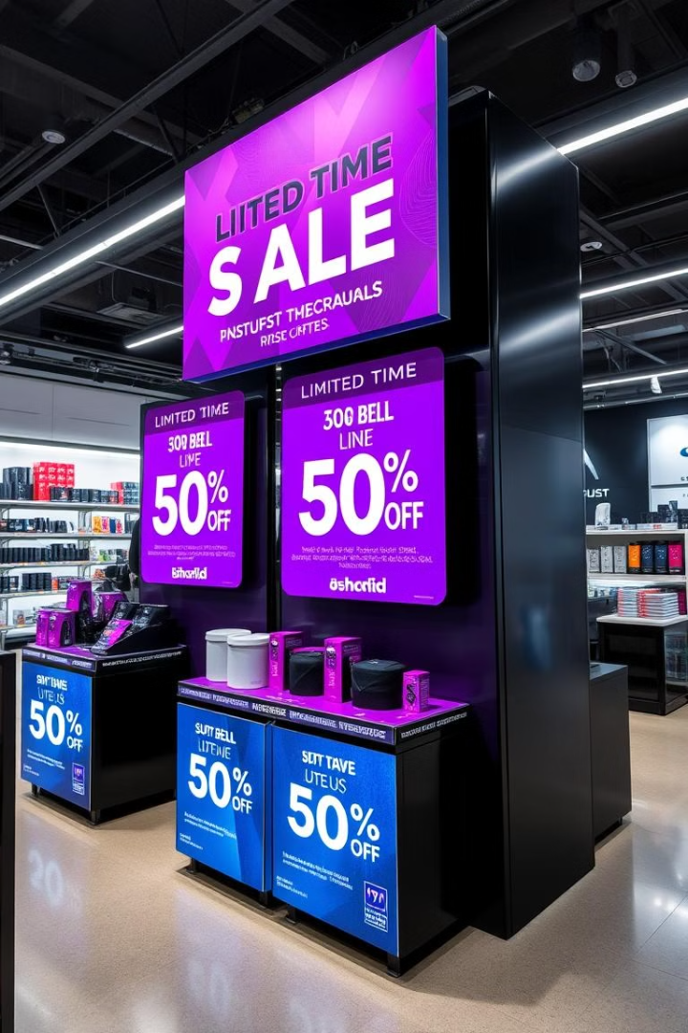


Products on Promotion with Sales During Promo Period
Identifying products with sales during promotion periods helps measure the effectiveness of our promotional campaigns.
SQL Query
SELECT DISTINCT p.ProductName
FROM Promotion pr
JOIN Product p ON pr.ProductID = p.ProductID
WHERE EXISTS (
SELECT 1
FROM Sales s
WHERE s.ProductID = pr.ProductID
AND s.Date BETWEEN pr.StartDate AND pr.EndDate
);
Solution Table
ProductName
Echo Dot
Keurig Coffee Maker
The Echo Dot and Keurig Coffee Maker had sales during their promotion periods.

Slide 7
Profit Per Product Analysis
Understanding the profit generated by each product helps optimize pricing and product mix.
1
SQL Query
SELECT p.ProductName, SUM(s.TotalPrice - (p.Cost * s.Quantity)) AS Profit
FROM Sales s
JOIN Product p ON s.ProductID = p.ProductID
GROUP BY p.ProductName
ORDER BY Profit DESC;
2
Solution Table
ProductName
Profit
iPhone 14
1234567.89
Samsung Galaxy S22
1122334.56
The iPhone 14 and Samsung Galaxy S22 generate the most profit.

Slide 8


Age Group Wise Sales Summary
Analyzing sales by age group informs targeted marketing campaigns and product placement strategies.
SQL Query
WITH AgeGroup AS (
SELECT CustomerID,
CASE
WHEN Age < 25 THEN 'Under 25'
WHEN Age BETWEEN 25 AND 40 THEN '25-40'
ELSE 'Above 40'
END AS AgeBracket
FROM Customer
)
SELECT a.AgeBracket, SUM(s.TotalPrice) AS TotalSpent
FROM AgeGroup a
JOIN Sales s ON a.CustomerID = s.CustomerID
GROUP BY a.AgeBracket;
Solution Table
AgeBracket
TotalSpent
25-40
2345678.90
1
2
Above 40
1876543.21
Under 25
987654.32
Customers aged 25-40 contribute the most revenue, followed by those above 40.

Slide 9

Key Takeaways and Strategic Decisions
By leveraging advanced SQL techniques across our datasets, we've unearthed key insights to drive strategic decisions.
3
25-40
Gold
Top Products
Target Age
Loyalty Leader
iPhone 14 and Galaxy S22 are top performers.
Customers in the 25-40 age range contribute the most revenue.
Certain loyalty tiers drive higher sales, suggesting targeted campaigns.
These insights support strategic decisions for sales, marketing, and inventory planning. I'm Ajay Priyakar M, and thank you for your time.

