Slide 1
Machine Learning

Slide 2
Machine learning in Data Science
Machine learning
Supervised learning
Unsupervised learning
Reinforcement learning
Definition
The art and science of:
Giving computers the ability to learn to make decisions from data
Without being explicitly programmed!
The learning begins with observations or data, such as examples, direct experience, or instruction, in order to look for patterns in data and make better decisions in the future.
The primary aim is to allow the computers to learn automatically without human intervention or assistance and adjust actions accordingly.
Target Driven
Algorithms learning to react based on the target
Data Driven
Algorithms learning to react based on patterns in data
Environment driven
Algorithms learning to react to environment and feedbacks
*Andrew Ng's Coursera course often gets rave reviews for its content

Slide 3

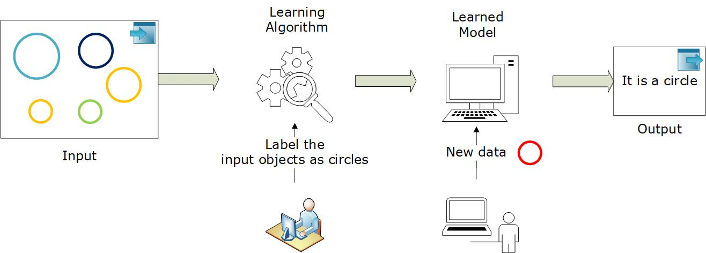
Supervised Learning
Definition
Supervised learning is the machine learning task of predicting the target/outcome variable from a given set of supporting predictor variables
Supervised learning deals with labelled data and it includes two categories of algorithm: classification and numerical prediction
Labelled data
Direct feedback
Predict output

Slide 4
Supervised Learning
Examples
Provide a bunch of photos with information of what is on them and you train a model to recognize new photos
Learning about a disease and their symptoms and classifying whether a patient has disease or not
Analyzing the trend data and predicting stock market price
Predicting the outcome of a cricket match based on various features such as pitch condition, toss, players, etc.
Rain prediction for the first month based on past data
Month | Temp (avg) | Rhumid (avg) | Wind (avg) | Rain (avg)
1 | 55.94 | 62.11 | 8.71 | 2.34
2 | 73.64 | 64.23 | 8.58 | 3.25
3 | 75.15 | 67.17 | 7.69 | 6.58
4 | 73.91 | 68.18 | 7.93 | 19.9
5 | 67.14 | 70.27 | 7.64 | 8.51
6 | 58.83 | 68.19 | 8.75 | 8.67
7 | 66.71 | 67.42 | 7.55 | 8.57
8 | 74.23 | 71.25 | 8.24 | 10.79
9 | 72.78 | 67.05 | 7.75 | 8.21
10 | 61.75 | 74.71 | 8.55 | 5.72
11 | 62.29 | 55.71 | 8.22 | 1.1
12 | 70.21 | 58.75 | 7.55 | 4.51
13 | 71.23 | 60.75 | 7.58 | ?

Slide 5
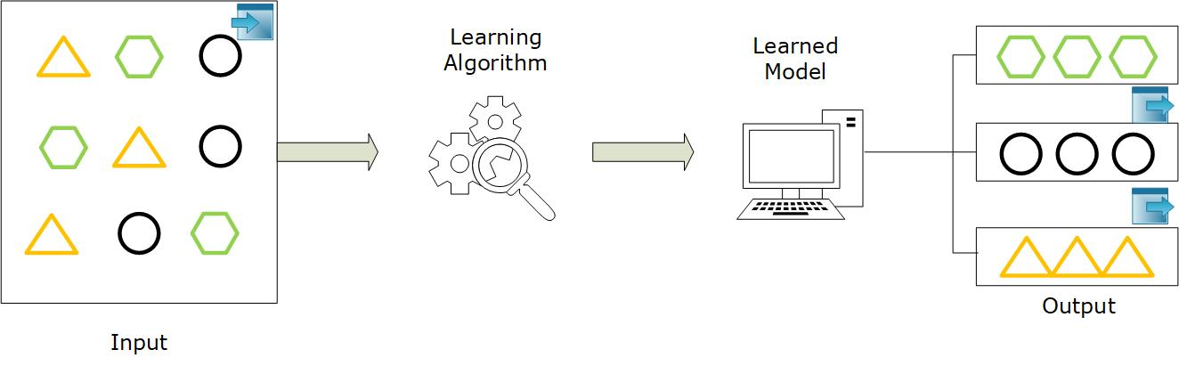
Unsupervised Learning
Definition
Unsupervised learning is the machine learning task used for finding out the hidden patterns in the dataset where there is no target variables
Unsupervised learning deals with unlabelled data and it includes two categories of algorithms: clustering and association rule mining
Non-labelled data
No feedback
Find hidden structures in data

Slide 6
Unsupervised Learning
Examples
Provide a bunch of photos of three people without information who is on which one and want to divide this dataset into piles, each with photos of one individual
Clustering or grouping customers based on their demographic features
Association problems discovering the purchase patterns such as people who watch movie X also tends to watch movie Y
Reducing the dimensions of questionnaire from 500 features to few while predicting the IQ level of students

Slide 7
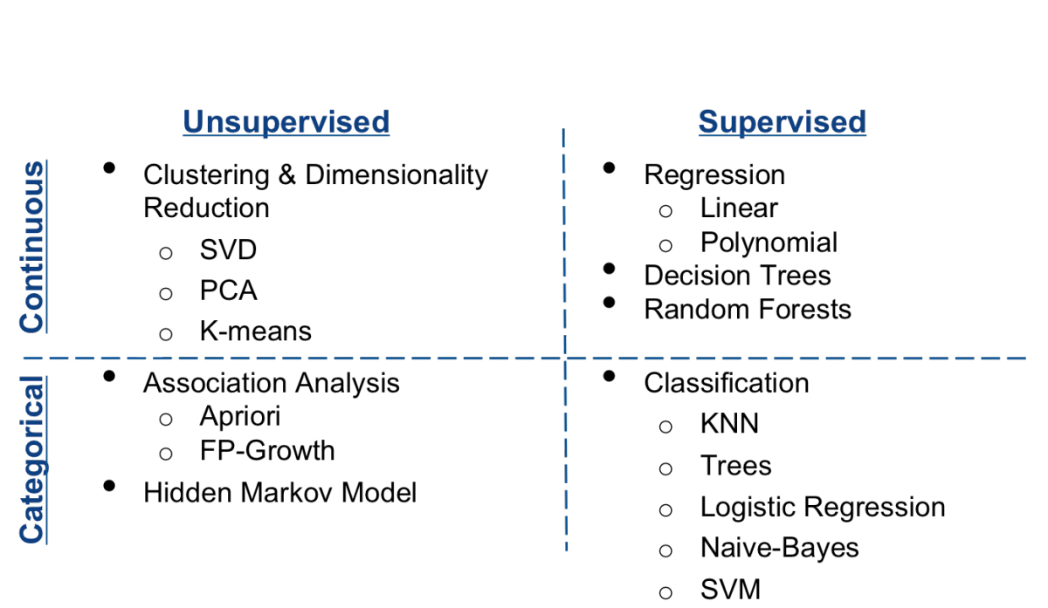
Unsupervised vs. Supervised
Algorithms

Slide 8
Pop Quiz
Given historical weather records, predict if tomorrow's weather will be sunny or rainy
Given a set of news articles from many different websites, find out what topics are the main topics covered
From the user click patterns on a website, figure out what different groups of users exists
Given many emails, you want to determine if they are Spam or Non-Spam emails
Given sales data from a large number of products in a supermarket, estimate future sales for each product

