Slide 1

Class 1
AWS Introduction

Slide 2
Agenda
General Cloud Concepts
Cloud Benefits
AWS Foundations
AWS Services
Labs and Exercises

Slide 3
General Cloud Concepts
Someone’s else computer with:
“Infinite” resources
No upfront investments
Pay as you go
Elastic services
Easy and cheap to test new technologies
Fast innovation pace

Slide 4
General Cloud Concepts
Architecting and developing for the cloud
Pets vs Cattle
Decoupled systems
Ephemeral Environments
Automation

Slide 5
AWS Foundations
Availability Zone
Consider it as a Datacenter
Currently at 69
Region
A geographical location with 2 or more Azs
Currently at 22
Edge Location
AWS Endpoint used for caching content(CDN)
Currently at 200

Slide 6
AWS Foundations
Include a Diagram with a solution using multiple AZs

Slide 7
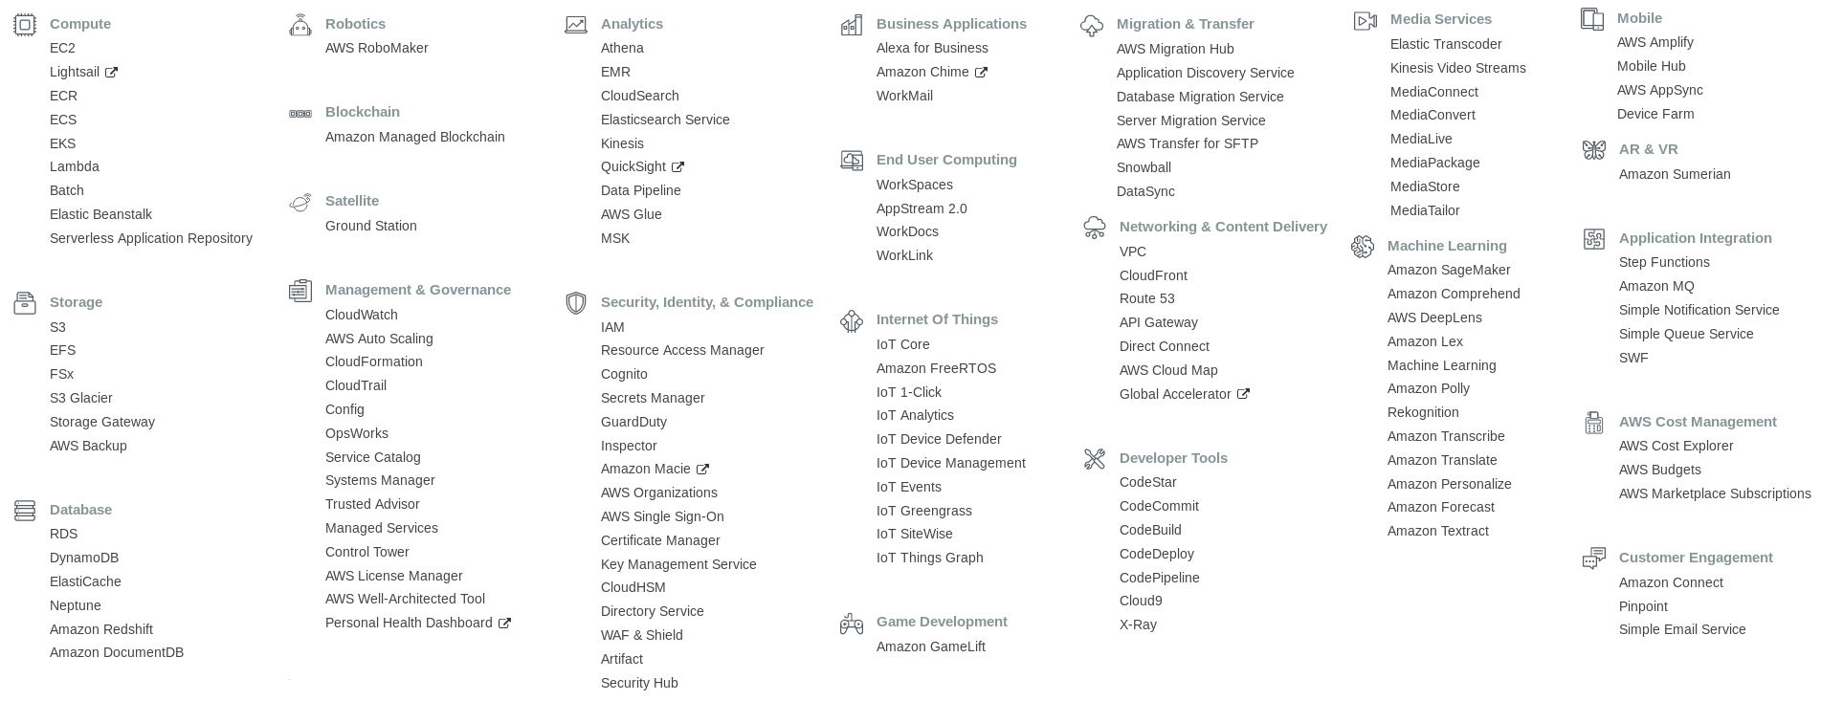
AWS Services(+130)

Slide 8
AWS Services(+130)
Include a chart with number of new services per year

Slide 9
Main AWS Services
Computing
EC2
ECS/EKS
Lambda
Database
RDS
ElasticCache
Dynamo
DocumentDB
Storage
S3
EBS
EFS
Networking
VPC
CloudFront
Route53
API Gateway

Slide 10
Main AWS Services
Management
CloudWatch
CloudTrail
CloudFormation
SystemManager
Messaging
SQS
SNS
SES
Security/Compliance
IAM
Certificate Manager
KMS
WAF
Development Tools
Code*

Slide 11
Labs and Exercises
EC2
Create a new EC2 Instance inside the default VPC with an public IP address and connect to it though SSH
Create a new EC2 instance in the same VPC but with private address only and connect to it
S3
Create a S3 bucket and upload a file to it
Access the file on the S3 bucket from the EC2 instance

