Slide 1
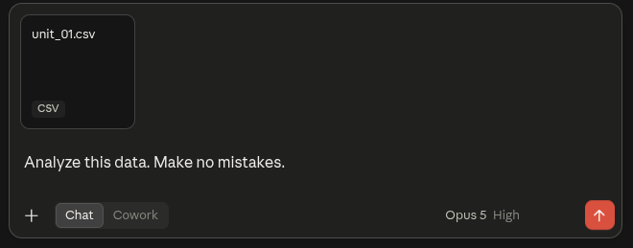
What could go wrong?

Slide 2
Confidentiality Broker
Introducing:

Slide 3
RESTRICTED
Problem
The data goes wherever the model is
OPERATOR'S ENVIRONMENT
EU
OUTSIDE THE EU
> what is wrong with unit_06?
sensordata/unit_06.csv
google [public]
810 samples x 52 tags, raw
316 KB
No record of what left, to which model, or why.
Nothing on this path asked whether it should happen, and nothing wrote down that it did.
RESTRICTED

Slide 4
PUBLIC
Solution
The label decides how far anything goes
OPERATOR'S ENVIRONMENT
EU
OUTSIDE THE EU
> what is wrong with unit_06?
google [public] ✗ no access
restricted-plant/ restricted
Not the rows, not the statistics, not a file listing.
lemonade, ollama the raw rows stay here
confidential-plant/reports/
verda [confidential] ✓
confidential 8.6 KB of statistics, no rows
Raw rows never leave the machine. Derived statistics stop in the EU. The question still gets answered.
PUBLIC

Slide 5
PUBLIC
THE RULE
The folder decides which model sees it
The broker compares the folder's label with the provider's clearance, on every tool call.
demo/restricted-plant/ restricted
lemonade, ollama
the raw rows: 18 recordings, 52 tags
no cloud model, not even the EU one
demo/confidential-plant/ confidential
mistral, verda, lemonade, ollama
the derived fingerprints the audit produced
the Finnish endpoint may, Google may not
Raw rows never leave this machine. Data minimization is two labels on two folders, not a sentence in a prompt.
PUBLIC

Slide 6
Demo

