Slide 1

Analysis of Ames, Iowa Housing Data
Analysis by Aviel Chang
Notes:
Picture by Grant Lemons on unsplash.com
https://unsplash.com/photos/jTCLppdwSEc

Slide 2



Objective
Analyze the most impactful factors driving home prices in Ames, Iowa

Slide 3
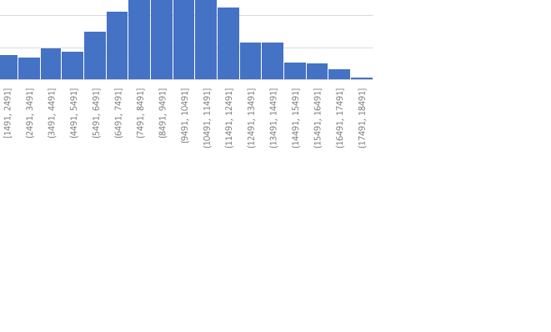
Factors Driving Home Prices
01
02
Lot Area
Neighborhood
1391 Observations │ 69 Outliers
Average Sale Price vs. Lot Area
Normally distributed
1220 Single Family Homes
240 Outliers / Building Types

Slide 4
Lot Area
Hypothesis
Null:
Homes with an Above Average Lot Area have the same Average Sale Price as homes with Below Average Lot Area
Alternative:
Homes with an Above Average Lot Area do not have the same Average Sale Price as homes with Below Average Lot Area
 | Count | Avg Sale Price
Above Average | 457 | $221,375
Below Average | 934 | $156,980

Slide 5
Lot Area
Above Average Lot Area │ Avg Sale Price $221,375
Below Average Lot Area │ Avg Sale Price $156,980
Difference in Average Total Sale Price│ $55,237 to $73,553

Slide 6
Neighborhoods
Hypothesis
Null:
Above Average Neighborhoods have the same Average Sale Price Per Square Footage as Below Average Neighborhoods
Alternative:
Above Average Neighborhoods do not have the same Average Sale Price Per Square Footage as Below Average Neighborhoods
 | Count | Avg Sale Price
Above Average | 532 | $137.57
Below Average | 688 | $108.89

Slide 7
Neighborhoods
Above Average Neighborhoods
Avg Sale Price Per Square Footage: $137.57
Below Average Neighborhoods
Avg Sale Price Per Square Footage: $108.89
Difference in Average Price Per Square Footage
$25.60 to $31.76

Slide 8
Recommendations
Further analysis required to provide sound recommendations on where to allocate dollars earmarked for mortgage-backed securities.

Slide 9
Notes:
Picture by Simone Hutsch on splash.com
https://unsplash.com/photos/-41Zks6Xahw

