Slide 1

A few things about
AIRSPACE

Slide 2
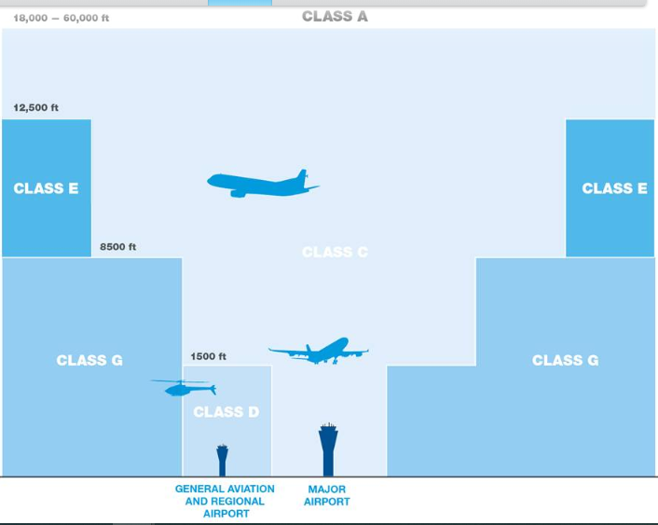
Airservices Australia

Slide 3
Violations
Police arrested PPG pilot in suburbs … court case
Criminal charges have been laid for blatant violations, eg. posting on youtube near Sydney airport
Uses baro-height - official measure of airspace
Comps use GPS height

Slide 4
My 4 checklists of a flight
Before leaving home
Arrival at launch
Just prior to launching
Back at home

Slide 5
1. Before leaving home
The night before
Charge instruments
Check siteguide and airspace
etc
In the morning
Commence hydration routine
Pack lunch, water, etc
etc

Slide 6
2. Arrival at launch
Setup glider
Pee tube
Reserve handle
Reset vario … old QNH
SPOT on
etc

Slide 7
3. Immediately before launching
Leg straps
Red safety clip
Chest strap, helmet, etc
Vario on
etc

Slide 8
Fly around
Pull out 100m minimum below max height 5 m/s * 20s = 100m
Same for cloudbase

Slide 9


10 m/s
45
10 m/s

Slide 10
Baro vs GPS
Official measure of airspace is Barometric
Comps use GPS height
Rod Merigan … WA guy that is paid to check violations
He checks xcontest, Leonardo, probably highcloud

Slide 11
IGC format
AXGD990 Flymaster F1, V1.21, S/N 1334
HFDTE161215
HOPLTPILOT: plyng
HOGTYGLIDERTYPE: None
HOGIDGLIDERID: None
HODTM100GPSDATUM: WGS-84
HOCIDCOMPETITIONID:
HOCCLCOMPETITION CLASS: None
HOSITSite: None
B0137053707291S14524779EA0057900550
B0137063707327S14524782EA0057900583
B0137073707338S14524783EA0057900603
B0137083707343S14524784EA0057900612
B0137093707347S14524785EA0057900617
B0137103707350S14524785EA0057900625
B0137113707353S14524786EA0057900628
B0137123707354S14524786EA0057900631

Slide 12
B0137053707291S14524779EA0057900550
UTC lat lon GPS BARO

Slide 13
IGC File
Aircheck
Paragliding Forum Leonardo
Highcloud
Xcontest

Slide 14
4. Back at home
Review my launch, decisions, landing etc
Do I need to report any incidents (me or others)
Check IGC track on AIRCHECK site
Upload track to internet sites

Slide 15
TAKE HOME MESSAGES
Check airspace the night before
Set Baro height on the hill before launching
Use AIRCHECK to validate your IGC before uploading

