Slide 1

GITHUB WORKSHOP
THE BASICS

Slide 2
WHY GITHUB?
It provides a way for multiple people to work on the project at the same time!
It’s used professionally by major tech companies.
It’s a great tool for maintaining version control.
The software is already on the university’s computers.

Slide 3
TERMINOLOGY
Version Control: It’s the process of tracking and making changes to code, in school projects this don’t matter too much, but in bigger projects(aka finals, 10k lines of code) this MATTERS.
Git: A open source (anyone can edit it/ FREEEEEE) program for tracking changes in files.
Repository(repo) : A bunch of code in a folder, either on the web or on your computer.
Main: The default development branch, where unless you change it, all you edits will happen here and affect all the things.
Branch: A parallel copy of a repo, residing in the same repo. Useful for VERSION CONTROLL, you can mess with stuff on here without affecting MAIN and can merge it back into main when you want.
Fork: This is making a personal copy of someone else’s REPO for your use. It can be Merged back into the original at ANY time.

Slide 4
TERMINOLOGY (Words… So Many Words…)
Pull Request: This is how we merge either a branch or a fork back into the MAIN codebase
Git Clone: This is where we copy a remote repo (such as one on the internet) to our computer
Git Checkout: This is how we change branches on a local repository (ADVANCED TOPIC)
Git Add(or Stage): This preps the changes you’ve made to be sent back to the remote repository on github. They then need to be committed
Git Commit: This records the changes you’ve made, and in this step, you add a MESSAGE on what you’ve changed.
Git Push: This pushes your changes on your local machine to the remote repository.

Slide 5
Step 1 - Get an Account
Google Github
Go to main webpage
Look at the top right for the sign up
Follow the prompts
NOTE: You can have multiple emails connected to one account, so don’t worry about if you should use your angelo.edu email or your personal one

Slide 6
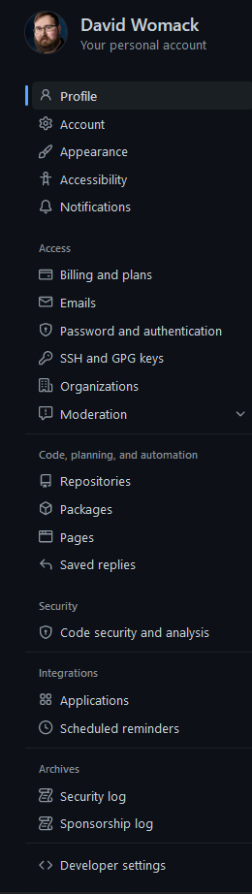

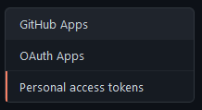
Step 2: Create a Personal Access Token (PAT)
Click the Icon on the top right
Go to Settings.
On the Left, Click on Developer Settings.
Click on Personal Access Token
Generate a New Token
Name it, set when it expires, select all the checkboxes.
COPY IT, THIS IS THE ONLY TIME YOU WILL SEE IT, EMAIL IT TO YOURSELF

Slide 7
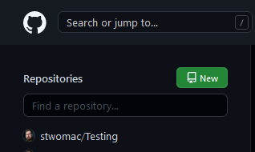
Step 3: Creating a Repository
Click the cat logo on the upper Left
Click on the New Button
Give it a name, make this first one private, and click the add README file
Then Hit click create.

Slide 8
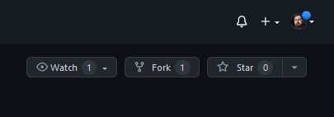
Step 4: Fork a Repository
Go to https://github.com/AngeloStateCS/GitWorkshop
Hit the Fork button on the top right.
And BOOM you got a copy of it on your github account

Slide 9
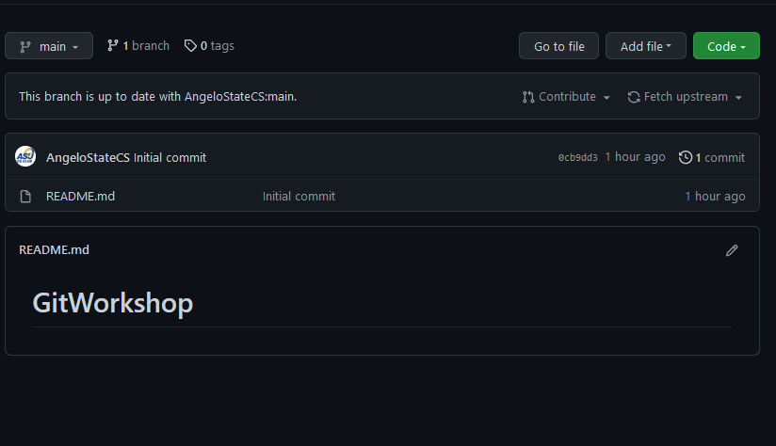
Step 5: Getting it on the Local Machine
Note: We’re gonna teach you the git GUI method here. This is the slower method, but it doesn’t require teaching about the command line. If you wanna know how to do it the command line way, stay a bit after the end of the meeting and we’ll show ya.
Click on Code on your local fork.

Slide 10
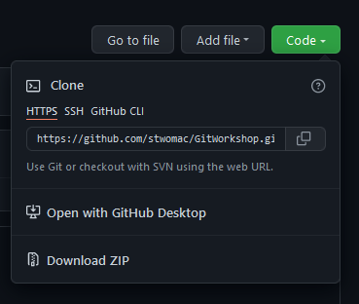
Step 5 (cont.)
Copy the https link

Slide 11
Step 6: Git Gui

