Slide 1
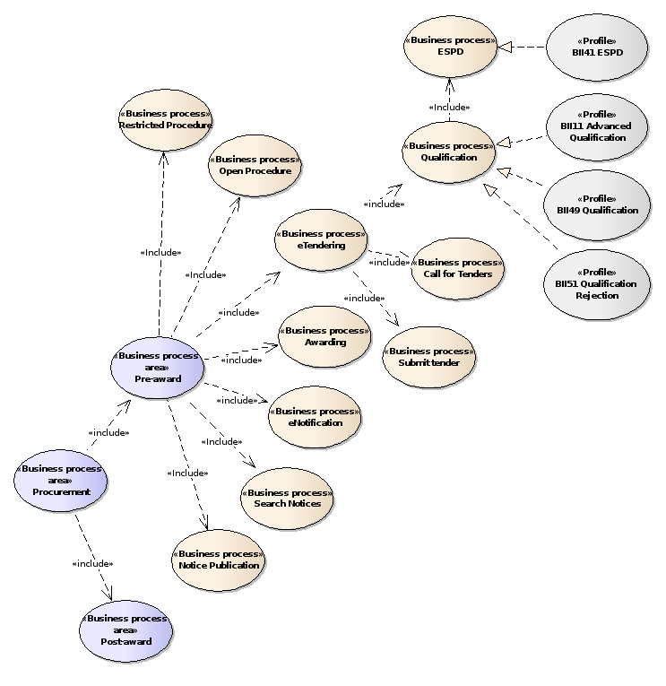

Slide 2
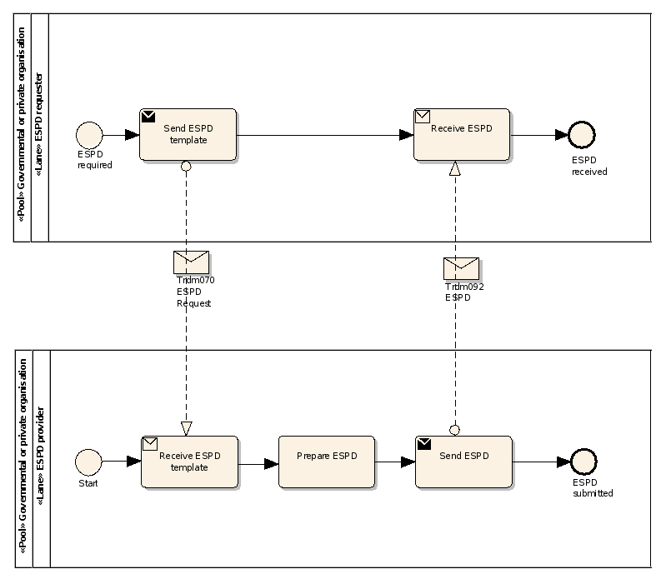
QualificationApplicationRequest
QualificationApplicationResponse

Slide 3
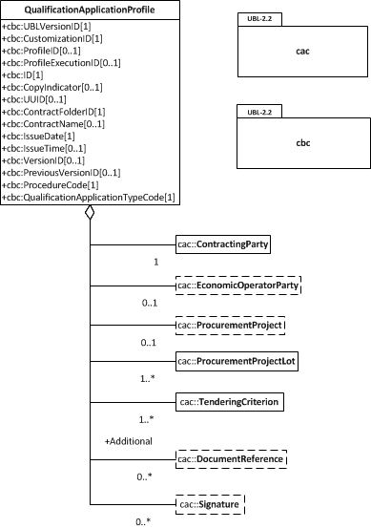

Slide 4
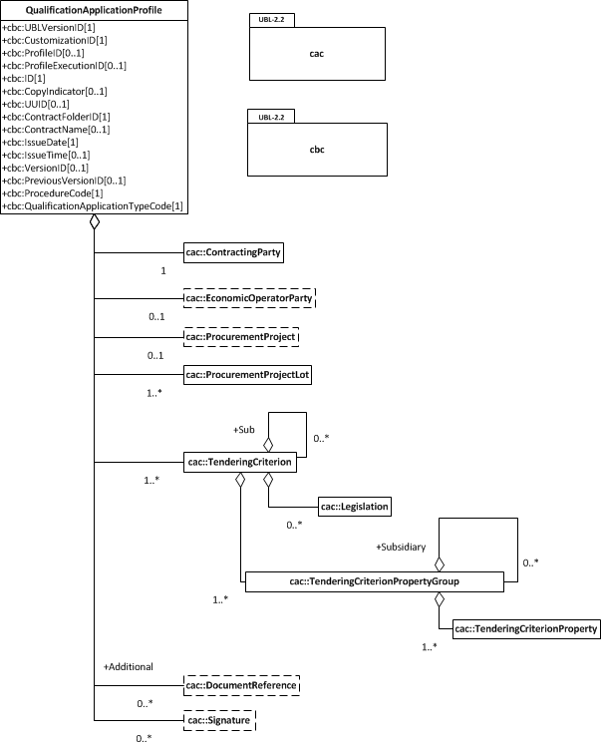

Slide 5
EXCLUSION
CONVICTIONS
PARTICIPATION_IN_CRIMINAL_ORGANISATION, CORRUPTION, FRAUD, TERRORIST_OFFENCES,
MONEY_LAUNDERING, CHILD_LABOUR-HUMAN_TRAFFICKING
CONTRIBUTIONS
PAYMENT_OF_TAXES, PAYMENT_OF_SOCIAL_SECURITY
SOCIAL
ENVIRONMENTAL_LAW, SOCIAL_LAW, LABOUR_LAW
BUSINESS
BANKRUPTCY, INSOLVENCY, CREDITORS_ARRANGEMENT, BANKRUPTCY_ANALOGOUS,
LIQUIDATOR_ADMINISTERED, ACTIVITIES_SUSPENDED
MISCONDUCT
MC_PROFESSIONAL, MARKET_DISTORSION
CONFLICT_OF_INTEREST
PROCEDURE_PARTICIPATION, PROCEDURE_PREPARATION
EARLY_TERMINATION
EARLY_TERMINATION, MISINTERPRETATION
NATIONAL
OTHER

Slide 6
SELECTION
ECONOMIC_FINANCIAL_STANDING
TURNOVER
GENERAL_YEARLY, SPECIFIC_YEARLY
GENERAL_YEARLY, SPECIFIC_YEARLY
SET_UP
FINANCIAL_RATIO
RISK_INDEMNITY_INSURANCE
OTHER_REQUIREMENTS
TECHNICAL_PROFESSIONAL_ABILITY
REFERENCES
WORKS_PERFORMANCE, SUPPLIES_DELIVERY_PERFORMANCE, SERVICES_DELIVERY_PERFORMANCE
TECHNICAL.TECHNICIANS_FOR_QUALITY_CONTROL, TECHNICAL.TECHNICIANS_FOR_CARRYING_WORKS, TECHNICAL.FACILITIES_FOR_QUALITY_ENSURING, TECHNICAL.FACILITIES_FOR_STUDY_RESEARCH, TECHNICAL.SUPPLY_CHAIN_MANAGEMENT, TECHNICAL.PROFESSIONAL_QUALIFICATIONS, TECHNICAL.ENVIRONMENTAL_MANAGEMENT_MEASURES, TECHNICAL.EQUIPMENT
TECHNICAL.CHECKS.ALLOWANCE_OF_CHECKS
MANAGEMENT.MANAGERIAL_STAFF, MANAGEMENT.AVERAGE_ANNUAL_MANPOWER
MANAGEMENT.SUBCONTRACTING_PROPORTION
MANAGEMENT.ARTEFACTS.NO_AUTHENTICATED_ARTEFACTS
MANAGEMENT.ARTEFACTS.NO_AUTHENTICATED_ARTEFACTS, MANAGEMENT.ARTEFACTS.AUTHENTICATED_ARTEFACTS
CERTIFICATES.QUALITY_ASSURANCE.QA_INSTITUTES_CERTIFICATE, CERTIFICATES.QUALITY_ASSURANCE.QA_INDEPENDENT_CERTIFICATE

Slide 7
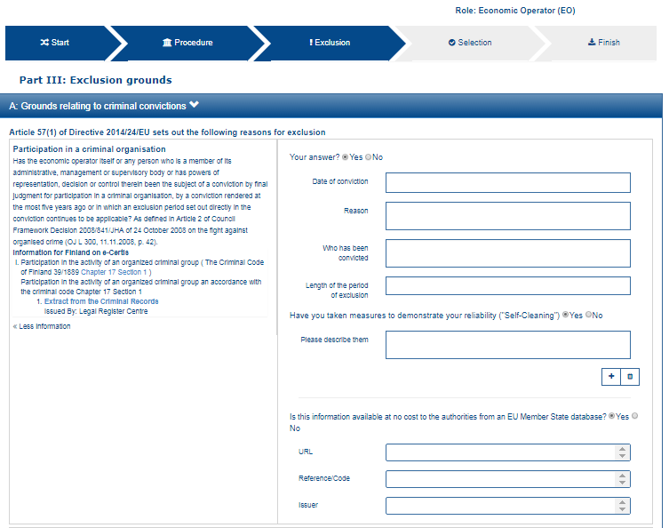
1
2
3
12
4
13
5
6
7
8
9
11
12

Slide 8
12
13

Slide 9
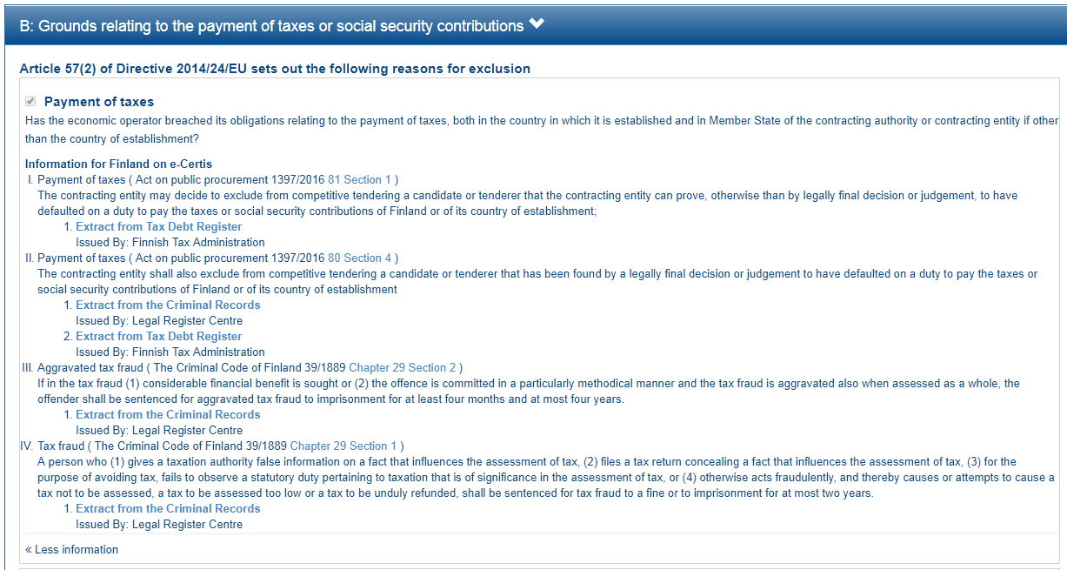

Slide 10
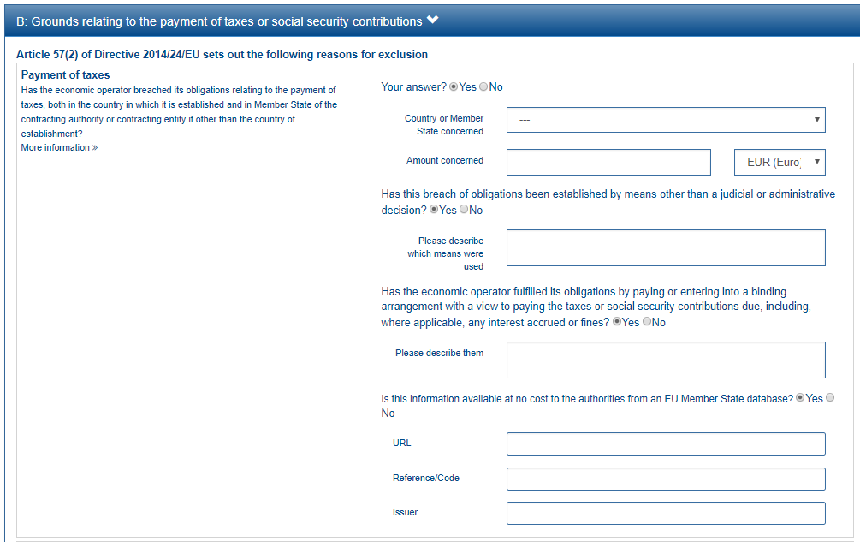
1
2
3
This property is shown only if the answer to the previous QUESTION is ‘Yes’
4
5
6
7
8

Slide 11
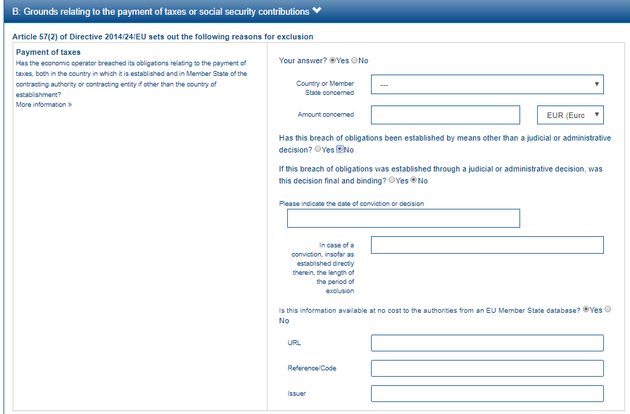
This group of property is shown only if the answer to the previous QUESTION is ‘No’
9
10

Slide 12
EU PoT Criterion
1
FI PoT Criterion I
2
FI PoT Criterion II
3
FI PoT Criterion III
4
FI PoT Criterion IV
5

Slide 13
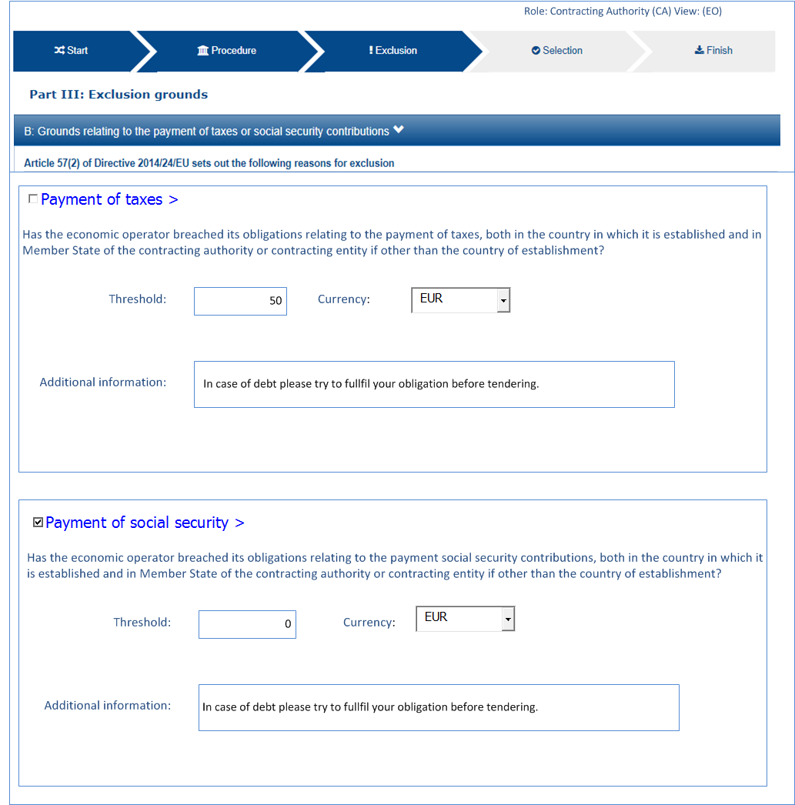
6
7
8

Slide 14
6
7
Minimum threshold: 50€
In case of debt please try to fulfil your obligation before tendering
8

Slide 15
2
3
4
5

Slide 16
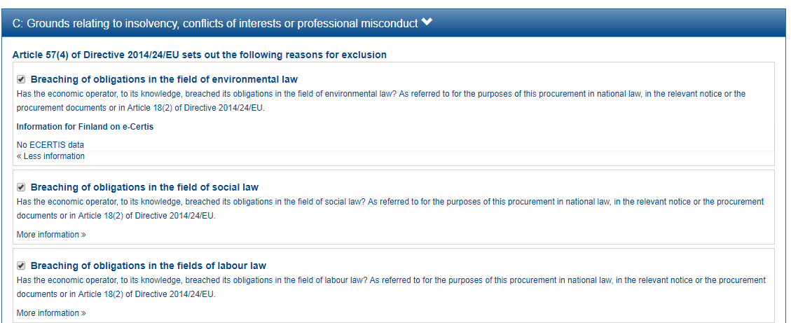

Slide 17
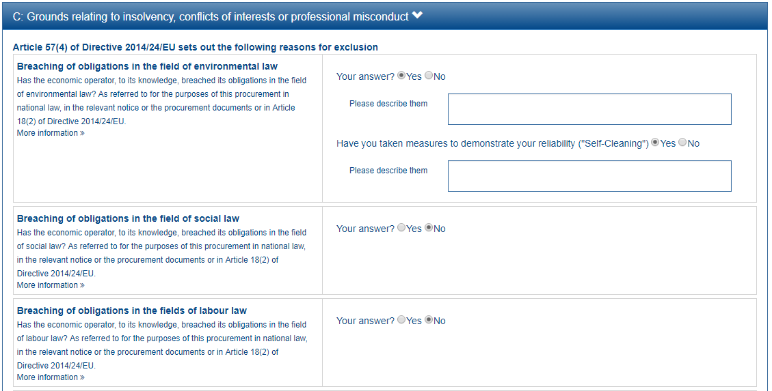
1
2

Slide 20
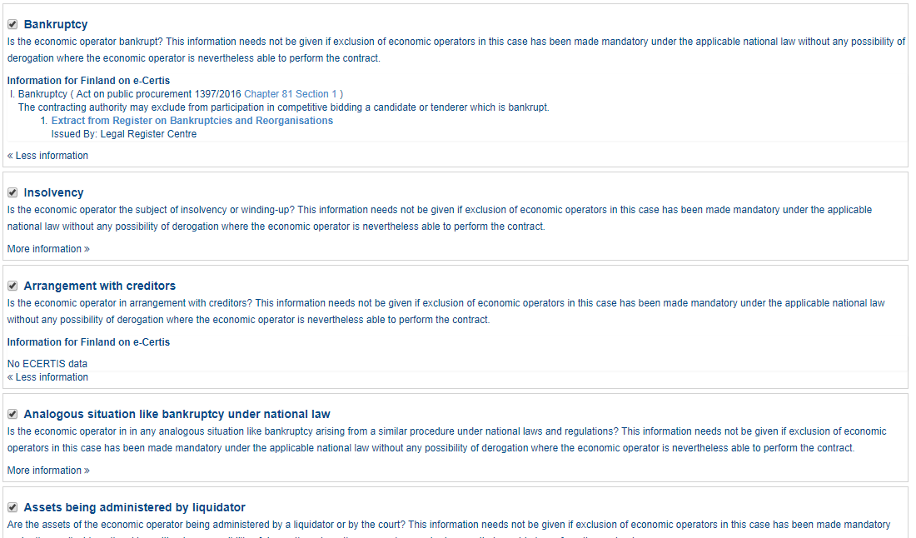

Slide 21
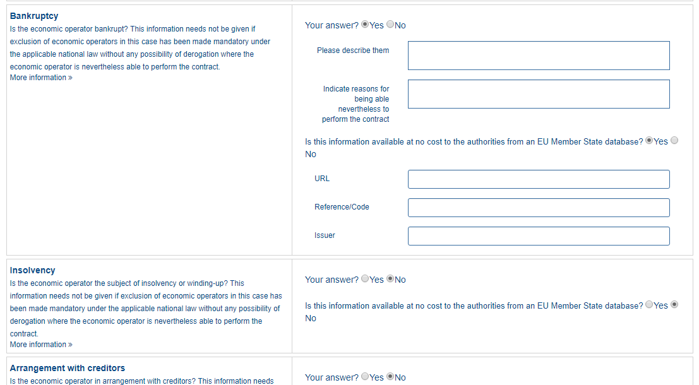
1
2
3
4
5
6

Slide 24
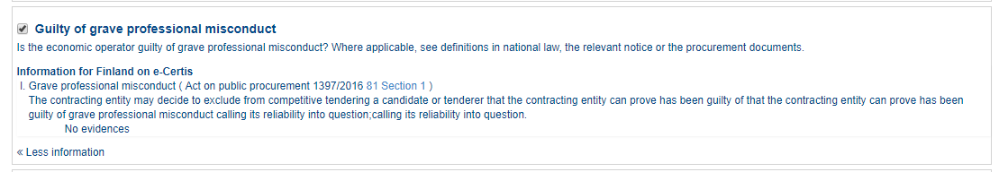

Slide 25
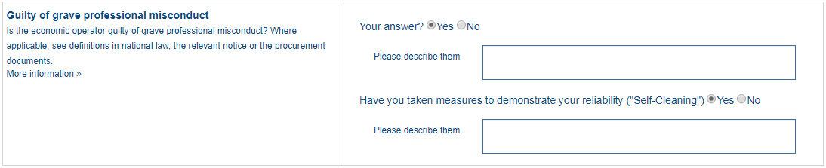
1
2

Slide 28
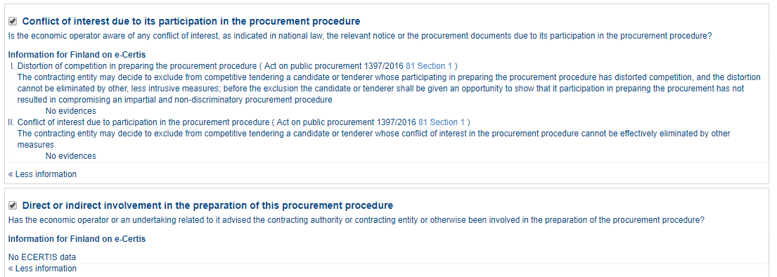

Slide 29
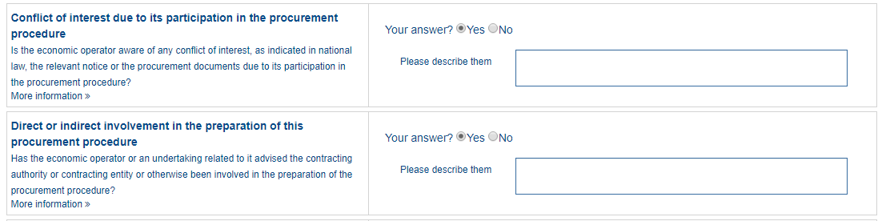
1

Slide 32
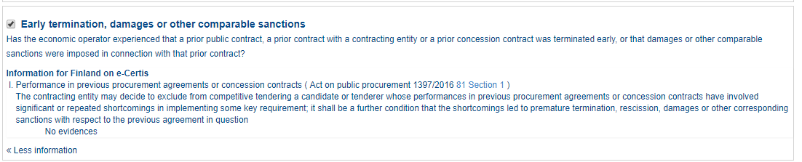

Slide 33
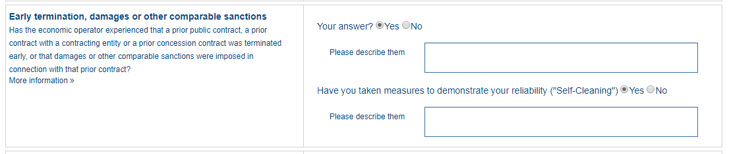
1
2

Slide 34
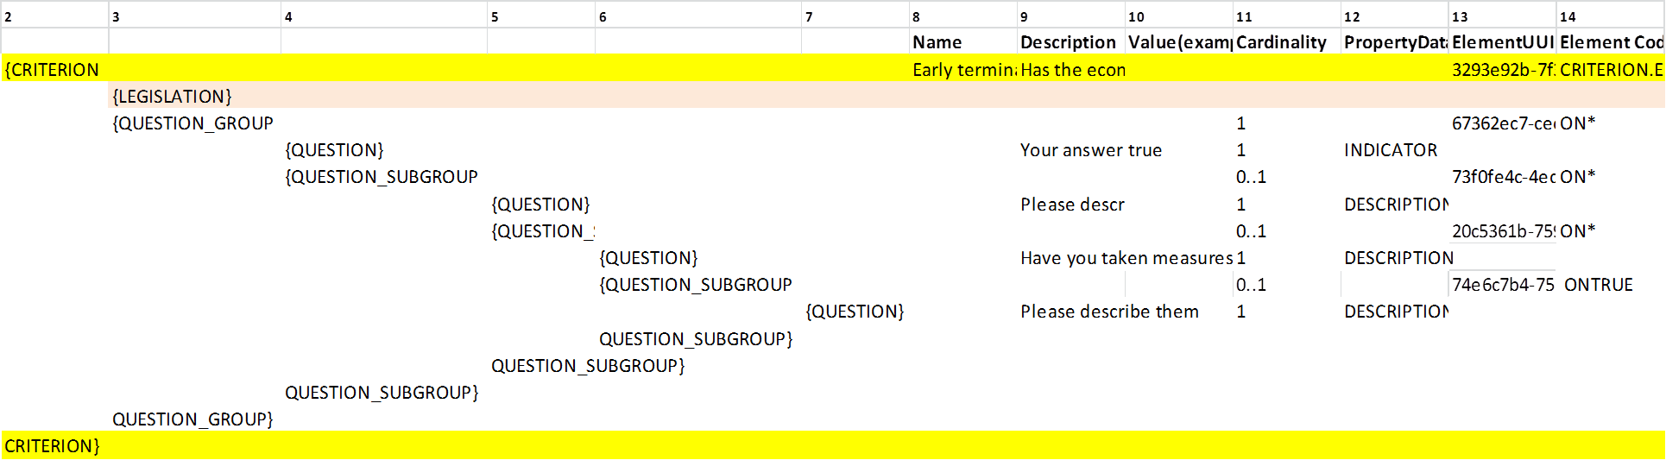

Slide 36
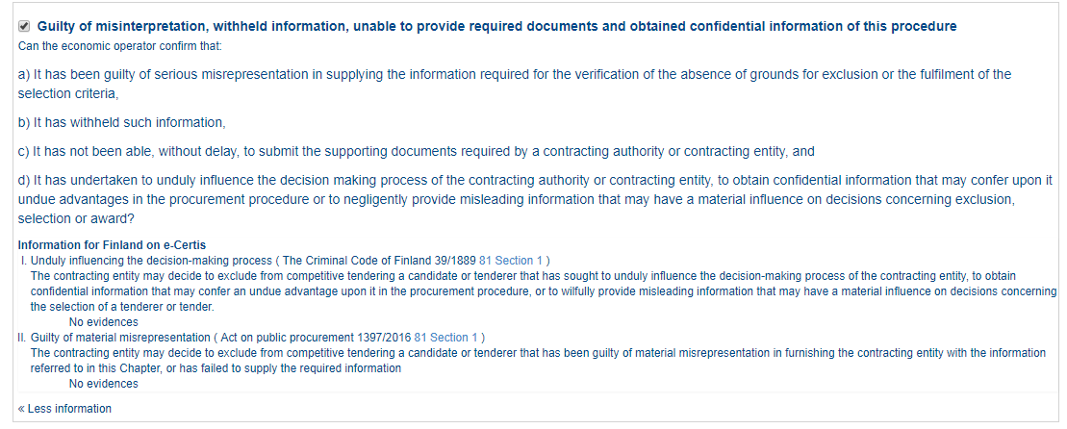

Slide 37
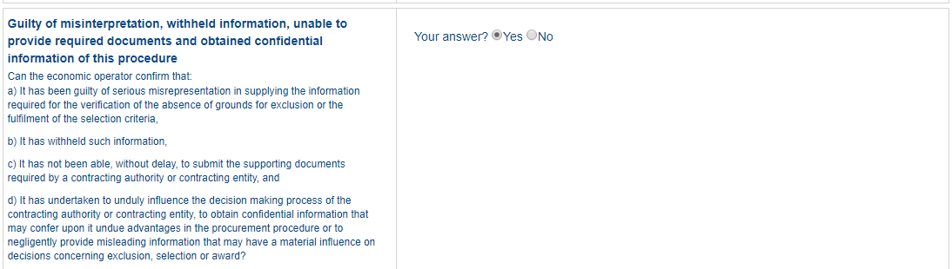
1

Slide 40
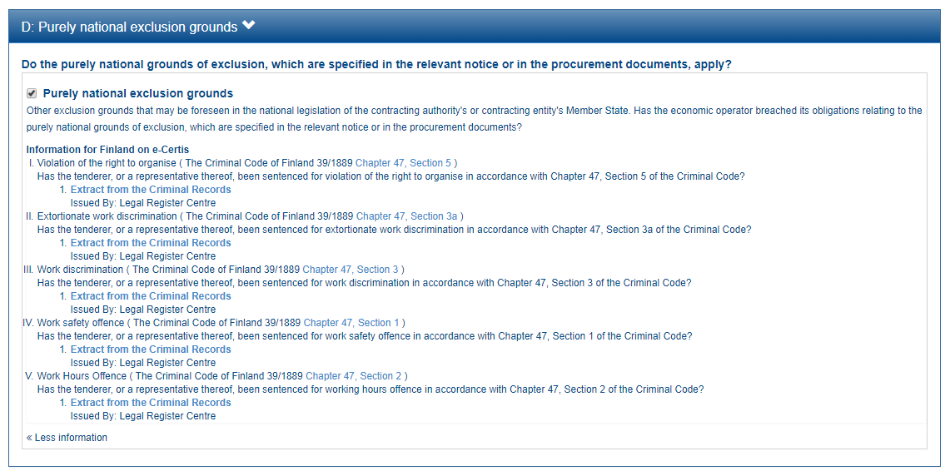

Slide 41
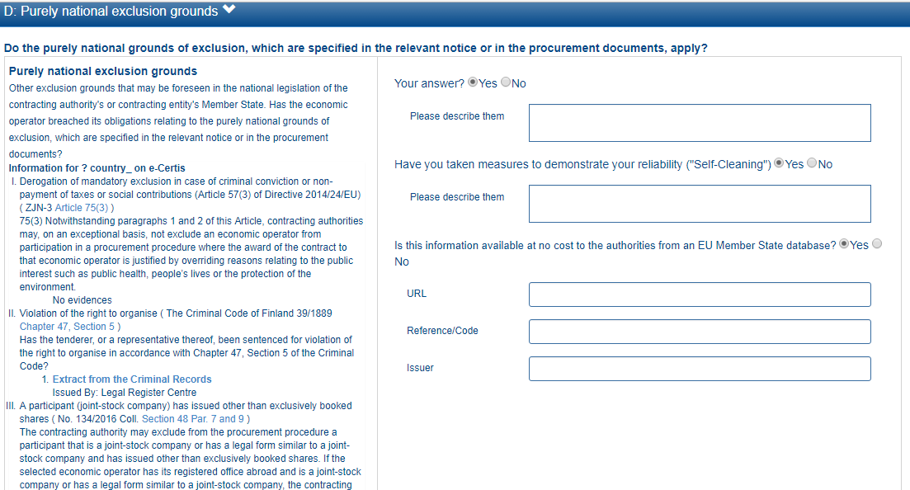
1
2
3
4
5
6

Slide 42
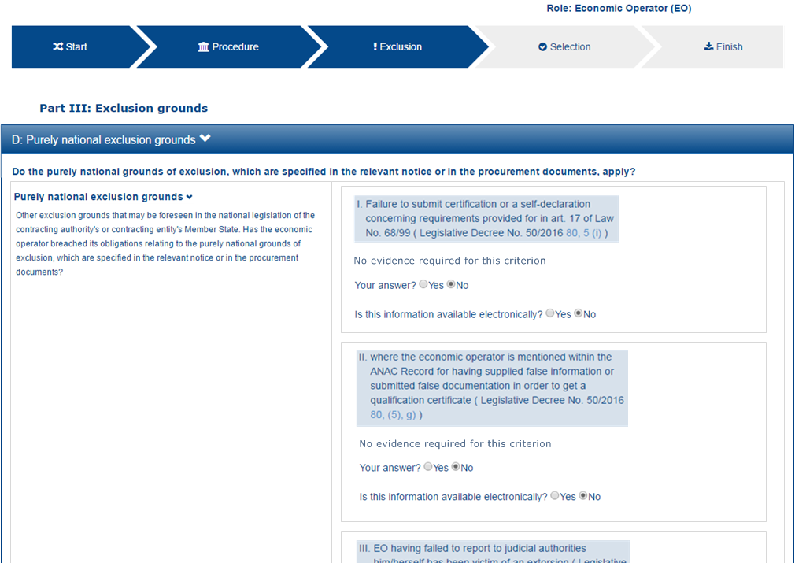
1
2

