Slide 1
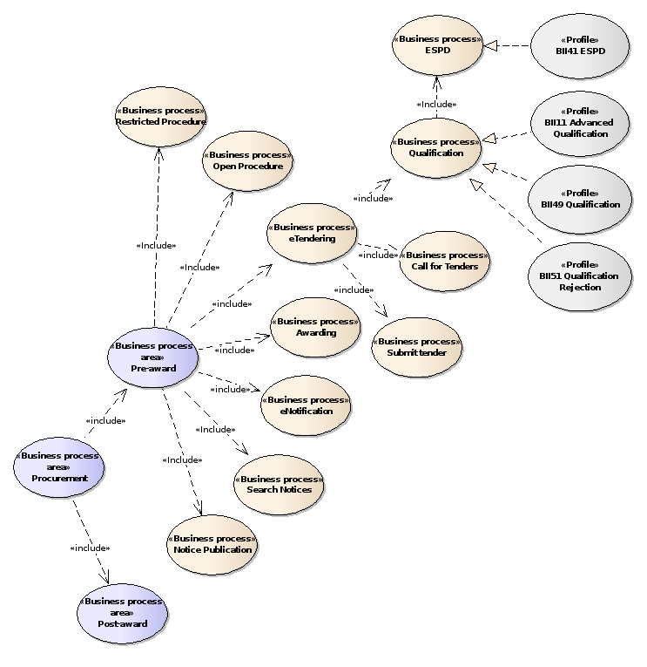

Slide 2
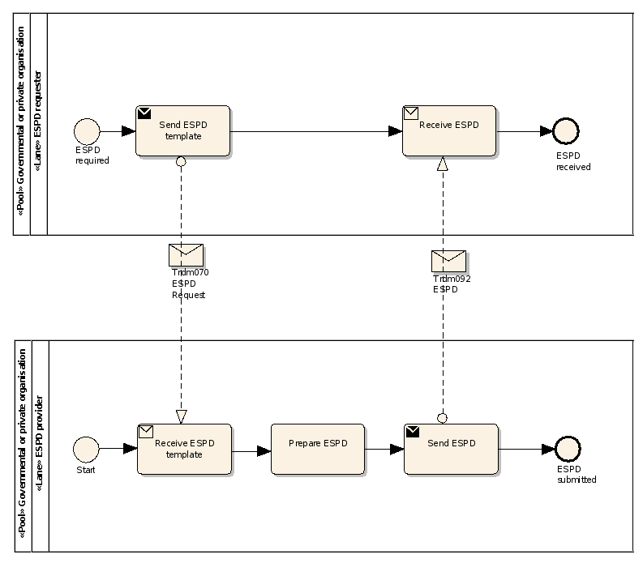
QualificationApplicationRequest
QualificationApplicationResponse

Slide 3
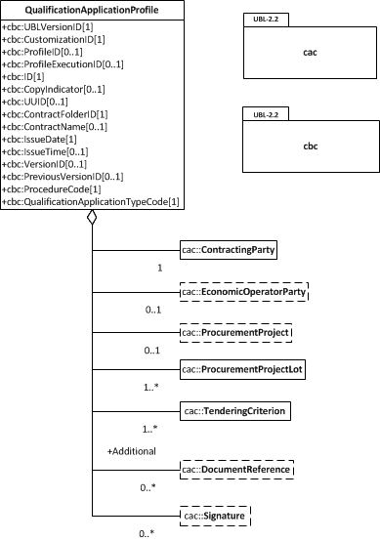

Slide 4
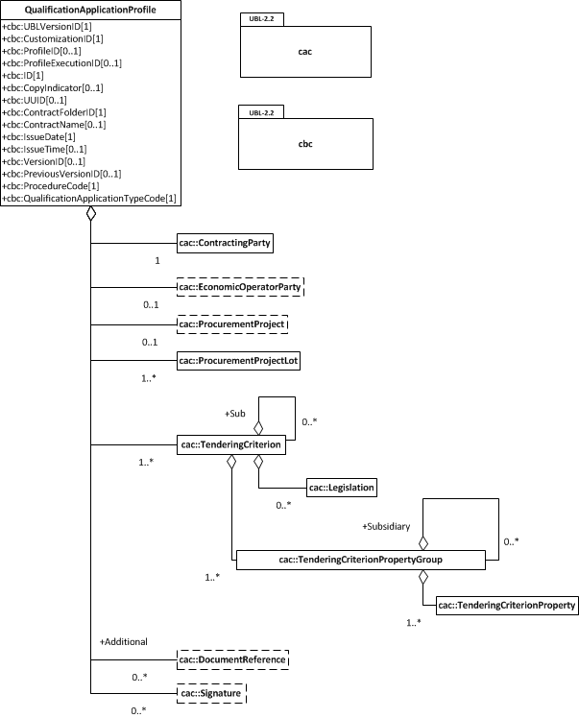

Slide 5
EXCLUSION
CONVICTIONS
PARTICIPATION_IN_CRIMINAL_ORGANISATION, CORRUPTION, FRAUD, TERRORIST_OFFENCES,
MONEY_LAUNDERING, CHILD_LABOUR-HUMAN_TRAFFICKING
CONTRIBUTIONS
PAYMENT_OF_TAXES, PAYMENT_OF_SOCIAL_SECURITY
SOCIAL
ENVIRONMENTAL_LAW, SOCIAL_LAW, LABOUR_LAW
BUSINESS
BANKRUPTCY, INSOLVENCY, CREDITORS_ARRANGEMENT, BANKRUPTCY_ANALOGOUS,
LIQUIDATOR_ADMINISTERED, ACTIVITIES_SUSPENDED
MISCONDUCT
MC_PROFESSIONAL, MARKET_DISTORSION
CONFLICT_OF_INTEREST
PROCEDURE_PARTICIPATION, PROCEDURE_PREPARATION
EARLY_TERMINATION
EARLY_TERMINATION, MISINTERPRETATION
NATIONAL
OTHER

Slide 6
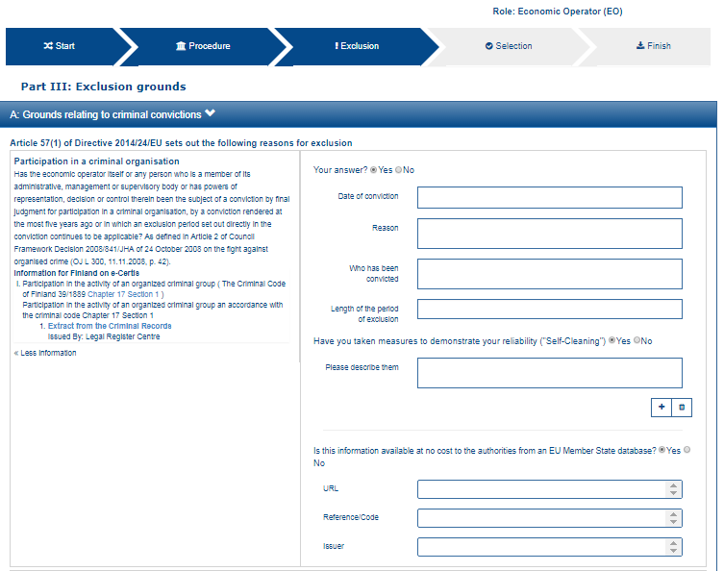
1
2
3
12
4
13
5
6
7
8
9
11
12

Slide 7
12
13

Slide 8
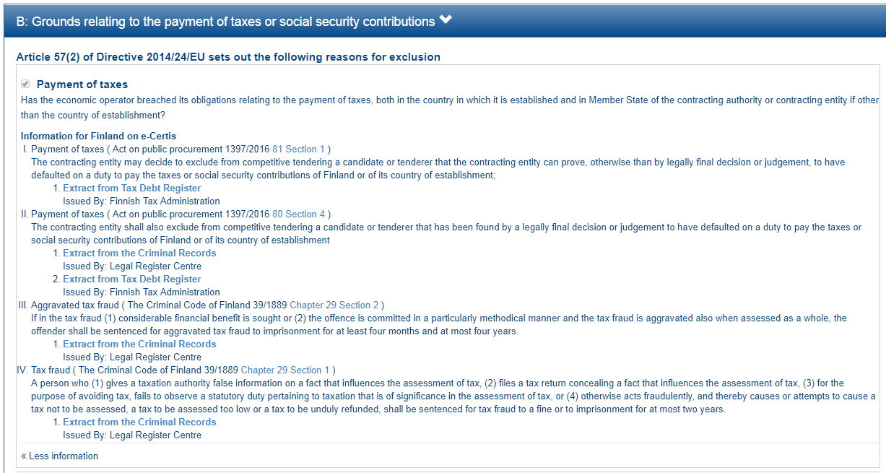

Slide 9
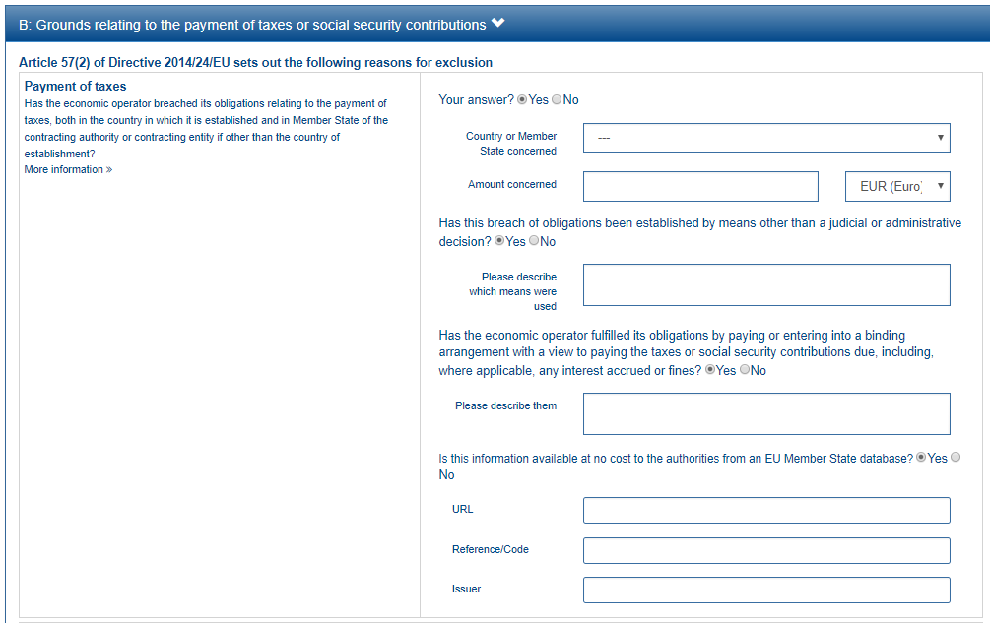
1
2
3
This property is shown only if the answer to the previous QUESTION is ‘Yes’
4
5
6
7
8

Slide 10
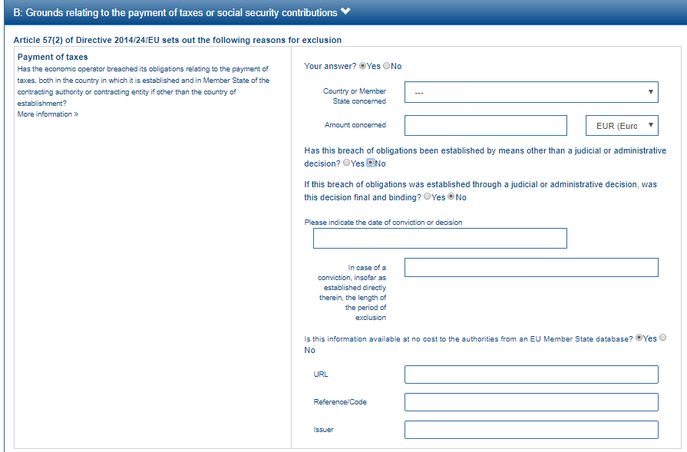
This group of property is shown only if the answer to the previous QUESTION is ‘No’
9
10

Slide 11
EU PoT Criterion
1
FI PoT Criterion I
2
FI PoT Criterion II
3
FI PoT Criterion III
4
FI PoT Criterion IV
5

Slide 12
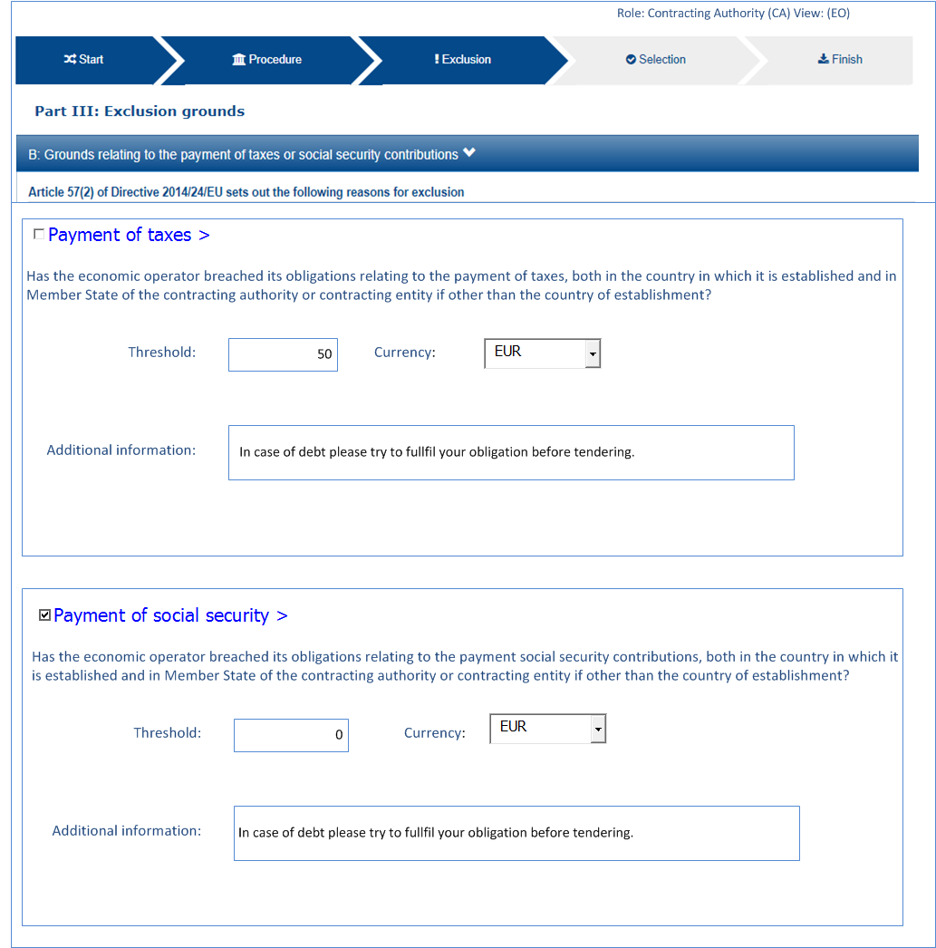
6
7
8

Slide 13
6
7
Minimum threshold: 50€
In case of debt please try to fulfil your obligation before tendering
8

Slide 14
2
3
4
5

Slide 15
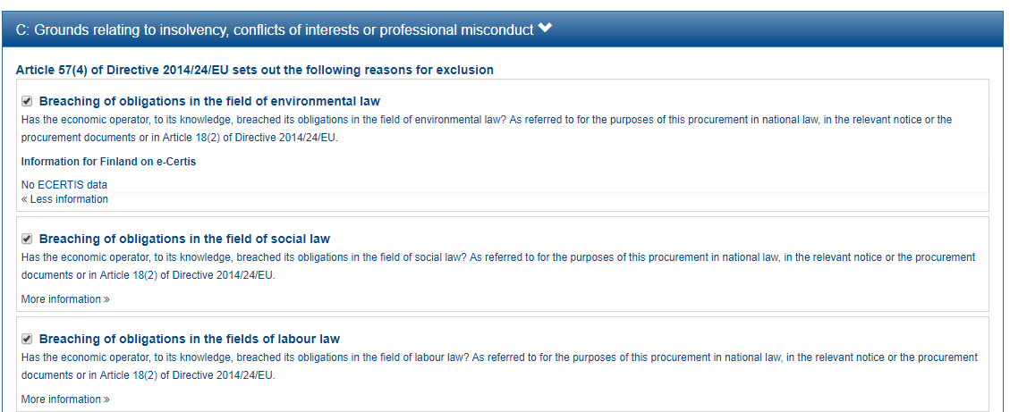

Slide 16
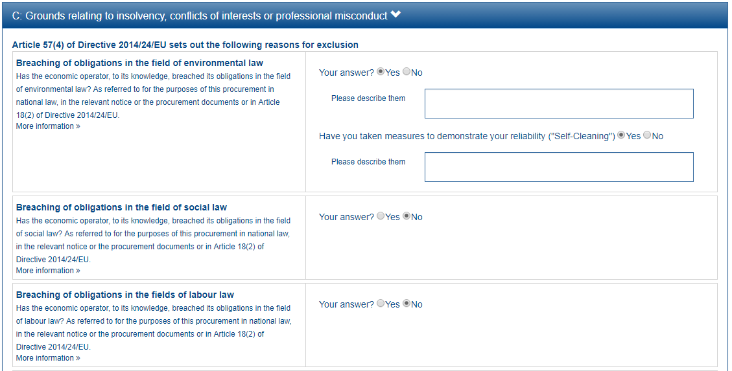
1
2

Slide 19
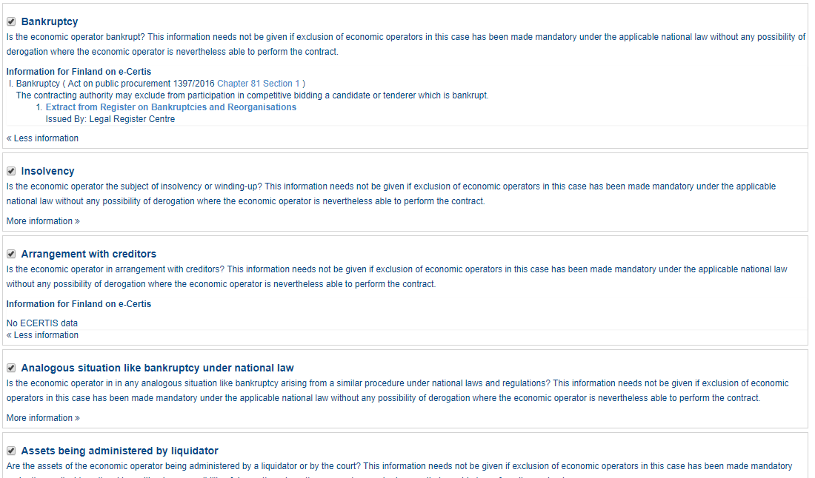

Slide 20
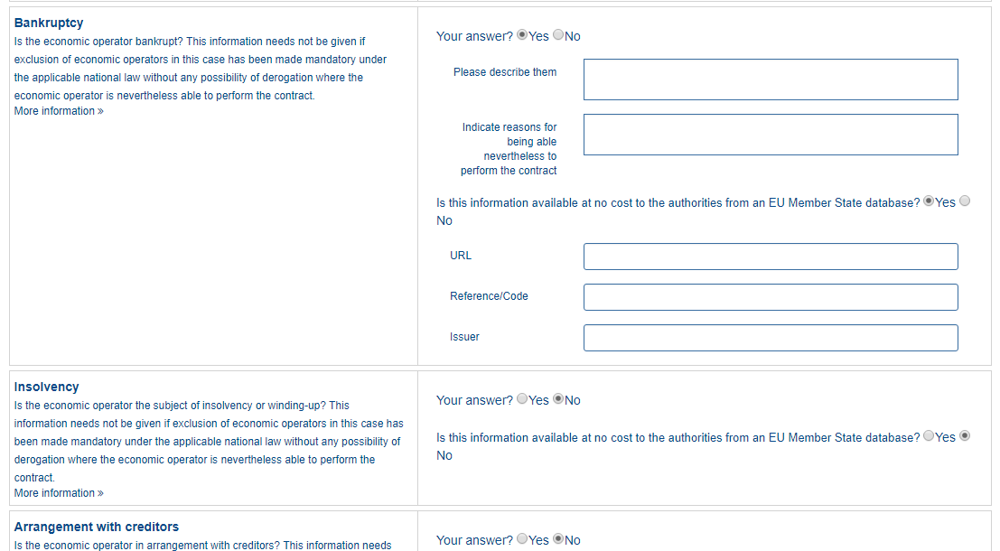
1
2
3
4
5
6

Slide 23
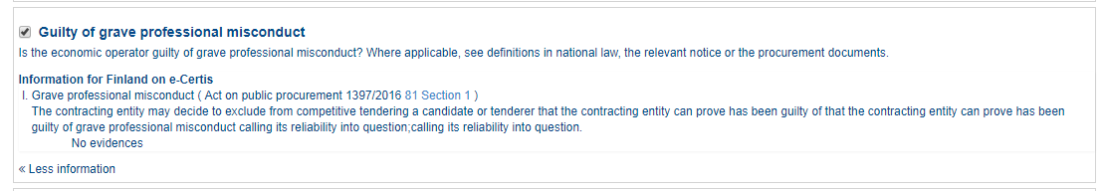

Slide 24
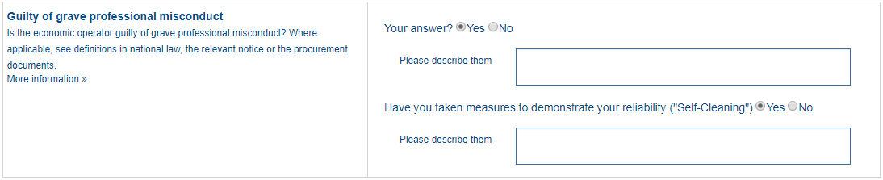
1
2

Slide 27
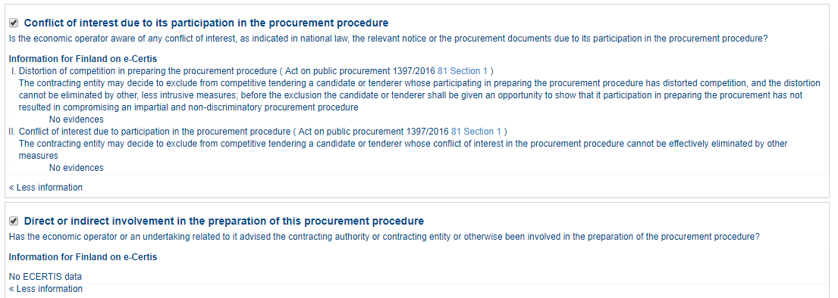

Slide 28
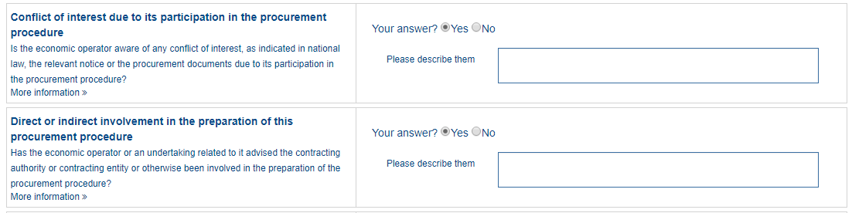
1

Slide 31
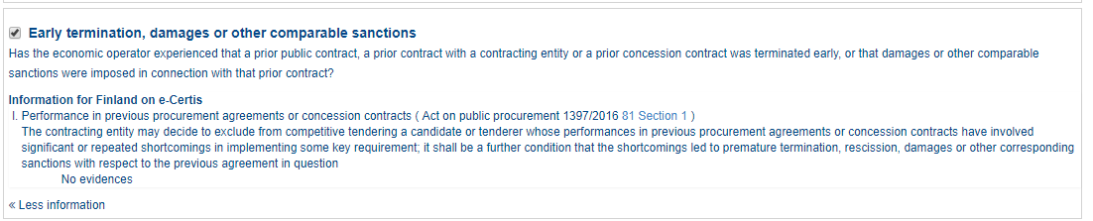

Slide 32
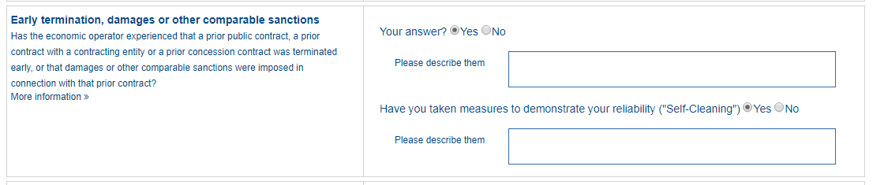
1
2

Slide 33
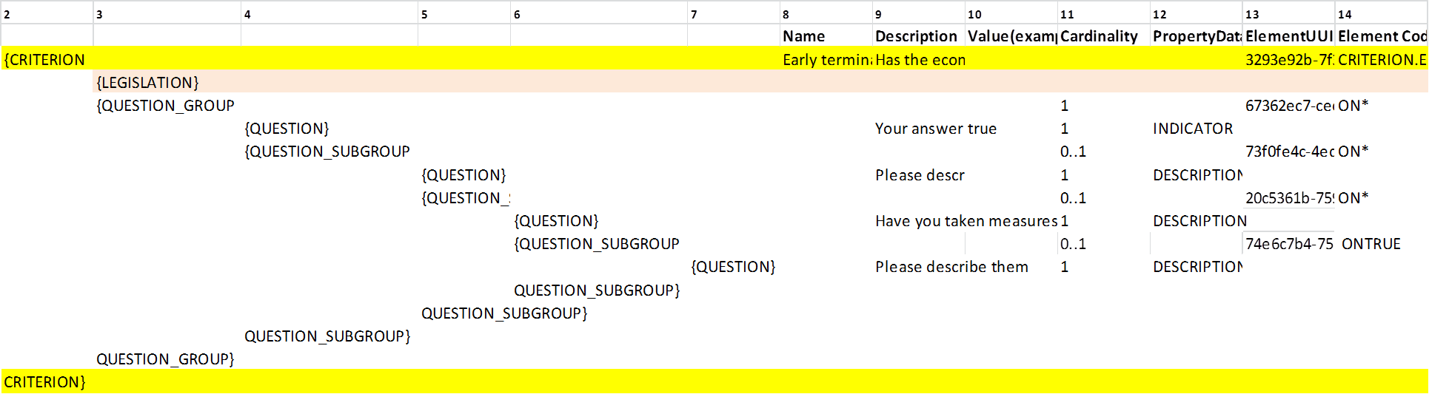

Slide 35
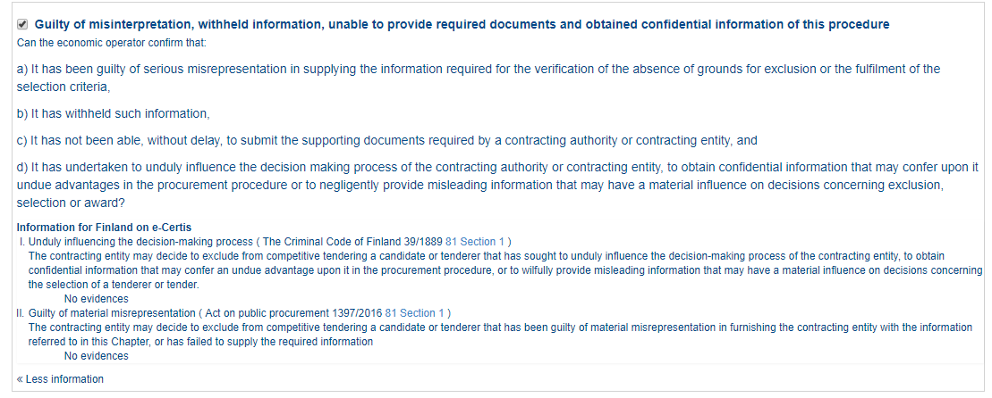

Slide 36
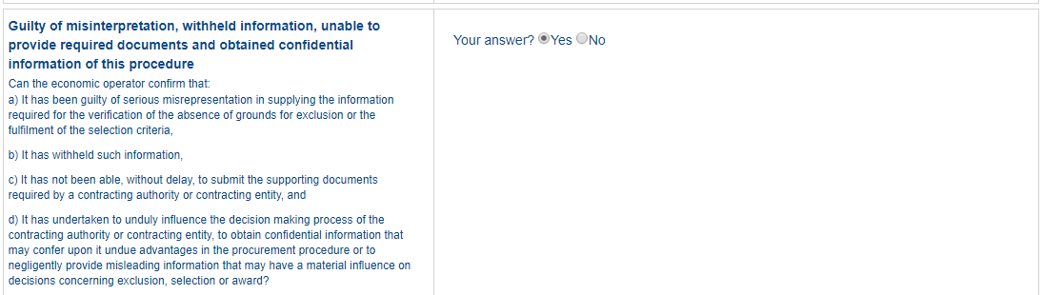
1

Slide 39
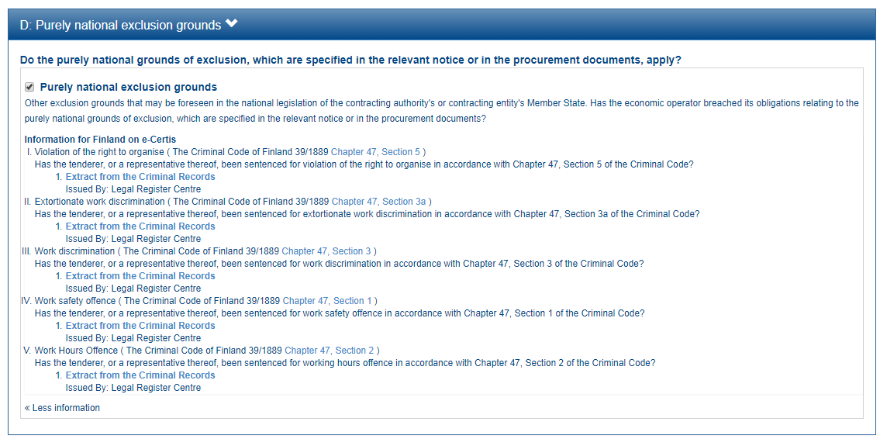

Slide 40
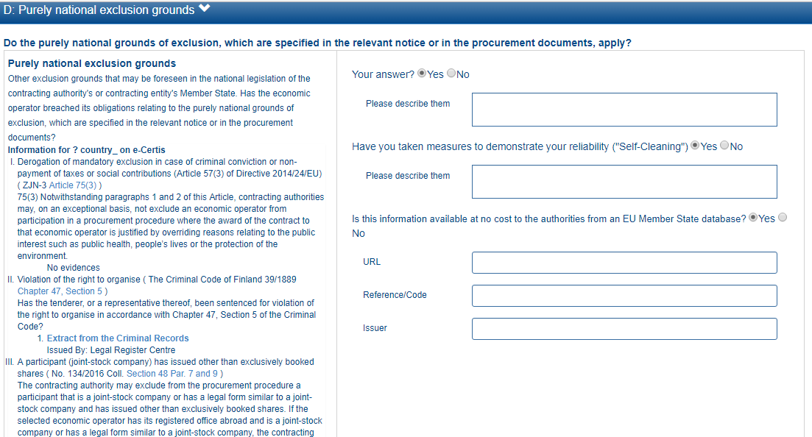
1
2
3
4
5
6

Slide 41
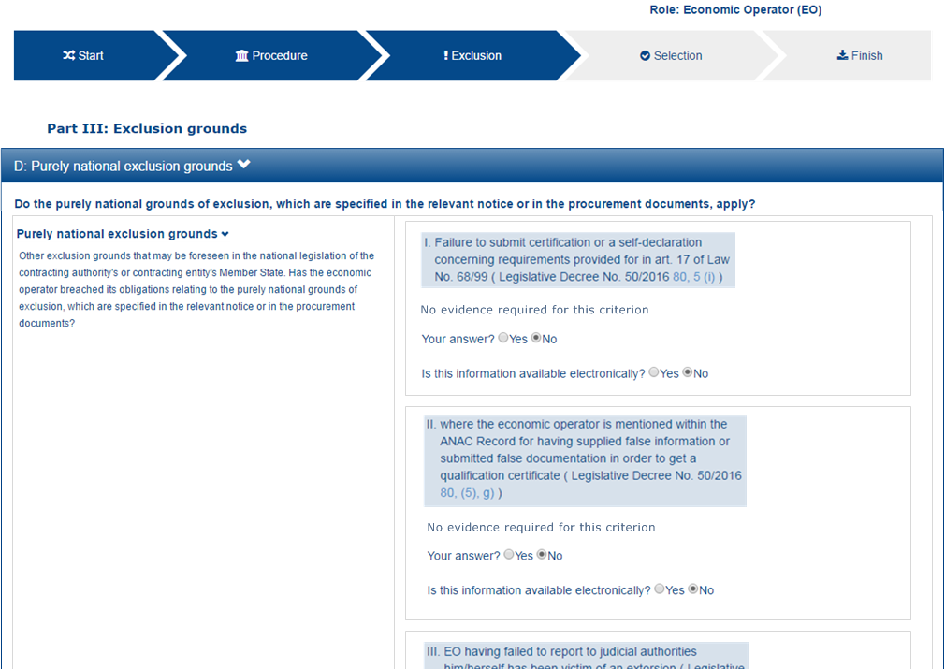
1
2

