Slide 1
The Wonders of Britain
Andy Evans
Notes:
This talk introduces the ‘Wonders of Britain’ project and some of its results and ongoing work.

Slide 2
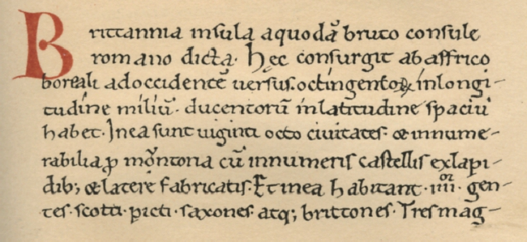
Historia Brittonum
Around 829 CE a monk compiled a series of folk histories. Oldest datable bits might be at least 796 CE (some possibly much older).
35 full Latin versions plus a handful of Irish versions of different detail.
Notes:
The text above is the start of the oldest version of this we have. The manuscript is from c.1100 CE, but internal evidence suggests the Historia itself (though not necessarily the documents appended to it) was pulled together c.829 CE.

Slide 3
Contents
I The Ages of the World II British and Irish Origins: Abridged late Roman cosmography Brutus the Roman (Trojan) The Picts The Irish Date Summary Biblical origins of British III The Roman Empire IV After the Romans: The Kentish Chronicle Life of St. Germanus The Tale of Emrys | Life of St. Patrick Campaigns of Arthur V Northern History: English Genealogies Northumbria VI The Chronographer Addenda: VII The 28 Cities VIII The Wonders: of Britain of Mona of Ireland
Notes:
The Historia includes a folk history of Britain, which is extremely unreliable as history, but very interesting as folklore. It includes one of the earliest mentions of King Arthur. Here we’re interested in the list of wonders appended to the history.

Slide 4
de mirabilibus britanniae of the Wonders of Britain
Britain:
2: Trahannon River
3: The Fiery Pool
4: The Salt Fountains
5: Two Severn Kings
6: Linn Liuan
7: Fount Guur Helic
8: The Apple Ash
9: The Wind Hole
10: The Levitating Altar
11: The Returning Plank
12: Cabal’s Cairn
13: Amr's Tomb
14: Cruc Mawr Tomb
17: The Well of Bones
18: The Undersea Birds
[Scotland?]
1: Loch Lumonoy?
15: Brebic’s Stone Cataract
16: Mauchline’s Quern
19: The Limpets of Ceoil
20: The Screams of Glen Ailbe
Mona
21: The Sealess Shore
22: The Circling Rock
23: The Swelling Ford
24: The Walking Stone
Ireland
25: Loch Lein
26: Loch Echach
Notes:
The list (usually in a section called “de mirabilibus britanniae”) varies slightly in both content and number of wonders, depending on which manuscript you look at, but the above is a list of everything that features. “Britain” here largely means Wales and Scotland, in the older sense of the area the British were pushed into by the Anglo-Saxons -- though some sites are within Saxon areas. The numbering is an indication of the order they appear in manuscripts. The manuscripts explicitly divide off Mona (probably Anglesey) and Ireland.

Slide 5
Structure
Dating
Sources
Purpose
Linn Liuan
Cabal’s Cairn
The Walking Stone
Notes:
Structure of this talk. I’ll detail some of the work I’ve done looking at dating this list, which may be older or younger than 829 CE. I’ll then talk about some of the sources used to construct the list, before looking at the purpose of the list when it was constructed and why it might have survived. To do this, I’ll talk about three of the wonders which exemplify different purposes and types of wonder.

Slide 6
Dating
Culture in 8th C Britain very different from 12th C.
Sources vary.
Elements may be older than whole.
Notes:
As I mentioned above, the appended list may not be as old as 829 CE; it could have been appended to the oldest manuscript after this – any time up to 1100 CE. Equally, it may be constructed from much older material. The date is important if we are to understand what the list represented for the people making it. 8th C Britain (or, at least, England) was still, in parts pagan, whereas by the 12th C Britain was entirely Christian, at least officially. So what evidence is there for the date? Unlike the Historia itself, there are no specific dates in the list, so we can’t use that kind of evidence. We have to look in more detail at what is said, and how.

Slide 7
Dating
Dates of objects in reality.
Date of object spelling in the list (may be persistent, but unlikely unless taken from earlier written sources).
Date of placename spellings in the list (may be persistent, but even less likely as these are used to direct people to the wonders).
Dates from tribal descriptions / locations.
Notes:
There are four potential forms of evidence, listed above.

Slide 8
Date
Historia
compilation
Oldest
manuscript
Dates of objects:
The Levitating Altar Relic treatment
The Apple Ash Introduction of tree by Romans
The Returning Plank After Meurig (500—700 CE)
Date of object spellings
Loch Lumonoy ? ? Could be Old Welsh, or older
Linn Liuan ‘linnliuan’ Old Welsh (or older?)
Two Severn Kings ? ? ? ? ? ? ‘Duo Rig Habren’ ?
Trahannon River ? ? ? ? ‘Trans Hannoni’ could be much older
Fount Guur Helic ? ‘Guur’ and ‘Helic’ pre-8th C
Amr's Tomb ? ? ? ‘Amr’ could be much older
Date of place spellings
The Wind Hole ? ? ‘Guent’ definitely post-Roman
Cruc Mawr Tomb ? ? ‘Cereticiaun’ post-615 pre-977
100 CE
200 CE
300 CE
400 CE
500 CE
600 CE
700 CE
800 CE
900 CE
1300 CE
1000 CE
1200 CE
1100 CE
Notes:
Here are those forms of evidence, with the evidence from the wonders divided up, with potential dates. The blocks are the most likely periods, where a likely period can be assigned.

Slide 9
Date
Historia
compilation
Oldest
manuscript
Dates of places:
Cruc Mawr Tomb ? ? ? ? ‘Cereticiaun’ post-615 pre-977
Tribal evidence
The Fiery Pool ? ? Huich (Hwicce) in Bath (post 577)
The Salt Fountains ? ? Hwicce in Droitwich (post 577?)
Mercians took over 7th C, but joint rule. Hwicce probably merged completely with Mercia by 790, but name may have remained.
Amr's Tomb ‘Ercing’ not ‘Ercingfeld’ or ‘Archenfield’ and no mention of Saxons. Saxon bishop in Hereford by 676, Hereford controlled by 800.
100 CE
200 CE
300 CE
400 CE
500 CE
600 CE
700 CE
800 CE
900 CE
1300 CE
1000 CE
1200 CE
1100 CE
Notes:
Given this, I’m inclined to assign the list in total to the date of the Historia compilation c.829 CE. More significantly and more solidly, perhaps, it is clear that the list is constructed from a variety of materials that are older. Future work will compare this dating work with the style in the text to see if it is possible to reconstruct the original lists.

Slide 10
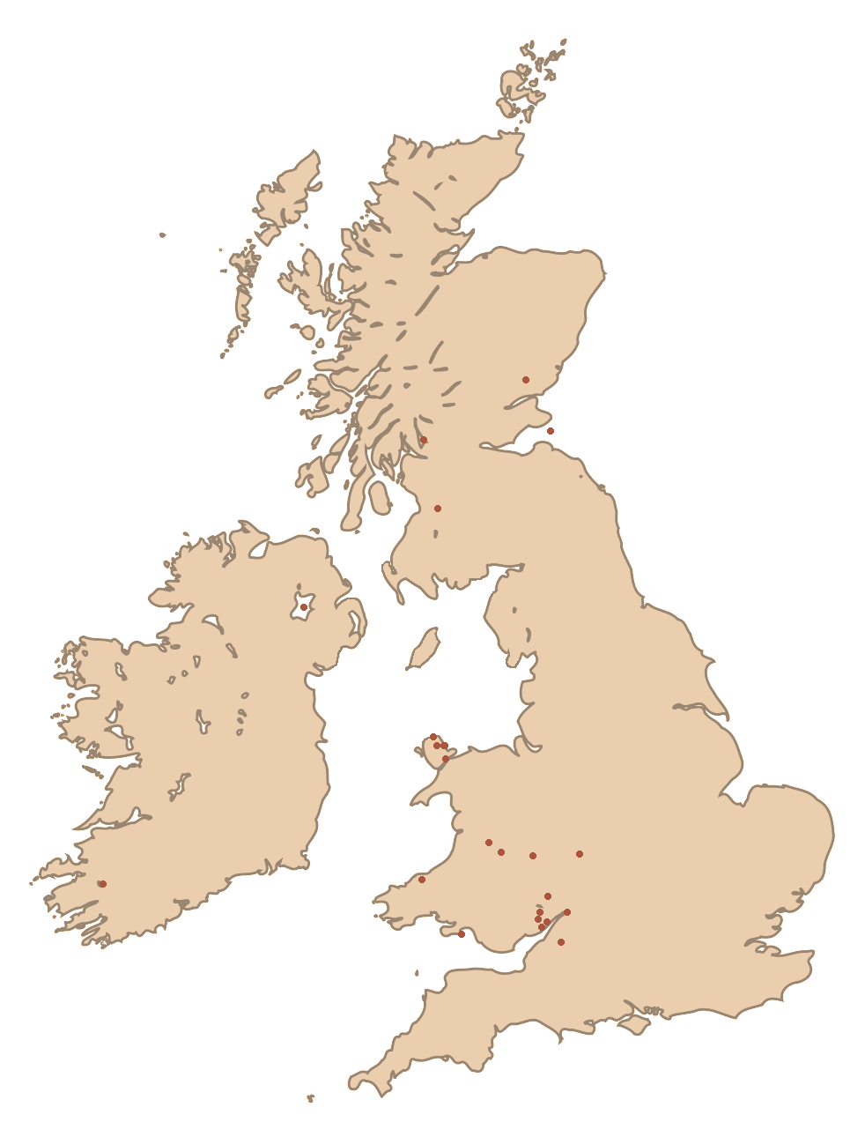
Date
Locations may give a clue.
Concentrated in: South Wales; Anglesey;
S. Scotland.
Notes:
Further dating evidence for the whole list might come from the geographical spread of the sites. If we look at the locations, they all fall in certain areas; essentially areas we now think of as ‘Celtic’. Moreover, the list excludes sites from England that appear in slightly later Anglo-Saxon/Norman lists.

Slide 11
Date
British control lost by c. 1030s
Match up reasonably well with stable British areas.
Lack south Solway Firth matches 638 – c.975
British lose N.Wales for short period
c .624
Battle of Chester
(c.600)
After Battle of
Deorham (577)
Notes:
If we look at the dates at which old “British” communities were excluded from England, we may get an idea of when the list was constructed. Of particular interest is those areas that are explicitly recorded as within Anglo-Saxon territories, as the invasion of these areas can give us dates of more or less reliability. For example, we know that the Bath wonder could not, as recorded, be from before the Battle of Deorham in 577 CE. (That’s not, of course, to say it wasn’t in other, lost, lists before then).

Slide 12
Sources
Saints’ lives
The Levitating Altar
The Returning Plank?
Triads
Loch Lumonoy
Linn Liuan
Fount Guur Helic
Geoffrey of Monmouth: Historia Regum Brittaniae (1129 to 1151 CE)
Notes:
So, what are the sources of the materials, and do these give us any clues about the date and purpose of the list?
Some of the wonders clearly come from saints “lives”. These were documents written between the late Roman period, through to the late medieval period (and still today). These lives are generally a mix of folklore and history, and have a complex position within the power struggles between the church and others in the early medieval period. Wonders were frequently quoted as stories showing the dominance of the saint (read ‘church’) over secular and local leaders. At least two of the wonders appear to be from this source. For more details, see the papers referenced at the end of the presentation.
At least three of the wonders appear group together elsewhere as a ‘triad’. These are early medieval (possibly as early as Iron Age) triplets, used as a memory aid by British (ie Celtic) storytellers and Bards. Three of the wonders from S.E.Wales appear together in Geoffrey of Monmouth’s Historia Regum Brittaniae, and it seems likely there was an extant list at the time that had these specifically as a triad. It is interesting that in the Historia list, these also present some of the oldest spellings.

Slide 13
Themes
Wondrous Springs
3: The Fiery Pool
4: The Salt Fountains
6: Linn Liuan
11: The Returning Plank
Wondrous Tombs
10: The Levitating Altar
12: Cabal's Cairn
13: Amr's Tomb
14: Cruc Mawr Tomb
Lakes Wonders
1: Loch Lumonoy
7: Fount Guur Helic
6: Linn Liuan
The Severn (Bore) Wonders
2: Trahannon River
5: Two Severn Kings
6: Linn Liuan
11: The Returning Plank
Notes:
Indeed, if one looks at the themes in the list, there do seem to be several triads represented when one removes the examples from the saints lives. However, in the absence of further information and a more detailed look at the stylistics it is hard, at this stage, to be more definite.

Slide 14
Sources
Other wonder lists
Wonders of Scotland / Mona
Possible Irish influence (though not for the Irish wonders, strangely)
Poetry
The Returning Plank
Appears to be in homeoteleutic verse
Notes:
Other sources. The Returning Plank, in particular appears to be in verse form. Future work will try to recreate the original verses.

Slide 15
Purpose
Purposes of individual descriptions may have been different (saints’ lives, in particular).
Classical interest in the natural world?
Doesn’t seem to be any explicit religious message.
Notes:
The list is unusual in that it seems likely to have been drawn together by someone in a religious community, but equally is not presented (as other lists are) as being proof of the wonder-making abilities of the Christian god. It seems much more in the classical style, of which Herodotus is the best early example. This includes, for example, the distinction between visited and unvisited sites. The compiler of the Historia notes that they drew together a heap of documents, and the same would appear to be true for the list of wonders.

Slide 16
Purpose
Explanation of landscape features:
Joy in the unusual?
Notes:
If the list itself seems to have been compiled for unclear reasons, perhaps we can look at the individual components and examine why they were constructed in the first place. We’ll look at three examples that seem to exemplify the types of wonders in the list. First up, an example that just seems to involve a joy in the unusual…

Slide 17
Linn Liuan
There is another wonder: it is the confluence of Linn Liuan; the mouth of that river flows into the Severn, and when both the Severn is flooded to The Teared [the bore], and the sea is flooded similarly into the aforementioned mouth of the river, both it is received into the lake/pool of the mouth in the mode of a whirlpool and the sea does not advance up. And a bank/shore exists near the river, and so long as the Severn is flooded to The Teared [the bore] that bank/shore is not covered, and when the sea and Severn ebbs, at that time lake Liuan vomits all that it has devoured from the sea and both that bank/shore is covered and in the likeness of a mountain in one wave it spews and bursts. And if there was the army of the whole region, in the midst of where it is, and it directed its face against the wave, even the army the wave carries off through the force, by fluid full clothes. If, on the other hand, the backs of the army were turned against it, the same wave doesn’t harm, and when the sea may have ebbed, then the entire bank, which the wave covers, backwards is bared and the sea recedes from it.
Notes:
The example is a vomiting lake.

Slide 18
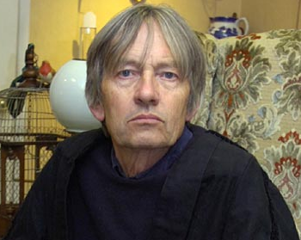
John Nettleship
The Late John Nettleship
Notes:
Credit where credit is due. I was struggling with finding this wonder, when John Nettleship got in touch, saying he recognised the description on my website as being somewhere near him. You may not recognise John, but you probably know more than you think about him.

Slide 19

John Nettleship
The Late John Nettleship
Notes:
John was, apparently, J.K.Rowling’s old chemistry teacher, and her mum worked as his lab assistant for a time. He was, allegedly, the model for Severus Snape; something he delighted in. Having spent some time with John before he died last year (2011) I can see the similarities. He had a very dry sense of humour, which hid a strong commitment to fighting for social justice.

Slide 20
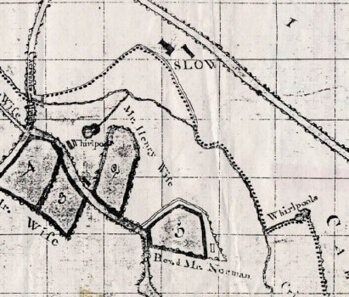
Whirlyholes, Caerwent
Whirlyholes
Local sources note the whirlyholes fountaining spectacularly and then rapidly turning into whirlpools to drain.
Notes:
John got in touch and noted that there was story local to him, near Caerwent, of spectacular fountaining springs that suddenly turned into whirlpools. This seems like it matched up with the wonder, but, unfortunately, they were 8km inland from the Severn, and had stopped working. We spent a year trying to get to the bottom of what had happened.

Slide 21
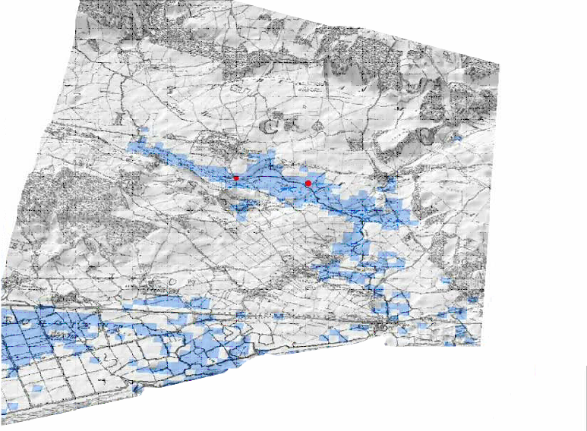
Whirlyholes, Caerwent
Whirlyholes
Notes:
Trawling back through old materials, it became apparent that the Severn did used to have an inlet that ran up to Caerwent. There are historical records showing that people sailed up to the foot of the old town. In addition, Geographical Information System modelling suggested that if some areas of infill were now removed, water could still reach the old town. Indeed, when there is heavy rainfall, the areas still forms a lake that gives a convincing outline of the old inlet.

Slide 22
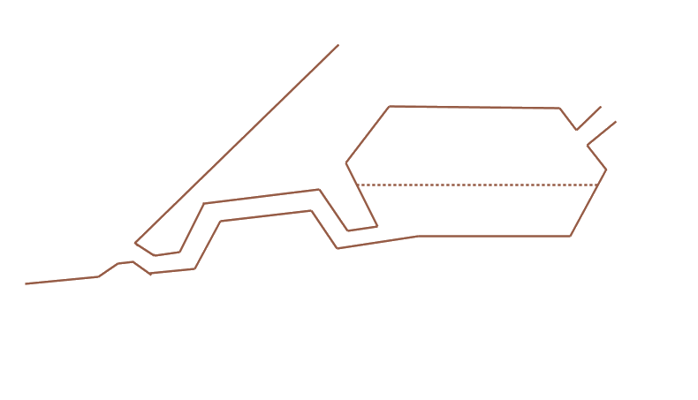
Syphoning springs
Hydrologically ‘complex’.
Charles Hutton in 1796.
Notes:
So what of the wonder. It sounds like it is what is know as a ‘syphoning spring’. These are connected to a cave system that acts as a syphon, sucking water into the system as the external water level rises, and vomiting it out again as it falls.

Slide 23
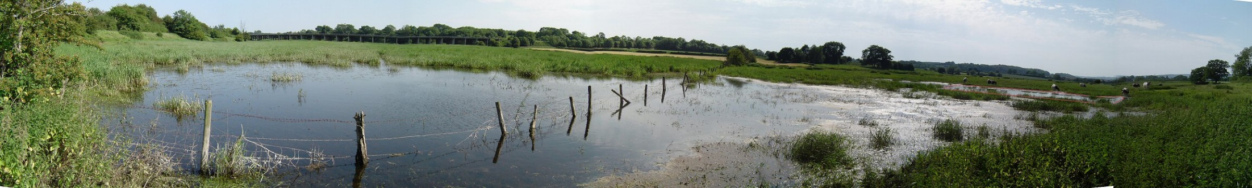
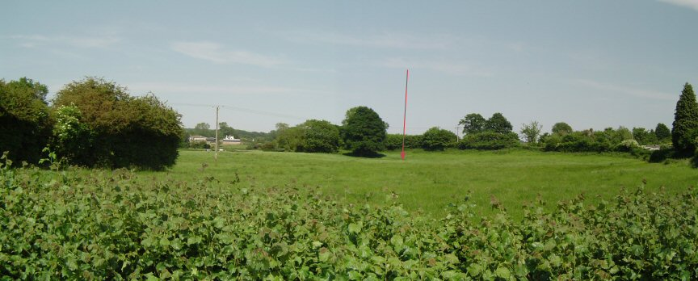
Visit
Whirlyholes today
Notes:
There were two (possibly three) of these features that used to be active. However, if you visit them today there are either only small springs, or no water at all. So what changed?

Slide 24
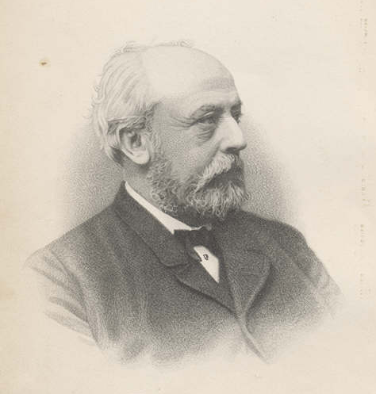
Severn tunnel
Building ok until 18th October 1879.
Thomas A. Walker
Notes:
Thomas A. Walker is what changed. To understand what happened, you have to step back a little before Walker, to the initial digging of the Severn Tunnel. This was a massive project to connect the industrial and resource-heavy South Wales with England. It promised to revolutionise the movement of goods and people from this area. All was going well, until 18th Oct 1879.
Image from Gathering the Jewels http://www.gtj.org.uk/en/small/item/GTJ01976/

Slide 25
Severn tunnel
Building ok until 18th October 1879.
Severn Tunnel Great Spring (5681.25 m³h⁻¹)
Thames flow is ~3180 m³h⁻¹
Tunnel flooded to ground level.
Thomas A. Walker – persistence personified.
Notes:
At this point, the tunnels dug into a giant spring system, flooding the miles of almost complete tunnel to the roof. The contractors involved took one look at the water pooled in the tunnel head and gave up; it seemed like an impossible job to drain the tunnel and stop it refilling. At that point, the tunnel owners drafted in engineer Thomas A. Walker, Victorian persistence personified. Walker rolled up his sleeves and got to work on what was one of the most titanic struggles of willpower against nature engineering has seen. The tunnel was drained and reflooded at least once more before he’d finished, and capping the spring involved astonishing feats of engineering and bravery, including the first proper use of scuba diving equipment. Nevertheless, the efforts paid off, and Walker not only managed to cap the spring, but also complete the tunnel.
However, in his efforts to stop the flooding, Walker did two things. Firstly, he set up huge pumps to drain the spring system. The system is still pumped out today, and rumour has it that the water pumped out would supply Liverpool with fresh water, if only it could be got there.
Secondly, he capped, with concrete, every crack in the surface above the tunnel and the surrounding countryside, to prevent water getting into the system. Not only did this cut off the springs used by local houses, which the company then had to resupply, it also dried up the springs associated with the wonders.
(NB if you want more on the story of Walker’s epic engineering, the book he wrote on it is a masterpiece in understated persistence: “The Severn Tunnel: Its Construction and Difficulties (1872–1887).”)

Slide 26
Purpose
Explanation of landscape features:
The desire to explain.
Notes:
Some of the wonders, however, seem to be included to do more than just highlight oddities. There is also a desire to test and explain the oddities, or the landscape features involved. These include some examples that capture older or perhaps more folk ways of understanding. A good example of this is Cabal’s Cairn…

Slide 27
Cabal's Cairn and Onomastic Tales
There is another wonderful thing in the region which is called Bucit [Builth]. There is there a mound of stones and one stone placed on top has a footprint of a dog on it. When hunting the porker Troynt, stamped Cabal (who was the dog of the soldier Arthur) the step in the stone, and afterward Arthur gathered together stones under the stone on which was the track of his dog, and it is called Carn Cabal. And men come, and they take the stone in their hands through the space of the day and night, even so, in the daylight of the following day it is come upon on top of his collection.
Notes:
Cabal’s cairn is a onomastic tale, that is, it seeks to explain the name of something. In addition, it also contains a tale about the testing of the wonder, so it represents an interesting mix of methods of explanation.

Slide 28
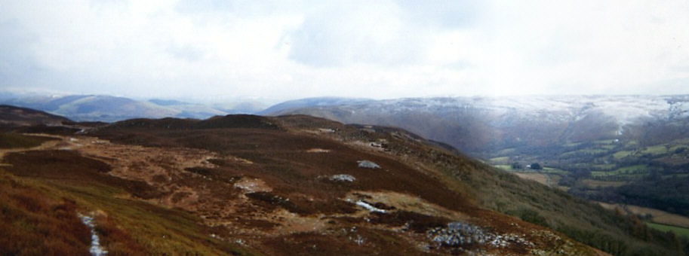
Cabal's Cairn
Carn Gafallt, in the Elan Valley
Notes:
The site was identified by the translator and energetic researcher of Welsh history, Charlotte Guest.

Slide 29
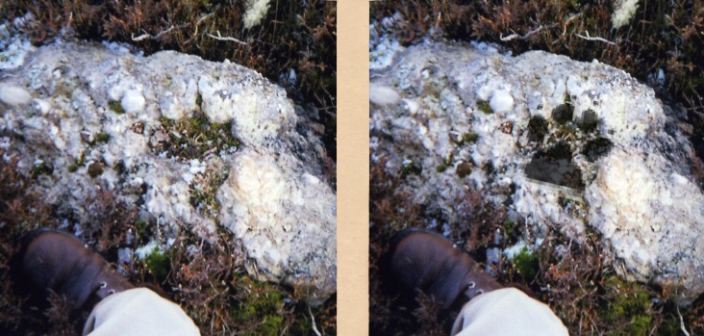
Cabal's Cairn
Lower Silurian conglomerate
Notes:
The site includes cairns made of Lower Silurian conglomerate. Conglomerate is a rock in which other rocks are embedded. They indicate that rocks have been produced, then eroded (for example, into pebbles in a sea or river), and then this material has been turned back into another rock, entrapping the original pebbles or broken up rocks. In the case of Carn Gafallt, the conglomerate includes pebbles that are easily knocked out to give shapes like the pads of dogs’ feet, and about the right size for a heroicly sized dog. Above is just one example, but they are easy to find.

Slide 30
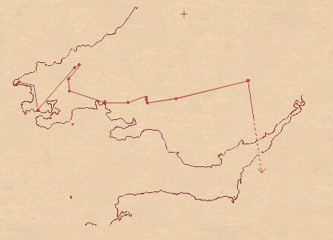
The Twrch Trwyth The Boar Trwyth
Culhwch ac Olwen (11thC, but possibly 9thC material)
Route used to comment on locations, but possibly also a military satire.
Cafall "horse" from the Latin caballus, though possibly from root “Cap” to capture.
Notes:
The wonder relates the feature to a famous boar hunt, which appears in other tales. Most notably, this includes a section in the early Arthurian tale “Culhwch and Olwen” . This tale describes the route taken by the boar, starting on the SW Welsh coast and ending near the vomiting lake mentioned above, though, strangely, it doesn’t include Carn Gafallt. This is a really nice example, however, of an onomastic tale, as it has the boar stopping at various points across the landscape, and each stop explains the name of the location.

Slide 31
Henwen
...who went about to bring forth to [Aust] in Cornwall, and there she went into the sea. And at Aber Tarogi in Gwent Is Coed she came to land… [At the foot of Mynydd Llwyd] she brought forth a grain of wheat and a bee; and therefore that place is the best for wheat and bees. And from there she went to [Lanion?] in Pembroke, and there she brought forth a grain of barley and a bee. And therefore [Lanion?] is the best place for Barley. From thence she made for the ["Slope of groaning"] in [Snowdonia]; there she brought forth a wolf-cub and a young eagle. And Coll son of Collfrewy gave the eagle to Bre(r)nnach the Irishman of the North, and the wolf he gave to Me(n)waedd of... Arllechwedd; and these were the Wolf of Me(n)waedd and the Eagle of Brennach. And from thence she went to the Black Stone [around Llanfair Hall], and there she brought forth a kitten; and Coll son of Collfrewy threw that kitten into the Menai. And she was afterwards Palug's Cat.
The Three Powerful Swineherds of the Island of Britain
Notes:
There’s a reverse version of it that starts more explicitly at the site we’ve identified as the vomiting lake (Aber Tarogi ).

Slide 32
Purpose
Desire to explain:
Not just folk explanations.
First recorded British scientific geographer.
Wonders tested:
Cabal's Cairn
The Walking Stone
Cruc Mawr Tomb
Amr's Tomb (narrator of list, or section?)
Wonders taboo:
The Levitating Altar
The Returning Plank
Notes:
Although there are many folk explanations in the list, one of the amazing things about the list is that it also represents the first real attempt in Britain at research geography. Previous information about geography and topology in Britain has concentrated on description: the length of the country and its exports, for example. Here, however, the author goes further, claiming to have visited sites and tested them out. This is a significant step; it represents the first real engagement in Britain with the scientific methodology, and it is interesting that this is in a document that is so secularly put together, despite the likelihood that it was pulled together in a religious house.
In some cases the author claims to have visited and tested the sites. This has a tradition outside of Britain dating back to Herodotus. It is unclear whether this really happened or not, but, given the clustering of these sites in SE Wales, where the Historia was probably compiled, it seems likely, and it seems likely that these comments were added by the compiler.
Equally, however, some wonders are only reported as having been tested. If we look at these alone, it is plain that the ones taken from saints’ lives are the only ones where a critical approach is rewarded with death.

Slide 33
Purpose
Linn Liuan
[Appears as the landing point of Henwen.]
Appears near the exit point of the Twrch Trwyth.
Appears as the home of the wise salmon in the tale of the rescue of Mabon son of Modron.
Hard to determine what is folkloric use of a famous area from some more significant element.
Notes:
As we’ve seen from the example of the vomiting lake, famous sites are referred to across a folklore tradition, and utilised in multiple ways.

Slide 34
Themes
Lakes Wonders
1: Loch Lumonoy
7: Fount Guur Helic
The Severn Bore Wonders
2: Trahannon River
5: Two Severn Kings
6: Linn Liuan
Wondrous Caves
9: The Wind Hole
Wondrous Springs
3: The Fiery Pool
4: The Salt Fountains
11: The Returning Plank
Wondrous Tombs
12: Cabal's Cairn
13: Amr's Tomb
14: Cruc Mawr Tomb
Wondrous Trees
8: The Appled Ash
Notes:
Nevertheless, looking at the wonders alone, key themes do seem to jump out.
Many of these themes map on to features that the early church regarded as sites of pagan worship.

Slide 35
Overall
Mix of folklore explanations of names.
Chunks of saints lives
(which have their own political purposes).
Pre-Christian(?) sites.
Genuine wonders.
In this sense, nearest equivalent literature is the Dindshenchas of Ireland.
Notes:
Overall then, there is strong evidence that the list has been constructed from several sources, at least some of which may be a good deal older, if not pre-Christian. The nearest analogy may, therefore, be the Dindshenchas of Ireland. These are exactly the same kinds of lists, containing very similar material, including material that is felt to be potentially pre-Christian cultic sites.

Slide 36
de mirabilibus britanniae of the Wonders of Britain
Britain:
2: Trahannon River
3: The Fiery Pool
4: The Salt Fountains
5: Two Severn Kings
6: Llyn Liuan
7: Fount Guur Helic
8: The Apple Ash
9: The Wind Hole
10: The Levitating Altar
11: The Returning Plank
12: Builth Cairn
13: Amr's Tomb
14: Cruc Mawr Tomb
17: The Well of Bones
18: The Undersea Birds
[Scotland?]
1: Loch Lumonoy?
15: Brebic’s Stone Cataract
16: Mauchline’s Quern
19: The Limpets of Ceoil
20: The Screams of Glen Ailbe
Mona
21: The Sealess Shore
22: The Circling Rock
23: The Swelling Ford
24: The Walking Stone
Ireland
25: Loch Lein
26: Loch Echach
Notes:
Hopefully, then, these examples have show that there’s a wealth of interesting material in these wonder lists, if only we look at them closely enough. Material that reflects on a very broad swathe of the early medieval period and potentially before.

Slide 37
More information
Evans, A.J. (2011) The Levitating Altar of Saint Illtud. Folklore 122(1), 55-75.
Evans, A.J., Nettleship, J. and Perry, S. (2008) Linn Liuan / Llynn Llyw: the wonderous lake of the Historia Brittonum's mirabilibus britanniae and Culhwch ac Olwen. Folklore, 119, 3, 295-318.
http://www.wondersofbritain.org/

Slide 38
The fiery pool
Wonder three - the hot pool, which is in the region of the Huich and encircled by a wall made of brick and stone and to that place men go during all seasons to be washed and to each, as it may have pleased them, the bath thus may be made according to his own will: if he may have willed, the bath will be cold, if warm, it will be warm.
Notes:
Extra slide

Slide 39
Bath
Mood quickened mind, and a man of wit,
Cunning in rings, bound bravely the wallbase
With iron, a wonder…
Wide streams welled
Hot from source, and a wall all caught
In its bright bosom, that the baths were
Hot at hall's hearth, that was fitting...
Thence hot streams loosed, ran over hoar stone,...
Into the ring tank.
(8thC?) Saxon poem The Ruin
from the 10thC Exeter Book.
Bath Heritage Services reconstruction
of Roman bath development
Notes:
Extra slide

Slide 40
28 (33) Cities of Britain
1. Cair ebrauc (York) 2. Cair ceint (Canterbury) 3. Cair gurcoc (Anglesey) 4. Cair guorthegern 5. Cair custeint (Carnarvon?) 6. Cair guoranegon (Worcester?) 7. Cair segeint (Silchester) 8. Cair guin truis (Norwich?) 9. Cair merdin (Caermarthen) 10. Cair peris (Porchester?) 11. Cair lion (Caerleon-upon-Usk) 12. Cair mencipit (Verulam) 13. Cair caratauc (Catterick?) 14. Cair ceri (Cirencester) 15. Cair gloui (Gloucester) 16. Cair lullid (Carlisle) 17. Cair grant (Cambridge) | 18. Cair daun (Doncaster) 19. Cair britoc (Bristol?) 20. Cair meguaid (Meivod?) 21. Cair mauiguid (Manchester??) 22. Cair ligion (Chester?) 23. Cair guent (Caerwent) 24. Cair collon (Colchester) 25. Cair londein (London) 26. Cair Guorcon (Worren) 27. Cair lerion (Leicester) 28. Cair draithou (Drayton?) 29. Cair ponsavelcoit (Pevenscy?) 30. Cair teimm (Teyn-Grace?) 31. Cair Urnahc (Wroxster) 32. Cair colemion 33. Cair loit coit (Lincoln?)
Identifications by J. A. Giles
Gildas' De excidio Britann(i)ae liber querulus ("the Fall/Ruin/Capture of Britain, a whining book") c.545 CE notes there are 28 cities in Britain so possibly had the same list.
Notes:
Extra slide

