Slide 1
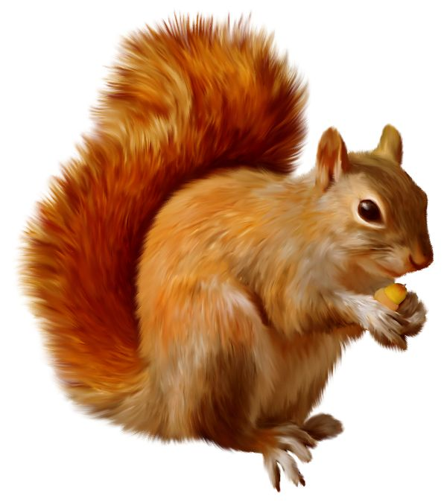
SQL

Slide 2
SQL
(Structured Query Language)
Databases make it easier to store and retrieve data.
SQL is the standard language to query data within databases.
Databases are usually designed to avoid the same data being stored in more than one place (Database normalisation).
SQL allows us to retrieve data from more than one place and see it together.
BioRails queries build an SQL statement, which is run on the database.
If something happens in SQL, it will happen in Biorails Queries!

Slide 3
SQL
Let's look at some queries!
(select, order, where)

Slide 4
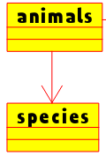
SQL
Database Normalization 1
(belongs_to/has_many)
Each animal belongs to one species
We only want to store information on species in one place (the species table)
Each animal has a species_id, which corresponds to the id column of the species table.
Sometimes we want to see information about both the animal and the species at one time.
This requires a join

Slide 5
SQL
Let's look at some queries!
(inner join, outer join)

Slide 6
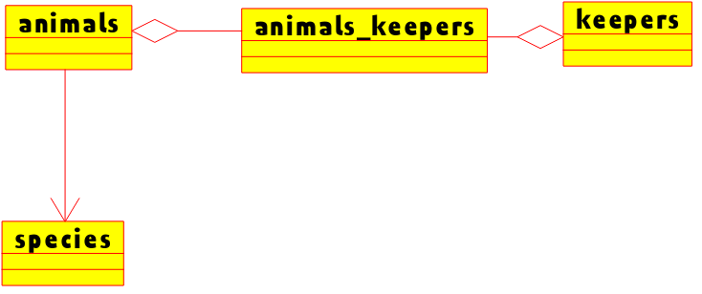
SQL
Database Normalization 2
(has_and_belongs_to_many)
Each keeper is responsible for feeding one or more animals
More than one keeper may be responsible for more than one animal
In order to link many (read 'any number of') animals to many keepers we need an extra table, called a join table.
animals_keepers has only got an animal_id and a keeper_id
To see this, we need two joins

Slide 7
SQL
Let's look at some queries!
(multiple joins)

