Slide 1
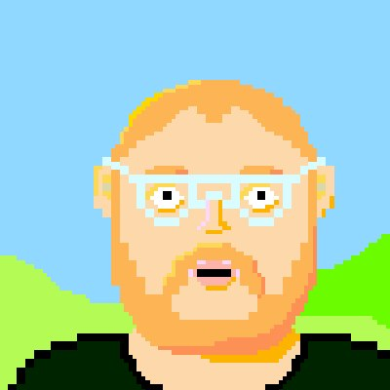

There once was a man from Dunoon
Who used to eat soup with a fork
The swordfish fly
Across the sky
There's thousands of melting clorks
@MarmiteJunction
Notes:
Line 1
Line 2
It gets a bit surreal after that
Lines 3,4,5
Most people would think this has gone off the rails

Slide 2
@MarmiteJunction
Notes:
Line 1
Line 2
It gets a bit surreal after that
Lines 3,4,5
Most people would think this has gone off the rails

Slide 3
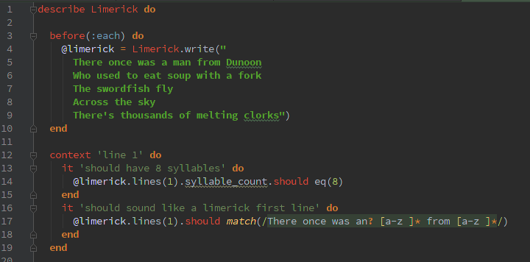
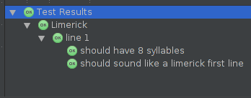
@MarmiteJunction
Notes:
Line 1
Line 2
It gets a bit surreal after that
Lines 3,4,5
Most people would think this has gone off the rails

Slide 4
@MarmiteJunction
Notes:
Line 1
Line 2
It gets a bit surreal after that
Lines 3,4,5
Most people would think this has gone off the rails

Slide 5
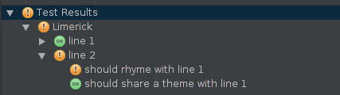
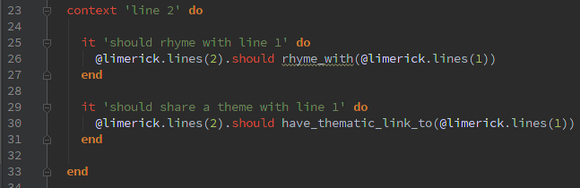
There once was a man from Dunoon
Who used to eat soup with a fork
@MarmiteJunction
Notes:
Line 1
Line 2
It gets a bit surreal after that
Lines 3,4,5
Most people would think this has gone off the rails

Slide 6
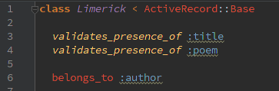
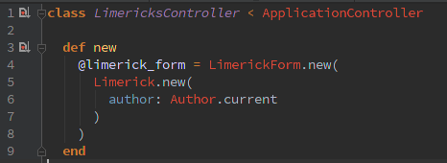
@MarmiteJunction
Notes:
Line 1
Line 2
It gets a bit surreal after that
Lines 3,4,5
Most people would think this has gone off the rails

Slide 7
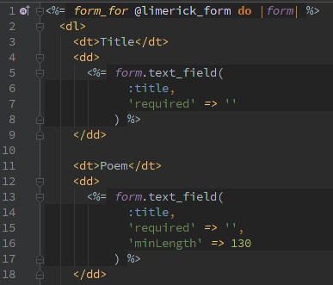
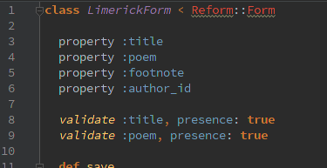
Across the sky
The swordfish fly
DRY?
@MarmiteJunction
Notes:
Line 1
Line 2
It gets a bit surreal after that
Lines 3,4,5
Most people would think this has gone off the rails

Slide 8
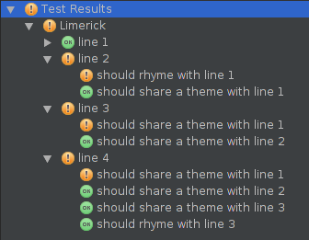

@MarmiteJunction
Notes:
Line 1
Line 2
It gets a bit surreal after that
Lines 3,4,5
Most people would think this has gone off the rails

Slide 9
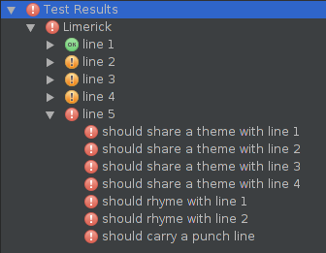
@MarmiteJunction
Notes:
Line 1
Line 2
It gets a bit surreal after that
Lines 3,4,5
Most people would think this has gone off the rails

Slide 10
There once was a man from Dunoon
Who used to eat soup with a fork
@MarmiteJunction
Notes:
Line 1
Line 2
It gets a bit surreal after that
Lines 3,4,5
Most people would think this has gone off the rails

