Slide 1

Derailing SMIFF
Andrew Faraday
@MarmiteJunction

Slide 2
Derailing SMIFF
IT'S TOO SLOW!
@MarmiteJunction
@MarmiteJunction

Slide 3
Derailing SMIFF
Binary Sequences
“[true, true, false, false, true, true, false, false, true, true, false, false, true, true, false, false]”
Too many characters
Full declaration: 162 – 194 characters
Binary String: 32 characters
Binary Number: 1 - 5 characters
“1100110011001100”
Too much data
For 7 drum patterns we've improved from 1134 - 1358 characters to 7 - 35 chcaracters!
"1100110011001100".to_i(2)
=> 52428
@MarmiteJunction
@MarmiteJunction

Slide 4
Derailing SMIFF
Versioning
Client: play kick on step 1
Server: Okay, here's the modified kick pattern
and the other drums
and the melodies
and the synthesis attributes
and the speed
Client: I'm playing the sequence, has anything changed?
Server: Here's the drums
and the melodies
and the synthesis attributes
and the speed
@MarmiteJunction
@MarmiteJunction

Slide 5
Derailing SMIFF
Versioning
Client: play kick on step 1. (I'm on version 5)
Server: Here's the modified kick pattern. It's now version 6.
Client: I'm playing the sequence, has anything changed? (I'm on version 6)
Server: ...
Client: I'm playing the sequence, has anything changed? (I'm on version 6)
Server: The snare pattern's changed here it is. It's now version 7.
@MarmiteJunction
@MarmiteJunction

Slide 6
Derailing SMIFF
ActiveRecord
@MarmiteJunction
@MarmiteJunction

Slide 7
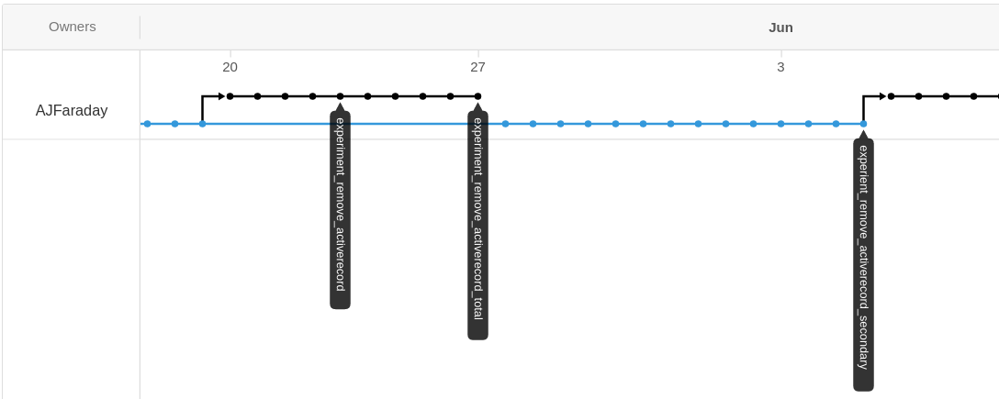
Derailing SMIFF
@MarmiteJunction
@MarmiteJunction

Slide 8
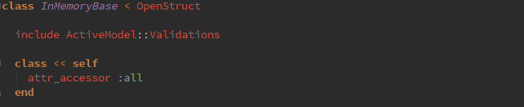
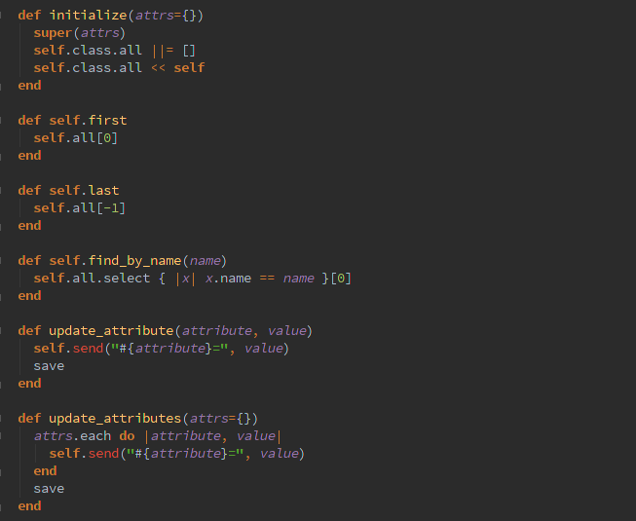
Derailing SMIFF
@MarmiteJunction
@MarmiteJunction

Slide 9
Derailing SMIFF
@MarmiteJunction
@MarmiteJunction

Slide 10
Derailing SMIFF
The big idea
SMIFF CLI
All of SMIFFs message interpretation, sequence data and version management is in two folders on the server.
They're no longer dependent on (much of) Rails.
My interface is text-based.
@MarmiteJunction
@MarmiteJunction

Slide 11
Derailing SMIFF
Andrew Faraday
smiff.andrewfaraday.com
github.com/ajfaraday/smiff-music
@MarmiteJunction

