Slide 1
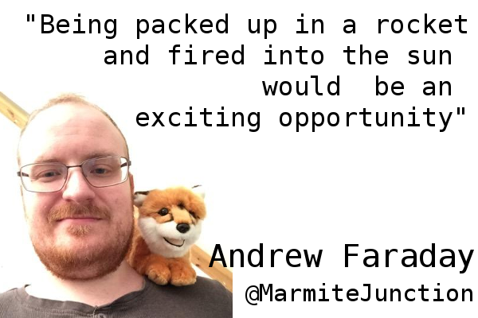
Ruby and Music

Slide 2
Outline
How to make a musical instrument in 5 minutes
The tale of the UglyWasp
Literal Twitter
Andrew Faraday
@MarmiteJunction
Andrewfaraday.com

Slide 3

Where's the Ruby?
Andrew Faraday
@MarmiteJunction
Andrewfaraday.com

Slide 4
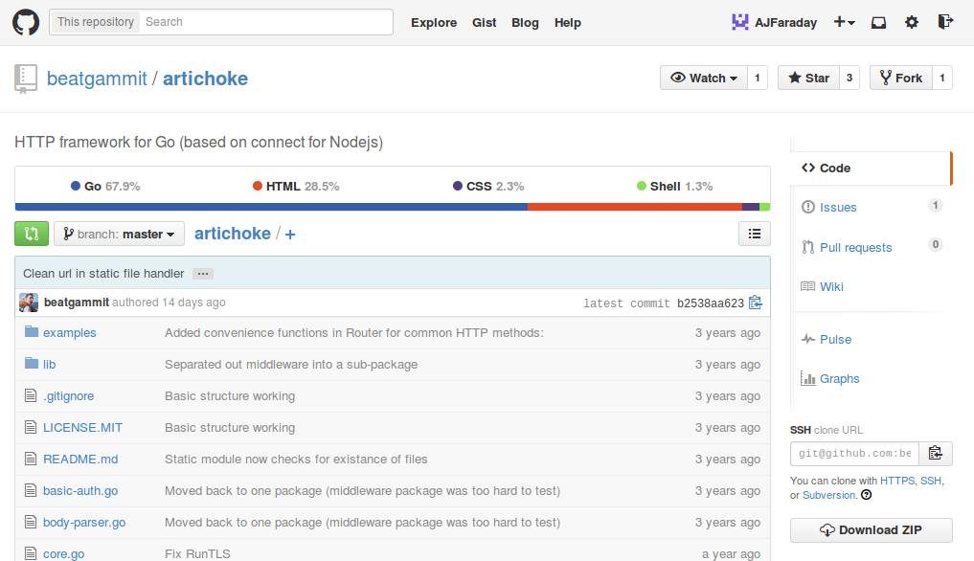
Library Name
Artichoke?
Andrew Faraday
@MarmiteJunction
Andrewfaraday.com

Slide 5
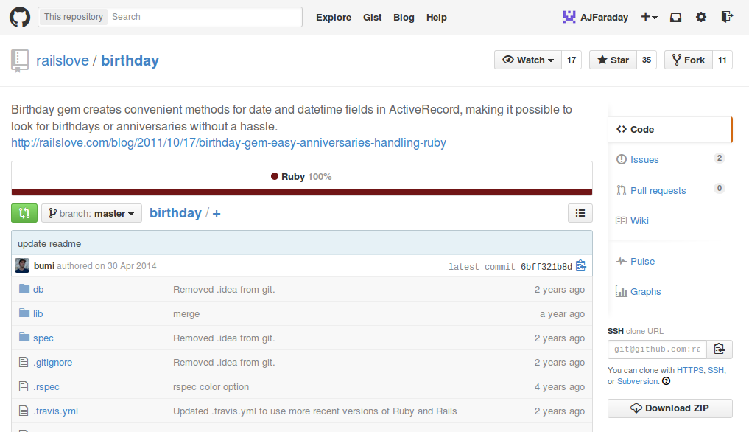
Library Name
Birthday?
Andrew Faraday
@MarmiteJunction
Andrewfaraday.com

Slide 6
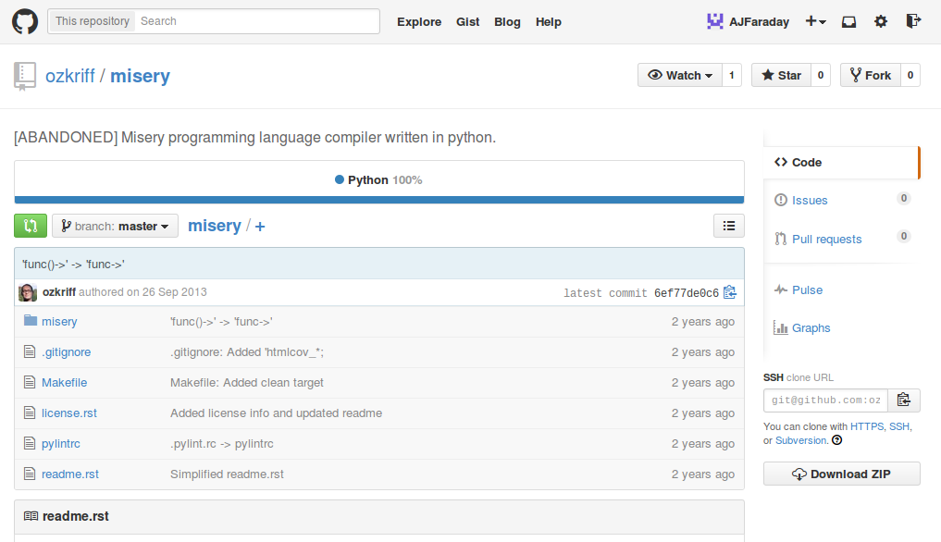
Library Name
Misery?
Andrew Faraday
@MarmiteJunction
Andrewfaraday.com

Slide 7
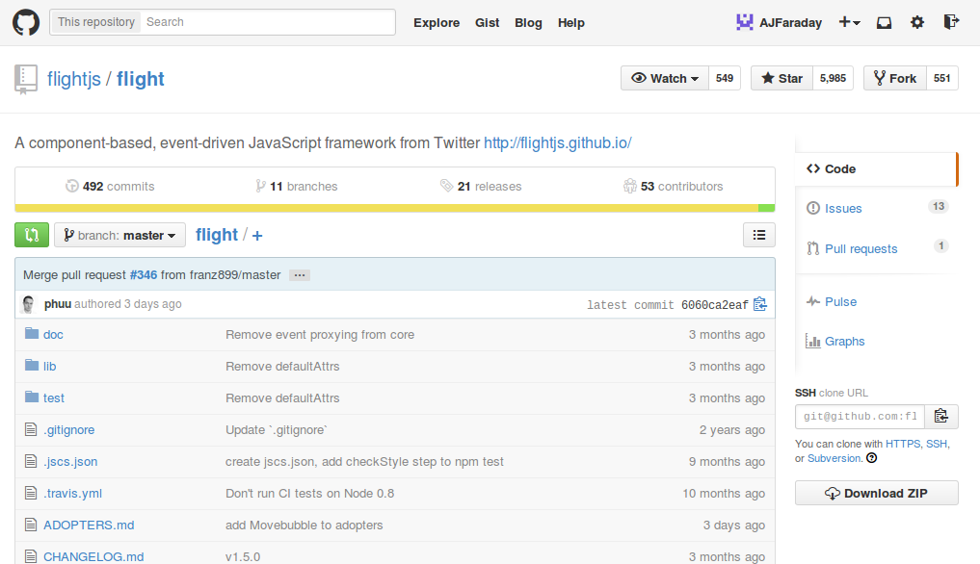
Library Name
Flying?
Andrew Faraday
@MarmiteJunction
Andrewfaraday.com

Slide 8
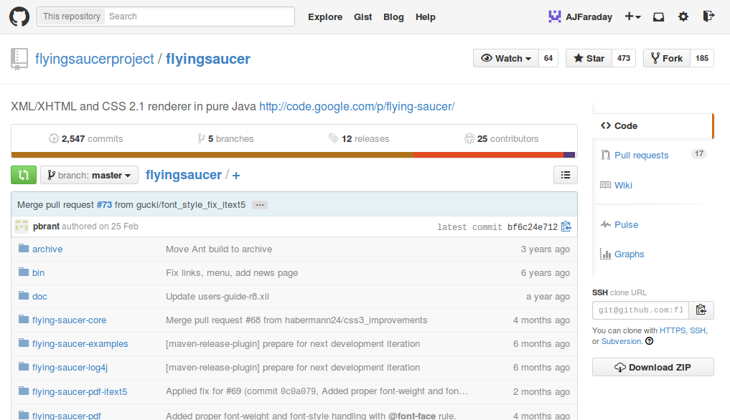
Library Name
Flying?
Andrew Faraday
@MarmiteJunction
Andrewfaraday.com

Slide 9
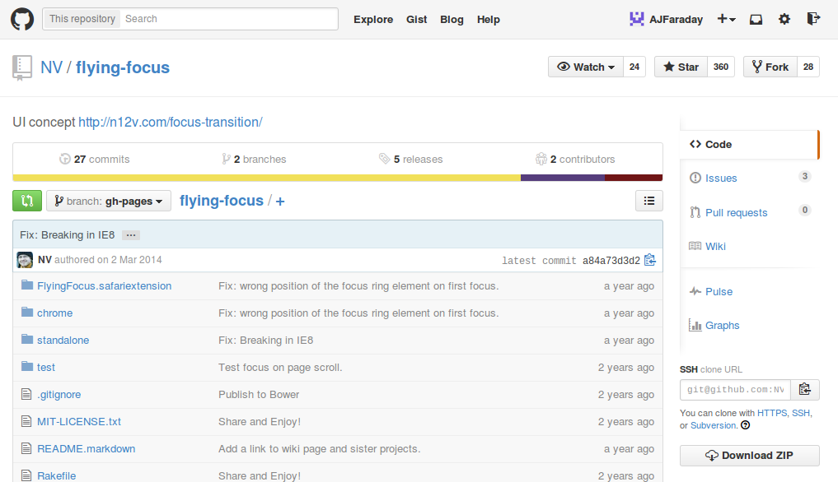
Library Name
Flying?
Andrew Faraday
@MarmiteJunction
Andrewfaraday.com

Slide 10
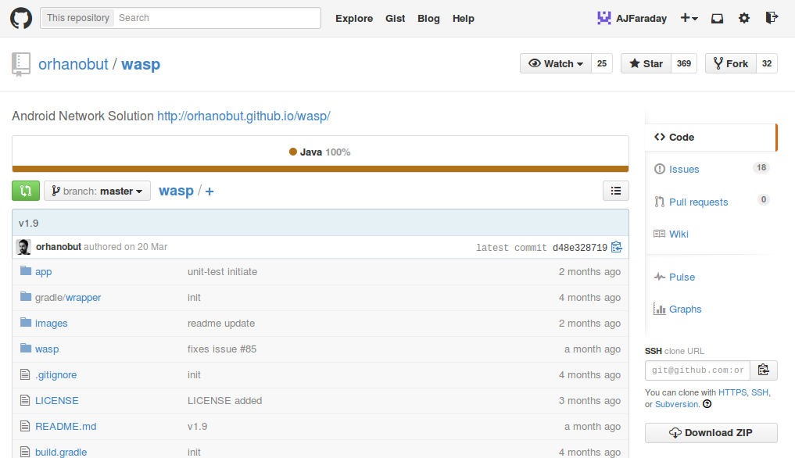
Library Name
Wasp?
Andrew Faraday
@MarmiteJunction
Andrewfaraday.com

Slide 11
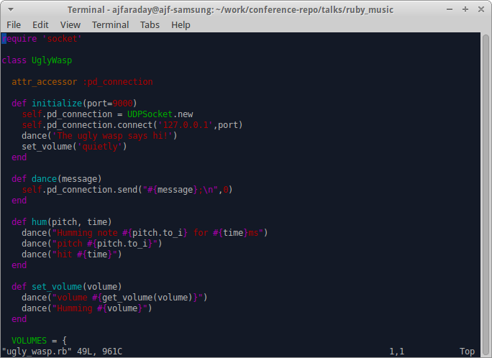
UglyWasp
Andrew Faraday
@MarmiteJunction
Andrewfaraday.com

Slide 12
The moral of the story?
Don't read too much
into your library name!
Andrew Faraday
@MarmiteJunction
Andrewfaraday.com

Slide 13
So what do you use this for?
Andrew Faraday
@MarmiteJunction
Andrewfaraday.com

