Slide 1
S
M
I
F
F
Music
Andrew Faraday
@MarmiteJuntction

Slide 2
Social
Media
Inter-
Face
For
Music
Andrew Faraday
@MarmiteJuntction

Slide 3
I'm Not
Andrew Faraday
@MarmiteJuntction

Slide 4

Andrew Faraday
@MarmiteJuntction

Slide 5
So what is SMIFF?
An experiment in collaborative music
Many users can send messages to modify a piece of music in real time. The resulting music is distributed to all browsers using SMIFF, where it can be reproduced.
End result: The internet makes music together
Andrew Faraday
@MarmiteJuntction

Slide 6
So what is SMIFF?
Ruby on Rails – pushing data around
Regex – parsing messages
Javascript – making audio happen
Andrew Faraday
@MarmiteJuntction

Slide 7
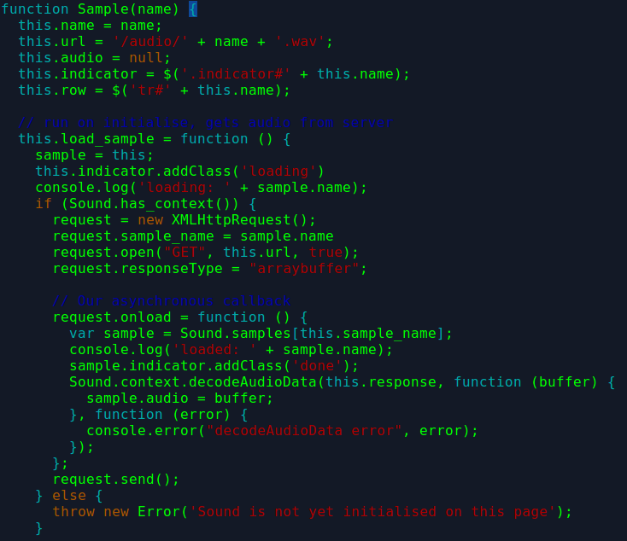
One-shot samples
Andrew Faraday
@MarmiteJuntction

Slide 8
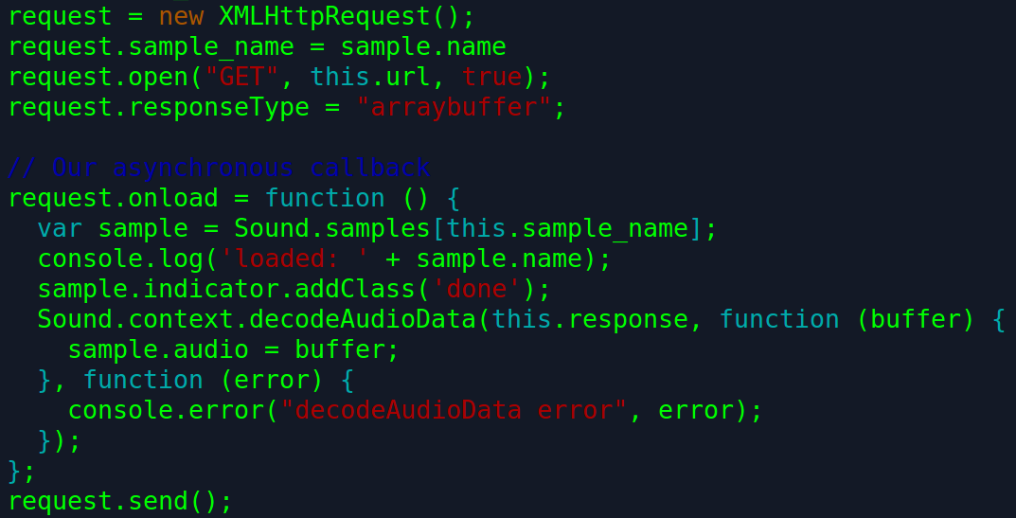
One-shot samples
Andrew Faraday
@MarmiteJuntction

Slide 9
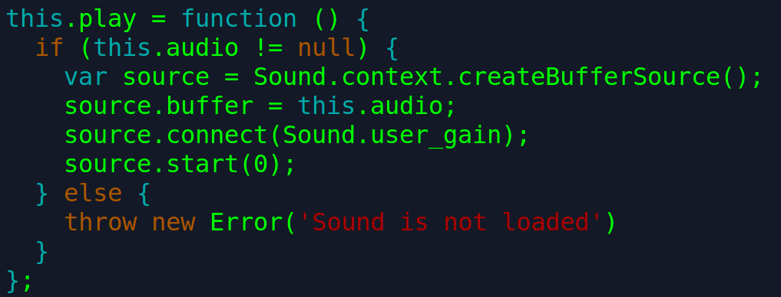
One-shot samples
Andrew Faraday
@MarmiteJuntction

Slide 10
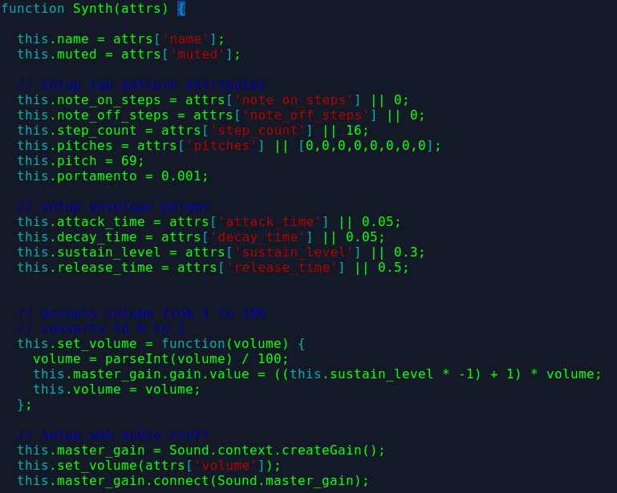
Synth
Andrew Faraday
@MarmiteJuntction

Slide 11
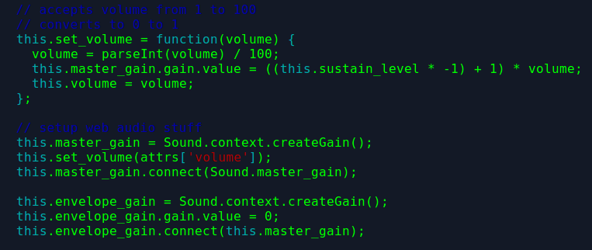
Synth
Andrew Faraday
@MarmiteJuntction

Slide 12
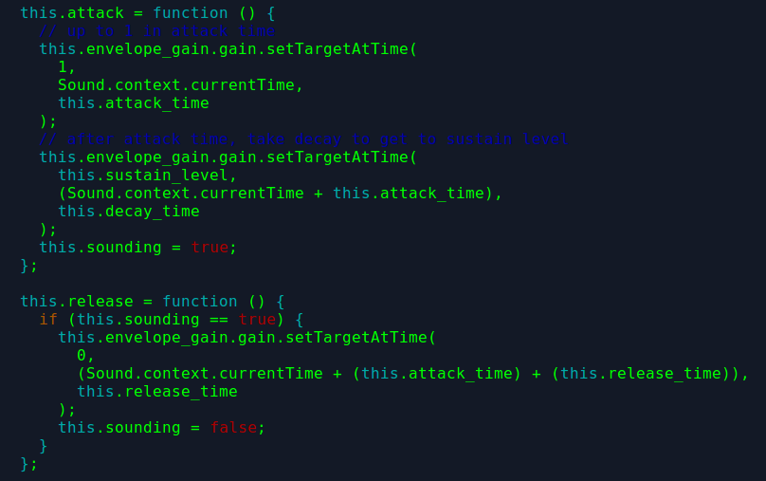
Synth
Andrew Faraday
@MarmiteJuntction

Slide 13
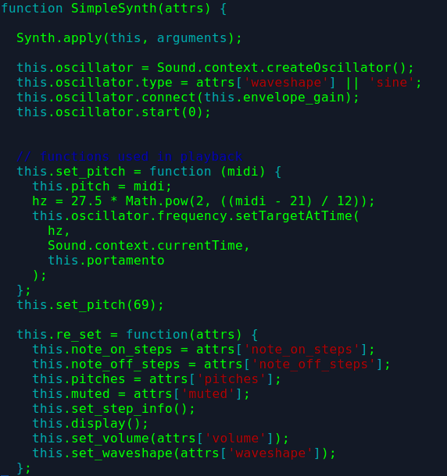
SimpleSynth
Andrew Faraday
@MarmiteJuntction

Slide 14
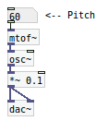
SimpleSynth
Andrew Faraday
@MarmiteJuntction

Slide 15
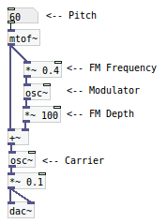
FmSynth
Andrew Faraday
@MarmiteJuntction

Slide 16
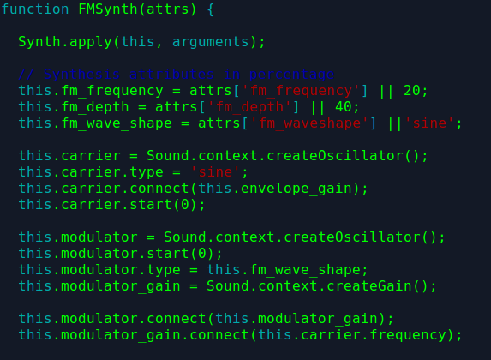
FmSynth
Andrew Faraday
@MarmiteJuntction

Slide 17
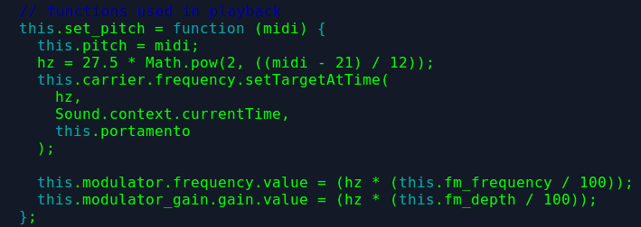
FmSynth
Andrew Faraday
@MarmiteJuntction

Slide 18
Have a go?
Drums:
play kick on step 1
play snare on steps 5, 13, 21, 29
play hihat on steps 1 to 32 skipping 3
Synths:
set synth to trevor
play c4 on step 1
play c4, d4, e4, f#4, g4 on step 17
do not play f#4 on trevor
do not play kick on step 1
mute hihat
play crash on steps 1 to 32
clear crash
set note length to 1
describe trevor
list parameters for trevor
set trevor volume to 20
set trevor fm_frequency to 10
Andrew Faraday
@MarmiteJuntction

Slide 19
That's all, folks!
smiff-music.andrewfaraday.com
www.github.com/ajfaraday/smiff_music
developer.mozilla.org/en-US/docs/Web/API
www.github.com/aduth/correctingInterval
Andrew Faraday
@MarmiteJuntction

