Slide 1


There once was a man from Dunoon
Who used to eat soup with a fork
The swordfish fly
Across the sky
There's thousands of melting clorks
@MarmiteJunction

Slide 2
@MarmiteJunction

Slide 3
@MarmiteJunction

Slide 4
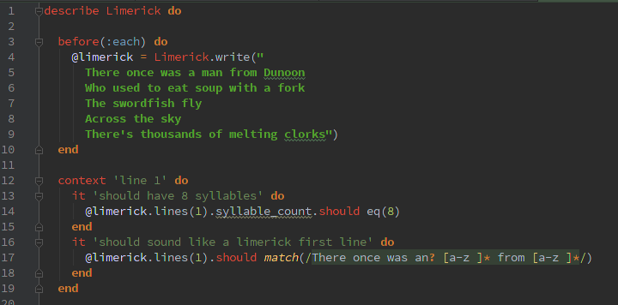

@MarmiteJunction

Slide 5


There once was a man from Dunoon
Who used to eat soup with a fork
@MarmiteJunction

Slide 6

There once was a man from Dunoon
Who used to eat soup with a fork
@MarmiteJunction

Slide 7
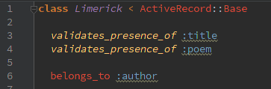


Across the sky
The swordfish fly
DRY?
@MarmiteJunction

Slide 8


@MarmiteJunction

Slide 9
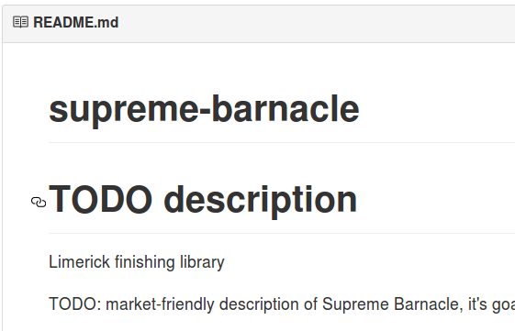
Clorks
@MarmiteJunction

Slide 10

@MarmiteJunction

Slide 11

@MarmiteJunction

Slide 12

Thousands of melting Clorks
@MarmiteJunction

Slide 13
There once was a man from Dunoon
Who used to eat soup with a fork
The swordfish fly
Across the sky
There's thousands of melting clorks
@MarmiteJunction

Slide 14
The customer didn't
ask for a Rails app
They wanted a
web-based application
@MarmiteJunction

Slide 15

@MarmiteJunction

Slide 16
There once was a man from Dunoon
Who used to eat soup with a fork
The swordfish fly
Across the sky
There's thousands of melting clorks
@MarmiteJunction

Slide 17
There once was a man from Dunoon
Who used to eat soup with a fork
The swordfish fly
Across the sky
There's thousands of melting clorks
@MarmiteJunction

Slide 18
There once was a man from Dunoon
Who used to eat soup with a fork
The swordfish fly
Across the sky
There's thousands of melting clorks
@MarmiteJunction

Slide 19
- There once was a man from Dunoon
+ There once was a panther from Cork
Who used to eat soup with a fork
The swordfish fly
Across the sky
@MarmiteJunction

Slide 20
- There once was a man from Dunoon
+ There once was a panther from Cork
Who used to eat soup with a fork
The swordfish fly
Across the sky
- there's thousands of melting clorks
+ and the chicken was outlined in chalk
@MarmiteJunction

Slide 21

There once was a panther from Cork
Who used to eat soup with a fork
The swordfish fly
Across the sky
and the chicken was outlined in chalk
@MarmiteJunction

Slide 22

What's all this got to
do with software development?
@MarmiteJunction

