Slide 1
JSON

Slide 2
SOAP vs. REST
So far we have talked about SOAP as the web service transport
Still works
Not going away
You can pick and choose when to use SOAP and when to use REST

Slide 3
What is REST
Representational State Transfer
Each unique URL is a representation of some object
REST is an architectural style that can be summed up as four verbs (GET, POST, PUT, and DELETE from HTTP 1.1) and the nouns, which are the resources available on the network (referenced in the URI).
How the web operates
Not tied to XML
Tied to HTTP transport (SOAP can use others)

Slide 4
Why use REST?
Lightweight - not a lot of extra xml markup
Tends to be easier to program
No toolkits required
Closer to the style of the web
Easier to use in Javascript

Slide 5
Why use SOAP?
Rigid - type checking, adheres to a contract
Development tools
Of course SOAP needs them
More robust
Better security features
Transactions

Slide 6
What is JSON?
JavaScript Object Notation
JSON (JavaScript Object Notation) is a lightweight data-interchange format. It is easy for humans to read and write. It is easy for machines to parse and generate. It is based on a subset of the JavaScript Programming Language, Standard ECMA-262 3rd Edition - December 1999. JSON is a text format that is completely language independent but uses conventions that are familiar to programmers of the C-family of languages, including C, C++, C#, Java, JavaScript, Perl, Python, and many others. These properties make JSON an ideal data-interchange language.
From http://www.json.org

Slide 7
Why use JSON instead of XML?
JSON is more closer to being a HashMap as in java or an associative array in some other languages like PHP.
It does not require parsing libraries in an application like XML does.
If you’re writing JavaScript in a web browser, JSON is a natural fit. The XML APIs in the browser are comparitively clumsy and the natural mapping from JavaScript objects to JSON eliminates the serialization issues that arise if you’re careless with XML.
JSON is a subset of JavaScript
XML is more complex than JSON
It is easier for programmers to use JSON
JSON can take almost half of the bandwidth as XML for transferring the same data
XML is document-oriented and JSON is data-oriented

Slide 8
Why use XML instead of JSON?
For complex data, the structure of XML is better than the array structure of JSON
With XML you can define Schemas
You can validate XML structures
You can extend existing document structures
Using Xpath, you can change an XML document and things will still work

Slide 9
JSON Syntax
JSON is built on two things:
A collection of name/value pairs. In various languages, this is realized as an object, record, struct, dictionary, hash table, keyed list, or associative array.
An ordered list of values. In most languages, this is realized as an array, vector, list, or sequence.

Slide 10
Sample JSON File
{ "menu": "File",
"commands": [
{ "title": "New",
"action":"CreateDoc“
},
{ "title": "Open",
"action": "OpenDoc"
},
{ "title": "Close",
"action": "CloseDoc"
}
]
}

Slide 11
Equivalent XML File
<?xml version="1.0" ?>
<root>
<menu>File</menu>
<commands>
<item>
<title>New</title>
<action>CreateDoc</action>
</item>
<item>
<title>Open</title>
<action>OpenDoc</action>
</item>
<item>
<title>Close</title>
<action>CloseDoc</action>
</item>
</commands>
</root>

Slide 12
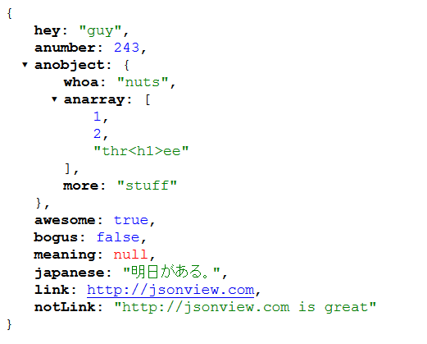
How can you see JSON easily?
There are a lot of browser extensions
You can pick your own for whatever browser you want to use
JSONView

Slide 13
Getting JSON
All you need to do is use the eval method in JavaScript
var myObject = eval('(' + myJSONtext + ')');
Note the parenthesis
This may be needed, it eliminates any javascript parsing issues
There are issues using eval
Eval runs whatever is passed to it
You could have malicious code
Not an issue if you trust the source
When in doubt, you should use a JSON parser
There are open source parsers
Later versions of browsers will have native JSON support
var myObj = JSON.parse(xmlhttp.responseText);

Slide 14
Calling web services via Javascript
Use the XMLHttpRequest object
XMLHttpRequest if you can
Microsoft.XMLHTTP if you can’t
Primarily for older browsers – you won’t need this for IE8
var xmlhttp = null; xmlhttp = new XMLHttpRequest();
Use the HTTP Get function
xmlhttp.open('GET', url, true);
Could use a post
The third parameter is whether this is a asynchronous call
Send the request
xmlhttp.send(null);

Slide 15
Calling web services via JavaScript
If you don’t do it right, you will have a synchronous call
User’s won’t like waiting with no indication that things are working
That’s where AJAX comes in
You need to create a callback
A callback method allows the webserver to callback into your code

Slide 16
Creating a callback method
Use xmlhttp’s onreadystatechange property
Set it to a function or create a function inline
xmlhttp.onreadystatechange = function() { alert(‘I am here’);
xmlhttp.onreadystatechange = updatePage;
Now create an updatePage function

Slide 17
HTTP ready states
When the callback happens, you want to make sure that everything is completed
The way to do it is via the readystate property
0 – request is unitialized
1 – request is set up, but hasn’t been sent (i.e. send method hasn’t been called)
2 – request was sent and is being processed
3 – request is being processed – some data has been received
You can’t access it yet
4 – request is complete

Slide 18
XMLHttp status code
This is the HTTP status code from the server
The one you care about is 200
Status is ok
Others you may want to check
400 – Bad Request
403 – Forbidden
404 – Not Found
500 – Internal Server Error
502 – Bad Gateway
503 – Service Unavailable
504 – Gateway Timeout

Slide 19
The callback code
xmlhttp.onreadystatechange = function() {
if (xmlhttp.readyState == 4 && xmlhttp.status == 200) {
var myObj = eval('(' + xmlhttp.responseText + ')'); } else {
// waiting for the call to complete
}
};
// The weird syntax on responseText is to make sure it parses correctly

Slide 20
Debugging Javascript via HTML pages
You need to enable script debugging in Internet Explorer
To force a stop you put the following line in your Javascript
debugger;

Slide 21
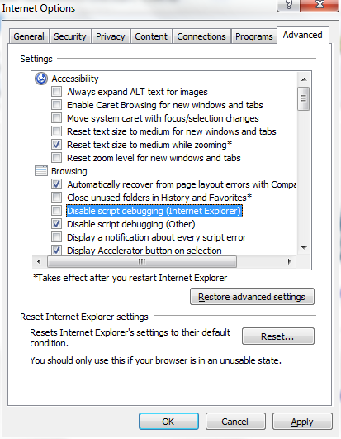

Slide 22
Writing Javascript back to the HTML page
Option 1
Use the document.write method
In this case, you are responsible for writing the HTML page that appears
No point creating any HTML markup on the page itself, it will be overwritten by document.write

Slide 23
Writing Javascript back to the HTML page
Option 2
Attach to the form objects and change their values
Add an HTML Form to the body of the document and set the Name attribute
Add form elements (textbox, etc.) to the form and set the Name attribute
In your javascript code, set the value of the form element via
Formname.Formelementname.value = “40”
document.MainForm.distance.value = myObj.route.distance;

Slide 24
Writing Javascript back to the HTML page
Option 3
Create an array and push things onto it
var html = []; html.push(‘test‘); document.getElementById("results").innerHTML = html.join("");
// results is an HTML div
<div id="results">
The push() method adds new elements to the end of an array, and returns the new length.
The join(separator) method joins all elements of an array into a string, and returns the string.
separator Optional. The separator to be used. If omitted, the elements are separated with a comma

Slide 25
How to stop the annoying Internet Explorer restricted this page

Slide 26
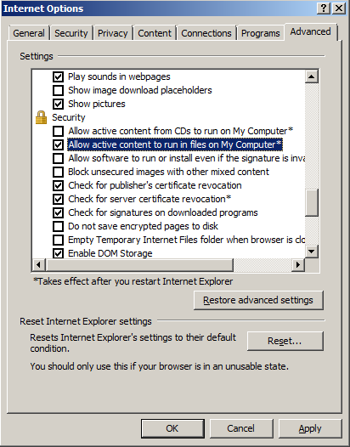

Slide 27
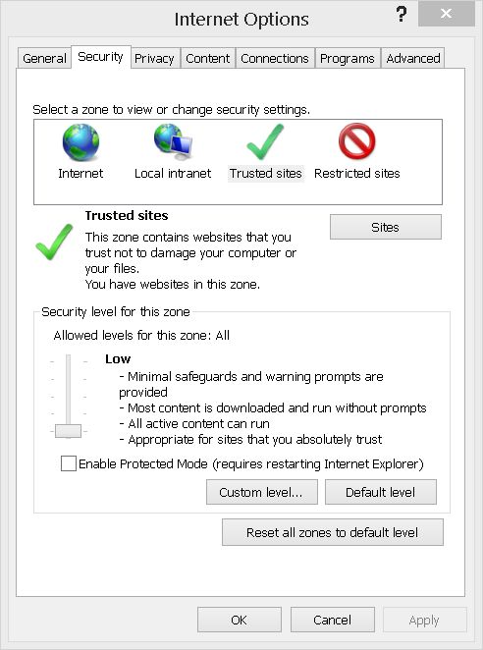
How do you get active content to run on HTML from Visual Studio
Add this website to the trusted sites and drop security down
Or run from Windows Explorer

