Slide 1

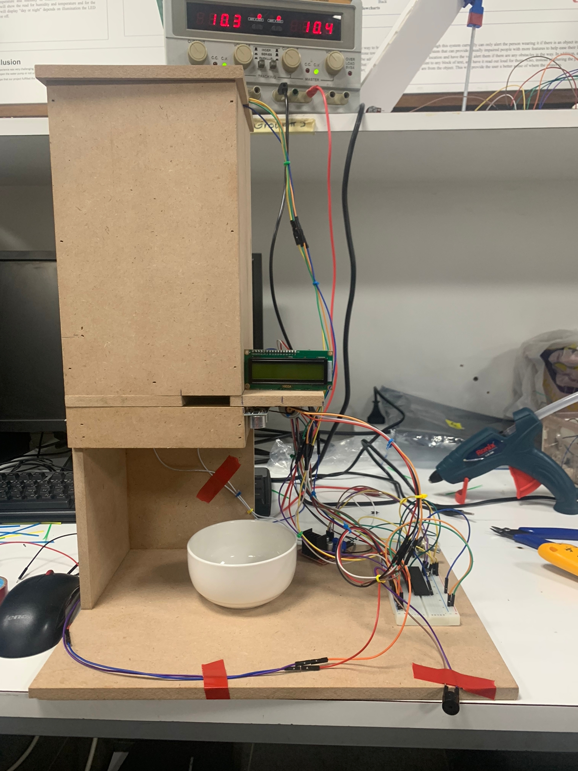
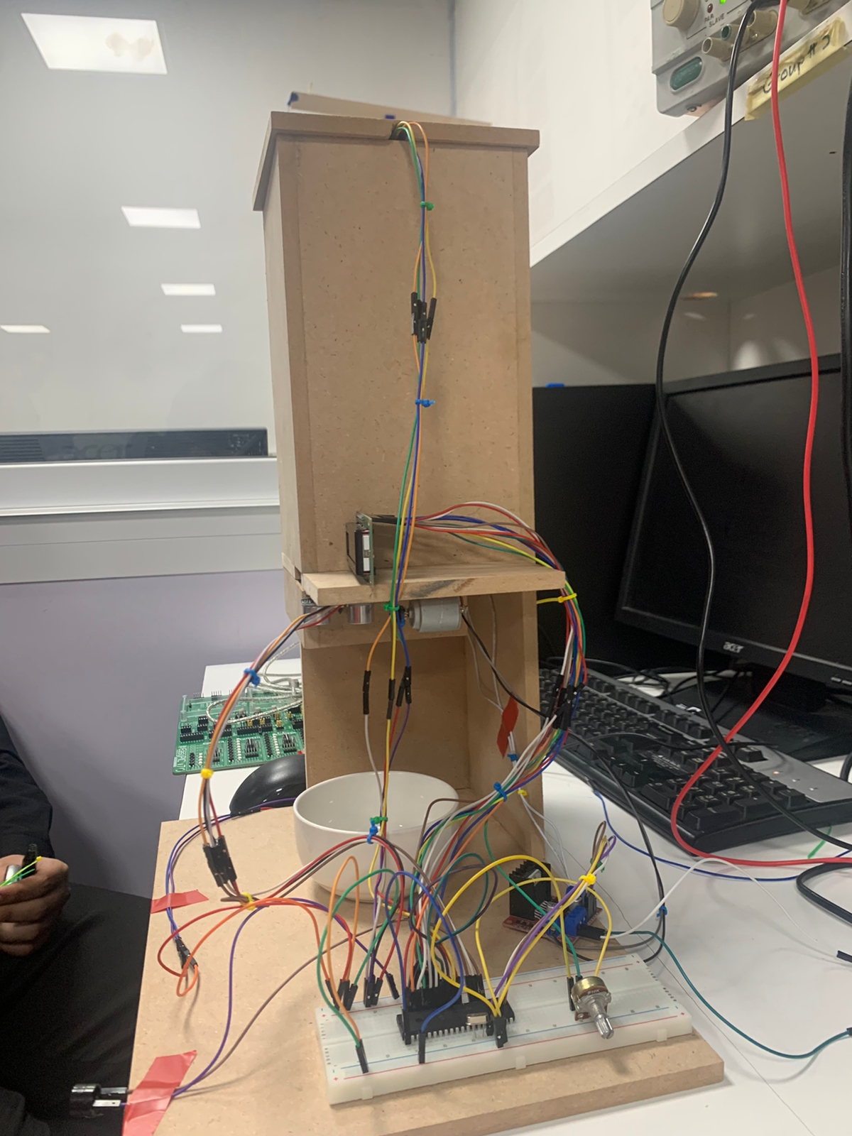
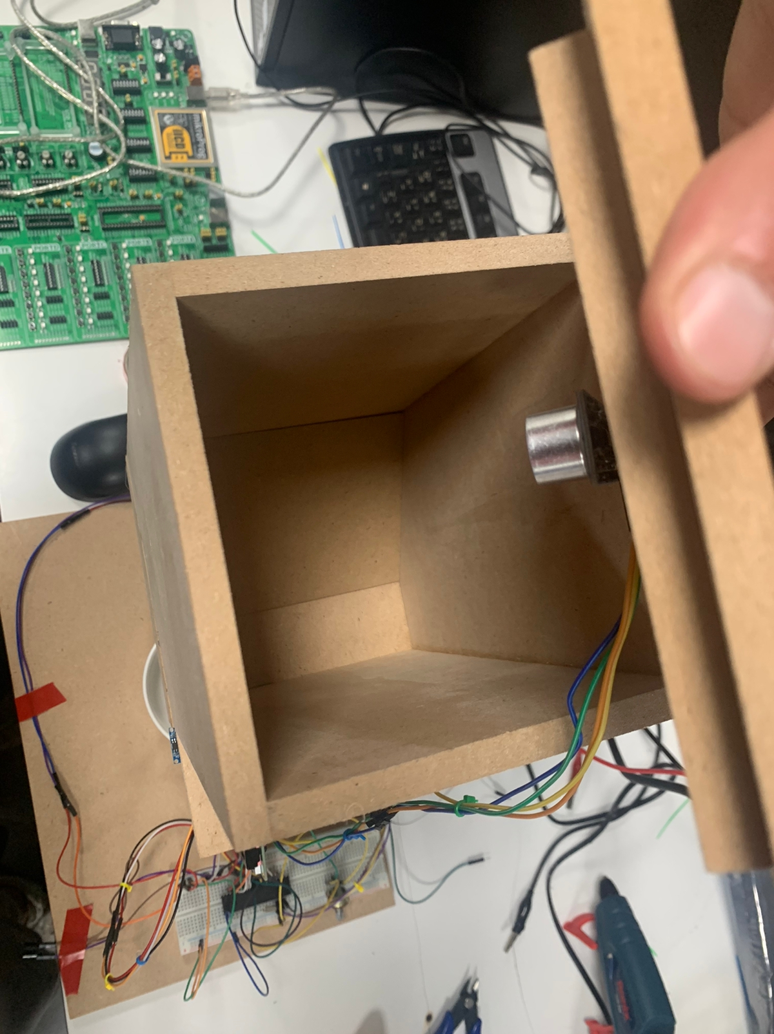
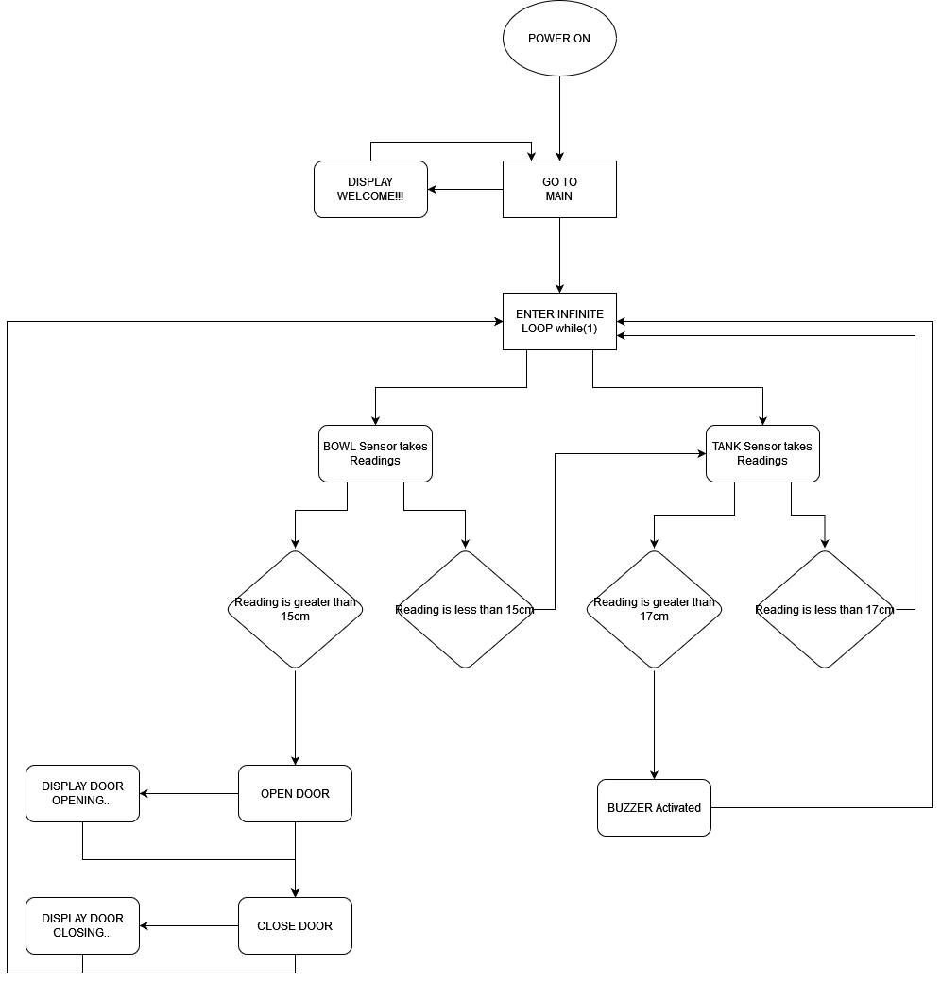
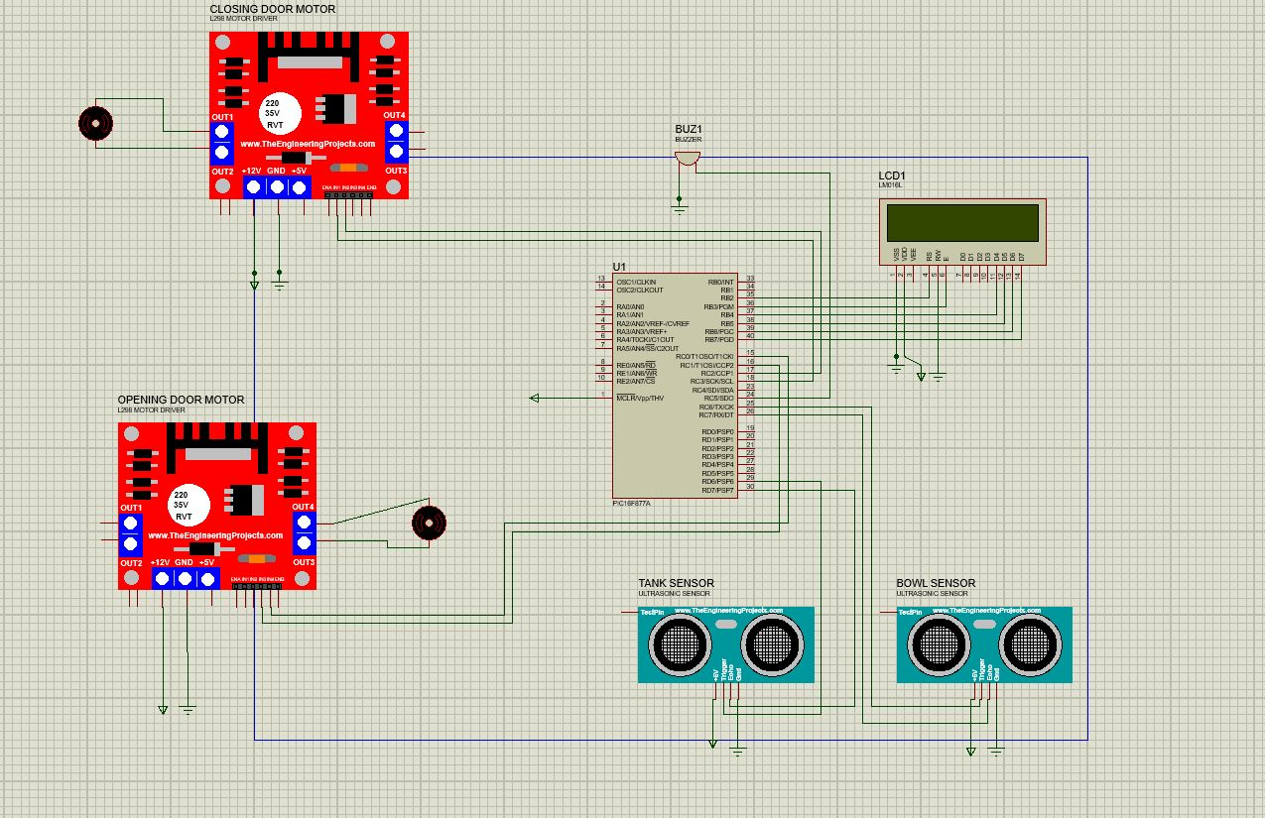
Pet Feeder Dispenser
O.AlAbdallah, A.AbuGhali, T.Morrar
Supervisor: Dr. Belal Sababha
Embedded Systems Final Design Project, Fall 2023
King Abdullah II School of Engineering
Princess Sumaya University for Technology
Introduction
This project’s purpose is to help people travel or leave their house without worrying about feeding their pets. It’s a pet feeding device that fills the bowl using a timer that you can set beforehand. The device will automatically open the door of the tank above the bowl, and drop the exact amount of food you selected using ultrasonic sensor. The ultrasonic sensor measures the distance between the top of the device and the gate that the food will be dropped from, if there is no food or is about to finish inside the tank then the ultrasonic will give us the distance between the top of the device and the gate, therefore that means the device is empty and a buzzer will ring indicating that we need to fill the tank with food.
Results
As a final result our project opens the door when the ultrasonic sensor detects that the food bowl is low or empty and opens the door to fill the bowl. As for the second ultrasonic sensor detects when the tank is almost empty and turns on the buzzer to notify us to fill the tank.
When ever the food bowl is full the door will not open until the ultrasonic sensor gives it a signal.
Figure 2
Figure 2 Figure 3
Figure 4
Figure 4
Figure 5 Electrical Design
Design
The Tank – Firstly we used a large box made of wood in which the upper part of the box is the tank where the food will be filled.
The tank is 15cm wide and 25cm long, at the top of the tank from the inside, an ultrasonic sensor is attached which will give us an indicator if the tank needs to be filled. Inside the tank at the base there is a hole which will be covered by a gate, and this gate will open only if there is low or no food, allowing the food to drop from the tank to lower part of the design. Outside the tank at the sides, we place a wood surface where we will place an LCD to make it user friendly, where the LCD will have messages such as welcome, opening, and closing.
Lower Part – The lower part of the design is an empty area where the bowl will be placed. At the top of the lower part, we placed an ultrasonic sensor that will measure if the bowl is full or need to be filled more with food.
.
Figure 1 Software Design
Conclusion
At the end of our project, we achieved our goal of designing an automated pet feeder. It’s concept what based on making it as simple as possible with no complicity. After many trials and errors, we had to make some changes on initial mechanical design where we have replaced the load cell sensor with Ultrasonic sensors, on the physical design side we used AutoCAD which helped us with visioning on what we wanted to have and made it easy for the dimensions. As for the software, our program had many changes until we have achieved what we needed in a way which we tried to keep the code as simple as possible and away from complicity, so after facing many challenges and many errors and after many trials, we reached our goal and ended up with a working pet feeder dispenser.

