Slide 1
CIS*3760 Sprint 3
Group 203

Slide 2
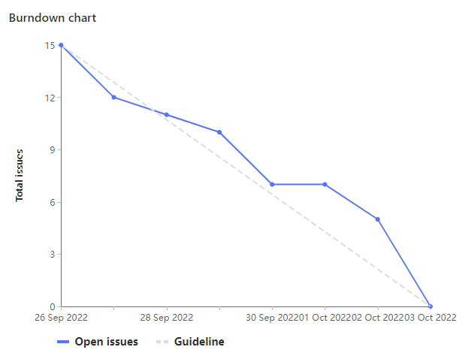

Burndown

Slide 3

Outcomes
Overall, Sprint 3 was successful. We were able to get the main schedule suggestion functionality to work on top of our original Sprint 2 features along with some additional functionality and testing through test cases and an automated CI/CD pipeline
We pair programmed a lot during this sprint. VBA doesn't have very robust development tools available for it so we relied on each other to write good code
This sprint we tried to have people who were more heavily involved in development in previous sprints take more of a backseat to give others a chance to code in VBA
Going forward, we will try to assign development tasks equally to all group members as this is always the most time consuming part of the sprint and an "all hands on deck" approach will help us meet deadlines more effectively

Slide 4
Mackenzie Kean
HIGHLIGHTS OF THE WEEK | Units Spent
CI/CD Pipeline - test automation | 4
Deciphering what makes a good schedule as we go Generate a schedule based on default constraints on UI | 2 4
Bug scanning and fixes Generate a schedule based on extra feature constraints | 2 4
Total Units Spent | 27

Slide 5
Sahejveer Singh Kumar
HIGHLIGHTS OF THE WEEK | Units Spent
Small prototype/mockup on figma for new functionality Making the excel based on the figma prototype | 2 2
Deciphering what makes a good schedule as we go Generate a schedule based on default constraints on UI | 2 4
Bug scanning and fixes Generate a schedule based on extra feature constraints | 2 4
Generate a PDF based on the generated schedule PI Planning & Attending Daily Standups | 3 3 , 4
Bug scanning and fixes Total Units Spent | 2 28

Slide 6
Alireza Sharif
HIGHLIGHTS OF THE WEEK | Units Spent
Deciphering what makes a good schedule as we go PI Planning & Attending Daily Standups | 2 3,4
Generate a schedule based on default constraints on UI Generate a schedule based on extra feature constraints | 4 4
Create Readme and Documentation | 2
Bug Scanning and Fixes | 2
 | Total: 23

Slide 7
Andrew Heft
HIGHLIGHTS OF THE WEEK​ | Units​ Spent​
Deciphering what makes a good schedule as we go​ ​ Bug Scanning and Fixes | 2​ ​ 2​
Json to CSV Test Suite VBA Test Suite | 2 ​ 3
Create Readme and Documentation​ ​ | 2 ​
PI Planning | 3​ ​ Total: 20

Slide 8
Robert Stegmann
HIGHLIGHTS OF THE WEEK | Units Spent
Deciphering what makes a good schedule as we go Generate a schedule based on default constraints on UI | 2 4
Pl Planning Bug scanning and fixes | 3 2
README | 2
Generate a schedule based on extra feature constraints | 4
Total Weight | Total: 23

Slide 9
Kyler Swanson
Highlights of the week | Time
Add time gap between meetings | 1 hour
Figma prototype Excel user input options | 1.5 hours
Test suite for json-to-csv script | 1 hour
CI/CD Test Automation Pipeline | 2 hours
Worked on ideas for suggestion flags | 1 hour
 | 26 units (13 hours)

Slide 10
Tristan Kerec
HIGHLIGHTS OF THE WEEK | Units Spent
Deciphering what makes a good schedule as we go Generate a schedule based on default constraints on UI | 2 4
Pl Planning Bug scanning and fixes | 3 2
VBA Test Suite | 3
Generate a schedule based on extra feature constraints | 4
Show meetings as ending with gap | 2 Total: 26

Slide 11
Demo

