Slide 1
Mapping the Application Usability Level (AUL) Framework to the Technology Readiness Levels (TRLs) and other Readiness Levels
A.J. Halford, A. C. Kellerman, A. G. Burrell, J. Klenzing, B. A. Carter, K. Garcia-Sage, S. Elvidge, S. Bingham

Slide 2


Technology Readiness Levels:
Will this tool, be it software or hardware, work in the space environment?
Application Readiness Levels:
Will this tool, be it software or hardware, work in the user specified environment and aid in a decision-making context.
Application Usability Levels:
Will the output of this project, be it software, hardware, data, or something else be able to provide a specific use and aid the identified user.

Slide 3



Why use a framework to track progress?
A tracking framework can ensure clear communication between developers/researchers and users about the use and current development stage of a product.

Slide 4
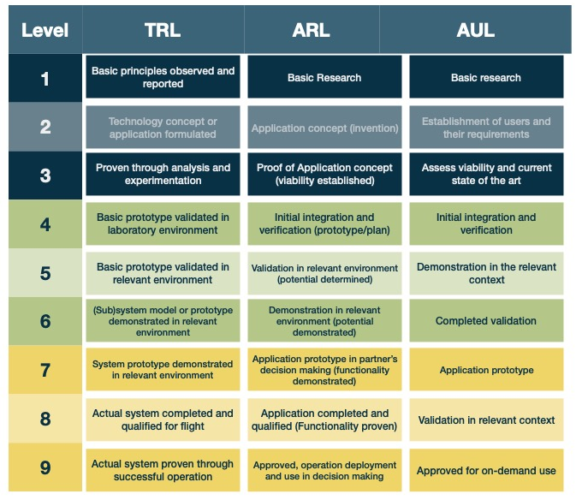
We can attempt to do a similar mapping – however there are areas without one-to- one correlation.
For example, no user is identified in the TRLs. The ARLs and AULs do not require operation in the space environment.

Slide 5
Pick the right framework: Which framework is right for you?
Unique to the AULs is that it transform the monolog of the TRLs and ARLs of the researcher/engineer about their projects progress, into a dialog with the user ensuring the products usability and want for the product upon completion

