Slide 2
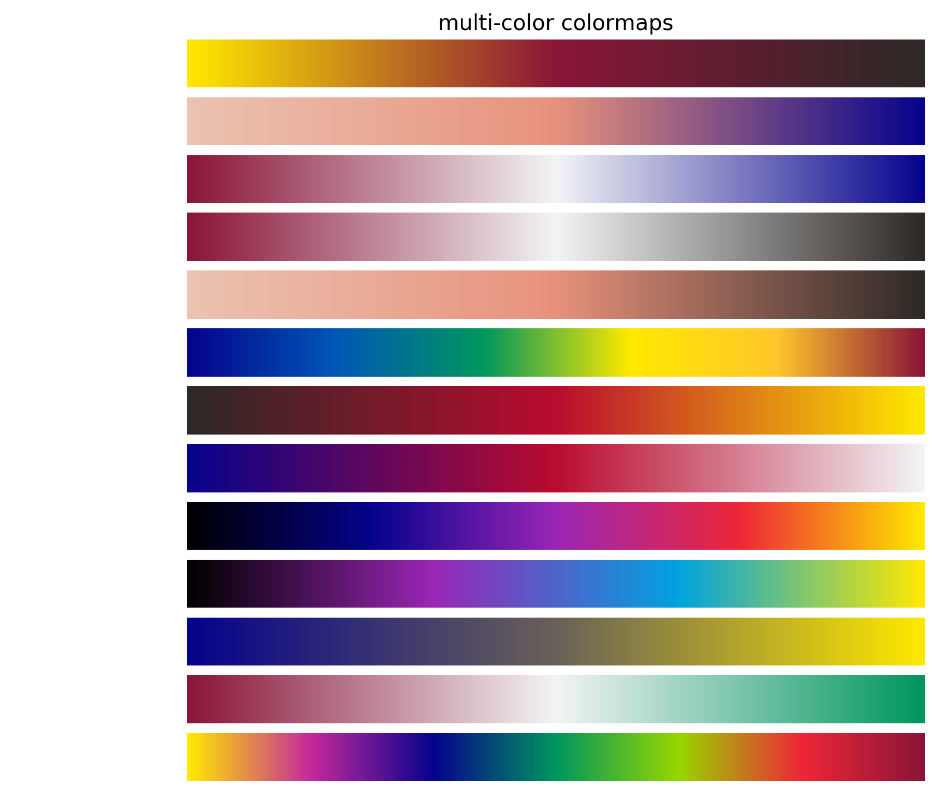
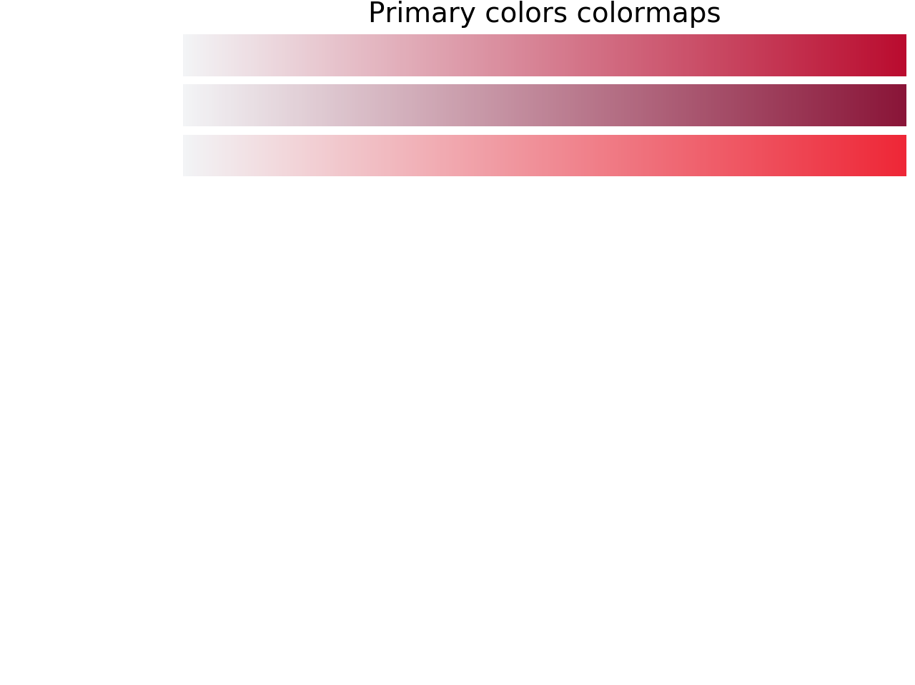
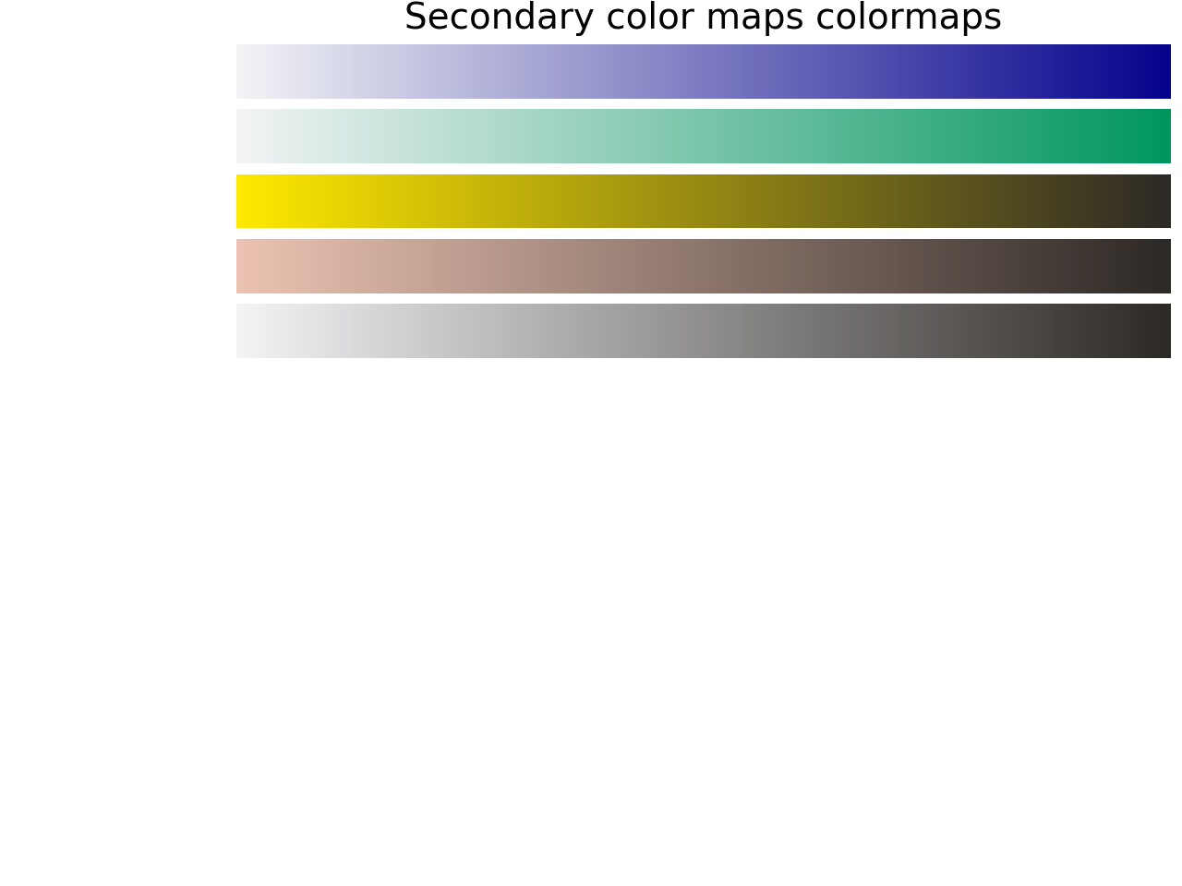
CUSIAHot
Reds
CUSIACool
Dark reds
Light reds
CUSIAdivergent
CUSIARedGrey
CUSIAneutralwgreymap
CUSIAJet
Blues
Greens
CUSIAredyellow
Yellows
CUSIAbpr
neutral
Greys
CUSIAplasma
CUSIAviridis
CUSIAcividis
CUSIAxmass
CUSIAaurora

Slide 3
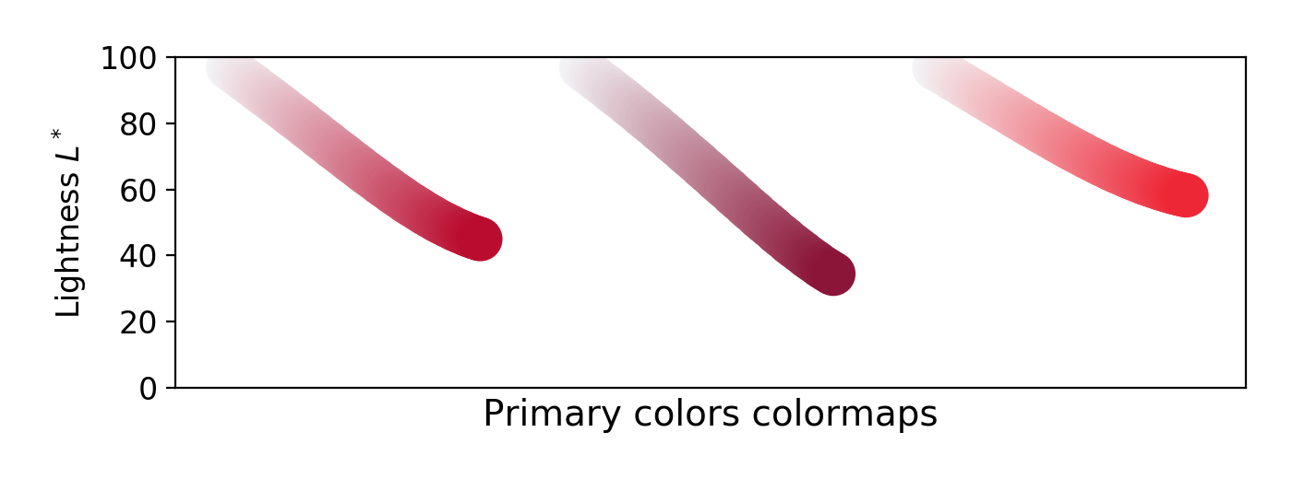
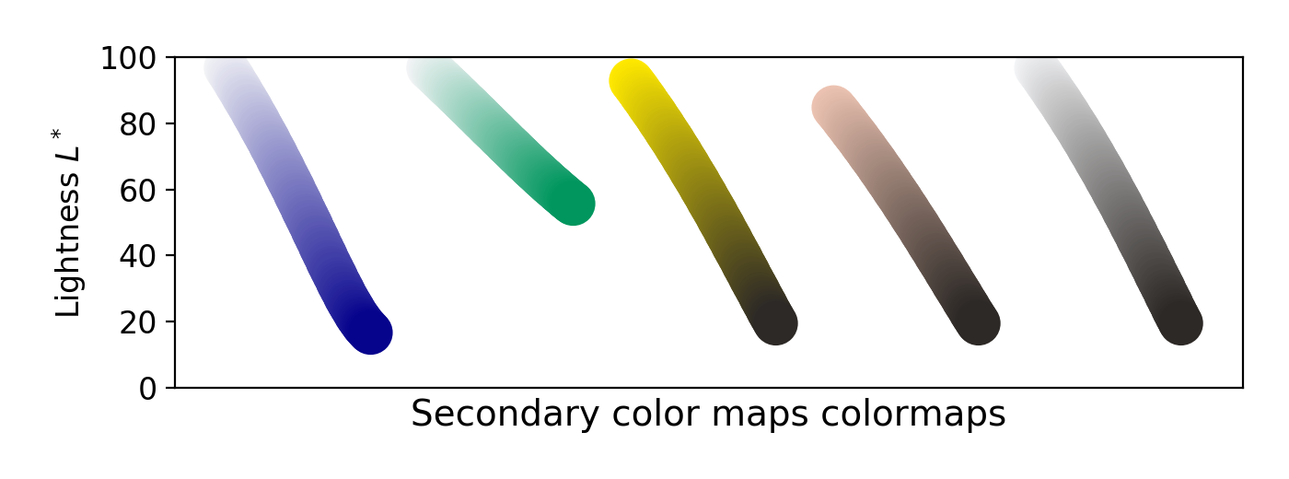
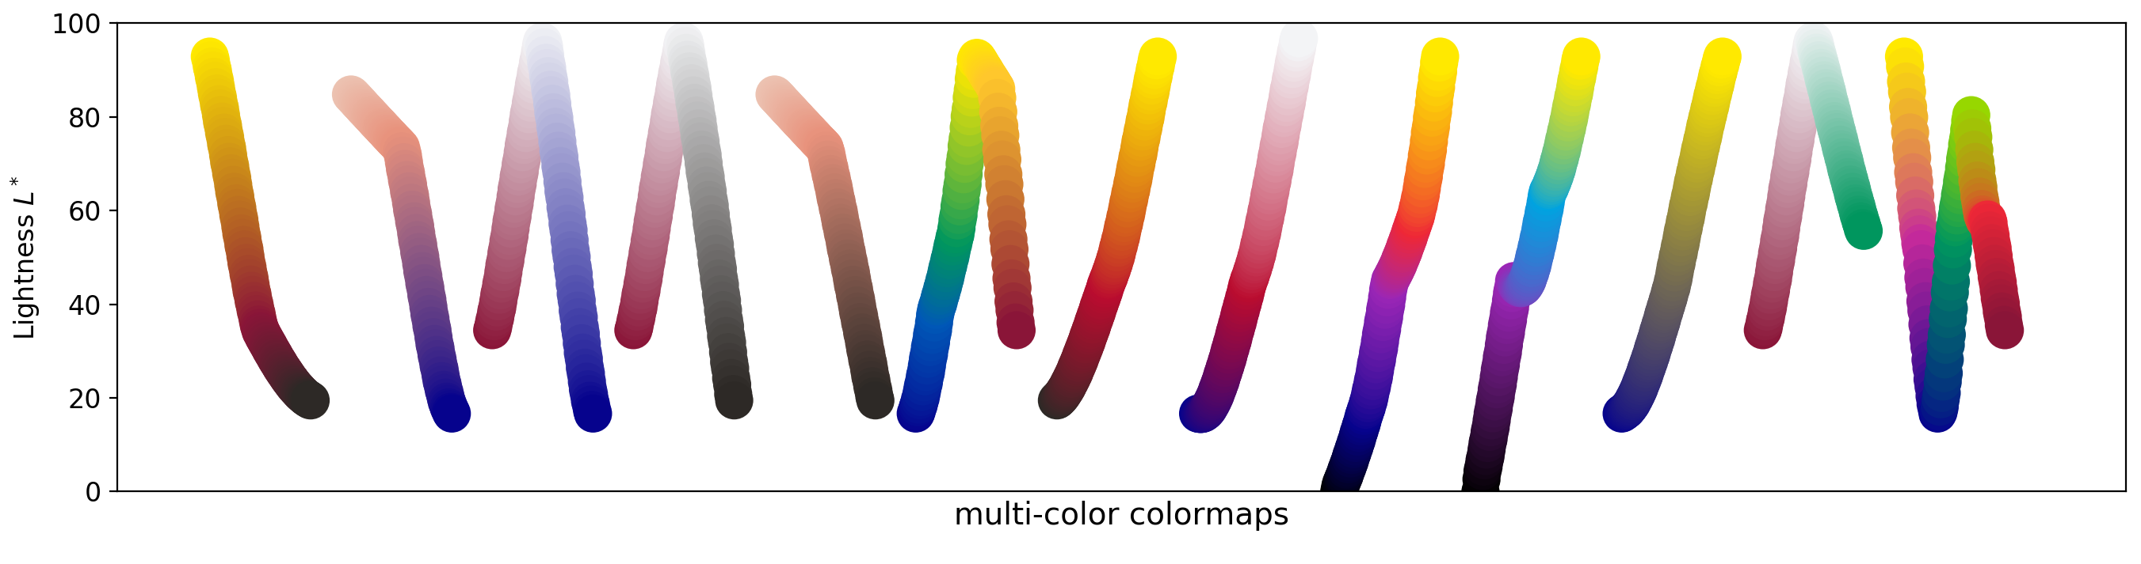
Light curves
Ideally these would be straight lines. Any bends means that there is a spot where people will see a distinction/event/point of interest where there isn’t one. And also, may have issues when considering from an accessibility point of view.

Slide 4
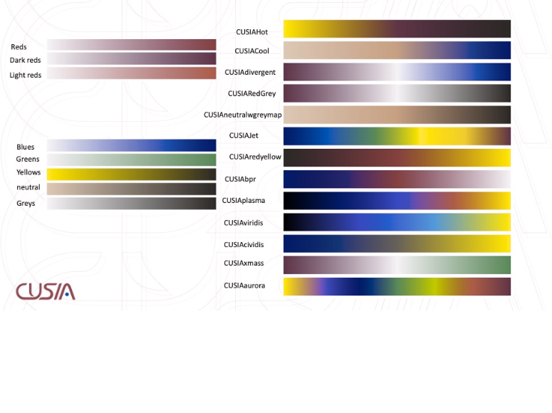
Anomalous Trichromacy: Red-Weak/Protanomaly

Slide 5

Anomalous Trichromacy: Green-Weak/Deuteranomaly

Slide 6
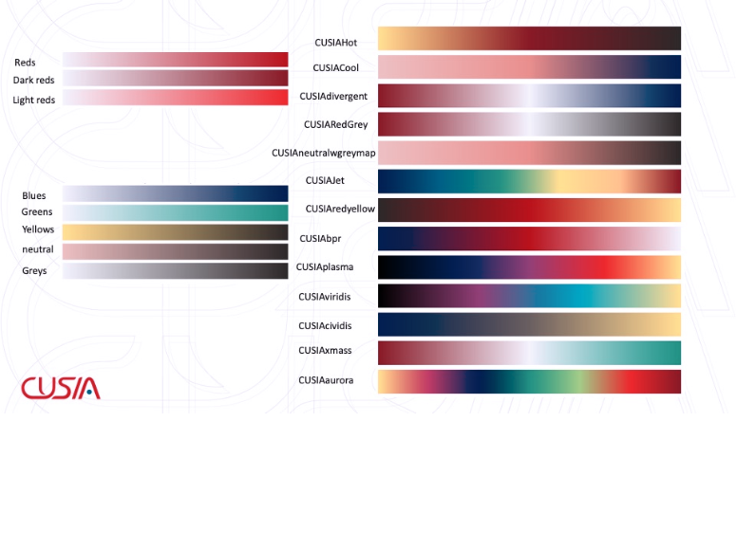
Anomalous Trichromacy: Blue-Weak/Tritanomaly

Slide 7
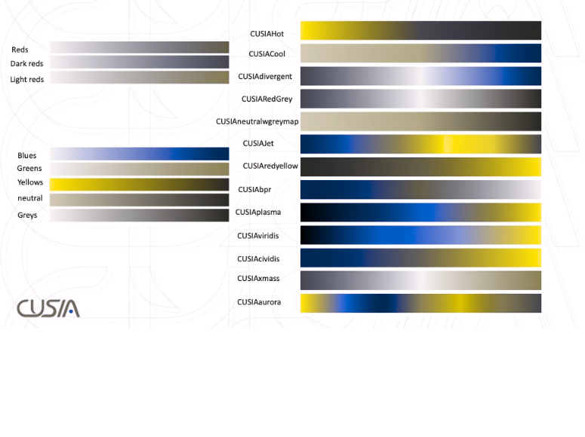
Dichromatic view: Red-Blind/Protanopia

Slide 8
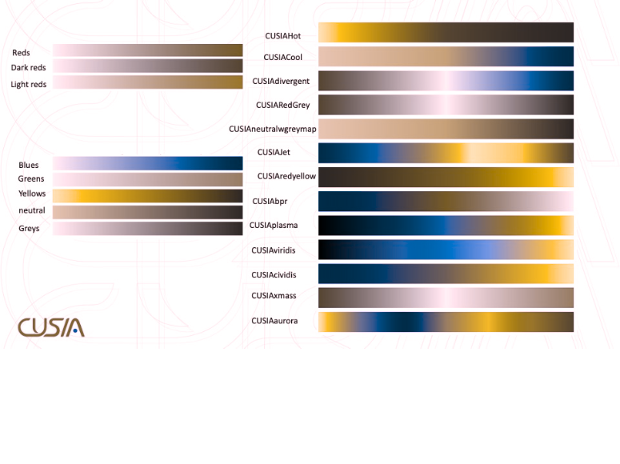
Dichromatic view: Green-Blind/Deuteranopia

Slide 9
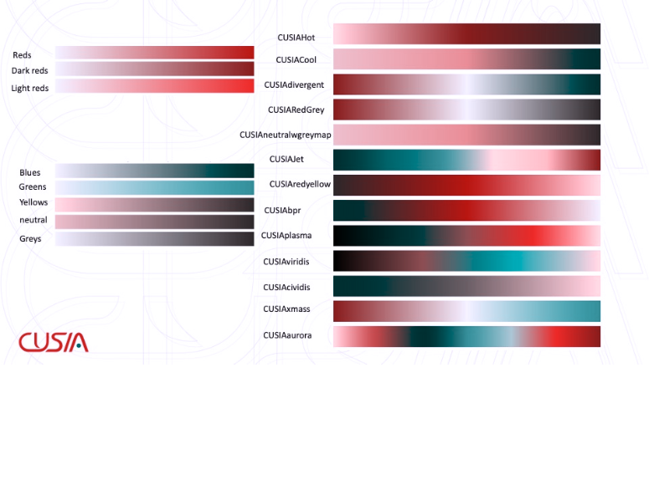
Dichromatic view: Blue-Blind/Tritanopia

Slide 10
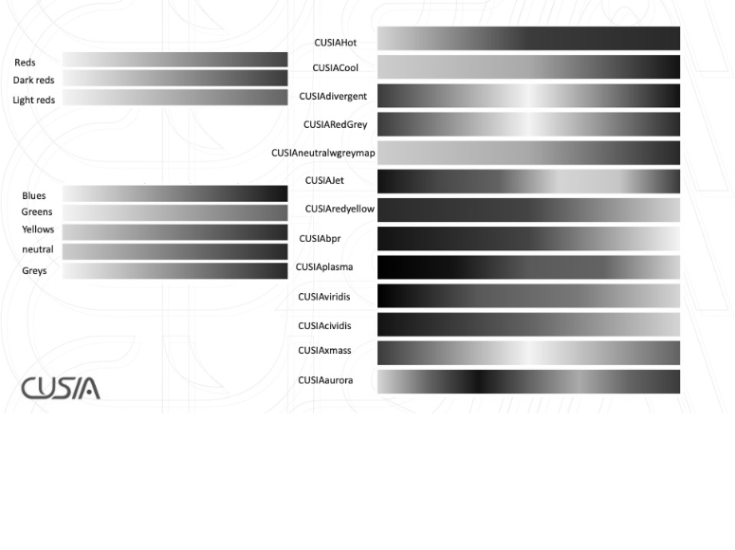
Monochromatic view: Monochromacy/Achromatopsia

Slide 11
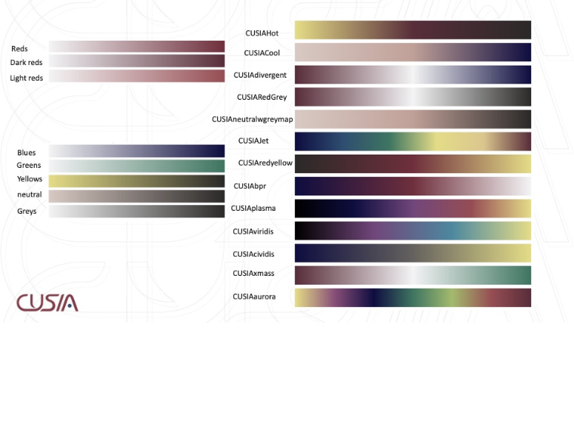
Monochromatic view: Blue Cone Monochromacy

