Slide 1
Introduction to
Git and Github –
A Hands-on Course
Class 1: Introduction to Version Control and Code Collaboration
November 14, 2016
Charles J. Lord, PE
President, Consultant, Trainer
Blue Ridge Advanced Design and Automation

Slide 2
This Week’s Agenda
11/14 Intro to Version Control and Code Collaboration
11/15 Basic Git Concepts
11/16 GitHub Hands-On, Part 1
11/17 GitHub Hands-On, Part 2
11/18 Local Clients and Other Hosts

Slide 3
This Week’s Agenda
11/14 Intro to Version Control and Code Collaboration
11/15 Basic Git Concepts
11/16 GitHub Hands-On, Part 1
11/17 GitHub Hands-On, Part 2
11/18 Local Clients and Other Hosts

Slide 4
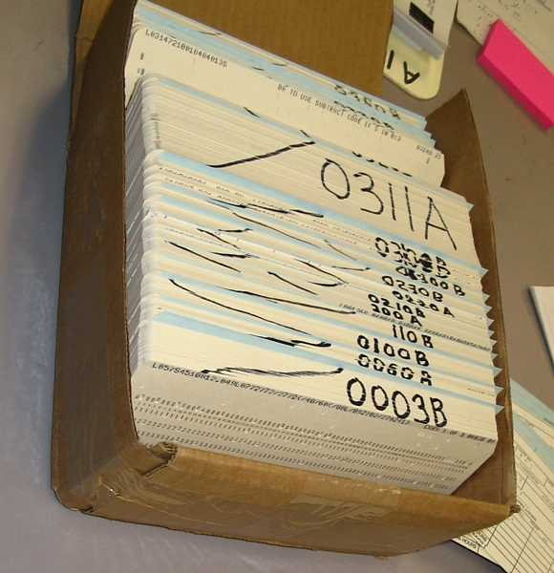
In The Beginning….
Code modules were formed by decks of punch cards
We took the same concept to text editors
Decks became text (source) files

Slide 5
The Development Path
New Version
Initial code
Next Revision
Next Revision
Next Revision

Slide 6
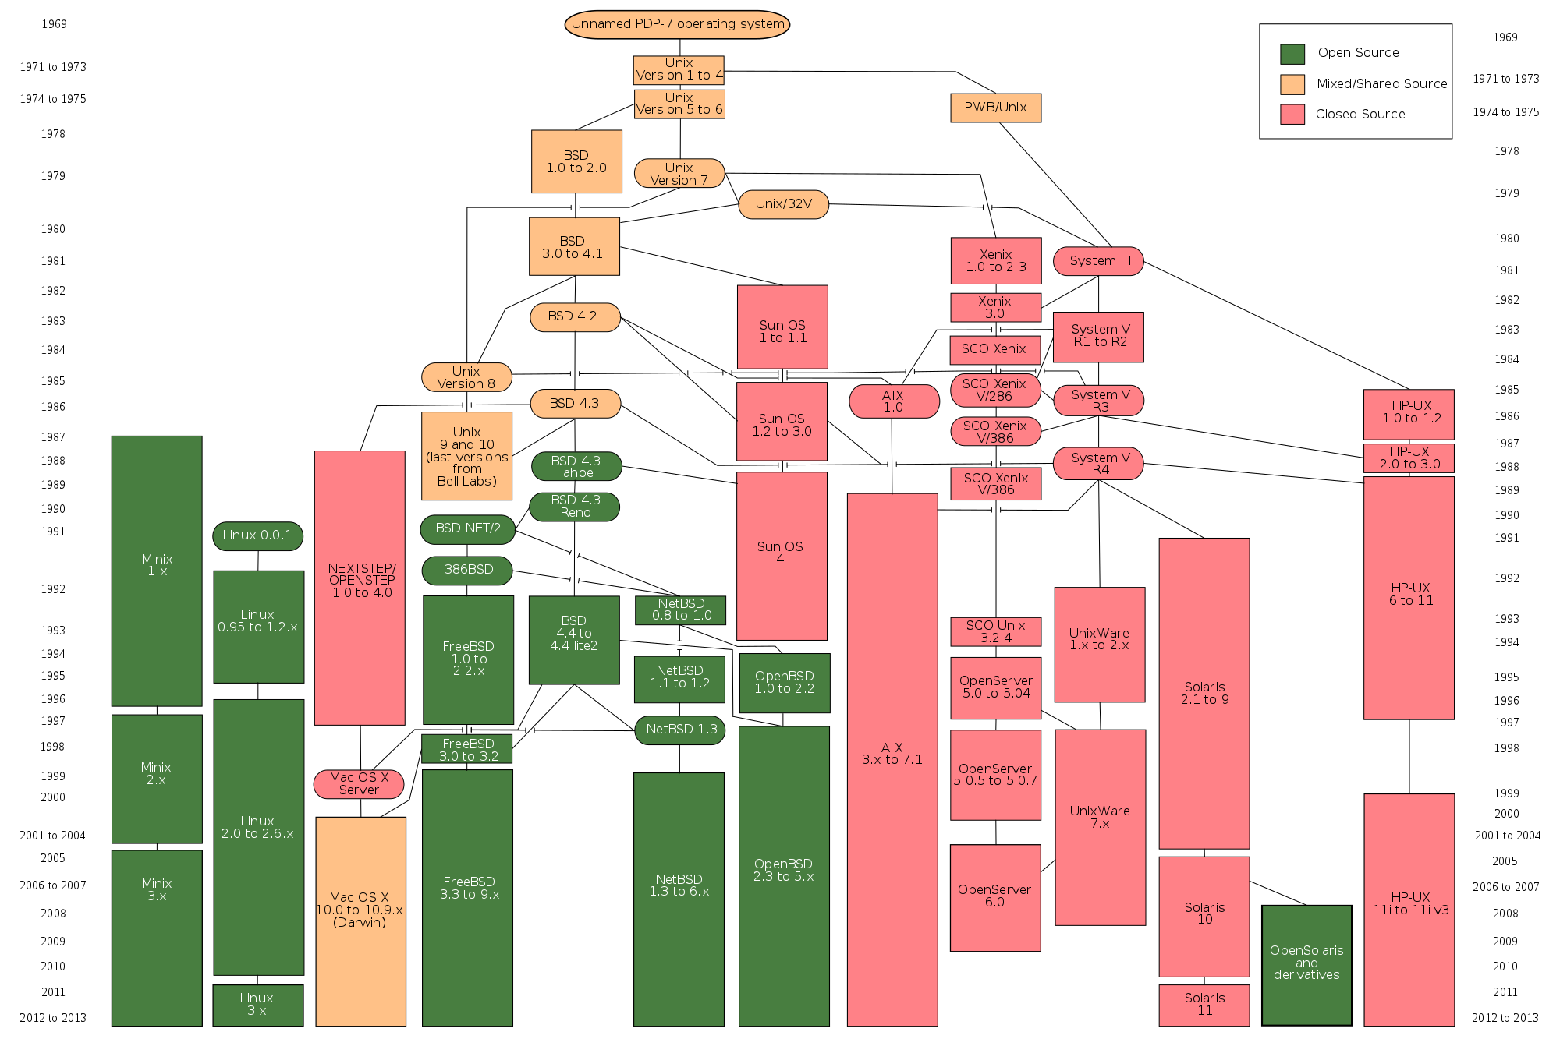

Slide 7
Hierarchy
The previous slide reflects major revisions or changes to code
These are typically designated as either new projects / names or as integers
(e.g. Windows 7 vs Windows 8)
Different groups use different hierarchies beyond this

Slide 8
Example
Foo 1.0 - Major level
Foo 1.1 - Minor release (feature, etc)
Foo 1.1.1 - Bug fix or minor feature
Foo 1.2 - Next feature release
Foo 2.0 - Major level revision
Foo 2.7.230 - Major level 2, minor level 7, release 230
Bar 1.0 - new derivative, or FORK

Slide 9
Checking In and Out
The previous concepts are pretty easy when you have just one coder
With more than one person revising code, things get a bit more complicated
We need to look at the modularity of the code, code interaction, and what to do when more than one person modifies code

Slide 10
Modularity
We already build code in modular form
  Allows addition of rarely-changing functions and calls
  Makes for efficient builds, as we can leave out unused code
  Makes it easier to modify without editing other code

Slide 11
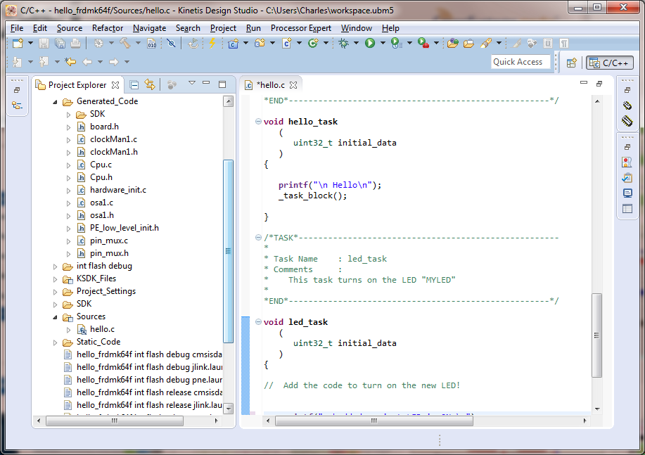
Modular Code

Slide 12
Version Control
Therefore, in managing even a simple project, we need to keep track of all of these versions of each module of code within that project
Ideally, we need to be able to identify what is unique about each version and what it changed from the previous (“when did we add USB support?”)
This allows for root-cause analysis, particularly for hunting down sources of bugs

Slide 13
Branching
Many times, when adding features (or fixing one), we may take multiple paths from one version to the next
This new path may become an alternative version with different features or supporting different hardware
OR – the path may be merged back into the project as the new version of the original
Branching also allows two coders to work on the same code at the same time

Slide 14
Merging
When a branch, or multiple branches, need to be combined back into the project, the different versions need to be merged
This process combines the different changes into a new version
Some of this process can be automated
The tool needs to present a clear “A-B” comparison of competing changes for review

Slide 15
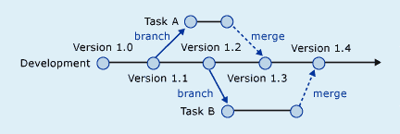
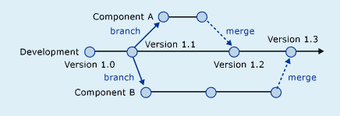
Two Examples of Branching

Slide 16
Traceability
The other aspect of archiving each version of a module of code is the traceability of that code in association with any project management or bug tracking that occurs
PM and bug tracking software needs a tie-in to our version control system so that we can assure that bug resolution is methodical
This feature is also critical when we go back and re-use this legacy code in future projects

Slide 17
Other Features
We also need to be able to check in and out these different versions of branches separate from what version is actually the “official” version, as we test these and work through merges
Therefore, we need some way of committing changes to the official, or “master” version of the project

Slide 18
Other Features
Finally, we need documentation!
We should have some overall document to describe the project and set forth the design criteria (what are the I/O, etc)
We should keep track of licensing and the ‘pedigree’ of our code – e.g. is it made up of open source (and if so, what license?), or commercial license (and what are the terms), etc

Slide 19
Tomorrow We Git it Done
We will look at a solution that allows us to fulfill these needs and more – Git
We will also look at the terminology that we will be using the rest of the week for some of these operations and will look at some hands-on implementations.

Slide 20
This Week’s Agenda
11/14 Intro to Version Control and Code Collaboration
11/15 Basic Git Concepts
11/16 GitHub Hands-On, Part 1
11/17 GitHub Hands-On, Part 2
11/18 Local Clients and Other Hosts

Slide 21
Please stick around as I answer your questions!
Please give me a moment to scroll back through the chat window to find your questions
I will stay on chat as long as it takes to answer!
I am available to answer simple questions or to consult (or offer in-house training for your company)
c.j.lord@ieee.org
http://www.blueridgetechnc.com
http://www.linkedin.com/in/charleslord
Twitter: @charleslord

