Slide 1
Introduction to
Git and Github –
A Hands-on Course
Class 2: Basic Git Concepts
November 15, 2016
Charles J. Lord, PE
President, Consultant, Trainer
Blue Ridge Advanced Design and Automation

Slide 2
This Week’s Agenda
11/14 Intro to Version Control and Code Collaboration
11/15 Basic Git Concepts
11/16 GitHub Hands-On, Part 1
11/17 GitHub Hands-On, Part 2
11/18 Local Clients and Other Hosts

Slide 3
This Week’s Agenda
11/14 Intro to Version Control and Code Collaboration
11/15 Basic Git Concepts
11/16 GitHub Hands-On, Part 1
11/17 GitHub Hands-On, Part 2
11/18 Local Clients and Other Hosts

Slide 4
Introducing Git
Created by Linus Torvalds in 2005
Initially used for writing much of Linux
Free software under GNU license
Command-line
Ports for essentially all OS

Slide 5
Types of Git Files
Tracked
  These are the files that are part of the tree we looked at yesterday
  Master – the current, latest ‘official’ code
  Staged – code that has not been deemed ‘official’ yet
  The process of changing Staged code to Master is called “committing”

Slide 6
Types of Git Files
Untracked
  Sometimes we want to store files for reference that are never part of the master
    Snippets
    Possible future or abandoned features
    Bug issues (tied in with bug tracking or PM software)
  Maintained but not part of version control

Slide 7
Types of Git Files
Ignored
  Log files (typically compile / link / debug logs)
  Binaries
  Object files
  Any other derivative files from compile / link / debug or other functions such as lint
  Git is set up to automatically ignore these file types (and this can be modified) *.o *.elf etc

Slide 8
A Distributed VCS
One powerful concept of git is that it can be local, remote, or both
You can have git running on your local computer (handy if you are using a portable computer or are remote from your local network)
You can also use a remote repository, which can be centralized (like GitHub) or another’s ‘local’ repository

Slide 9
Local Git
Git was written in (of course!) linux
Ports to windows originally used cygwin
Python and java versions
https://git-scm.com/download/win
https://git-for-windows.github.io/

Slide 10
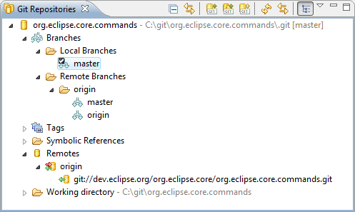
Egit – Git Plug-in For Eclipse
http://www.eclipse.org/egit/

Slide 11
Getting Your Code
You can copy an entire repository by using the “clone” command. This is handy for pulling in copies of the entire project from a remote repository
To work on a branch (revision), we use the “checkout” command. This can either get a copy of the Master, or we can create and name a new branch (to develop a possible new feature, etc)

Slide 12
Handy Cheat Sheet
There are a number of handy one-page guides or cheat sheets to help us when we are learning the command line.
The following is from
http://rogerdudler.github.io/git-guide/files/git_cheat_sheet.pdf

Slide 13
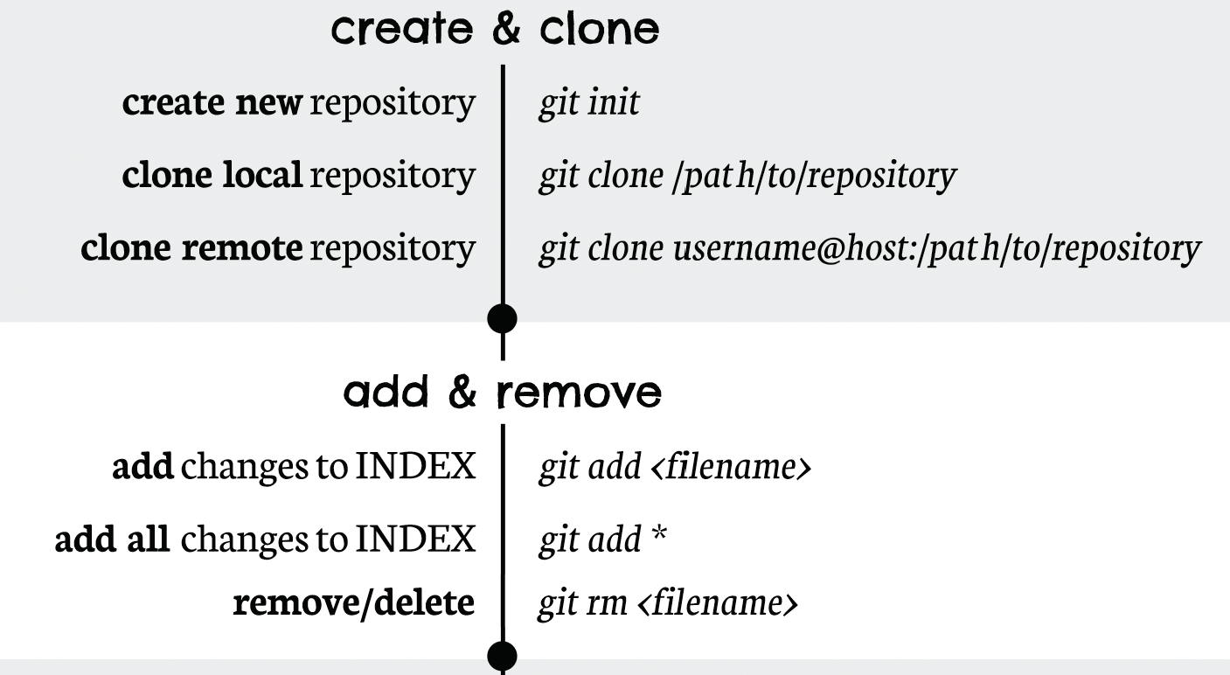
Cheat Sheet 1

Slide 14
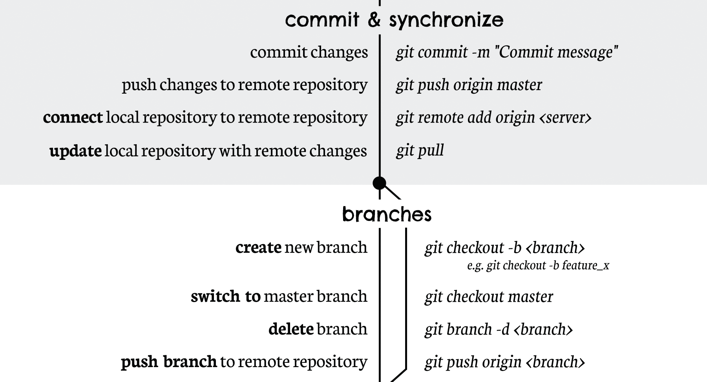
Cheat Sheet 2

Slide 15
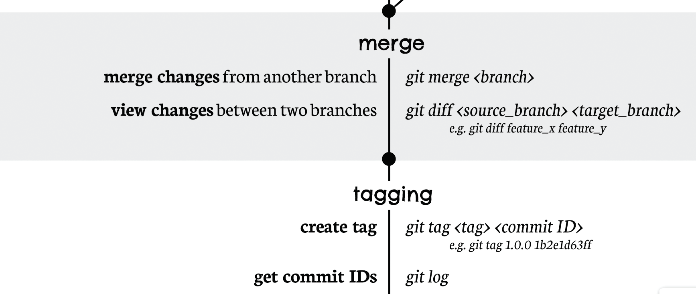
Cheat Sheet 3

Slide 16
GUI To The Rescue
There are a number of GUI-based tools for git for Windows
One of the most popular is SourceTree
https://www.sourcetreeapp.com/
Supports both git and Mercurial (Hg) repositories
Works seamlessly with Bitbucket, which we will look at Friday

Slide 17
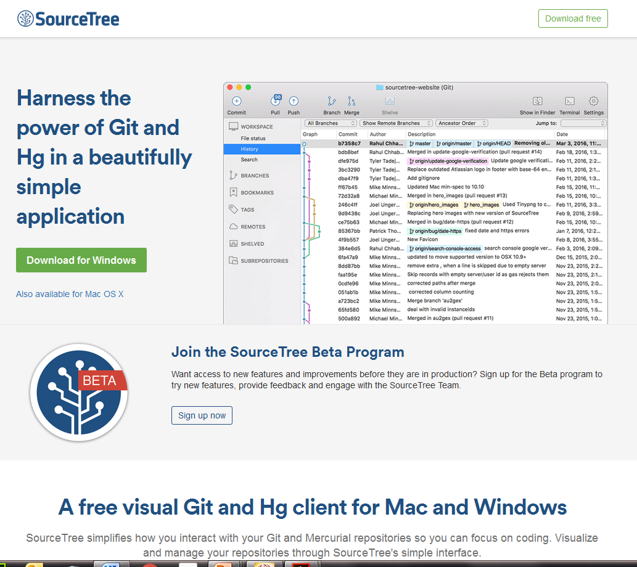
SourceTree

Slide 18
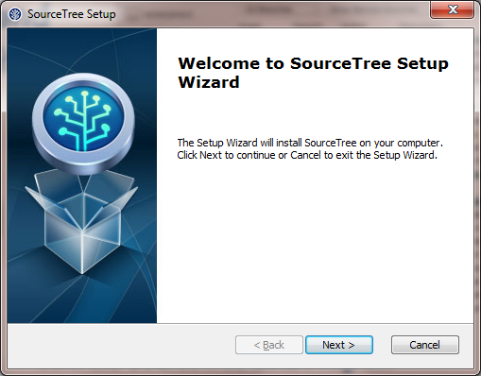
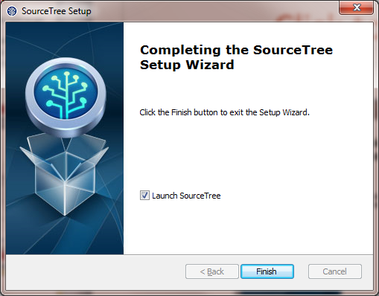
Install – use defaults

Slide 19
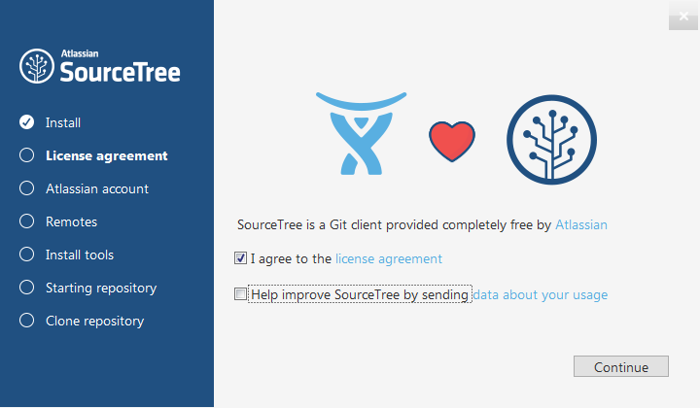

Slide 20
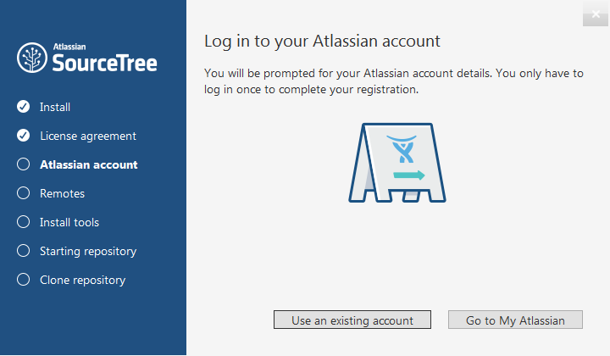
Set Up Account

Slide 21
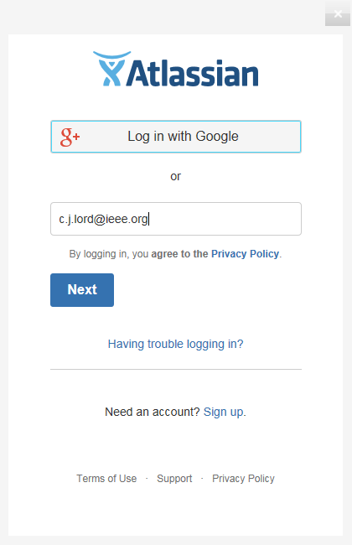
Sign up or Sign in

Slide 22
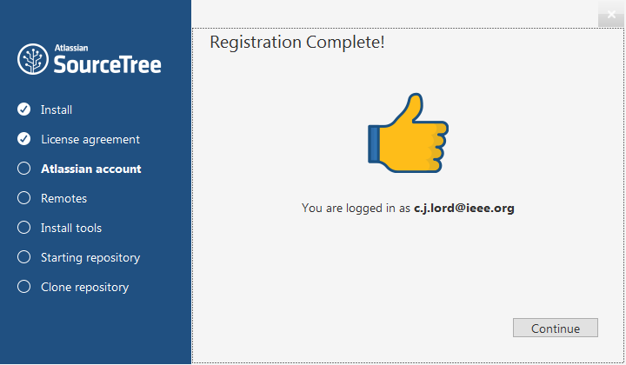

Slide 23
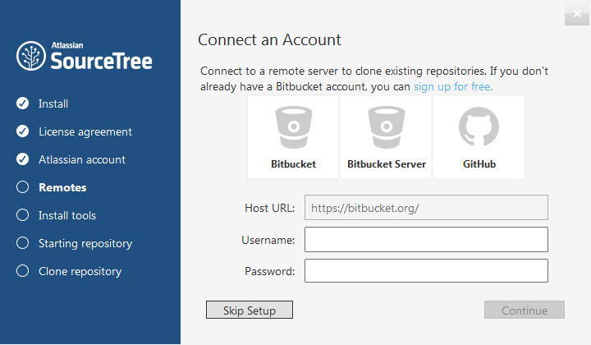
If You Have an Account

Slide 24
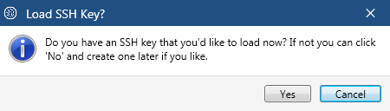
Find the “No” Button

Slide 25
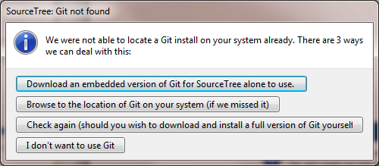
NOW download Git

Slide 26
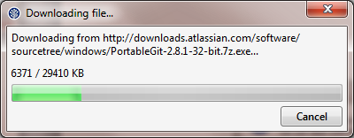
Sourcetree Will Download Git For You

Slide 27
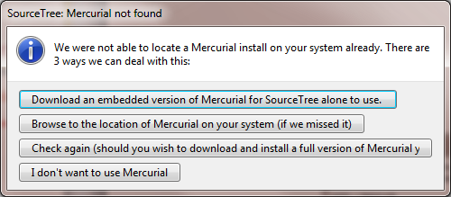
Let’s Ignore Hg for Now

Slide 28

Click on New/Clone

Slide 29
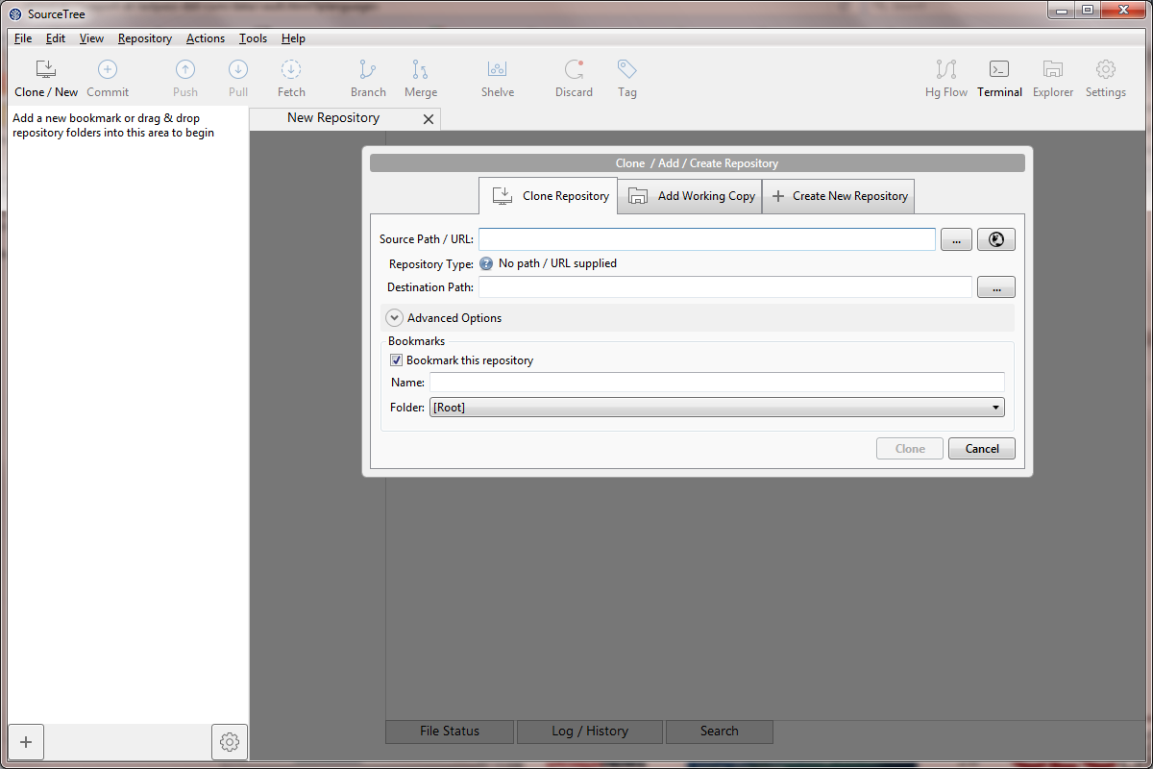
Now We Are Ready

Slide 30
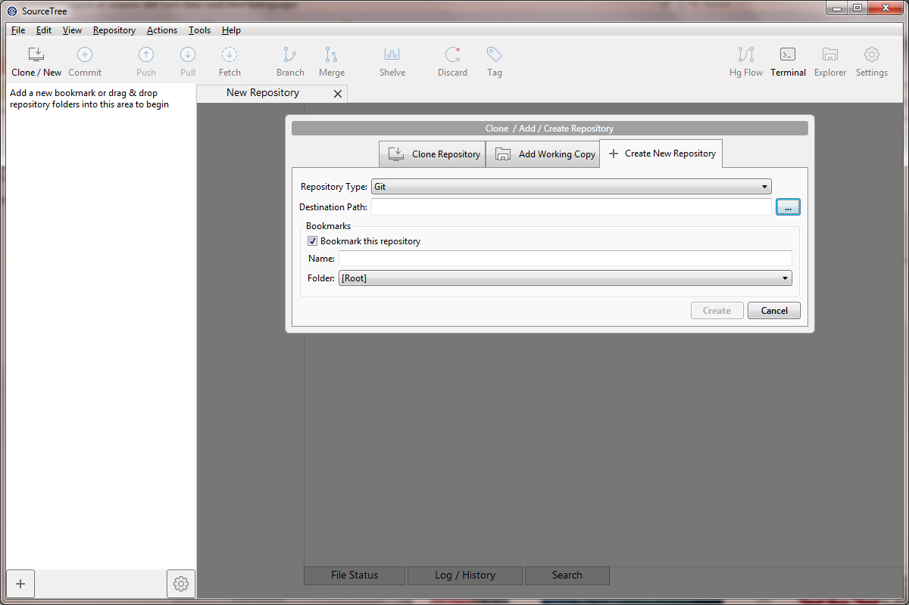
New

Slide 31
What About Remote?
There are many good repositories for shared projects
Next we will look at the very popular GitHub
Friday we will look at the companion Bitbucket

Slide 32
This Week’s Agenda
11/14 Intro to Version Control and Code Collaboration
11/15 Basic Git Concepts
11/16 GitHub Hands-On, Part 1
11/17 GitHub Hands-On, Part 2
11/18 Local Clients and Other Hosts

Slide 33
Please stick around as I answer your questions!
Please give me a moment to scroll back through the chat window to find your questions
I will stay on chat as long as it takes to answer!
I am available to answer simple questions or to consult (or offer in-house training for your company)
c.j.lord@ieee.org
http://www.blueridgetechnc.com
http://www.linkedin.com/in/charleslord
Twitter: @charleslord

