Slide 1
Documentation for using the production costing program with high fidelity energy storage dispatch model
Dr. Trishna Das and Dr. Venkat Krishnan
Major professor: Dr. James D. McCalley
Iowa State University
June-03-2014
vkrish@iastate.edu/venky83krish@gmail.com

Slide 2
Production costing program
48-hour SCUC (solved as 1 MIP)
Unit status constraints
…
SYSTEM
EQUATIONS FOR
Unit ramping constraints
SYSTEM
EQUATIONS FOR
SYSTEM
EQUATIONS FOR
t=1
Reservoir update constraint
t=2
t=48
Unit statuses, dispatch levels, AS commitments
48-hour SCED (solved as 1 LP)
…
SYSTEM
EQUATIONS FOR
SYSTEM
EQUATIONS FOR
SYSTEM
EQUATIONS FOR
t=1
Reservoir update constraint
t=2
t=48
Inter-temporal constraints have always been required in SCUC, but storage requires them on SCED as well.
Unit dispatch levels, AS commitments, LMPs

Slide 3
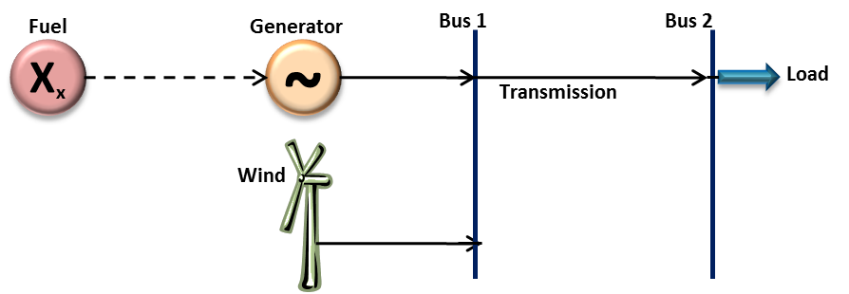
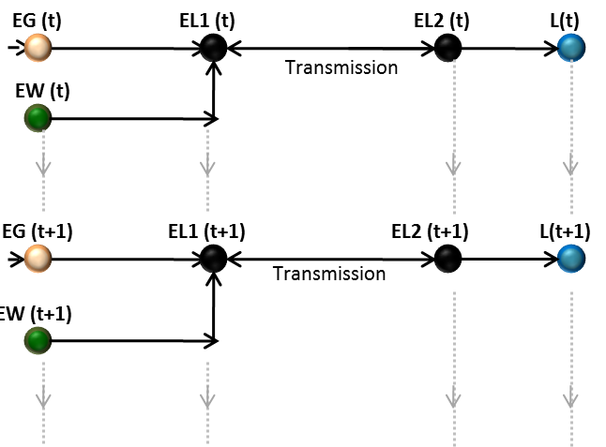
Network flow model
DC power flow equations

Slide 4
Objective Function for Hourly Unit Commitment
Minimize:
Energy Cost ($/MWh)
* Energy Flow (MW)
ANCILLARY SERVICES
Spinning Reserve (SR) Cost ($/MWh)
* Spinning Reserve (MW)
Non-Spinning Reserve (NSR) Cost ($/MWh)
* Non-Spinning Reserve(MW)
Regulation Up (RU) Cost ($/MWh)
* Regulation Up (MW)
Regulation Down (RD) Cost ($/MWh)
* Regulation Down (MW)
Start-Up Cost ($/MWh)
* (Start-Up Indicator + NSR Start-up Indicator)
Shut-Down Cost ($/MWh)
* (Shut-Down Indicator + NSR Shut-Down Indicator)
Penalty($/MWh)
* Load not served (MW)
Notes:
Introduce PC
Align columns
Load Penalty = Not serving 1 MW = $250

Slide 5
Access to and executing the program
Uses tomlab for optimization in matlab
The TOMLAB Optimization Environment is a powerful optimization platform and modeling language for solving applied optimization problems in Matlab.
medvall@tomopt.com (Marcus M. Edvall)
http://tomopt.com/scripts/register.php (demo license for 21 days)
1. Open Matlab environment
2. Go to tomlab folder, type “startup” (if license is valid, it initiates Tomlab)
3. Go to your code folder, open codes and execute in proper sequence! (indicated in slide 8)

Slide 6
Data
nodesinitial.txt - has the data of all the nodes in the system.
The various columns are: Node Name, 2 and 3. node types (transmission line end or generator, ...), and 4. initial value at t=0
arcsinitial.txt - has the data of all the arcs in the system, that connect various nodes
New scenarios – change this file! (w & w/o storage, DR, wind penetration, bids…)
The various columns are: 1. Arc Name, 2. From, 3. To, 4. Type ,5. Cost, 6. Efficiency, 7. Min. flow, 8. Max. Flow, 9. Number, 10. Inv. Cost, 11. Susceptance, 12. Whether it can provide spinning reserve or not (binary), 13. Whether it can provide non-spinning reserve or not (binary), 14. Ramp-up rate, 15. Ramp-down rate, 16. Start-up cost, 17. Shut-down cost, 18/19/20. energy bidding 1 (minimum capacity, maximum capacity, cost), 21/22/23. energy bidding 2, 24/25/26. energy bidding 3, 27. Spinning reserve bidding ($/MW), 28. Non-spinning reserve bidding ($/MW), 29. Forced-outage rate, 30. Co2 emission, 31. Regulation bidding ($/MW), 32. Whether it can provide regulation or not (binary).
loadhourly.mat - hourly load data
windfc.mat - hourly wind forecast
Reg_req.mat - hourly regulation requirements data
UpDn – minimum up and down times for generators

Slide 7
Codes
1. CAISO_avg_5min.m or CAISO_Reg.m– estimate regulation requirements for a wind penetration ← change data for new wind penetration and re-run!
2. expandnodes.m - expands the system data in nodesinitial.txt to multiperiods (default 48 hours, though it can changed by changing variables a=#days and b=#hours)
3. expandarcs.m - expands the system data in arcsinitial.txt to multiperiods (default 48 hours, though it can changed by changing variables a=#days and b=#hours) ← re-run everytime change arcsinitial.txt for new scenario!
4. Run_storage_monte.m
main program that initiates monte carlo simulation (changes in random gen. outages, prices...), and calls for programs Slave_UC.m (SCUC) and Slave_ED.m (SCED), and gets the output from SCED for plotting purposes.
5. Slave_UC.m ---- SCUC (uses loadhourly.mat, Reg_req.mat)
6. Slave_ED.m ---- SCED (uses loadhourly.mat, Reg_req.mat)
7. sortcell.m ---- used by SCUC and SCED

Slide 8
Code structure-I/O, flow
execute
Program flow
CAISOdata
CAISO_Reg.m
Reg_req.mat
I/O
expandnodes.m
Output variables
objv_ed
wspillagep
LMP_21, LMP_2
MCP_ru, MCP_rd, MCP_1(sr), MCP_3(nsr)
STOR_strlvl
STOR_charge
STOR_dischar
STOR_spin
STOR_nonspin2
STOR_upreg
STOR_downreg
STOR_comupreg
STOR_comdownreg
STOR_comspin
energy_profit_21
ancillary_profit_21
nodesinitial.txt
nodes.txt
expandarcs.m
arcsinitial.txt
arcs.txt
loadhourly.mat windfc.mat
Run_storage_monte.m
n=? (sample gen./tarns. outage, prices)
arcs.txt
nodes.txt
loadhourly.mat Reg_req.mat
Slave_UC.m
Slave_ED.m
sortcell.m

Slide 9
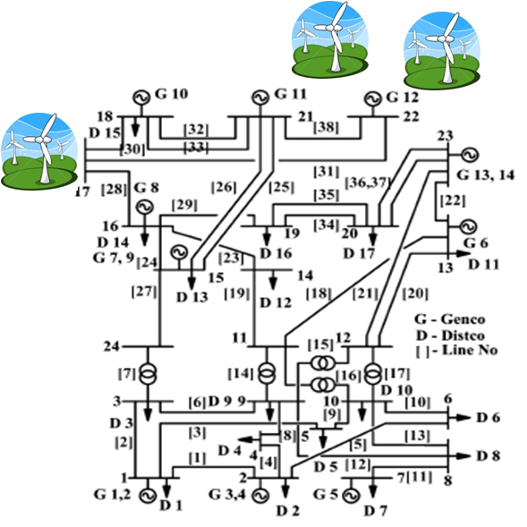
System model for illustrations
Storage at bus 21
3405 MW of installed generation capacity (w/o wind)
2490 MW of peak load
Storage at bus 2

Slide 10
Generator Energy Offers
Gen (Bus) | Min-Max (MW) | Offer 1 MW / $ per MWh | Offer 2 MW / $ per MWh | Offer 3 MW / $ per MWh
Oil (1) | 0-40 | 0-20/93.7 | 21-40/98.8 | -
Coal (1) | 50-152 | 50/26.9 | 51-100/32.4 | 101-152/41.9
Oil (2) | 0-40 | 0-20/93.7 | 21-40/98.8 | -
Coal (2) | 50-152 | 50/26.9 | 51-100/32.4 | 101-152/41.9
NG (7) | 100-300 | 100/51.8 | 101-200/60.8 | 201-300/73.8
NG (13) | 200-591 | 200/48.6 | 201-400/57.6 | 401-591/70.6
NG (15) | 0-60 | 0-20/48.6 | 21-40/54.7 | 41-60/66.4
Coal (15) | 50-155 | 50/24.5 | 51-100/28.5 | 101-155/36.5
Coal (16) | 50-155 | 50/24.5 | 51-100/28.7 | 101-155/37.1
Nuc (18) | 300-400 | 300/10.5 | 301-400/17.5 | -
Nuc (21) | 300-400 | 300/10.5 | 301-400/17.5 | -
Coal (22) | 150-300 | 150/24.6 | 151-250/32.2 | 251-300/44.3
Coal (23) | 150-310 | 150/20.5 | 151-250/28.5 | 251-310/41.3
Coal (23) | 150-350 | 150/20.6 | 151-250/27.8 | 251-350/39.3
Wind (17) | 0-300 | 0-300/15 | - | -
Wind (21) | 0-400 | 0-400/15 | - | -
Wind (22) | 0-300 | 0-300/15 | - | -
Gen AS Offers
Storage Energy & AS Offers
Gen | Ramp Rate (%) | SR offer ($/MWh) | NSR offer ($/MWh) | RU/RD offer ($/MWh)
Oil | 6.25 | 7.8 | - | 62
Coal | 3.25 | 8 | - | 26
NG | 10 | 7.9 | 4.1 | 27
Storage | Enrgy offer ($/MWh) | SR offer ($/MWh) | NSR offer ($/MWh) | RU/RD offr ($/MWh)
STOR | 20.15 | 7.5 | 4 | 17.9/12.5
Flywheel | - | - | - | 1/1
Battery | 1 | 5 | - | 1/1

Slide 11
Relevant references
Das, Trishna, "Performance and Economic Evaluation of Storage Technologies" (2013).Graduate Theses and Dissertations. Paper 13047
T. Das, V. Krishnan, and J. D. McCalley, High-Fidelity Dispatch Model of Storage Technologies for Production Costing Studies, IEEE Transactions on Sustainable Energy, vol.5, no.4, pp.1242–1252, Oct. 2014
T. Das, V. Krishnan, and J. McCalley, Incorporating cycling costs in generation dispatch program — an economic value stream for energy storage, International Journal of Energy Research, Wiley Online Library, Volume 38, Issue 12, pages 1551–1561, 10 October 2014
T. Das, V. Krishnan, and J. D. McCalley, Assessing the benefits and economics of bulk energy storage technologies in the power grid, Applied Energy, Volume 139, pp. 104–118 , 1 February 2015
V. Krishnan and T. Das, Optimal allocation of energy storage in a co-optimized electricity market: Benefits assessment and deriving indicators for economic storage ventures, Energy, Available online 8 January 2015
D. Nock, V. Krishnan, and J. McCalley, Dispatching Intermittent Wind Resources for Ancillary services via Wind Control and its Impact on Power System Economics, Renewable Energy, Volume 71, November 2014, Pages 396–400
M. Howland, V. Krishnan, N. Brown, and J. McCalley, Assessing the Impact of Power Rate Limitation based Wind Control Strategy, Proceedings of the 2014 IEEE PES Transmission & Distribution Conference & Exposition, Chicago USA, April 2014

