Slide 1
The
Project.
TEAM F4CE
Ajith K S
Nitin R
PROJECT GUIDE
Ms Ajil Aylwin
Ananth Kshap
Manigandan

Slide 2

Outline :
Introduction and Motivation.
The Technology.
What is wrong with the current design?
Solution:
Freedom in the cloud.
Step 1 : Server to client interaction.
Step 2 : Client to Server interaction.
Technology being used:
Hardware
Software
Conclusion.
Future Enhancement.

Slide 3
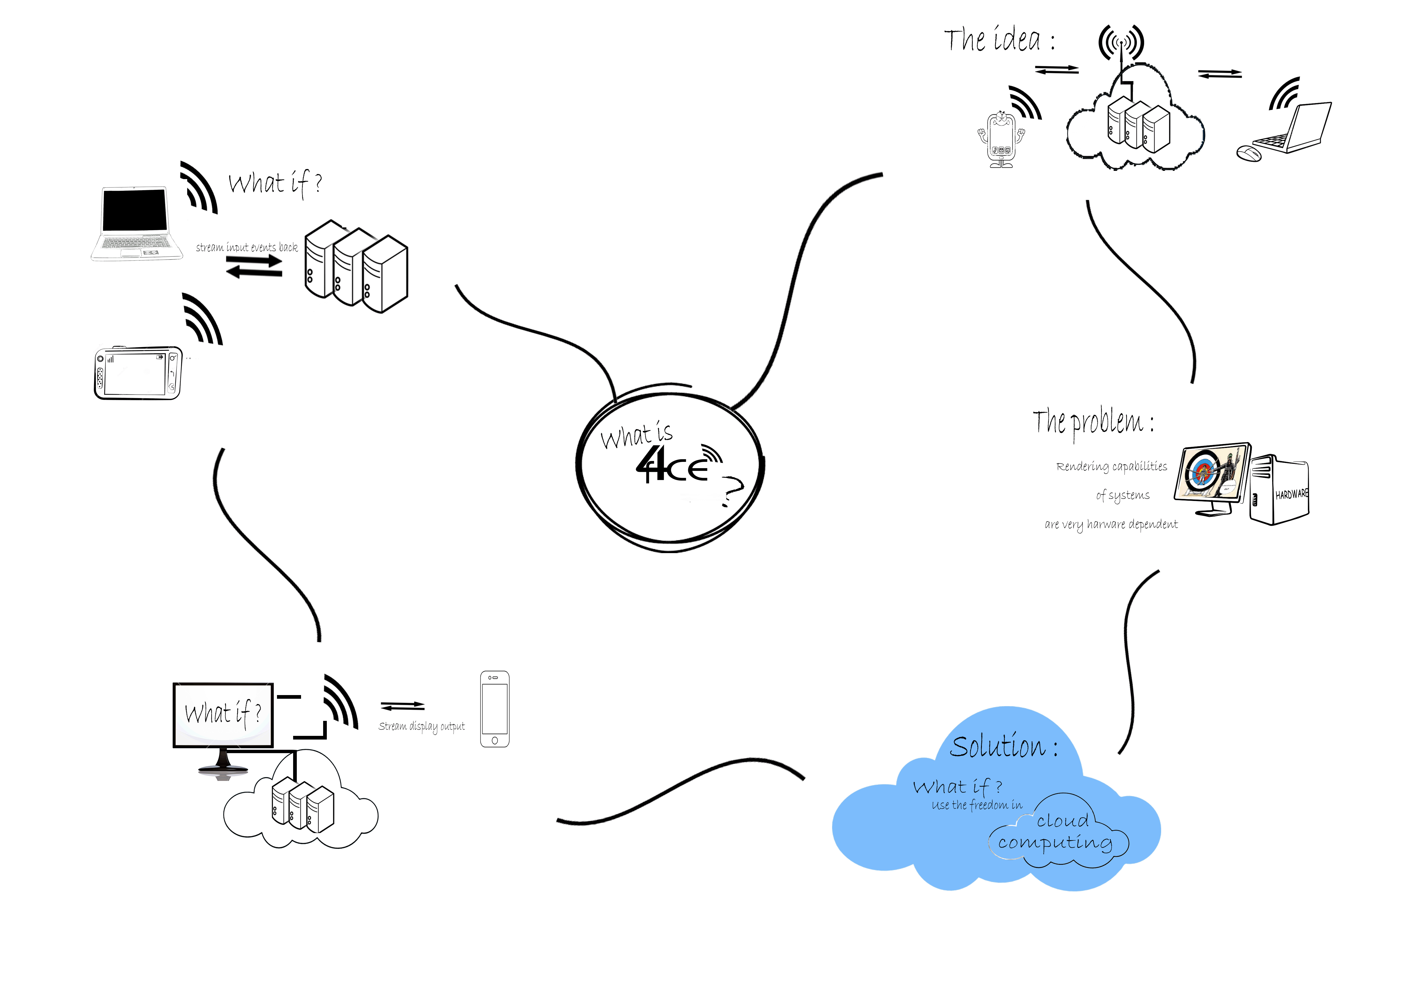

Slide 10
The
Project.

Slide 11
Hardware Requirements :
Server side :
High compatibility laptop.
Client side :
Mobile device.
Low compatibility laptop.

Slide 12
Software Requirements :
Server side :
Support for LAMP integrated with python support.
Client side :
Support for applications built on Kivy.

Slide 13
Conclusion:
We obtain a cross platform application that allow a cloud
based access to graphics application.

Slide 14
Future Enhancements:
Access to the technology over the internet.
Thus allowing the software to be commercialized.

Slide 15
The
Project.

