Slide 1

Assignment-2 MAL 7350 FINANCIAL ENGINEERING MAL7350 Assignment 2: Binomial Model & Black Scholes Instructor: Dr. Vivek Vijay Submitted by Ajit Kumar (M21CS017) Nammi Venkata Apparao (P20MA210) Rajat Rawat (M21CS014) Binomial Model & Black Scholes MAL 7350

Slide 2
Contents
Introduction
Calculating annual volatility
Calculating call option using binomial model and Black Scholes
formula
Black Scholes formula is limiting case of binomial
Calculating value of delta every week using implied volatility
Reason for the price obtained by the formula different from the
market

Slide 3
Introduction
Option pricing models like binomial Black Scholes models, we give us option price of a call option or a put option for a traders. These models sometimes gives closer values to actual market values. These models suggest investing strategy to traders.
In this assignment when calculating Binomial option Pricing, Black Scholes option pricing, we will use fixed rate of interest r=0.025 and we will consider number of trading days per year are 253 days and also number trading days per week are five.

Slide 4
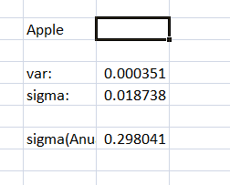
Calculating annual volatility
We considered three months(01/01/2022 to 31/03/2022) closing prices of apple company from the investing.com and calculated daily log returns.
From log return , we have calculated variance and sigma(daily volatility).
Then we calculated annual volatility by using following formula.
Annual volatility=daily volatility*(sqrt(253))
Annual volatility= 0.298041295

Slide 5
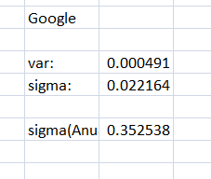

Slide 6
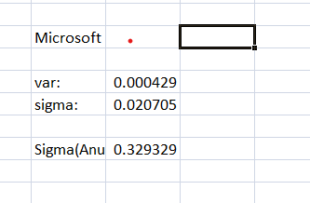

Slide 7
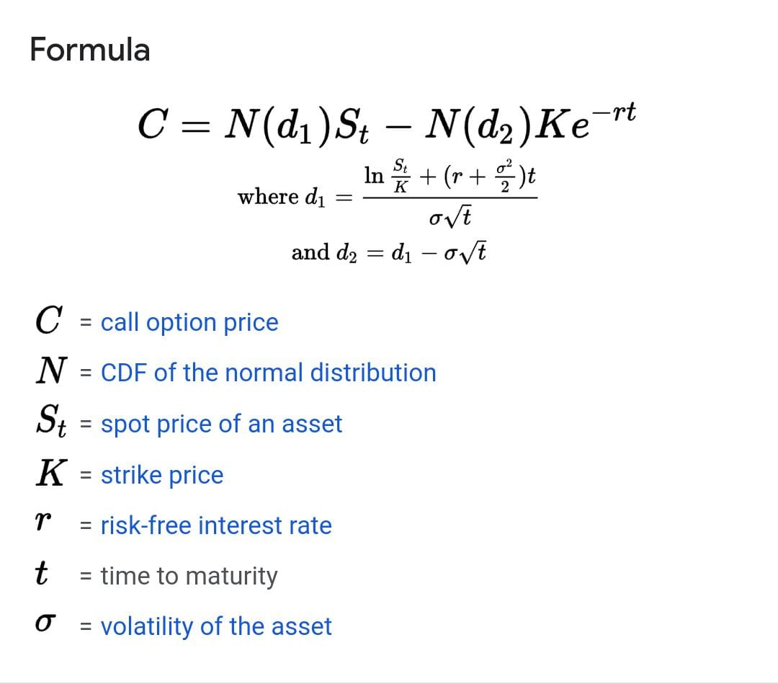
Call option using binomial model and Black Scholes Formula
By using the following formula, we have calculated European call option price:

Slide 8
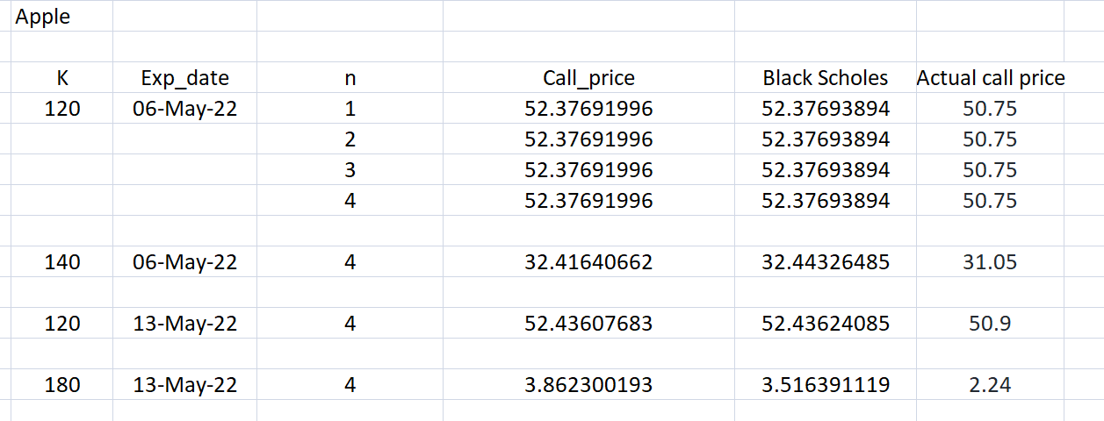
Here we have calculated the call option using binomial model and Black Scholes formula and also comparing with the actual price.
Apple

Slide 9
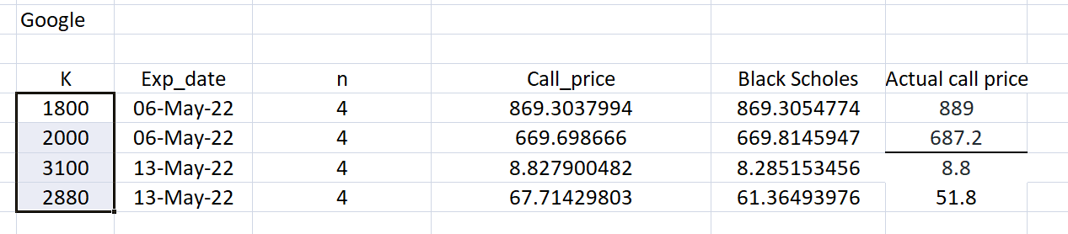
Google

Slide 10
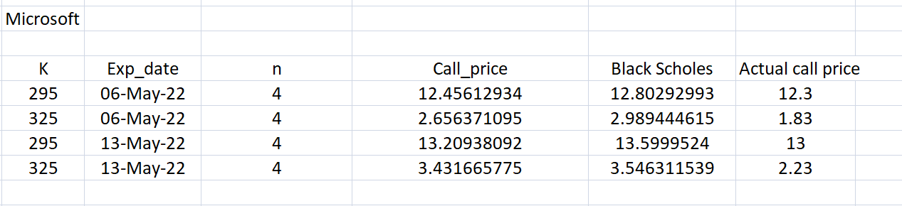
Microsoft

Slide 11
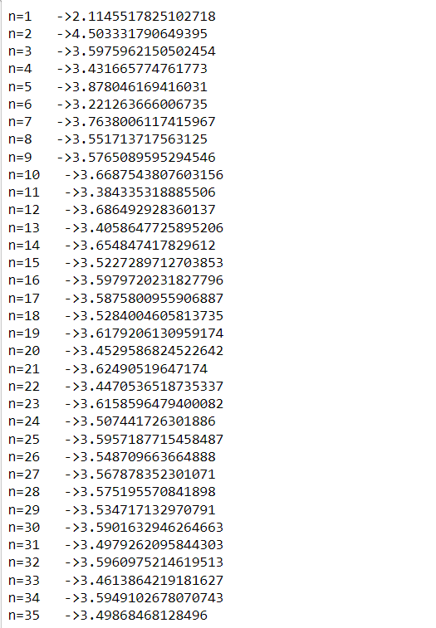
Black Scholes formula is limiting case of binomial
Call option price from Black Scholes formula is 3.5463115391121818

Slide 12
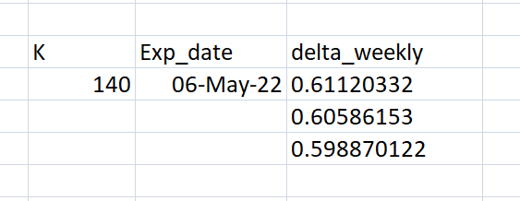
Calculating value of delta every week using implied volatility
We have calculated delta using following formula:
Delta(t)=N(d1)

Slide 13
Reason for the price obtained by the formula different from the market
In theoritical option pricing like binomial and Black Scholes model. We will use fixed rate of interest but in case of market option pricing may not be.
In theoritical option pricing like binomial and Black Scholes model. We will use fixed annual volatility but in case of market option pricing may not be.
In market option pricing may be follow demand and supply rule.

