Slide 1



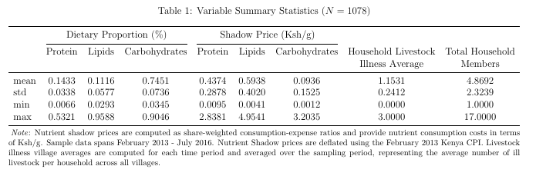
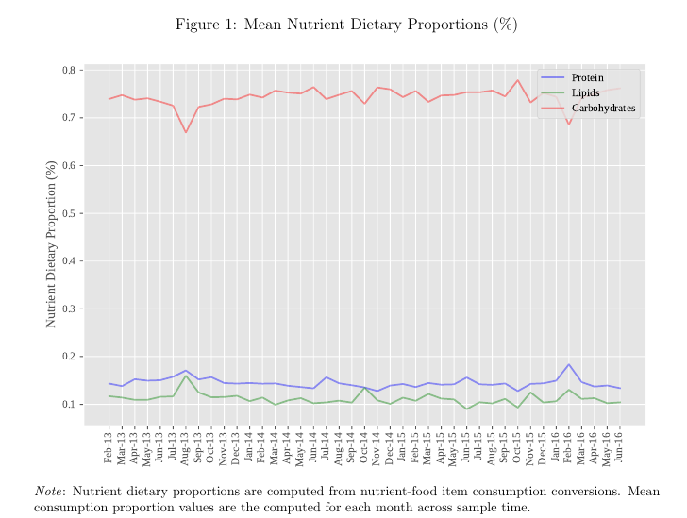
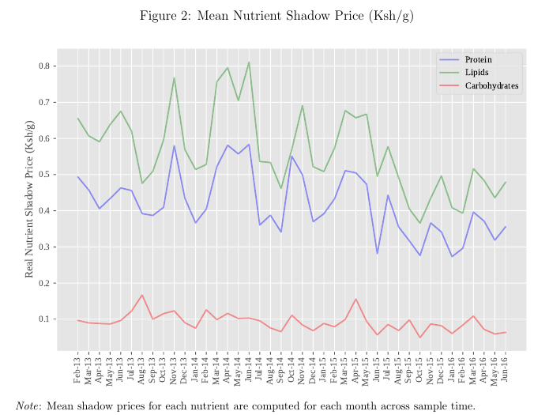
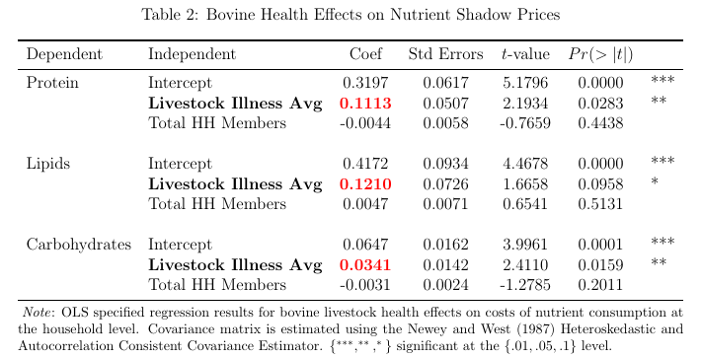
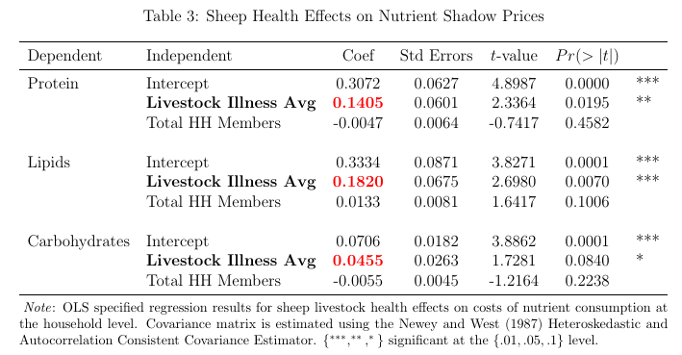
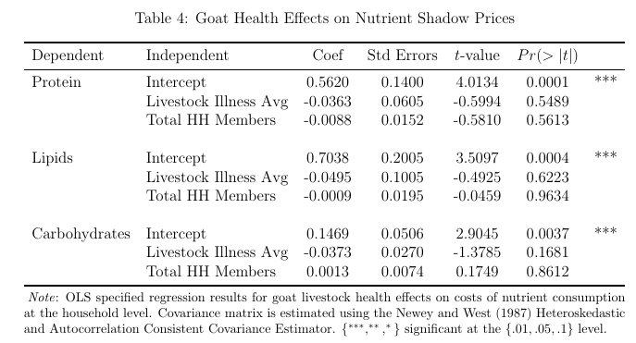
Livestock health effects on cost of nutrient consumption in western kenya
Alexander J. Kappes, Thomas L. Marsh
Introduction
Attributed to recurrent food insecurity issues, north eastern sub-Saharan Africa as the lowest per person per day energy availability ranking worldwide. Understanding food insecurity issues is in part contingent on understanding nutrient consumption and its costs.
We develop estimates of protein, lipid, and carbohydrate macronutrient consumption from food consumption. We then calculate the shadow price per gram of macronutrient consumption as a share-weighted consumption-expense ratio.
Smallholder agriculture provides the primary supply of subsistence and community market foodstuffs in rural western Kenya. Using household bovine, goat, and sheep livestock health observations we analyze the effect livestock illness has on macronutrient consumption costs.
Data & Methods
Data consists of once-a-month weekly food consumption and expense observations for western Kenyan households from 2013 to 2016, and is provided by the ongoing Population Based Animal Syndromic Surveillance Socioeconomic Survey.
Nutrient consumption and costs
C_{t} represents total nutrient consumption in grams for nutrient n conversion factor γ and food F item j in household h
P_{n,t} represents the shadow price of nutrient n for nutrient consumption share α and total consumption expense E in household h
Livestock illness effects on nutrient shadow prices
L represents village v average livestock illness occurrence in month m
THM represents total household members in household h
ε represent the stochastic error component for household h
β₁ represents the estimable parameter of interest for livestock health effects on the shadow price P_{n,h} for nutrient n in household h
Cov(β) is estimated using the Newey and West (1987) Heteroskedastic and Autocorrelation Consistent Covariance Estimator
Hypothesis:
Livestock illness increases costs of nutrient consumption in developing areas reliant on smallholder agriculture.
Results:
Village-level bovine and sheep illness occurrence has positive marginal effects on costs of protein and lipids macronutrient consumption.
Increases in average household bovine and sheep illness occurrences result in increases of protein and lipids shadow prices.
Average bovine illness occurrence significantly explains an increase of 0.1113 Ksh/g in protein’s shadow price and an increase of 0.121 Ksh/g in the shadow price of lipids. Average sheep illness occurrence significantly explains increases of 0.1405 Ksh/g and 0.182 Ksh/g in the shadow prices of protein and lipids, respectively.
Implications:
Agriculture production losses from livestock illness directly influence energy availability. Further, livestock illness is empirically shown to increase the costs of available energy consumption in terms of macronutrient shadow prices.
Empirical marginal effect estimates of livestock illness on nutrient consumption critically informs policy decision-making in undernourished, developing areas.
Increasing livestock health lowers the costs of nutrient consumption, making consumption more attainable in constrained-resource environments.
Livestock health effects

