Slide 1
CCDC Quick Guide to VM-100 on ESXi
Jim Boardman
jboardman@paloaltonetworks.com

Slide 2
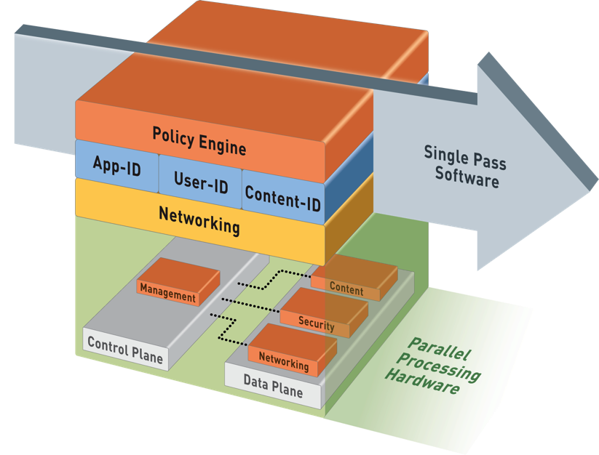
Palo Alto Networks Single Pass Architecture
Single Pass
Operations per packet
Traffic classification with App-ID
User/group mapping
Content scanning – threats, URLs, confidential data
One policy
Parallel Processing
Function-specific parallel processing hardware engines
Separate data/control planes
Notes:
The Palo Alto Networks firewall allows you to specify security policies based on a more accurate identification of each application seeking access to your network. Unlike traditional firewalls that identify applications only by protocol and port number, the firewall uses packet inspection and a library of application signatures to distinguish between applications that have the same protocol and port, and to identify potentially malicious applications that use nonstandard ports.
The strength of the Palo Alto Networks firewall is its Single Pass Parallel Processing™ (SP3) engine. Each of the current protection features in the device (Anti Virus, Spyware, Data Filtering and vulnerability protection) utilize the same stream-based signature format. As a result, the SP3 engine can search for all of these risks simultaneously.
The advantage of providing a stream-based engine is that the traffic is scanned as it crosses the box with a minimal amount of buffering. This speed allows you to turn on advanced features like scanning for viruses and malware without slowing down the firewall’s performance.

Slide 3
Flow Logic of the Next-Generation Firewall
Initial Packet Processing
Source Zone/ Address/ User-ID
Security
Pre-Policy
Check Allowed Ports
Application
Check for Encrypted Traffic
PBF/ Forwarding Lookup
Destination Zone
Decryption Policy
Security Policy
Post Policy Processing
Session Created
Application Override Policy
App-ID/
Content-ID Labeling
Check Security Policy
Check Security Profiles
Re-Encrypt Traffic
Packet Forwarded
NAT Policy Applied
NAT Policy
Evaluated

Slide 4
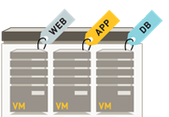
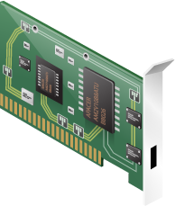


Default ESXi Configuration
All virtual machines connected to one virtual switch
All virtual server VMs have assigned fixed IP addresses
Competition rules don’t allow changing addresses
Servers access competition network via ESXi network Adapter, vmnic0
East – West Traffic
Competition Network
Virtual Server VMs
vSwith0
vmnic0
ESXi
In this example, the

Slide 5

Your Goal: VM-100 Protected Virtual Servers
East – West Traffic
VM-100 Vwire Mode
Virtual Server VMs
vSwith1
vSwith0
CompetitionNetwork
Mgt Int
vmnic0
Trust-VW
Ingress
Untrust-VW
Egress
ESXi

Slide 6
Import the VM-100 OVA into ESXi
Download Palo Alto Networks Admin Guide: https://www.paloaltonetworks.com/documentation/70/pan-os/pan-os
Vsphere Client or ESXi client
File>import VMF -100 OVF file
Firewall has 2 network adapters by default
Network Adapter 1: Management Interface has to be able to reach our public update server for licensing
Network Adapter 2: Data interface (untrust Zone Vwire egress)
If ESXi Server is in default configuration then there will be:
One vSwitch0 with the host’s physical NIC, vmnic0, attached
2 port groups on vSwtich0: VM Network and Management (for ESXi host)

Slide 7
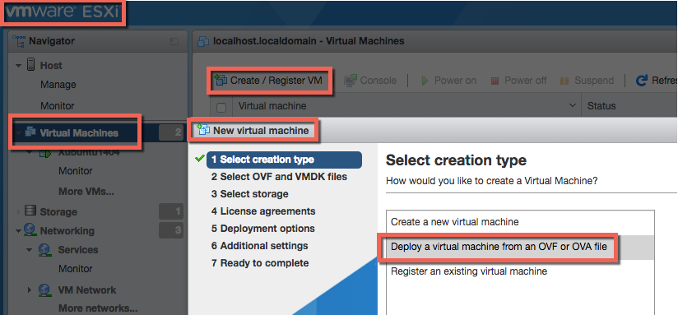
Deploying Your VM-100 OVF on ESXi

Slide 8
ESXi Network Connections
Your mission is to put all your ESXi server virtual machines behind your VM-100 appliance
On your ESXi host, create another vSwitch and port group
Name the switch ServerSwitch and port group “Services”
Make sure both vSwitch0 and vSwitch “ServerSwitch” switches are in promiscuous mode
You will configure VM-100 with Virtual Wire deployment
Virtual Servers will be able to maintain competition assigned IP addressing
VM-100 will filter traffic between competition network and Server VM services

Slide 9
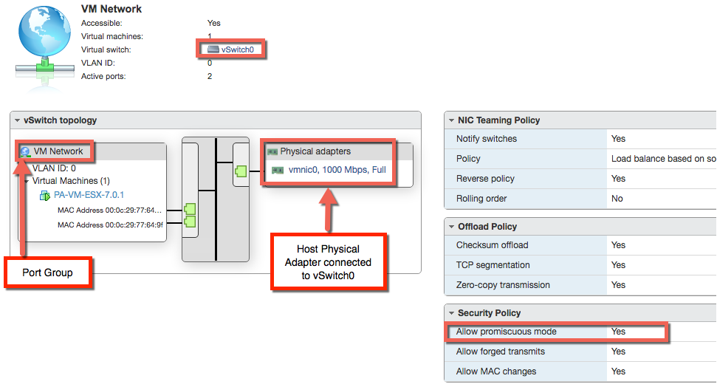
ESXi vSwitch0, Port Group “VM Network”

Slide 10
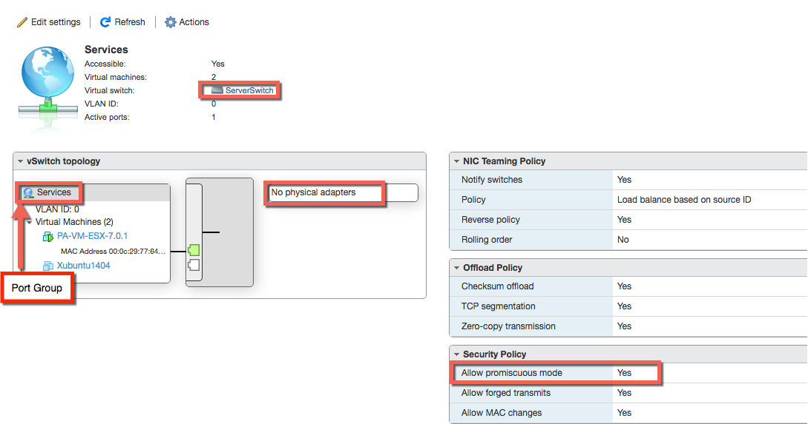
ESXi ServerSwitch vSwitch with Port Group “Services”

Slide 11
VM-100 ESXi Network Connectivity
Add a 3rd adapter to the VM-100
Must use the vmxnet3 driver; this is the default
Attach VM-100 network adapter1 and 2 to vSwitch0, VM Network port group
Netwwork adapter 1 is your management interface for WebUI
Network adapter 2 is the data interface connection to ”Competition Network”
This will be your egress interface assigned to Untrust Vwire Zone
Attach VM-100 network adapter 3 to “ServerSwitch” vSwitch and “Services” port group
Network adapter 3 is the data interface connection to the Server VMs you are protecting
This will be your ingress interface assigned to Trust Vwire Zone

Slide 12
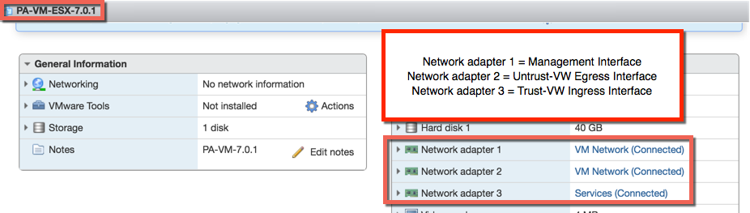
VM-100 ESXi Network Connectivity (continued)

Slide 13
Server VMs ESXi Network Connectivity
All your server VMs will be connected to “ServerSwitch” vSwitch, port group Services
Only path to ”Competition Network” is through your VM-100
You do not need to change IP addresses of your Server VMs
Your VM-100’s Vwire configuration will create bridged connection between your Server VMs and the ”Competition Network”
The VM-100 data ports, Network adapters 2 and 3, will be invisible
No IP addresses
No MAC addresses

Slide 14
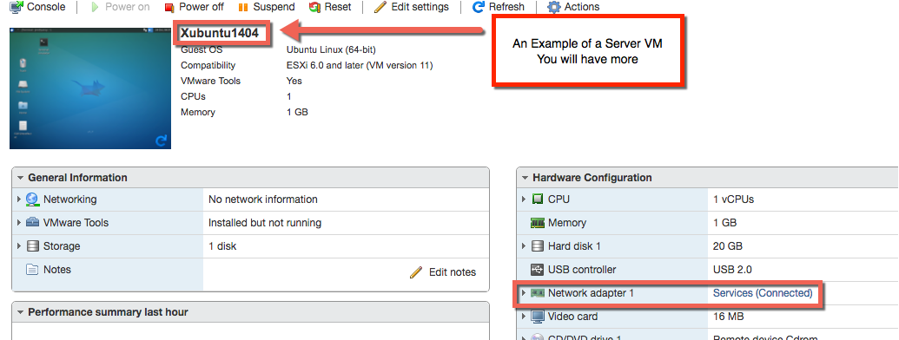
Server VMs ESXi Network Connectivity

Slide 15
Console Login to Your VM-100
From your ESXi VMWare Host Client, power on your VM-100 and access the Console
Login your VM-100 console using default username: ”admin” and password “admin”

Slide 16
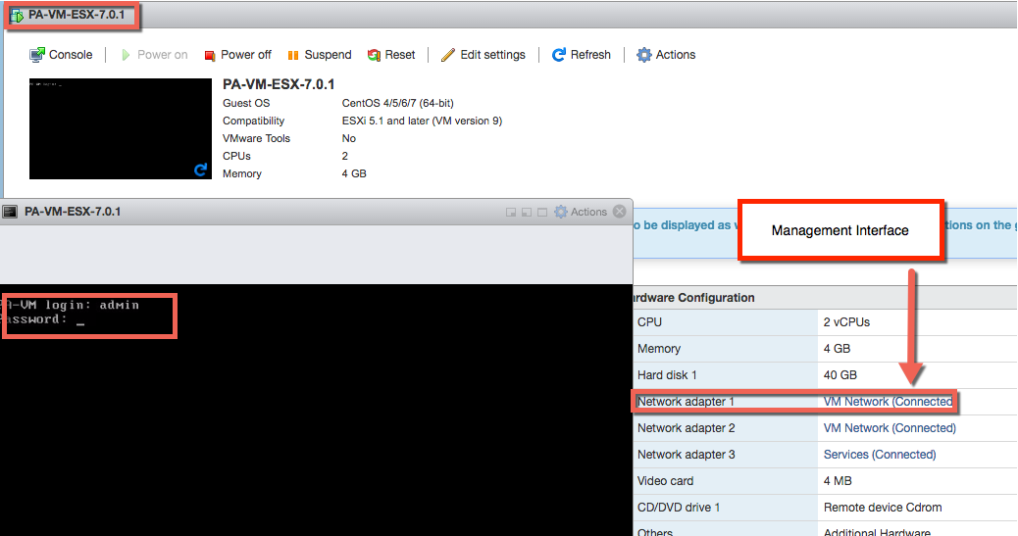
Access VM-100 Console Login

Slide 17
VM-100 WebUI Access
WebUI Connection to Management Interface
Management interface is Network Adapter 1 on your VM-100
Network Adapter 1 is connected to vSwitch0, port group VM Network
You will access Management interface WebUI via a PC on your competition/corporate network
You will need to change the IP address of your management interface to be on same network as your competition/corporate network via CLI

Slide 18


Change Mgt Int IP Address to Access WebUI from PC on Competition/Corporate Network
Change Mgt Int IP address
vSwith0
Mgt Int
Competition Network
vmnic0
Trust-VW
Ingress
Untrust-VW
Egress
Access WebUI
Url = https://mgt ipaddress
ESXi

Slide 19
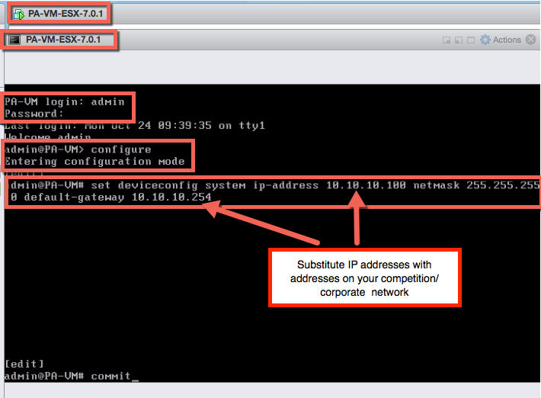
Changing the VM-100’s Mgt Interface IP Address
Management interface default address is 192.168.1.1, ping, https and ssh allowed by default
After logging into your VM-100 change to configuration mode by entering command “configure”
Enter the following command: ”set deviceconfig system ip-address x.x.x.x netmask x.x.x.x default-gateway x.x.x.x”
The x.x.x.x addresses should be on your competition/corporate network
Enter command “commit” to commit changes

Slide 20
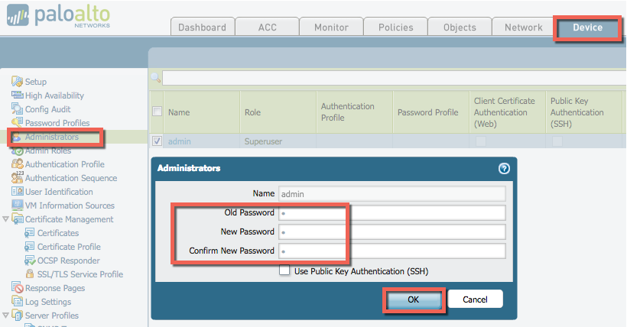
Access the VM-100 WebUI and Change Admin Password
From a PC on your competition/corporate network open browser
Enter https://<your mgt int ip address> as URL and log on using username: admin and password: admin
Go to Device tab>Setup>Administrators
Click admin user and change default password

Slide 21
In WebUI, Configure Timezone and DNS
Navigate to Device tab>Setup>Management>General Settings and click setting’s gear wheel.
Confirm or Change time zone
Navigate to Device tab>Setup>Management>Services and click settings gear wheel
Enter DNS server address for your management interface
Your management interface has to be connected to public Web to receive licenses, signature updates and URL category updates
Add NTP server address for accurate time for logs
Commit All of your changes

Slide 22
Change Admin Password

Slide 23
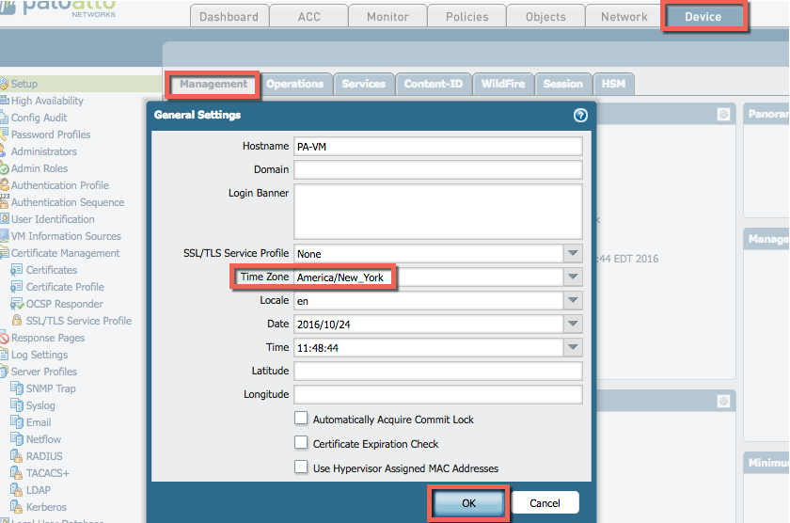
Change Time Zone if Necessary

Slide 24
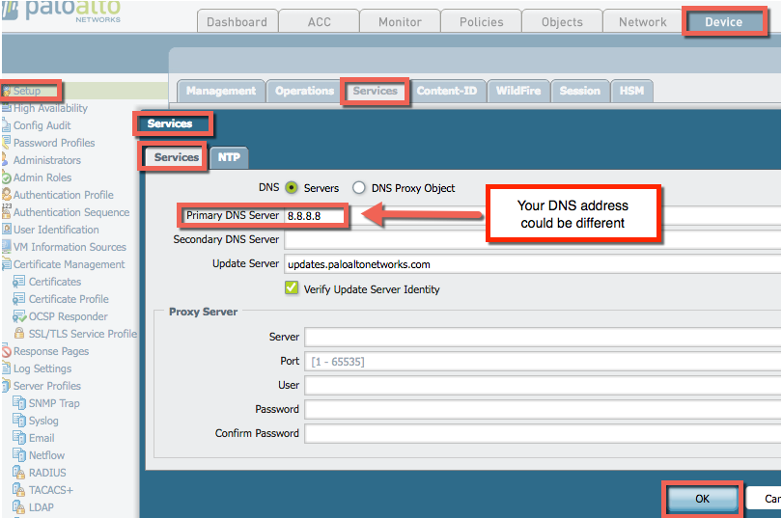
Configure DNS for Mgt Interface

Slide 25
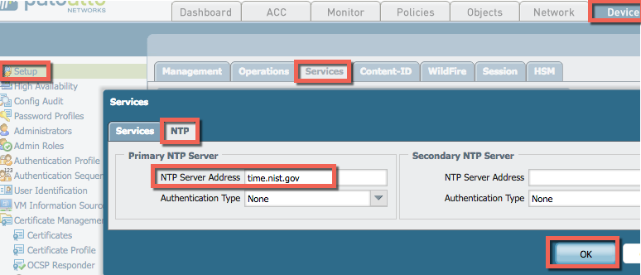
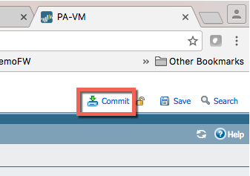
Configure NTP for Accurate Log Times and Commit

Slide 26
Install Licenses
In WebUI, navigate to Device tab>Licenses> License Management
Click ”Activate feature using authorization code”
Enter the authcode provided to your team
Your firewall will install licenses and reboot
You should have the following licenses
PA-VM
GlobalProtect Portal
Threat prevention
Global Protect Gateway
PAN-DB URL Filtering
Wildfire

Slide 27
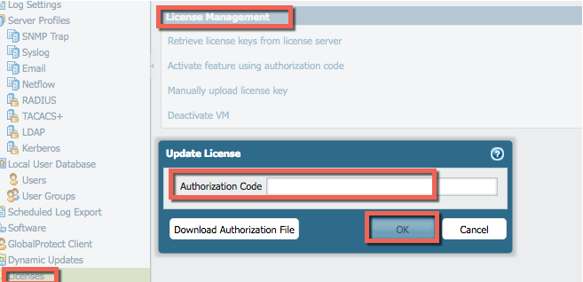
Install Authorization Code

Slide 28
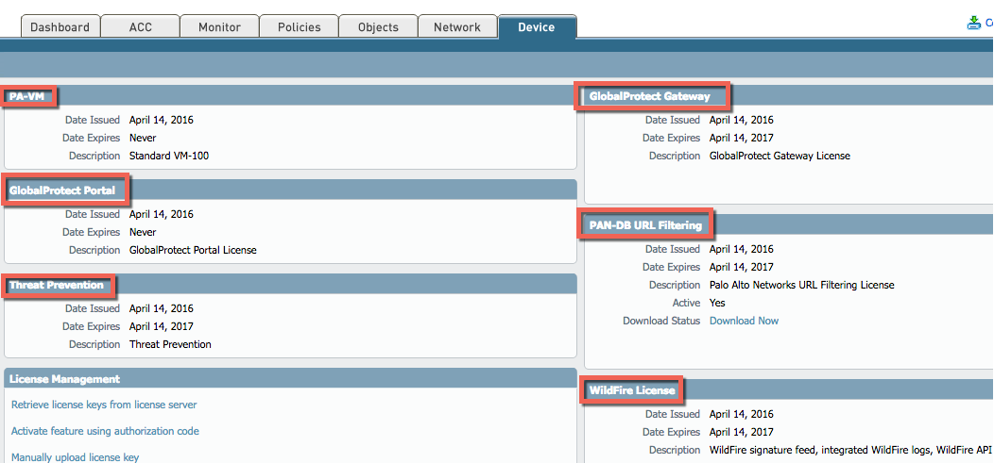
Licenses Installed After Reboot

Slide 29
Dynamic Updates of Signatures
In your WebUI, naviage to Device tab>Licenses>Dynamic Updates and click ”Check Now”
Download and install signatures
Click ”Check Now” again and download and install signatures again
Commit your changes
Set up schedule for Wildfire automatic updates
For 7.0 OS every 15 minutes
For 7.1 OS ever 5 minutes
Commit your changes

Slide 30
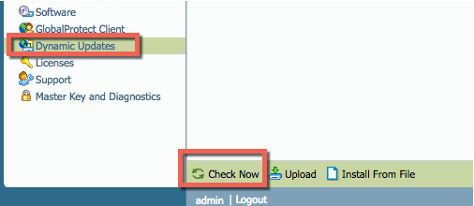
Dynamic Updates – Check Now

Slide 31
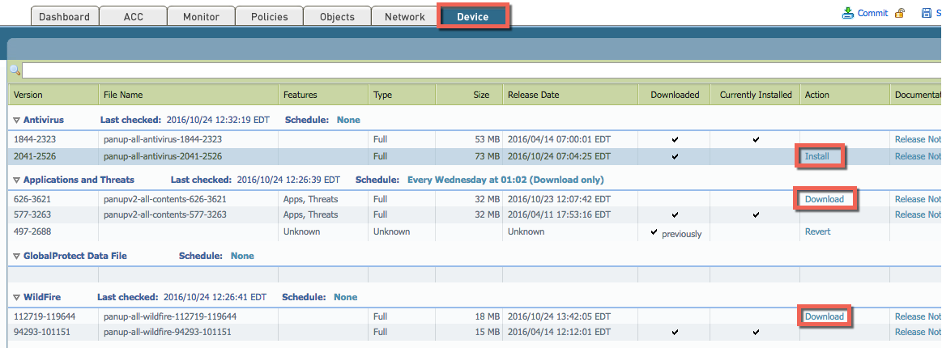
Download and Install Signatures

Slide 32
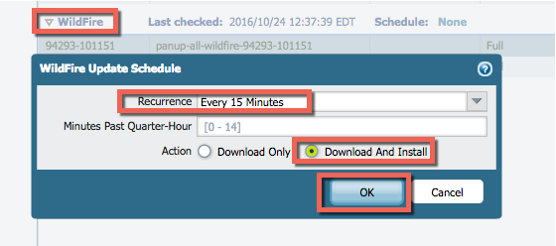
Wildfire Schedule

Slide 33
Configure Your Network for Virtual Wire
Configure Virtual Wire Zones
In WebUI, navigate to Network tab>Zones and click Add to add new zone
Name Zone Untrust-VW, select Virtual Wire for Type and click OK
Click Add again to add another Zone
Name Zone Trust-VW, select Virtual Wire for Type and click OK
Configure Interfaces for Virtual Wire
Navigate to Network tab>Interfaces and select Ethernet1/1
For Interface Type, select Virtual Wire
For Security Zone, select Untrust-VW
This will be your Egress interface connecting to Competition Network
Select interface Ethernet1/2
For interface Type, select Virtual Wire
For Security Zone select Trust-VW
This will be your Ingress interface for your Server VMs to access Competition Network

Slide 34
Configure Your Network for Virtual Wire (Continued)
Configure your Virtual Wire Object
Navigate to Network tab>Virtual Wires and click Add to add a virtual wire object
Name Virtual Wire object “SimpleVwire”
Select ethernet1/1 for Interface1 and select ethernet1/2 for Interface2 and click OK
Commit all your changes

Slide 35
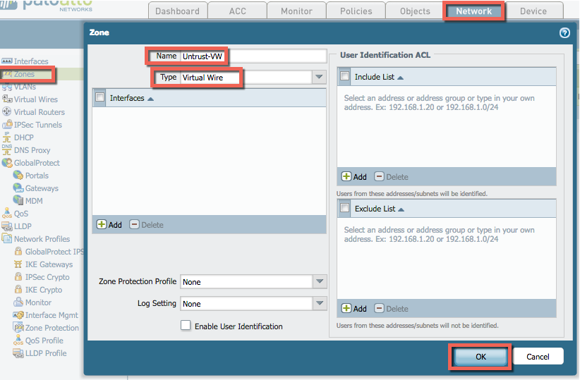
Virtual Wire Untrust-VW Zone

Slide 36
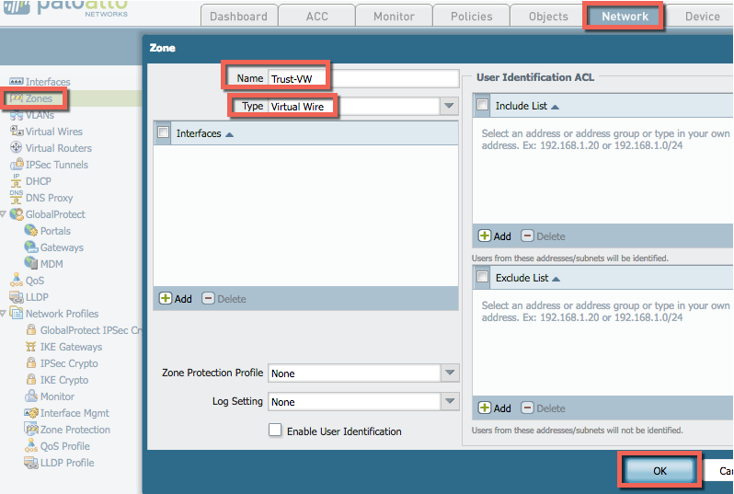
Virtual Wire Trust-VW Zone

Slide 37
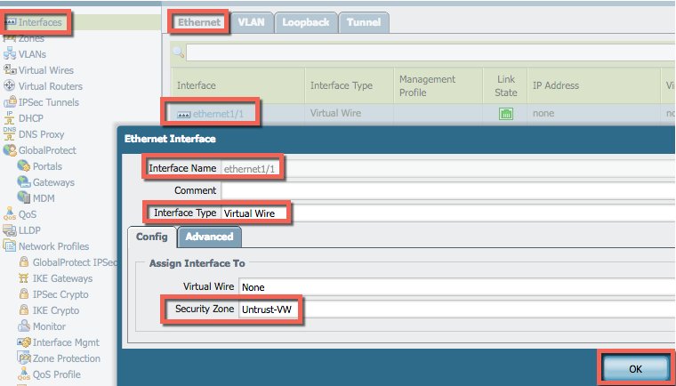
Ethernet1/1 Interface

Slide 38
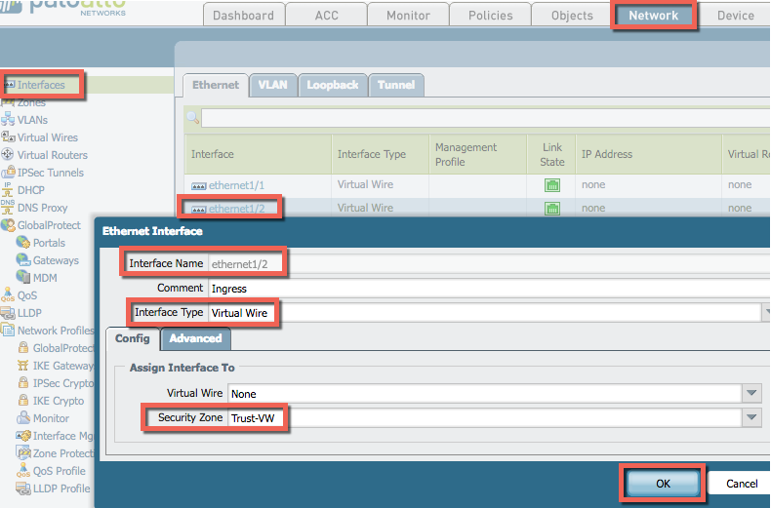
Ethernet1/2 Interface

Slide 39
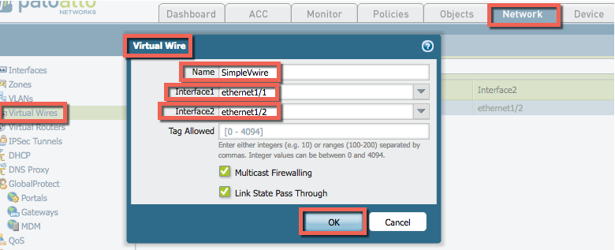
Virtual Wire

Slide 40
Determine Egress and Ingress Traffic to Allow
By default all Intra zone traffic is allowed and all inter zone traffic is blocked
Determine what outbound access you want to provide for your server VMs, some examples:
Windows update server, (http://windowsupdate.microsoft.com)
External DNS if you don’t have an internal DNS
Search Engines, (www.google.com)
Web browsing
SSL
Determine what Inbound access you want to provide to your server VMs
This should match services your Server VMs are providing to public/competition network
For Example if you’re providing public DNS then you would need to allow DNS from Untrust-VW zone to Trust-VW Zone

Slide 41
Configure Your Outbound Security Policy
In WebUI, navigate to Policies tab>Security and click Add to add a Security Policy
Name your policy Vwire Outbound
Source Zone is Trust-VW
Destination Zone is Untrust-VW
Applications: Only what you absolutely need such as web-browsing, google-base, ssl, office 365 etc (the less the better)
For services/url select application default and for URL consider restricting categories to computer and internet info and search engines
For Actions tab select allow and for Profile Setting add the following profiles to alert and block malware
Antivirus select “default”
Vulnerability Protection select “strict”
Antispyware select “strict”
URL Filtering select “default”
Wildfire analysis select “default”

Slide 42
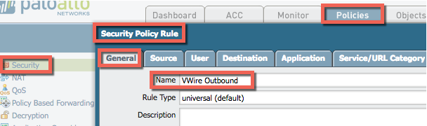
Outbound Security Policy General

Slide 43
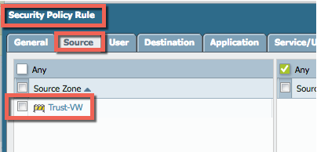
Outbound Security Policy Source

Slide 44
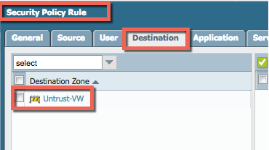
Outbound Security Policy Destination

Slide 45
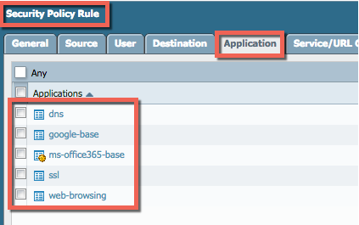
Outbound Security Policy Application

Slide 46
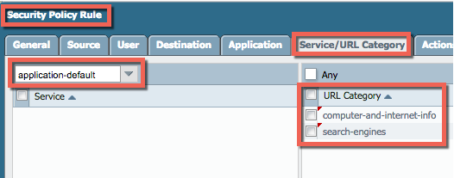
Outbound Security Policy Service/URL Category

Slide 47
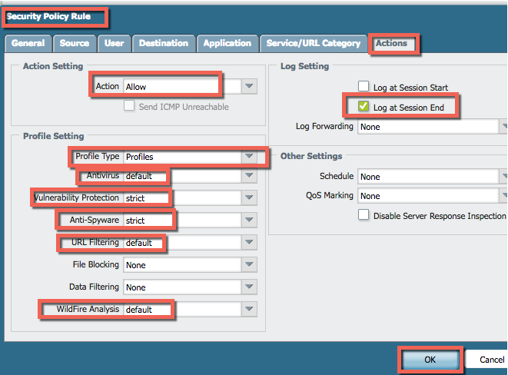
Outbound Security Policy Actions

Slide 48
Configure Your Inbound Security Policy for Your Server VMs
In WebUI, navigate to Policies tab>Security and click Add to add a Security Policy
Name your policy Vwire Inbound
Source Zone is Utrust-VW
Destination Zone is Trust-VW
Applications: Only what you absolutely need to allow for your public services such as web-browsing, ftp, smtp, dns, ssl
For services/url select application default
For Actions tab select allow and for Profile Setting add the following profiles to alert and block malware
Antivirus select “default”
Vulnerability Protection select “strict”
Antispyware select “strict”
URL Filtering select “default”
Wildfire analysis select “default”

Slide 49
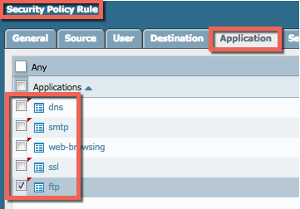
Inbound Security Policies Application Tab
Add Applications that your Server VMs are providing to public
DNS
SMTP
Web-browsing
SSL
FTP

Slide 50
Monitor Your traffic and Adjust Your Security Policies
Navigate to Monitor tab and examine all your logs periodically
Adjust your security policies and consult Admin Guide
Consider adding open source IP blocklists
Consider setting up decryption policies
Consider providing DDOS protection via Zone Protection Profile and DoS Policies

Slide 51
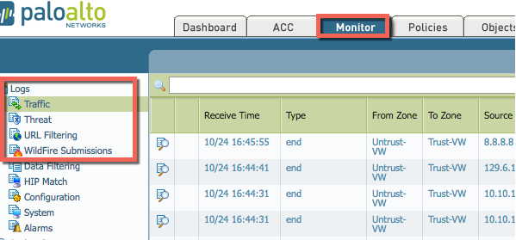
Logs

