Slide 1

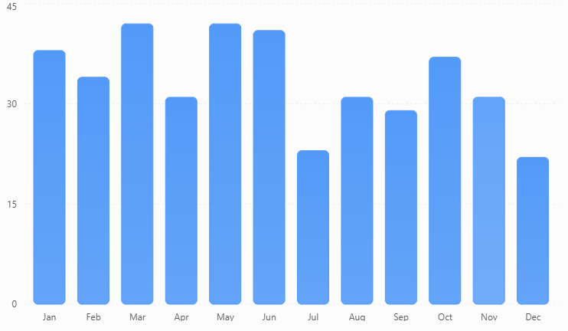
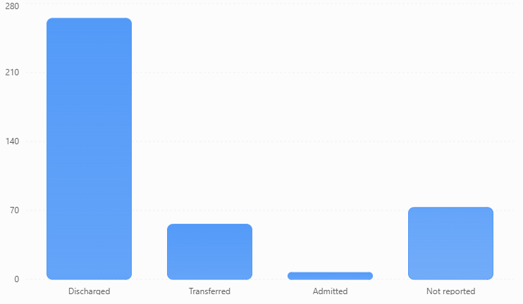
Using Syndromic Surveillance to Describe Hospital Disposition Patterns Following Suspected Overdose and Poisoning in a Medically Underserved Community
Adriana D. Morales, MS, LCDC
Health Opioid Abatement | City of Laredo Public Health Department · APHA 2026, Abstract #586221
INTRODUCTION OR ABSTRACT
MATERIALS & METHODS
CONCLUSIONS
Hospital encounters involving suspected drug overdose and poisoning represent important opportunities for prevention and linkage to treatment. In Laredo, Texas, a medically underserved U.S.–Mexico border community, Laredo Public Health identified 401 suspected overdose/poisoning hospital encounters in 2025 through secondary review of syndromic surveillance data. Understanding documented hospital disposition patterns may support collaboration between public health and healthcare systems to strengthen post-overdose prevention efforts.
Study Design: Retrospective, descriptive observational study.
Setting and Period: Two hospitals in Laredo, Texas; January–December 2025.Data Source: ESSENCE syndromic surveillance data provided by the Laredo Public Health Epidemiology Department.
Sample Selection: An initial 706 encounters were identified through existing CDC surveillance queries incorporating chief complaint and discharge diagnosis information. A single researcher manually reviewed all original chief complaints and retained 401 encounters (56.8%) meeting the study's suspected overdose/poisoning criteria.
Inclusion Criteria: Current suspected overdose, poisoning, potentially excessive or unknown-quantity medication ingestion, or acute altered mental status/unresponsiveness associated with suspected substance exposure.
Analysis: Descriptive statistics summarized demographics, monthly encounter counts, researcher-classified intent, and disposition outcomes. Intent was categorized as Accidental/Unintentional, Intentional/Self-Harm, or Not Stated/Unclear.
Denominators: Overall percentages use 401 encounters unless a specific subgroup denominator is identified. Encounters, not unique patients, were the unit of analysis.
Most selected suspected overdose/poisoning encounters were categorized as discharged; however, ESSENCE does not capture the full range of post-overdose care or discharge services. Findings provide a starting point for collaboration between Laredo Public Health and hospital partners to examine existing practices, identify potential prevention opportunities, and support technical assistance.
Limitation: Single-researcher chief complaint classification introduces potential misclassification, and 18.2% of encounters lacked a reported disposition.
OBJECTIVES
REFERENCES
To examine hospital encounter characteristics, temporal patterns, documented intent, and discharge disposition among suspected drug overdose and poisoning encounters in Laredo, Texas, using ESSENCE syndromic surveillance data.
1. Vivolo-Kantor AM, et al. Vital signs: Trends in emergency department visits for suspected opioid overdoses—United States, July 2016–September 2017. *MMWR.* 2018;67:279–285. https://doi.org/10.15585/mmwr.mm6709e1
2. Holland KM, et al. Trends in US emergency department visits for mental health, overdose, and violence outcomes before and during the COVID-19 pandemic. *JAMA Psychiatry.* 2021;78(4):372–379. https://doi.org/10.1001/jamapsychiatry.2020.4402
3. Centers for Disease Control and Prevention. *PHIN Messaging Guide for Syndromic Surveillance.* Release 2.0. Appendix G: Discharge Disposition Value Set. 2015. https://www.cdc.gov/nssp/documents/guides/syndrsurvmessagguide2_messagingguide_phn.pdf
4. Syndromic Surveillance Knowledge Repository. *CDC All Drug Overdose v3 Parsed.* https://knowledgerepository.syndromicsurveillance.org/cdc-all-drug-overdose-v3-parsed
RESULTS
ADDITIONAL KEY FINDINGS
66.1%265 of 401 suspected overdose/poisoning encounters were classified as discharged. Existing syndromic surveillance data can help local public health departments begin informed conversations with healthcare partners about overdose prevention and continuity of care.
Intent: Not Stated/Unclear in 271 encounters (67.6%); Accidental/Unintentional in 89 (22.2%); Intentional/Self-Harm in 41 (10.2%).
Transfers: Of 56 transferred encounters, 36 (64.3%) were coded as transfer to a psychiatric hospital or unit.
Intent and transfer: Among 41 Intentional/Self-Harm encounters, 26 (63.4%) were transferred.
Additional discharge classifications: Of 265 discharged encounters, 15 (5.7%) were coded as left against medical advice and 17 (6.4%) as discharged to law enforcement/custody.
Death disposition: No encounters were coded with an in-hospital death disposition; this does not establish that no deaths occurred.
Figure 1 — Temporal Distribution
Figure 2 — Discharge Disposition
ACKNOWLEDGEMENTS
CONTACT
Figure 1. Temporal distribution of suspected overdose/poisoning hospital encounters, January–December 2025 (N = 401). Monthly counts represent selected encounters, not overdose rates among all hospital encounters.
Figure 2. Discharge disposition of selected hospital encounters (N = 401).66.1% discharged, 14.0% transferred, 1.7% admitted, and 18.2% not reported. Percentages are based on all 401 included encounters.
The author acknowledges the City of Laredo Public Health Department's Epidemiology Department for providing the ESSENCE surveillance dataset and supporting local overdose surveillance efforts.
Contact email: admorales@ci.laredo.tx.us
Full Research Report: Available through QR code

