Slide 1






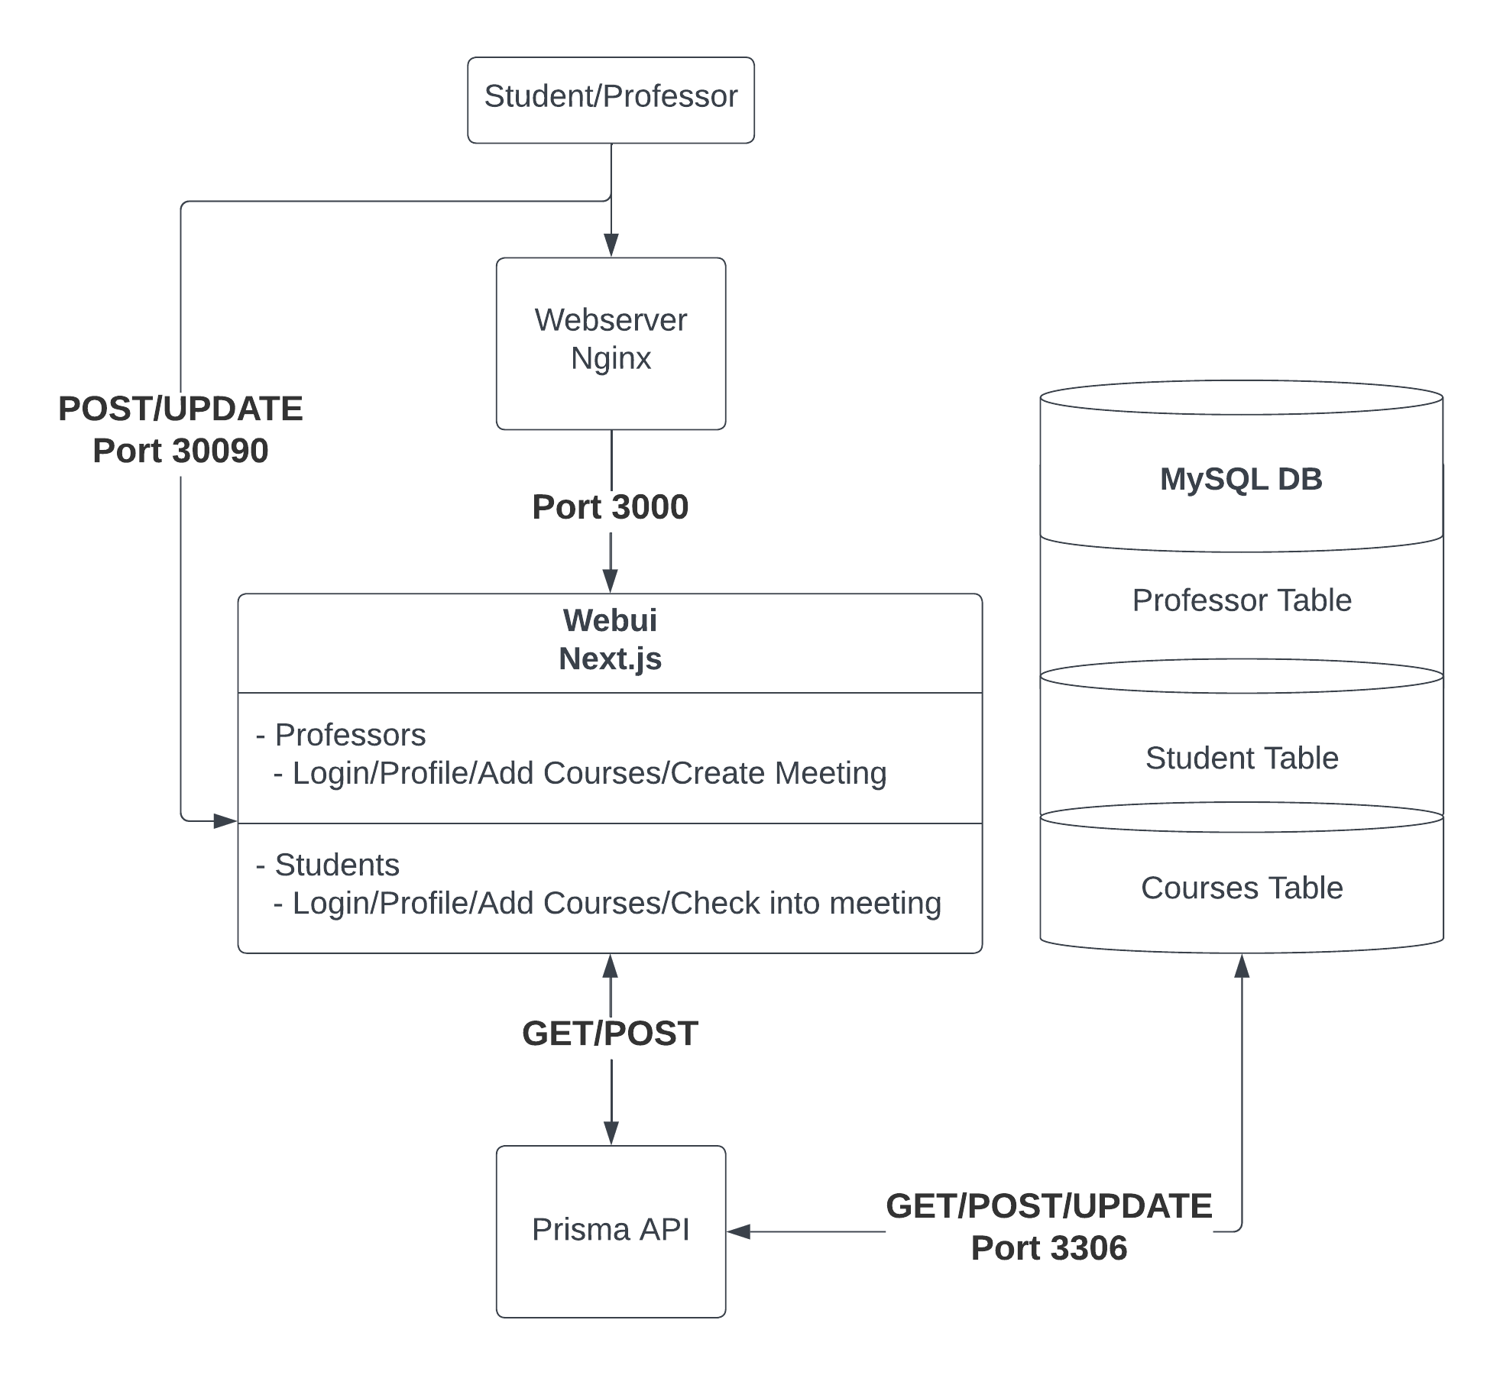
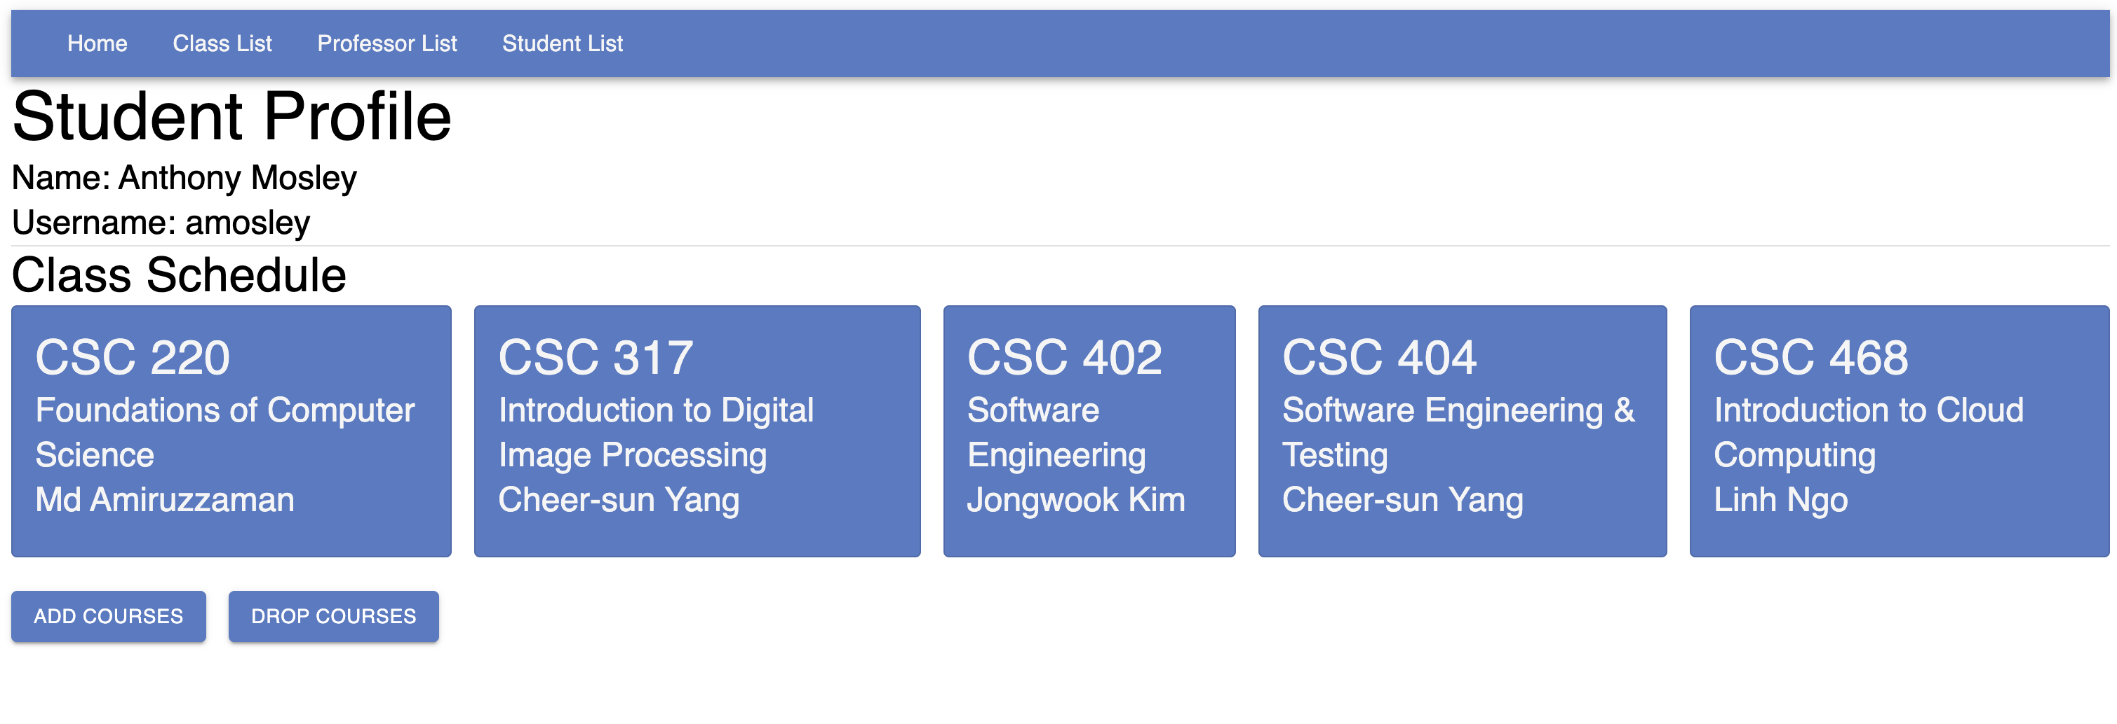
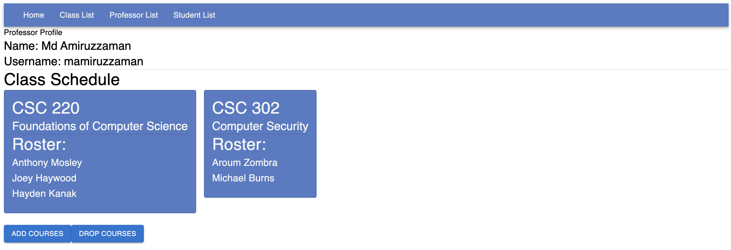
Attend & Learn
Anthony Mosley, Aroum Zombra, Hayden Kanak, Joseph Haywood, Michael Burns https://github.com/AJMosley345/CSC468-Project
Team Vision
Design & Implementation
CI/CD Application
Attend & Learn is a cloud-based attendance system for West Chester University students and faculty. For students, the service is similar to MyWCU, where students can login using username ID and password, select classes, and see what professors are instructing which classes. For faculty, they are able to view the attendance roster for each course they are instructing. While having similar capabilities to MyWCU, Attend & Learn creates a much more user-friendly environment that is more inviting to users. Attend & Learn was designed to make attending class more intuitive for both, students and faculty.
WebUI: Utilizing Next.js which uses powerful page routing to have multiple pages. Used to create indivudal pages for each student, professor, a class lsit, and add class page.
Webserver: Created on Nginx using a reverse proxy to serve content more easily.
Database: MySQL database with multiple tables for storing professor and student info. Chose mySQL for its ease of making relational tables.
Prisma API: An API connected to our mySQL database. Takes care of queries and table creation, powerful for getting the necessary and appropriate data from each table.
Using Jenkins for Attend & Learn to build and test autonomously through Kubernetes cluster. ​
​
Dev pushes files to GitHub, then it triggers a build pushing it to Jenkins, then with Kubernetes it automates and tests the build, then to DockerHub which deploys the container and images. ​
Technical Diagram
WebUI
Student View
Professor View

