Slide 1
GAS LEAKAGE DETECTION AND ALERT SYSTEM (USING ESP32 AND THINGSPEAK)
SUBMITTED BY:
AJNA SAJ(24BAI0270)
B.TECH CSE (AI&ML), VIT VELLORE

Slide 2
AIM
To design and simulate an IoT-based Gas Leakage Detection and Alert System using an ESP32 microcontroller, MQ-2 gas sensor, and ThingSpeak cloud platform to detect hazardous gas concentrations and provide visual, audible, and cloud-based alerts.

Slide 3
PROBLEM STATEMENT
Unnoticed gas leaks in residential and industrial environments pose significant safety hazards, including fire and explosions. Existing manual or periodic inspection methods are often unreliable and may fail to provide timely warnings. Therefore, there is a need for an automated, low-cost system that continuously monitors gas concentration levels, provides immediate local alerts when dangerous levels are detected, and transmits real-time notifications to remote users or authorities, enabling rapid response and reducing potential risks.

Slide 4
SCOPE OF SOLUTION
Scope
Simulation-based implementation using Wokwi.
Remote monitoring through ThingSpeak integration.
Validation under safe and leak conditions.
Limitations
Requires internet connectivity for cloud services.
Threshold calibration is simulation-specific.
Does not support SMS, email, or mobile notifications.

Slide 5
OBJECTIVES
Detect combustible gas using MQ-2 sensor
Display gas concentration on LCD
Indicate safe and unsafe conditions using LEDs
Sound a buzzer when gas concentration exceeds a threshold
Upload sensor readings to ThingSpeak
Enable cloud-based monitoring and visualization

Slide 6
COMPONENTS USED
COMPONENT | QUANTITY
ESP32 Development Board | 1
MQ-2 Gas Sensor | 1
16×2 I2C LCD | 1
Red LED | 1
Green LED | 1
Buzzer | 1
220 Ω Resistors | 2
Jump Wires | As required
Wokwi Simulator | 1
ThingSpeak Platform | 1

Slide 7
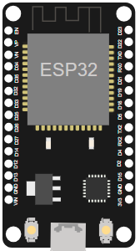
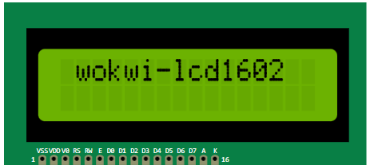
COMPONENTS USED
The ESP32 is a popular WiFi and Bluetooth-enabled microcontroller, widely used for IoT Projects. Wokwi simulates the ESP32, ESP32-C3, ESP32-S2, ESP32-S3, ESP32-C5 (alpha), ESP32-C6, ESP32-C61, ESP32-H2, ESP32-S31 (alpha), and ESP32-P4 (beta).
An LCD with 2 lines, 16 characters per line.

Slide 8

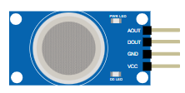
COMPONENTS USED
The piezoelectric buzzer is used to provide an audible warning whenever a gas leak is detected. In the Wokwi simulation, it is activated by the ESP32 when the gas concentration surpasses the safety limit, alerting nearby users to a potentially hazardous condition.
The MQ-2 gas sensor module is used in Wokwi to simulate the detection of combustible gases and smoke by producing an analog output proportional to the gas concentration.

Slide 9

COMPONENTS USED
The standard 5 mm LED serves as a visual indicator of the system status. In this project, the green LED indicates normal operating conditions, while the red LED lights up when a gas leak is detected.
A resistor is used to limit the amount of current flowing through the LEDs, preventing damage to the components.

Slide 10
CIRCUIT DESCRIPTION
MQ-2 AOUT → GPIO34
MQ-2 VCC → 5V
MQ-2 GND → GND
Red LED → GPIO19
Green LED → GPIO18
Buzzer → GPIO23
LCD SDA → GPIO21
LCD SCL → GPIO22
LCD VCC → 5V
LCD GND → GND

Slide 11
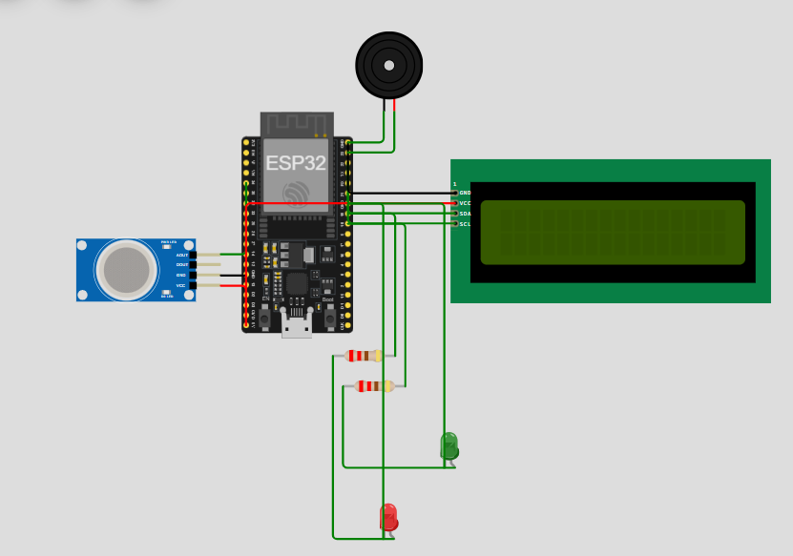
SIMULATED CIRCUIT DIAGRAM

Slide 12
WORKING PRINCIPLE
The proposed gas leakage detection system continuously monitors the concentration of combustible gases using an MQ-2 gas sensor connected to an ESP32 microcontroller. The analog output of the sensor is read through GPIO34 and compared with a predefined threshold value of 2600 ADC units.
When the measured gas concentration is below the threshold, the environment is considered safe. The ESP32 turns on the green LED, keeps the buzzer turned off, and displays “All Clear” on the LCD screen. A status value of 0 is assigned to indicate a safe condition.
When the gas concentration exceeds the threshold value, the ESP32 detects a gas leak. The red LED is switched on, the green LED is turned off, the buzzer is activated, and the LCD displays “Gas Detected!”. A status value of 1 is assigned to indicate a leak condition.
The ESP32 uploads the gas concentration and status information to the ThingSpeak cloud platform every 15 seconds through a WiFi connection, enabling real-time remote monitoring and data visualization.

Slide 13
WORKING PRINCIPLE FLOWCHART
START
INITIALISE ESP32, LCD,WIFI
READ MQ2 SENSOR VALUE
NO
GAS VALUE>2600
YES

Slide 14
WORKING PRINCIPLE FLOWCHART
GREEN LED ON
BUZZER OFF
LCD: ALL CLEAR
STATUS=0
RED LED ON
BUZZER ON
LCD: GAS DETECTED!
STATUS=1
UPLOAD TO THINGSPEAK
REPEAT

Slide 15
ThingSpeak Integration
ThingSpeak was used as the cloud platform for storing and visualizing gas concentration data. The ESP32 connects to the Wokwi-GUEST WiFi network and sends sensor readings to ThingSpeak using HTTP GET requests.
Two fields were configured in the ThingSpeak channel:
FIELD | DESCRPTION
FIELD 1 | GAS CONCENTRATION
FIELD 2 | STATUS ( 0=SAFE, 1=LEAK)
The ESP32 uploads data at an interval of 15 seconds, complying with the limitations of the free ThingSpeak service.

Slide 16
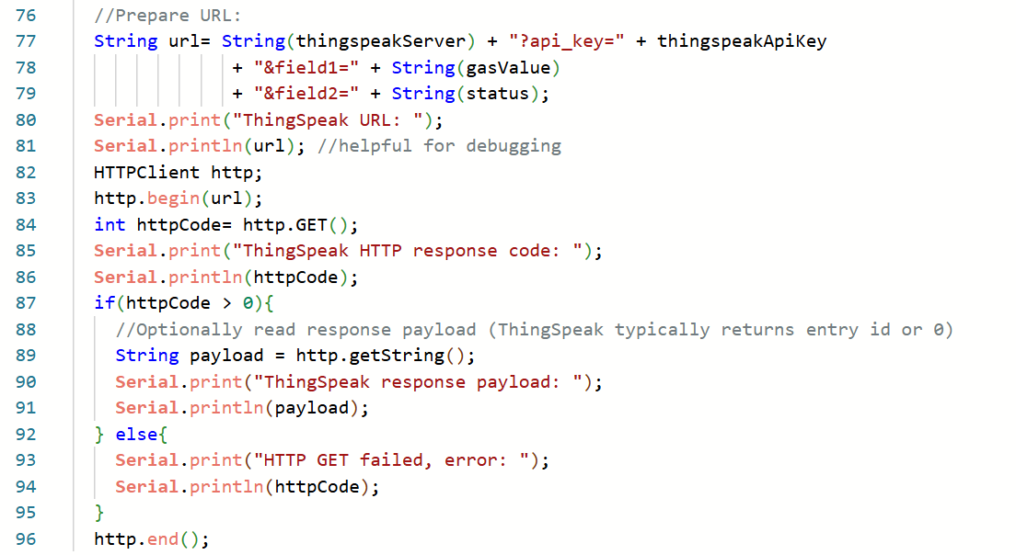
ThingSpeak Integration
CODE SNIPPET

Slide 17
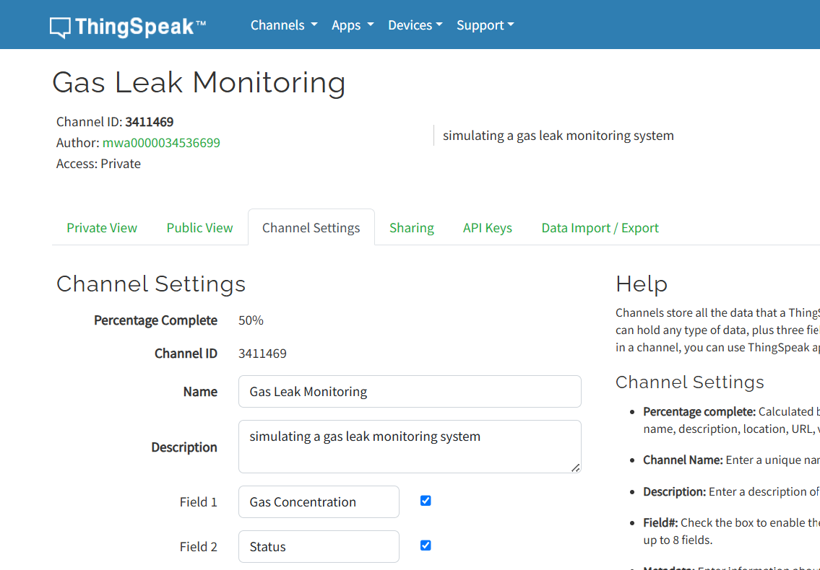
ThingSpeak Integration

Slide 18
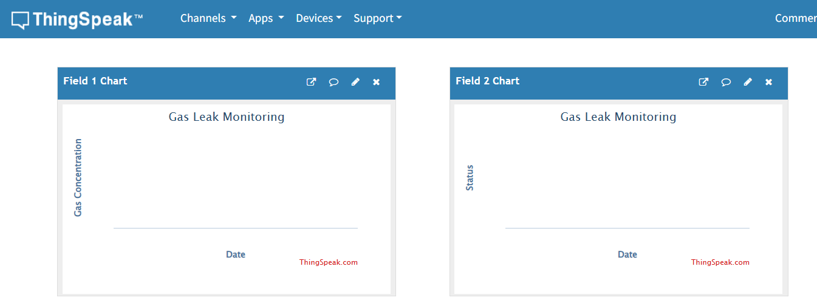
ThingSpeak Integration
THE GRAPHS BEFORE ANY SIMULATION, RIGHT AFTER CREATING THE CHANNEL.

Slide 19
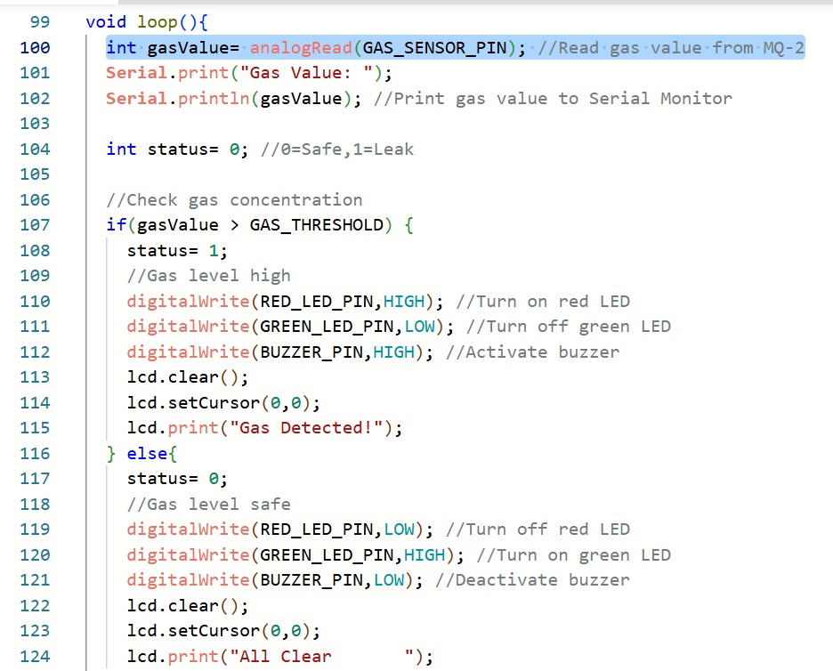
PROGRAM IMPLEMENTATION
Main Functionalities of the Program
During the setup phase, serial communication, LCD display, LEDs, buzzer, and WiFi connectivity are initialized.
The ESP32 program performs five major tasks:
1. Sensor Data Acquisition
The analog output of the MQ-2 gas sensor connected to GPIO34 is continuously monitored.
2. Gas Leak Detection
The sensed gas concentration is compared against a predefined threshold value of 2600 ADC units

Slide 20
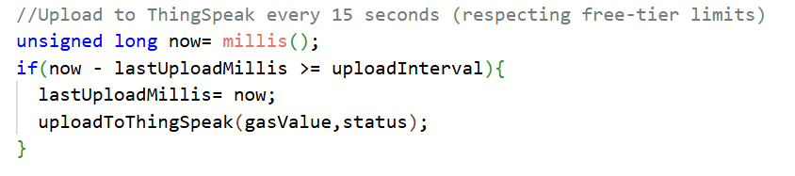
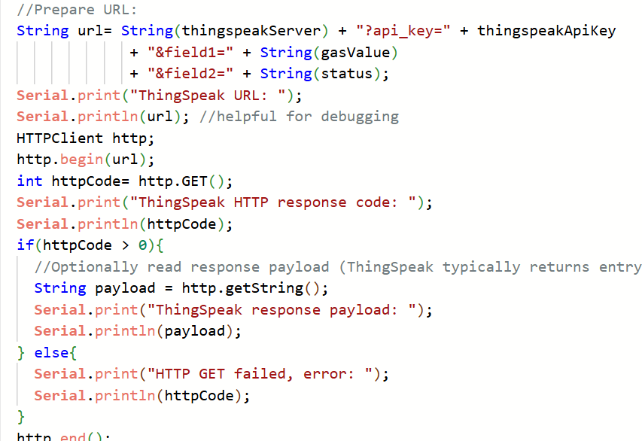
PROGRAM IMPLEMENTATION
3. Local Alert Generation
Depending on the gas concentration, the ESP32 controls the LEDs, buzzer, and LCD display.
4. WiFi Connectivity
The ESP32 establishes a connection with the Wokwi-GUEST network to enable cloud communication.
5. ThingSpeak Data Upload
Gas concentration and leak status are uploaded to ThingSpeak every 15 seconds using HTTP requests

Slide 21
EXPERIMENTAL RESULT: SAFE-TO-LEAK TEST
Test Procedure
The system was initially operated under safe conditions by setting the MQ-2 gas sensor to its minimum concentration level. Halfway through, the gas concentration was gradually increased to simulate a leakage scenario. The response of the local alert system and the data uploaded to ThingSpeak were observed.
PARAMETER | SAFE CONDITION | LEAK CONDITION
GAS CONCENTRATION | 843 | 4041
STATUS VALUE | 0 | 1
LCD DISPLAY | ALL CLEAR | GAS DETECTED!
GREEN LED | ON | OFF
RED LED | OFF | ON
BUZZER | OFF | ON

Slide 22
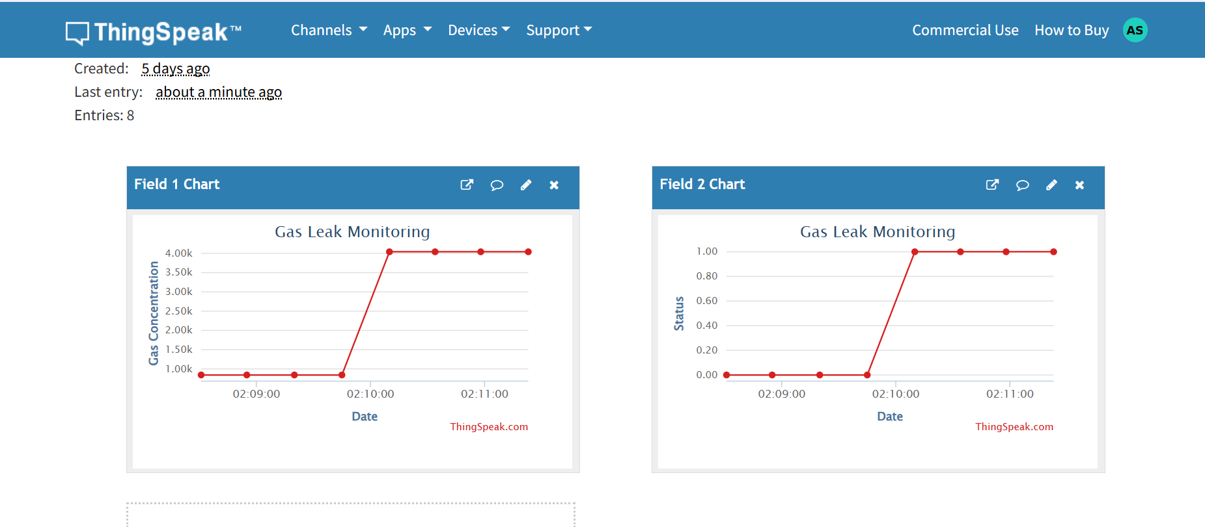
EXPERIMENTAL RESULT: SAFE-TO-LEAK TEST
Result
The developed system successfully identified the transition from a safe state to a gas leakage condition. Upon exceeding the threshold value of 2600 ADC units, the ESP32 activated the buzzer, illuminated the red LED, updated the LCD display with "Gas Detected!", and transmitted the corresponding gas concentration and status information to ThingSpeak. The cloud graphs clearly depict the transition from Status = 0 (Safe) to Status = 1 (Leak), demonstrating reliable real-time monitoring and alert generation.

Slide 23
CONCLUSION
The proposed IoT-based Gas Leakage Detection and Alert System was successfully designed and simulated using ESP32 and Wokwi. The system continuously monitored gas concentration using an MQ-2 sensor and accurately detected hazardous gas levels using a predefined threshold of 2600 ADC units.
Upon detecting a gas leak, the ESP32 activated a buzzer, illuminated a red LED, displayed warning messages on the LCD, and transmitted sensor readings to ThingSpeak for cloud-based monitoring. The experimental results demonstrated reliable operation under both safe and leak conditions, validating the effectiveness of the proposed system for real-time gas leakage detection and alert generation

Slide 24
PROJECT REPOSITORY

