Slide 1
VK
VK DSA SHEET
Master Patterns. Solve Problems. Level Up.
The only free, open-source DSA practice sheet that unifies LeetCode, GeeksforGeeks, TakeUForward and Codeforces — organized by pattern, with built-in progress tracking and a personal knowledge base.
https://vk-dsa-sheet-aw7j.vercel.app/
React + Firebase + Vercel
Ajnabh Koushik Baruah ✉ ajnabhb.ug24.cs@nitp.ac.in ⌘ github.com/AJNABH-KOUSHIK

Slide 2
THE PROBLEM
Every platform promotes its own sheet
Students bounce between four or five sites with no single place to track progress — and none of them think in patterns.
LeetCode
HAS Huge question bank
MISSING No pattern roadmap, no cross-platform tracking
TakeUForward
HAS Striver's SDE Sheet
MISSING Limited to their own curated list
GeeksforGeeks
HAS Topic-wise problems
MISSING No unified progress tracking
Codeforces
HAS Competitive problems
MISSING No structured DSA sheet at all
VK DSA SHEET
2

Slide 3
THE IDEA
One place for everything a
DSA journey actually needs
No website combined LeetCode, GFG, TUF and Codeforces with pattern names and a real progress tracker. So this was built.
All patterns, not just topics
Questions from every major platform
Separate Completed vs Revise tracking
A personal bookshelf
Saved links & editorials
Personal notes per topic
A calendar of practice history
Easy / Medium / Hard breakdown
VK DSA SHEET
3

Slide 4
CORE DSA SHEET
16 pattern categories, not just topics
Each pattern breaks down further into sub-patterns — e.g. Arrays → Traversal, Rotation, Kadane's Algorithm — with problems pulled from every platform.
01
02
03
04
Arrays
Binary Search
Strings
Bit Manipulation
05
06
07
08
Linked List
Two Pointers
Sliding Window
Stacks & Queues
09
10
11
12
Greedy Algorithms
Heaps
Binary Trees
BST
13
14
15
16
Graphs
Tries
Dynamic Programming
+ More Added Regularly
VK DSA SHEET
4

Slide 5




PROGRESS TRACKING
Know exactly where you stand
Completion Tick
Revision Tick
Difficulty Counter
Beats Percentage
Mark any question done the moment you solve it.
A separate flag for problems that need a second pass.
Live Easy / Medium / Hard split across the whole sheet.
See how your pace compares to other solvers.
Array Traversal
5 / 16 solved
VK DSA SHEET
5

Slide 6





BEYOND THE SHEET
A calendar and a personal knowledge vault
Search
Practice Calendar
Instantly find any pattern or question.
GitHub-style streak tracking with a full monthly view and a detailed daily practice history.
Books
S
M
T
W
T
F
S
A shelf for recommended reads plus your own favourites.
1
2
3
4
5
6
7
8
9
10
11
12
Links
13
14
15
16
17
18
19
Save YouTube videos, articles and editorials for later.
20
21
22
23
24
25
26
27
28
29
30
31
Notes
Write personal notes against any topic or problem.
VK DSA SHEET
6

Slide 7
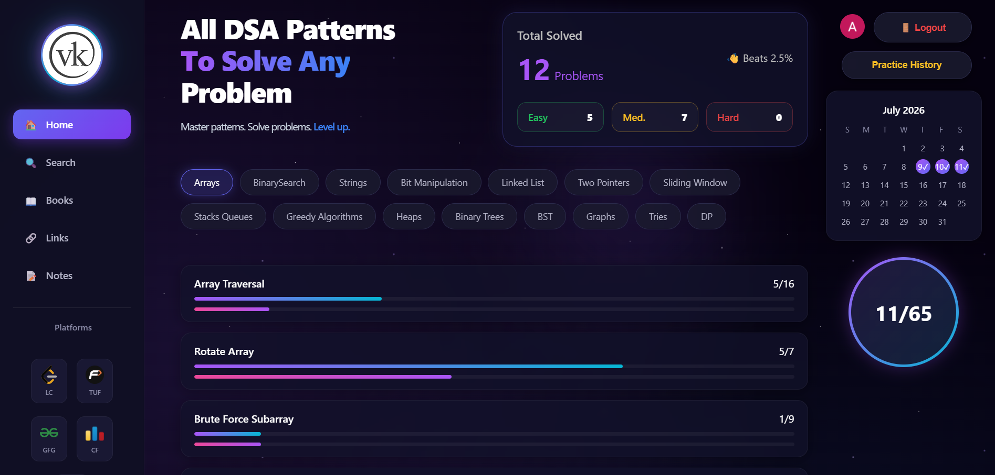
PRODUCT WALKTHROUGH
The dashboard, live
VK DSA SHEET
7

Slide 8





UNDER THE HOOD
Built lean, ships fast
React
Firebase Auth
Cloud Firestore
Component UI
Secure login
Real-time data
React Router
Custom CSS3
Vercel
Client routing
Dark theme + motion
Deployment
VK DSA SHEET
8

Slide 9
HOW IT WORKS
From first visit to daily habit
01
02
03
04
05
Browse Freely
Sign Up
Pick A Pattern
Track Progress
Build The Habit
Explore every pattern with no login required.
Firebase Authentication in a couple of clicks.
Drill into sub-patterns and platform-sourced questions.
Mark Complete or Revise; synced live to Firestore.
Calendar, notes, books and links keep you coming back.
VK DSA SHEET
9

Slide 10
WHY IT'S DIFFERENT
One sheet, every advantage
Feature
LeetCode
TUF
GFG
NeetCode
VK DSA Sheet
Pattern-wise roadmap
–
own only
–
own only
✓
Multi-platform questions
–
–
–
–
✓
Progress tracking
premium
✓
–
✓
✓
Revision tracking
–
–
–
–
✓
Practice calendar
✓
–
–
–
✓
Personal notes & books
–
–
–
–
✓
Completely free
–
✓
✓
–
✓
VK DSA SHEET
10

Slide 11
READY WHEN YOU ARE
Stop juggling tabs.
Start solving by pattern.
https://vk-dsa-sheet-aw7j.vercel.app/
16
4
100%
Pattern Categories
Platforms United
Free & Open Source
Ajnabh Koushik Baruah ✉ ajnabhb.ug24.cs@nitp.ac.in ⌘ github.com/AJNABH-KOUSHIK
VK DSA SHEET
11

