Slide 1
ALGORITHM ASSIGNMENT
ANJOLAOLUWA OLOWOKERE

Slide 2
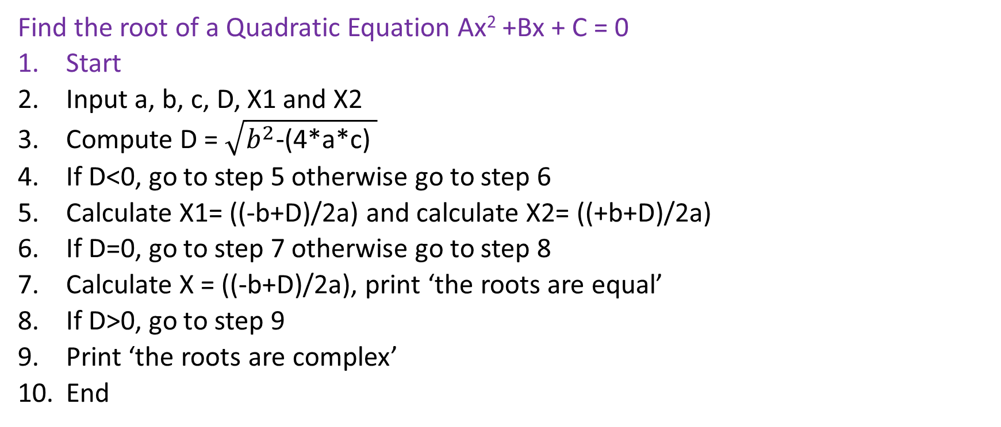
EXERCISE 1
Find the root of a Quadratic Equation Ax² +Bx + C = 0
Start
Input a, b, c, D, X1 and X2
Compute D = $\sqrt{b^{2}\text{−(4∗}\text{a}\text{∗}\text{c}\text{) }}$
If D<0, go to step 5 otherwise go to step 6
Calculate X1= ((-b+D)/2a) and calculate X2= ((+b+D)/2a)
If D=0, go to step 7 otherwise go to step 8
Calculate X = ((-b+D)/2a), print ‘the roots are equal’
If D>0, go to step 9
Print ‘the roots are complex’
End

Slide 3
EXERCISE 1: FLOWCHART
START
INPUT a, b, c, D, X1, X2
PRINT ‘The roots are complex’
D = sqrt(b**2-(4*a*c))
No
Is D > 0?
Is D = 0?
Yes
Yes
X1= ((-b+D)/2a)
X= ((-b+D)/2a)
X2= ((-b-D)/2a)
PRINT X1 & X2
PRINT X
PRINT ‘The roots are equal’
END

Slide 4
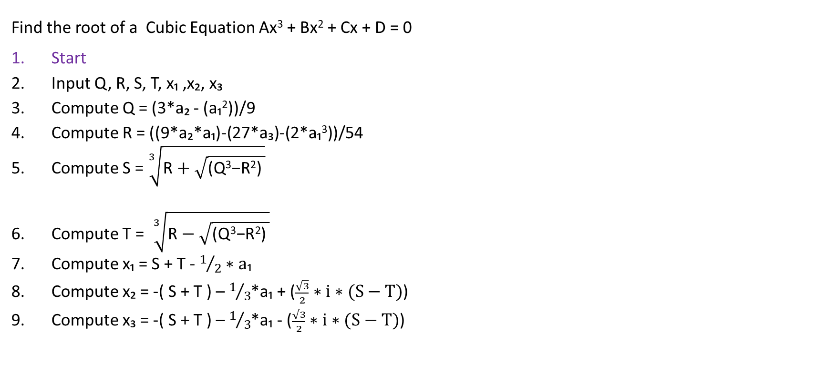
EXERCISE 2
Find the root of a Cubic Equation Ax³ + Bx² + Cx + D = 0
Start
Input Q, R, S, T, x₁ ,x₂, x₃
Compute Q = (3*a₂ - (a₁²))/9
Compute R = ((9*a₂*a₁)-(27*a₃)-(2*a₁³))/54
Compute S = $\sqrt[3]{\text{R}+\sqrt{\text{(}\text{Q}\text{3}\text{−}\text{R}\text{2}\text{) }}}$
Compute T = $\sqrt[3]{\text{R}−\sqrt{\text{(}\text{Q}\text{3}\text{−}\text{R}\text{2}\text{) }}}$
Compute x₁ = S + T - $1/2∗a\text{₁}$
Compute x₂ = -( S + T ) – $1/3$*a₁ + ($\frac{\sqrt{3}}{2}∗i∗(S−T)$)
Compute x₃ = -( S + T ) – $1/3$*a₁ - ($\frac{\sqrt{3}}{2}∗i∗(S−T)$)

Slide 5
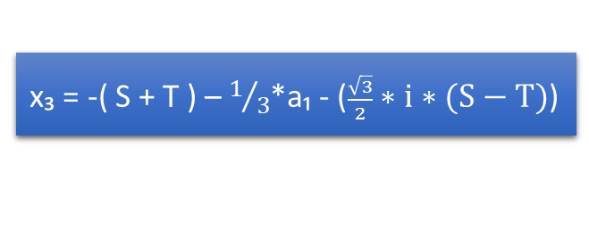
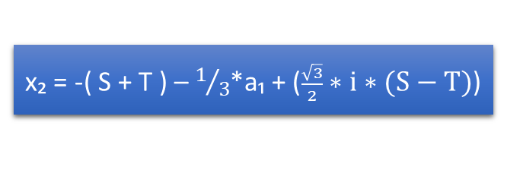
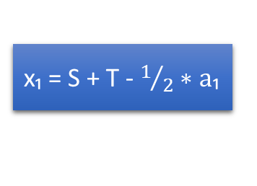
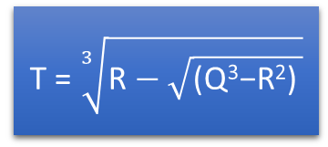
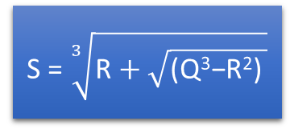
EXERCISE 2: FLOWCHART
START
INPUT Q, R, S, T, x₁ ,x₂, x₃, a₁ ,a₂, a₃
Q = (3*a₂ - (a₁²))/9
R = ((9*a₂*a₁)-(27*a₃)-(2*a₁³))/54
PRINT x₁ ,x₂, x₃
S = $\sqrt[3]{\text{R}+\sqrt{\text{(}\text{Q}\text{3}\text{−}\text{R}\text{2}\text{) }}}$
x₃ = -( S + T ) – $1/3$*a₁ - ($\frac{\sqrt{3}}{2}∗i∗(S−T)$)
T = $\sqrt[3]{\text{R}−\sqrt{\text{(}\text{Q}\text{3}\text{−}\text{R}\text{2}\text{) }}}$
x₂ = -( S + T ) – $1/3$*a₁ + ($\frac{\sqrt{3}}{2}∗i∗(S−T)$)
END
x₁ = S + T - $1/2∗a\text{₁}$

Slide 6
EXERCISE 3
Find the largest of three numbers.
Start
Declare variable a, b, c, LARGEST
If a>b, then go to step 4 otherwise go to step 5
If a>c, then SET LARGEST = a otherwise SET LARGEST = c
If b>c, then SET LARGEST = b otherwise SET LARGEST = c
End

Slide 7
EXERCISE 3: FLOWCHART
START
INPUT A,B,C, LARGEST
IS A > B?
NO
YES
IS B > C?
IS A > C?
SET LARGEST = A
SET LARGEST = A
SET LARGEST = C
PRINT LARGEST
END

Slide 8
EXERCISE 4
Find the GCD of two numbers.
Start
Input A, B
If A>B, SET CounterLimit = A otherwise go to step 4
SET CounterLimit = B
Loop : Counter i in range (1, CounterLimit+1)
If A%i == 0 and B%i == 0, GCD = i
Print GCD
End

Slide 9
EXERCISE 4: FLOWCHART
START
INPUT A,B
IS A > B?
NO
YES
SET COUNTERLIMIT = B
SET COUNTERLIMIT = A
END
COUNTER I in range (1, COUNTERLIMIT +1)
PRINT GCD
NO
IS A%I = 0?
IS B%I = 0?
NO
YES
YES
I = GCD

Slide 10
EXERCISE 5
Find the Factorial of number n (n! = 1 x 2 x 3 x …. n)
Start
Initialize sum to 0
Input num
Loop: Counter p in range ( 1, num + 1)
Factorial = p * factorial
Print Factorial
Stop

Slide 11
EXERCISE 5: FLOWCHART
START
Initialize FACTORIAL TO 0
INPUT NUM
COUNTER P in range (1, NUM +1)
FACTORIAL = P * FACTORIAL
PRINT FACTORIAL
END

