Slide 1

KAN-based decoder for Message Detection in BMOCZ Communication Systems
By Anthony Perre and Jack Hyatt

Slide 2


Problem Statement
Ownership of wireless devices across the world continues to increase year-over-year.
As consumer demand grows & better performance is needed, we need new methods to improve the data rate of devices.
Strategy #1: Development of new error-correction code schemes such as Polar codes.
Strategy #2: Development of new modulation schemes with unique properties.
A novel modulation scheme called binary modulation on conjugate-reciprocal zeros (BMOCZ) has emerged as a promising alternative to existing modulation schemes.
$$m$$
Encoder
Modulator
Channel
$$\hat{m}$$
Decoder
Demodulator

Slide 3
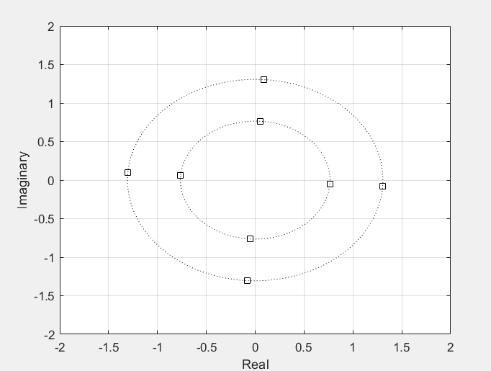
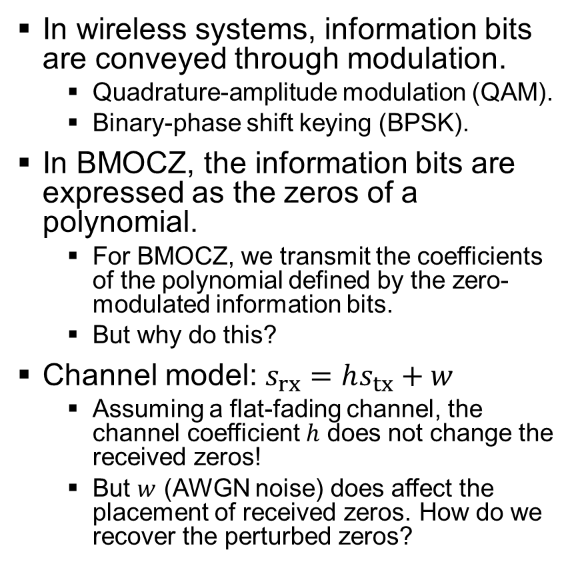
Problem Statement Cont.
In wireless systems, information bits are conveyed through modulation.
Quadrature-amplitude modulation (QAM).
Binary-phase shift keying (BPSK).
In BMOCZ, the information bits are expressed as the zeros of a polynomial.
For BMOCZ, we transmit the coefficients of the polynomial defined by the zero-modulated information bits.
But why do this?
Channel model: $s_{rx}=hs_{tx}+w$
Assuming a flat-fading channel, the channel coefficient $h$ does not change the received zeros!
But $w$ (AWGN noise) does affect the placement of received zeros. How do we recover the perturbed zeros?

Slide 4
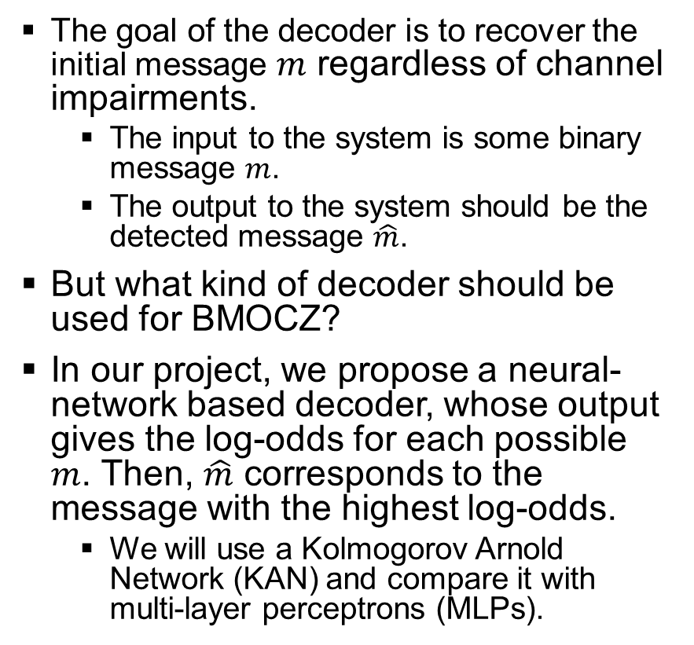
Problem Statement Cont.
The goal of the decoder is to recover the initial message $m$ regardless of channel impairments.
The input to the system is some binary message $m$.
The output to the system should be the detected message $\hat{m}$.
But what kind of decoder should be used for BMOCZ?
In our project, we propose a neural-network based decoder, whose output gives the log-odds for each possible $m$. Then, $\hat{m}$ corresponds to the message with the highest log-odds.
We will use a Kolmogorov Arnold Network (KAN) and compare it with multi-layer perceptrons (MLPs).
$$m$$
Encoder
Modulator
Channel
$$\hat{m}$$
Decoder
Demodulator

Slide 5
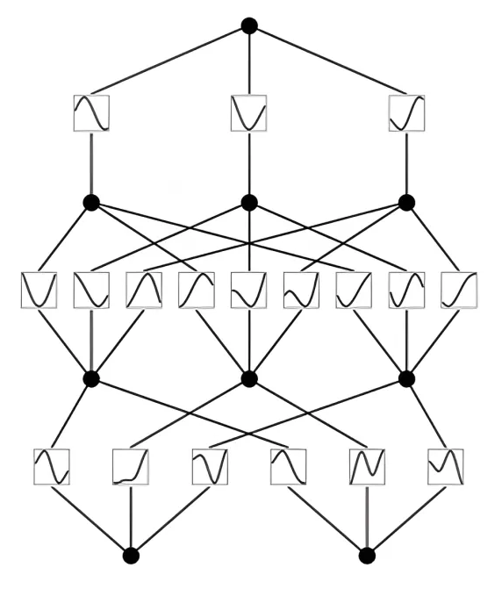
Kolmogorov Arnold Network Preliminaries
Deeper KANs have been proposed within the past year [1].
New type of deep-learning structure!
KANs and MLP’s have similar structure but differ in that KANs have learnable activation functions on edges.
In contrast, MLPs use fixed activation functions on nodes. KANs learn control points for a B-spline, which is the method used to represent univariate functions.

Slide 6

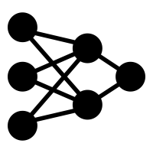
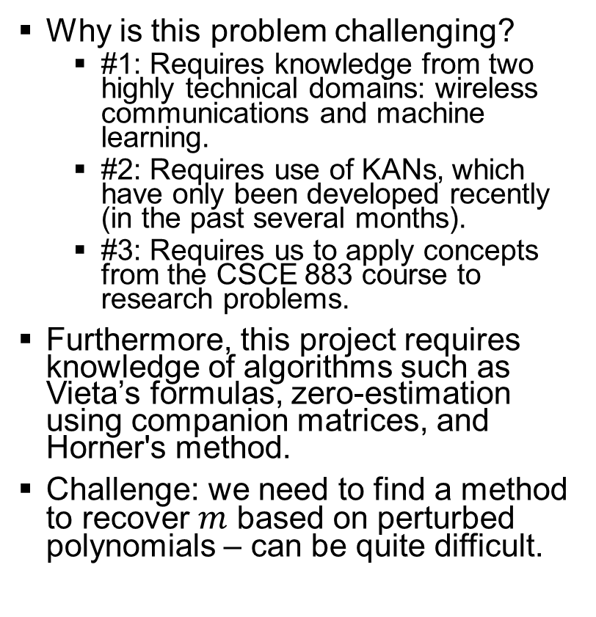

Technical Challenges
Why is this problem challenging?
#1: Requires knowledge from two highly technical domains: wireless communications and machine learning.
#2: Requires use of KANs, which have only been developed recently (in the past several months).
#3: Requires us to apply concepts from the CSCE 883 course to research problems.
Furthermore, this project requires knowledge of algorithms such as Vieta’s formulas, zero-estimation using companion matrices, and Horner's method.
Challenge: we need to find a method to recover $m$ based on perturbed polynomials – can be quite difficult.
$$+$$

Slide 7
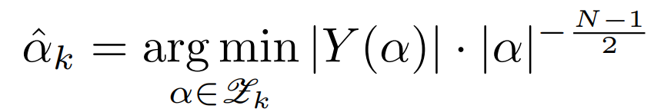
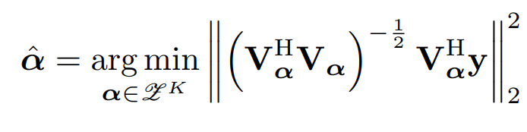
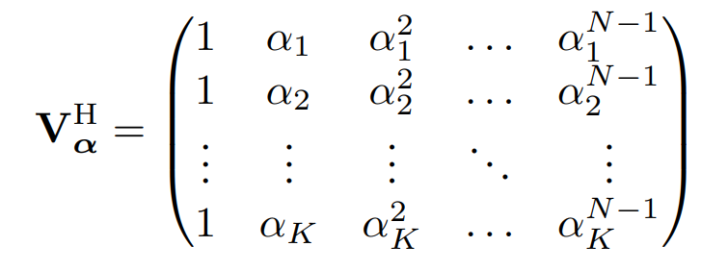
Related Works
DiZeT Decoder
BMOCZ is a very niche area of wireless communications; consequently, there are not many publications on the subject.
Original BMOXZ paper [2] introduces two decoders.
Direct zero-testing decoder (DiZeT).
Maximum likelihood (ML) decoder.
ML decoder performs better but is too computationally intensive to be used in a practical system.
DiZeT decoder is the standard in the literature.
ML Decoder

Slide 8
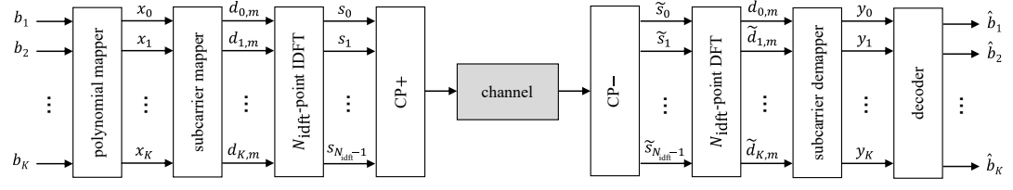
Related Works Cont.
Another paper (written by AJ’s PI) explores the optimal radius and orthogonal frequency-division multiplexing (OFDM) subcarrier mapping for BMOCZ communication systems [3].
However, this paper further explores the DiZeT & ML decoders.
No clear alternative to DiZeT & ML in the current literature.

Slide 9
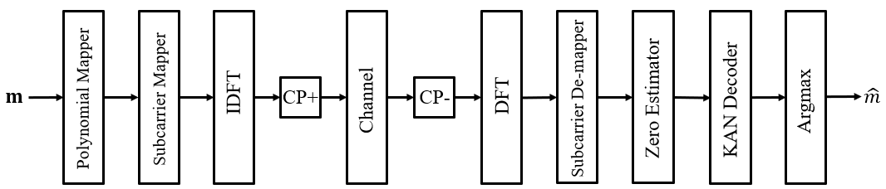
OUR Approach
Our approach assumes an OFDM communication scheme where we transmit K=4 and K=6 bits per message.
We propose learning the zero-mapping via gradient descent; rather, we can adjust parameters (radius and phase associated with each bit-to-zero mapping) using the same loss as the neural network.

Slide 10
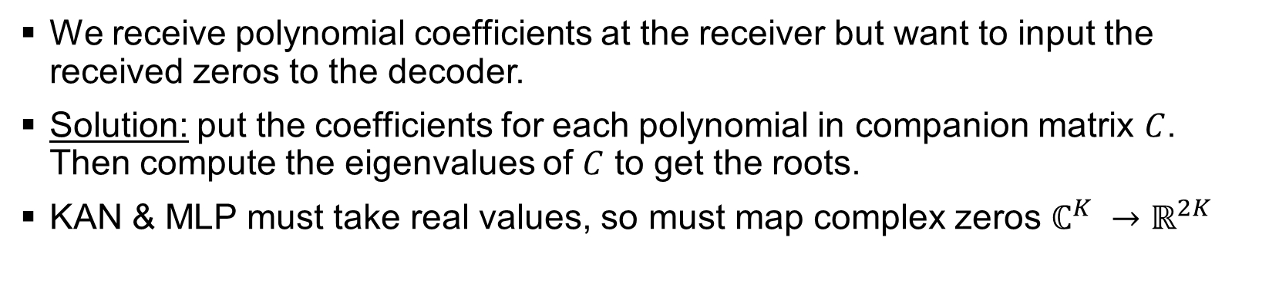
OUR Approach Cont.
We receive polynomial coefficients at the receiver but want to input the received zeros to the decoder.
Solution: put the coefficients for each polynomial in companion matrix $C$. Then compute the eigenvalues of $C$ to get the roots.
KAN & MLP must take real values, so must map complex zeros $ℂ^{K} →ℝ^{2K}$

Slide 11
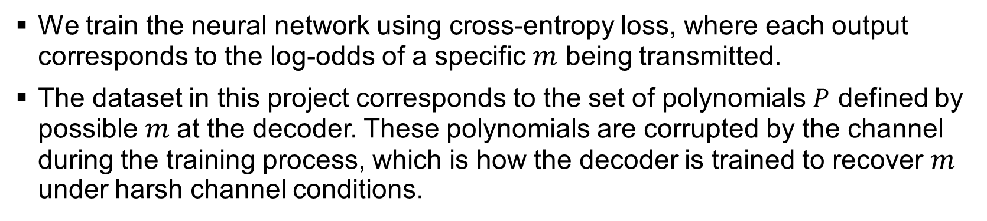
OUR Approach Cont.
We train the neural network using cross-entropy loss, where each output corresponds to the log-odds of a specific $m$ being transmitted.
The dataset in this project corresponds to the set of polynomials $P$ defined by possible $m$at the decoder. These polynomials are corrupted by the channel during the training process, which is how the decoder is trained to recover $m$ under harsh channel conditions.

Slide 12
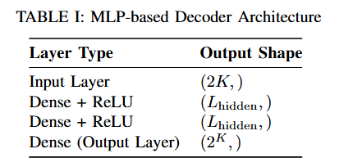
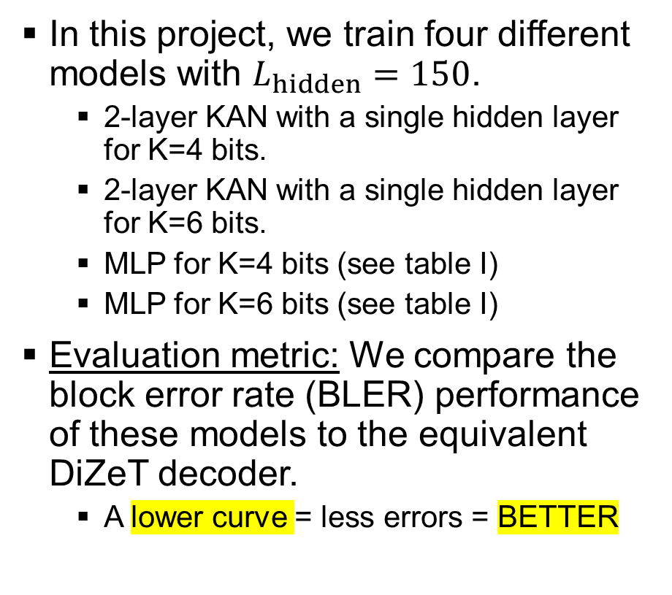
OUR Approach Cont.
In this project, we train four different models with $L_{hidden}=150$.
2-layer KAN with a single hidden layer for K=4 bits.
2-layer KAN with a single hidden layer for K=6 bits.
MLP for K=4 bits (see table I)
MLP for K=6 bits (see table I)
Evaluation metric: We compare the block error rate (BLER) performance of these models to the equivalent DiZeT decoder.
A lower curve = less errors = BETTER

Slide 13
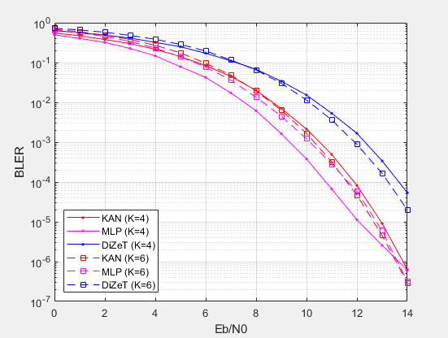
Results in AWGN Channel
For K=4 and K=6 bits, we see that both MLP & KAN perform much better as compared to DiZeT.
For K=4, the MLP-based decoder performs the best at lower SNRs, but levels off at higher SNRs, which allows KAN to catch up.
For K=6 bits, we see that KAN & MLP achieve roughly the same performance.
KAN has 1 less hidden layer as compared to MLP (& fewer total parameters), yet it still competes well.

Slide 14
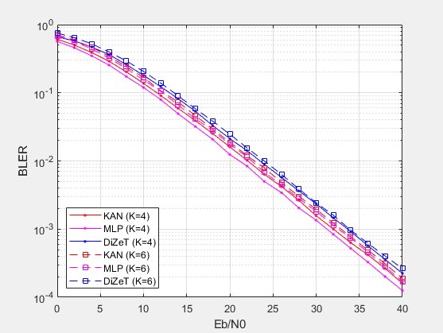
Results in flat-fading Rayleigh channel
For K=4 and K=6 bits, we again see that both MLP & KAN perform better as compared to DiZeT, but not by as much.
For K=4, MLP-based decoder achieves the best overall BLER performance again.
Again, for K=6 bits, we see that KAN & MLP achieve roughly the same performance.

Slide 15
Broader Impact & Improvements
Our project could have broad impact.
Stepping-stone for further advancements in BMOCZ deep-learning decoder schemes.
BMOCZ and other non-coherent communication schemes have the potential to improve the data rate for wireless devices, which is ever-so-important for the next generation of mobile devices.
It is important to show that KANs did not show better performance as compared to MLPs.
We could improve it in several ways.
Experimenting further and testing different model configurations such as # of hidden layers, dropout layers, and different activation functions.
Adding error correction codes to the BMOCZ system to improve reliability.
Experimenting with transformer models, which have been used to generate error correction codes.

Slide 16
References
[1] Z. Liu, Y. Wang, S. Vaidya, F. Ruehle, J. Halverson, M. Soljacic, T. Y.Hou, and M. Tegmark, “KAN: Kolmogorov-Arnold networks,” arXivpreprint arXiv:2404.19756, 2024.
[2] “MOCZ for blind short-packet communication: Basic principles,” IEEE Transactions on Wireless Communications, vol. 18, no. 11, pp. 5080–5097, 2019.
[3] P. Huggins and A. Sahin, “On the optimal radius and subcarrier mapping for binary modulation on conjugate-reciprocal zeros,” in Proc. IEEEMilitary Communications Conference (MILCOM). IEEE, 2024.

Slide 17
Any Questions?
Anthony Perre & Jack Hyatt
KAN-based decoder for Message Detection in BMOCZ Communication Systems
{aperre, jahyatt}@email.sc.edu

