Slide 1

MACHINE LEARNING
(24AD2204)
Lecture - 3
Preparing to Model: Basic Data Types, Exploring Numerical Data

Slide 2
RECAP

Slide 3
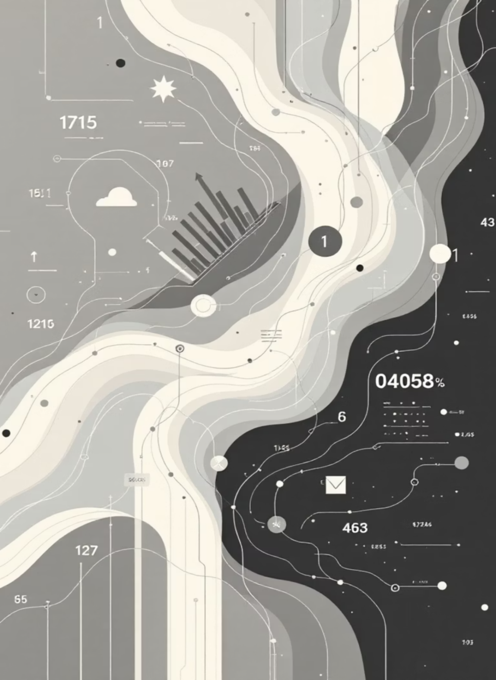
Preparing to Model
This session provides a detailed view of understanding incoming data and creating basic understanding about its nature and quality.
This knowledge helps select and apply the right model, enabling beginners to take their first step towards effective machine learning problem-solving.

Slide 4

The Machine Learning Journey
Historical Evolution
Breakthrough Applications
Machine learning evolved from Alan Turing's proposition that machines can 'learn' and become artificially intelligent. Pioneers like Arthur Samuel, Frank Rosenblatt, John Hopfield, Christopher Watkins, and Geoffrey Hinton shaped concepts of Neural Networks, Recurrent Neural Networks, Reinforcement Learning, and Deep Learning.
IBM's Deep Blue defeated world chess champion Gary Kasparov. IBM's Watson beat human champions in Jeopardy. Google developed innovations like Google Brain, Sibyl, Waymo, and AlphaGo—all advanced applications that elevated machine learning technology to new heights.

Slide 5



Types of Machine Learning
Supervised Learning
Unsupervised Learning
Reinforcement Learning
Learning from past labeled training data with known values or classes. Machines learn from past data and assign classes to unknown test data, solving prediction problems—similar to human learning through expert guidance.
Finding patterns in unlabeled data without guided inputs. Like humans grouping objects of similar shape, this learning uses knowledge gained from the data itself rather than external labels.
Machines learn independently through penalty and reward mechanisms—similar to human self-learning. The system improves through trial and error, optimizing decisions based on feedback.

Slide 6
Real-World Applications
Banking & Finance
Insurance
Healthcare
Fraud detection is a critical business case implemented in almost all banks worldwide, using machine learning predominantly to identify suspicious transactions and protect customers.
Risk prediction for new customers is a critical case in the insurance industry, applying machine learning to assess policyholder risk profiles and optimize pricing strategies.
Disease prediction makes wide use of machine learning, especially in developed countries, enabling early diagnosis and personalized treatment plans through data analysis.

Slide 7

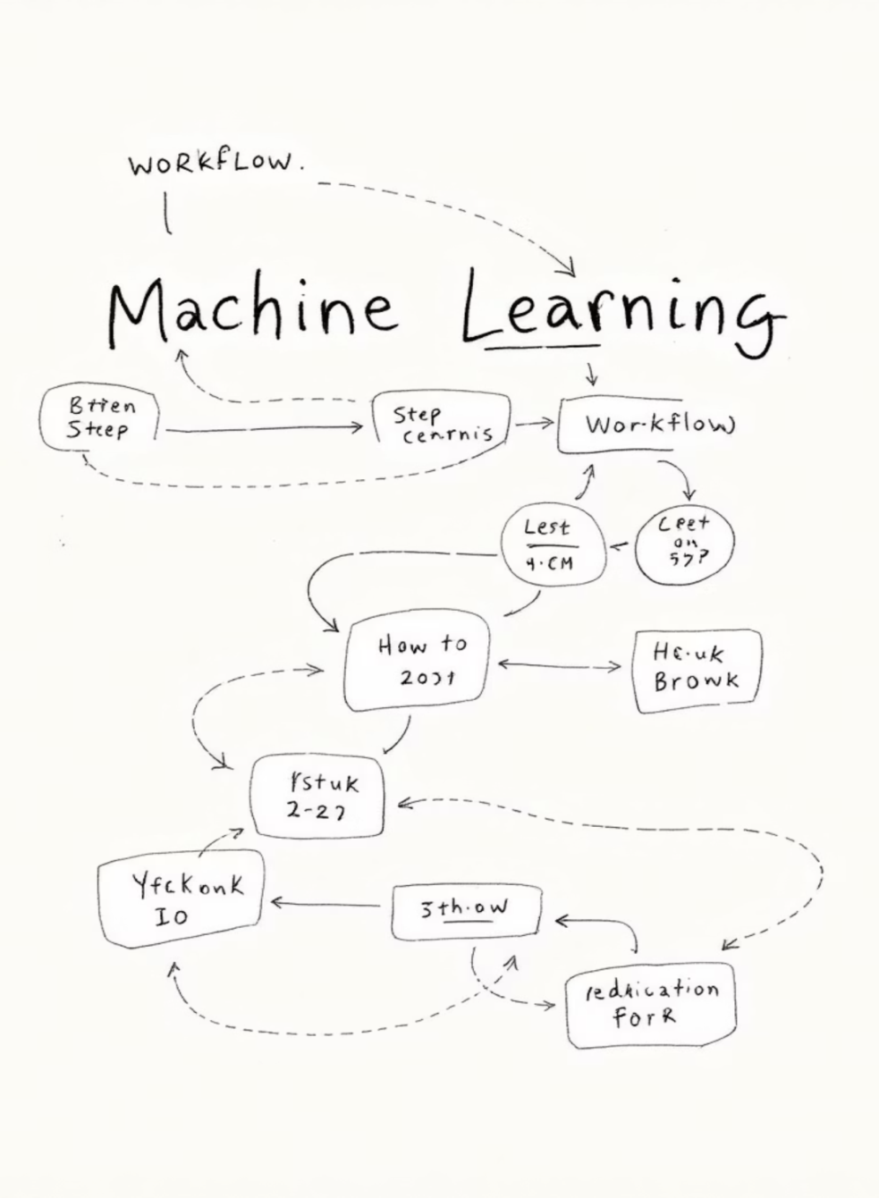



The Four-Step Machine Learning Process
Step 1: Preparing to Model
Understand data types
Explore data quality
Find potential issues
Remediate and preprocess
Step 2: Learning
Data partitioning
Model selection
Cross-validation
Step 3: Performance Evaluation
Examine model performance
Visualize trade-offs
Use confusion matrices
Step 4: Performance Improvement
Tuning the model
Ensembling
Bagging and boosting

Slide 8
Understanding Data Types
Qualitative (Categorical) Data
Quantitative (Numeric) Data
Information about quality that cannot be measured. Examples include blood group (A, B, O, AB), nationality, and gender.
Information about quantity that can be measured using a scale.
Interval Data
Nominal Data
Numeric data where order and exact differences are known (e.g., Celsius temperature). Addition and subtraction possible. Mean, median, mode, and standard deviation can be calculated. No true zero value.
Named values with no numeric value or natural order. Cannot be quantified. Mode can be identified but not mean or median.
Ordinal Data
Ratio Data
Named values that can be naturally ordered (e.g., customer satisfaction: Very Happy, Happy, Unhappy). Mode and median can be identified, but not mean.
Numeric data with exact measurable values and absolute zero (e.g., height, weight, age, salary). All mathematical operations possible.

Slide 9
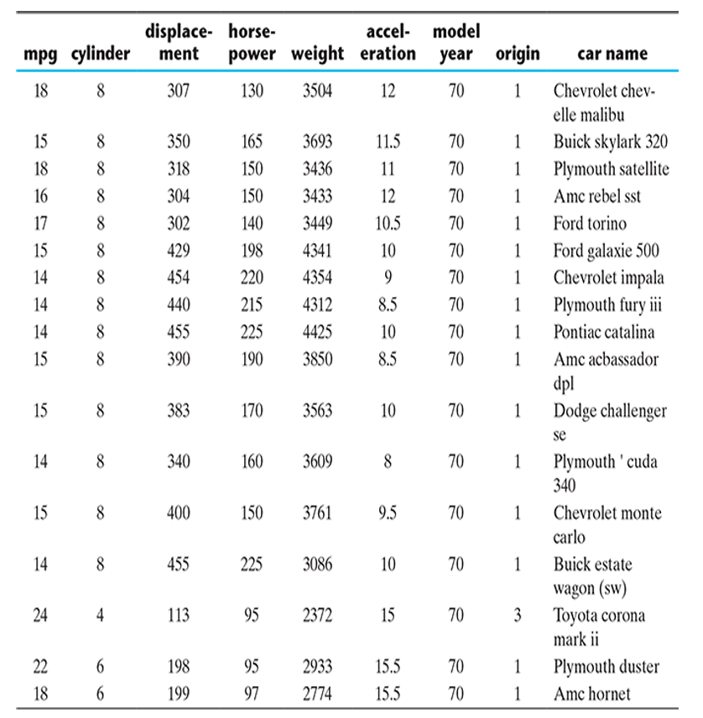
Exploring the Auto MPG Dataset
The Auto MPG dataset from UCI Machine Learning Repository serves as our reference example. It contains information about fuel consumption in miles per gallon (mpg) for various vehicles.
Numeric Attributes
Categorical Attributes
Continuous: mpg, displacement, horsepower, weight, acceleration
Nominal: car name
Discrete: cylinders, model year, origin
Target Variable
The numeric attribute 'mpg' (miles per gallon) is the target attribute for prediction of fuel consumption.

Slide 10
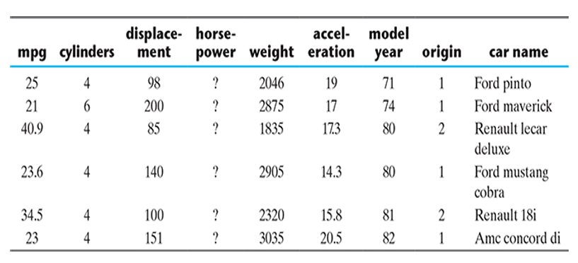


Central Tendency: Mean vs. Median
Mean and median are measures of central tendency that help understand the central point of data. Mean is the sum of all values divided by count. Median is the middle value in an ordered list. Large deviations between mean and median indicate potential outliers.
23.51
5.455
193.4
2970
MPG Mean
Cylinders Mean
Displacement Mean
Weight Mean
Median: 23 (2.17% deviation - Low)
Median: 4 (26.67% deviation - High)
Median: 148.5 (23.22% deviation - High)
Median: 2804 (5.59% deviation - Low)
Data Quality Issue: The 'horsepower' attribute has 6 missing values, preventing mean and median calculation. These missing values must be remediated before exploration can continue.

Slide 11
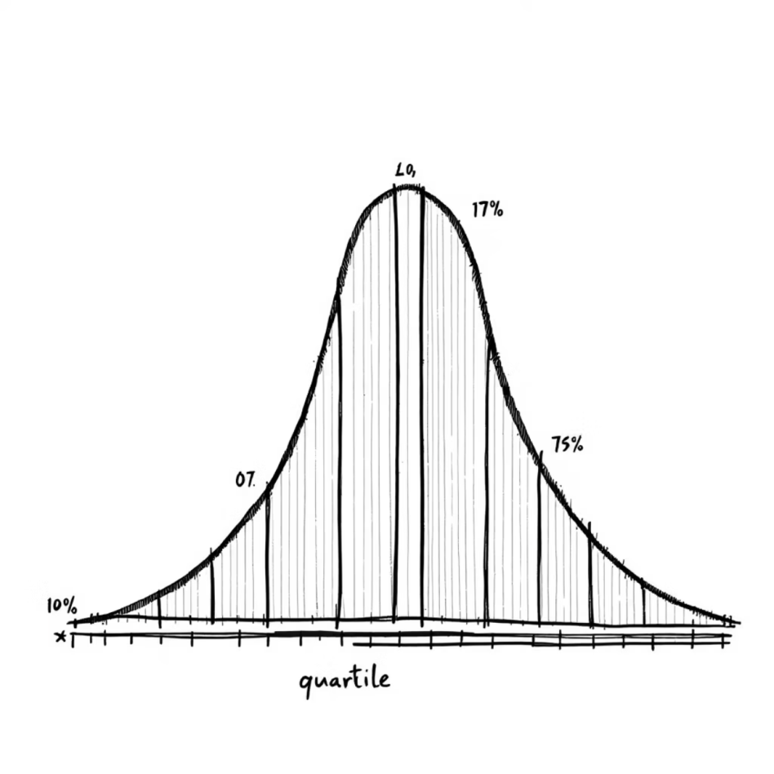
Understanding Data Spread and Position
Measuring Dispersion
Variance and standard deviation measure how spread out data values are. Larger values indicate more dispersion. Variance is calculated as the average of squared differences from the mean.
Quartiles and Position
Data arranged in order can be divided into quartiles:
Q1 (First Quartile): Median of first half
Q2 (Median): Central value
Q3 (Third Quartile): Median of second half
The five-number summary includes minimum, Q1, median, Q3, and maximum values.

Slide 12
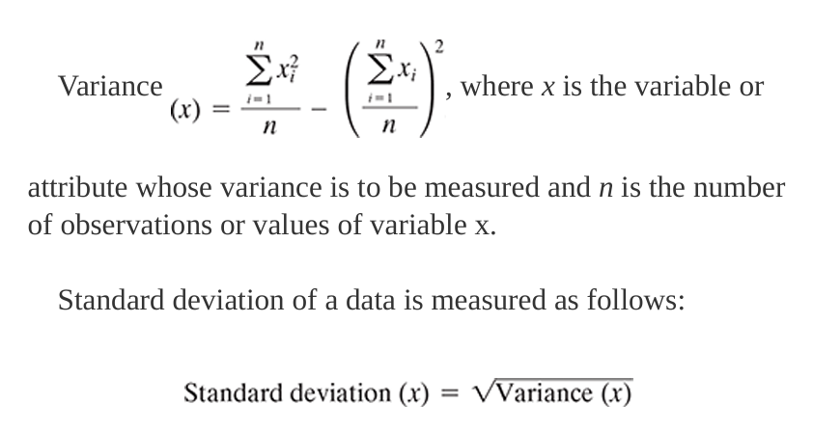
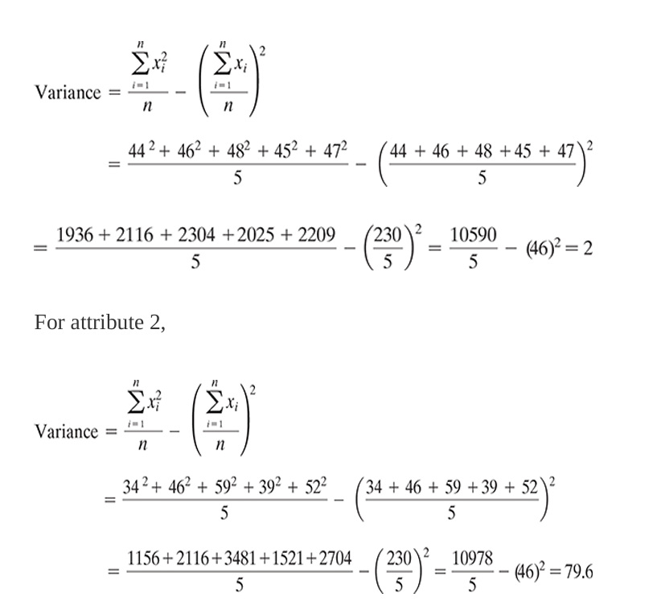
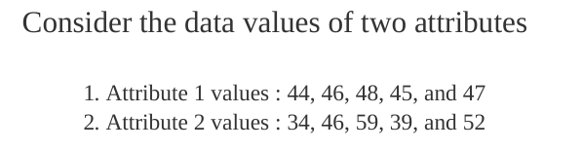
Measuring Dispersion Example:
To measure the extent of dispersion of a data, or to find out how much the different values of a data are spread out, the variance of the data is measured. Larger value of variance or standard deviation indicates more dispersion in the data and vice versa.

Slide 13
Measuring data value position Example
Every dataset can be summarized using five key values, called the five-number summary:
Minimum – smallest value
First Quartile (Q1) – middle of the first half
Median (Q2) – middle of the entire data
Third Quartile (Q3) – middle of the second half
Maximum – largest value
Let Data be (in Sorted Order): 2, 4, 6, 8, 10, 12, 14
Five Number Summary
Min = 2
Q1 = 4
Q2 = 8
Q3 = 12
Max = 14
Step-by-step:
Median (Q2) = 8
Lower half = 2, 4, 6 → Q1 = 4
Upper half = 10, 12, 14 → Q3 = 12

Slide 14
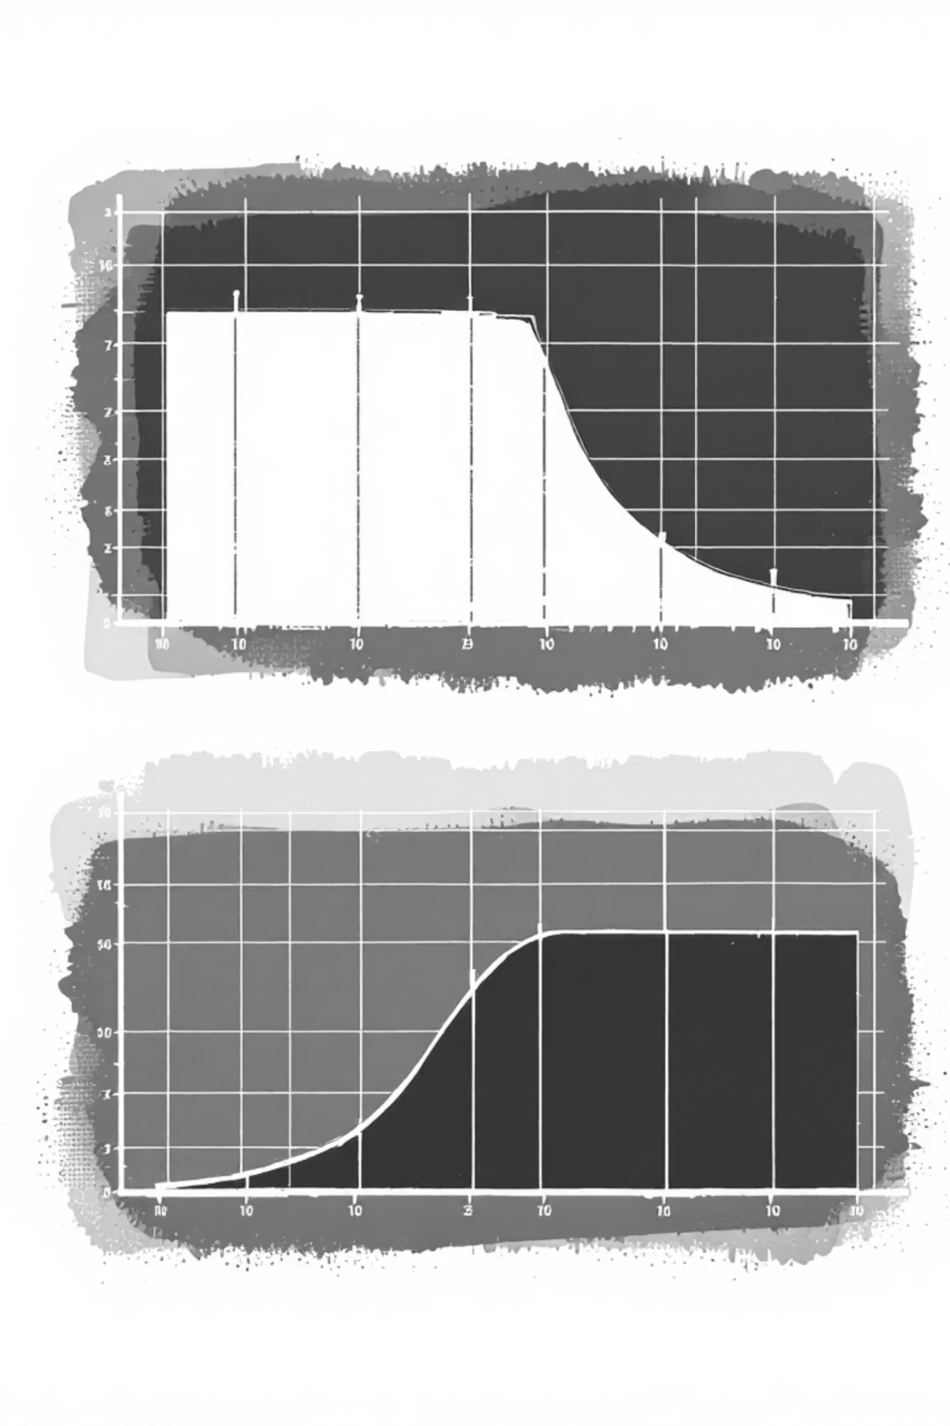
Visualizing Data with Box Plots and Histograms
Box Plots
Box plots visualize the five-number summary. The box spans Q1 to Q3 (IQR), with a band showing the median. Whiskers extend to 1.5 × IQR. Points beyond whiskers are outliers requiring special consideration.
Histograms
Histograms show data distribution across intervals (bins). Bar heights reflect frequency of values in each range. Shapes reveal patterns: right-skewed, left-skewed, symmetric, uniform, or multimodal distributions.
These visualization tools are essential for data exploration, helping identify patterns, outliers, and distribution characteristics that inform model selection and preprocessing decisions.

Slide 15
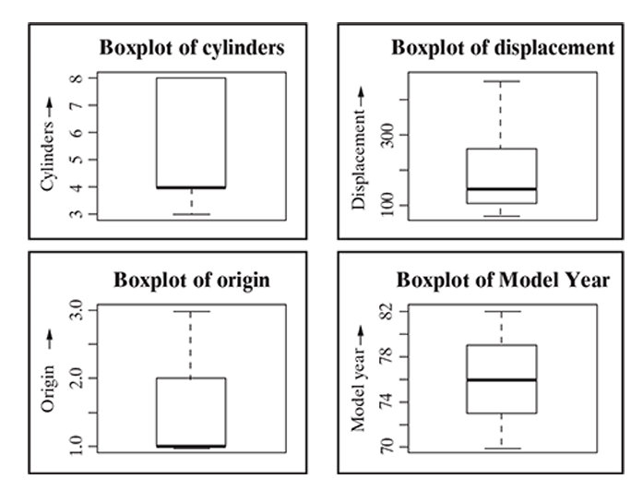
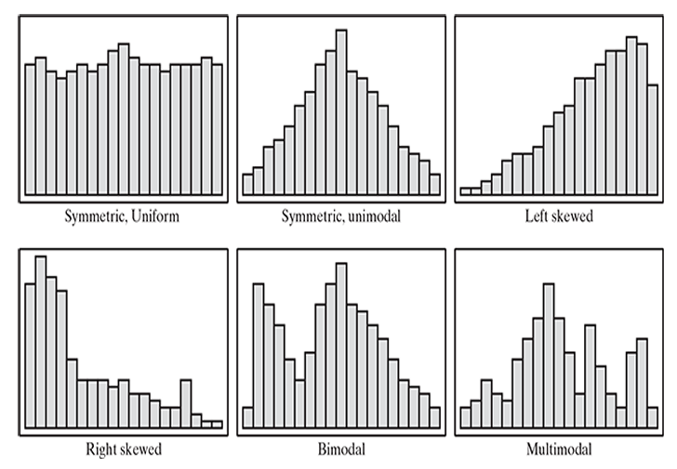

Slide 16
SUMMARY

Slide 17

THANK YOU!

