Slide 1

MACHINE LEARNING
(24AD2204)
Lecture - 4
Exploring Categorical Data, Exploring Relationship Between Variables

Slide 2
RECAP

Slide 3

Exploring Data Distributions and Relationships
Understanding how data is distributed and how variables relate to each other is fundamental to data analysis.
This presentation explores key techniques for examining both categorical and numeric data, revealing patterns and relationships that drive insights.

Slide 4
Auto MPG Data Distribution Patterns
The histograms display frequency distributions across multiple Auto MPG attributes.
The data reveals distinct patterns: MPG values center around 20-30, displacement clusters around 100-200, and other variables show their own characteristic distributions.
These visualizations help identify central tendencies, spread, and potential outliers across the dataset's key variables including cylinders, weight, acceleration, model year, origin, and horsepower.

Slide 5
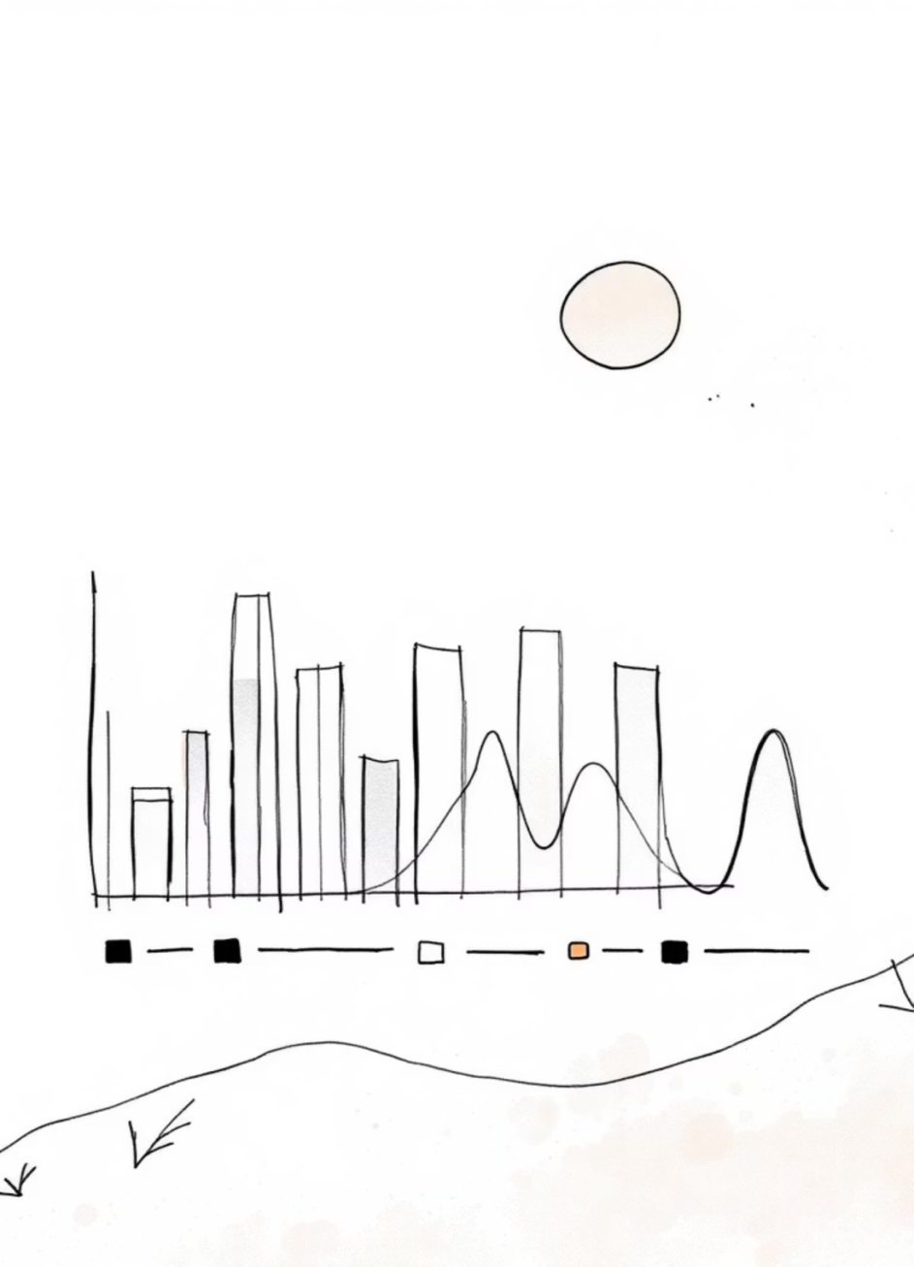
Understanding Categorical Data
Unique Values Analysis
Frequency Counts
Categorical data exploration begins with identifying unique values. The Auto MPG dataset contains attributes like 'car name' with numerous unique entries and 'cylinders' with just five distinct values: 3, 4, 5, 6, and 8.
Beyond unique values, we examine how data elements distribute across categories. For cylinders, 4-cylinder vehicles dominate with 204 instances (51.3%), followed by 8-cylinder (103), 6-cylinder (84), 3-cylinder (4), and 5-cylinder (3) vehicles.
This initial assessment helps understand the granularity and diversity within categorical variables.

Slide 6




Cylinder Distribution Analysis
51.3%
25.9%
4-Cylinder Vehicles
8-Cylinder Vehicles
Dominant category with 204 vehicles
Second largest with 103 vehicles
21.1%
1.0%
6-Cylinder Vehicles
3-Cylinder Vehicles
Third category with 84 vehicles
Rare category with only 4 vehicles
The cylinder distribution reveals clear preferences in automotive design, with 4-cylinder engines representing over half of all vehicles in the dataset. This pattern reflects fuel efficiency trends and market demands during the data collection period.

Slide 7
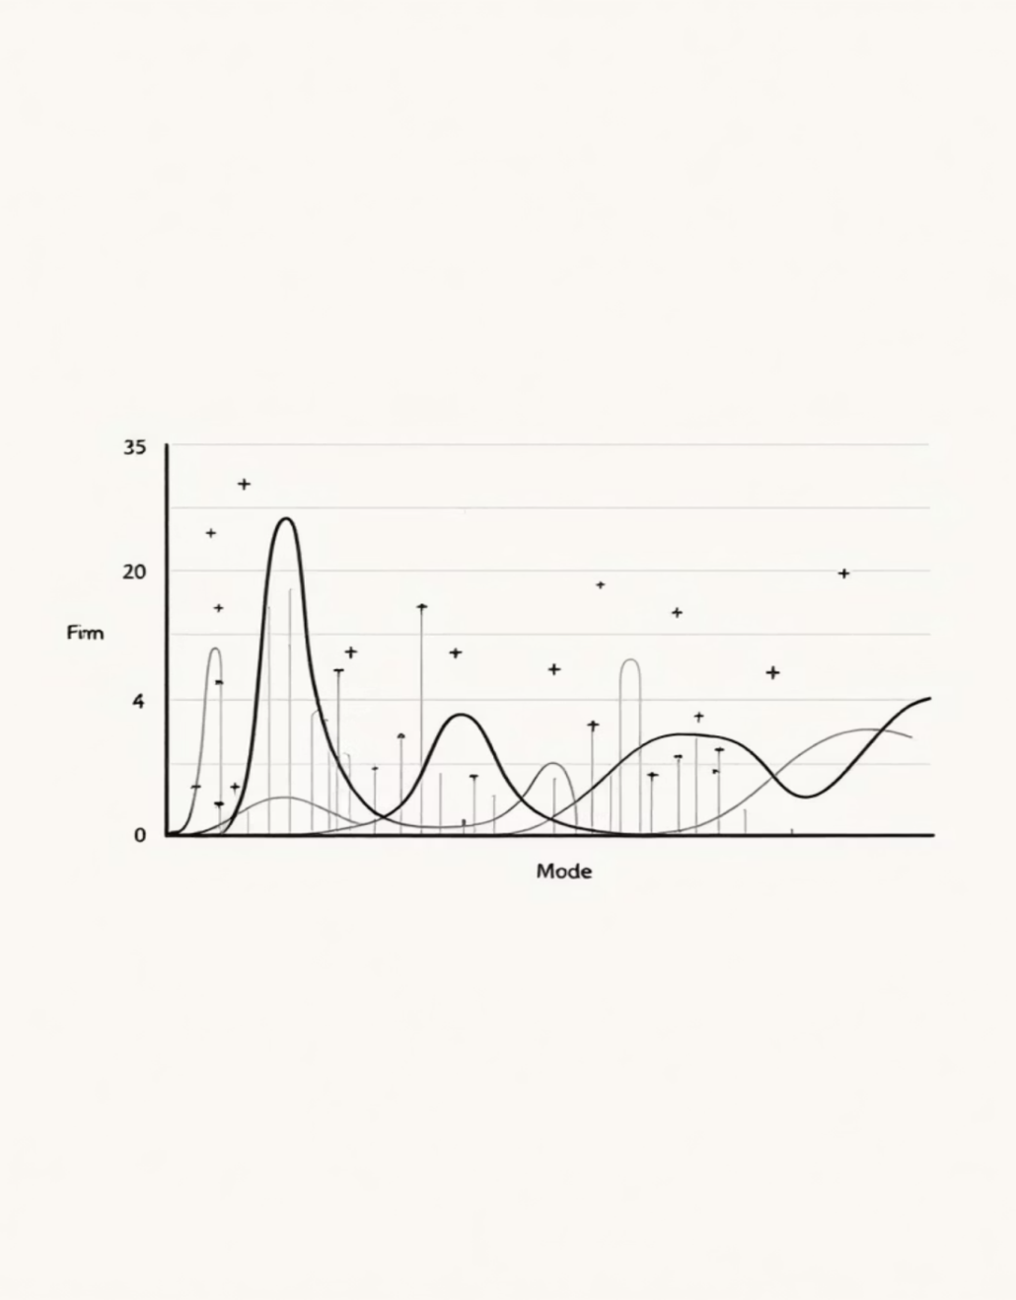




Mode: The Key to Categorical Data
Central Tendency
Cylinders Mode
Mode identifies the most frequently occurring category in categorical data, serving as the sole measure of central tendency when mean and median cannot be applied.
For the cylinders attribute, the mode is 4, appearing in over 50% of data elements, indicating the most common engine configuration.
Car Name Mode
The 'Ford Pinto' emerges as the mode for car names with the highest frequency of 6 occurrences in the dataset.
Modal Distribution Types: Unimodal (single mode), bimodal (two modes), and multimodal (multiple modes) describe the frequency patterns in categorical data.

Slide 8
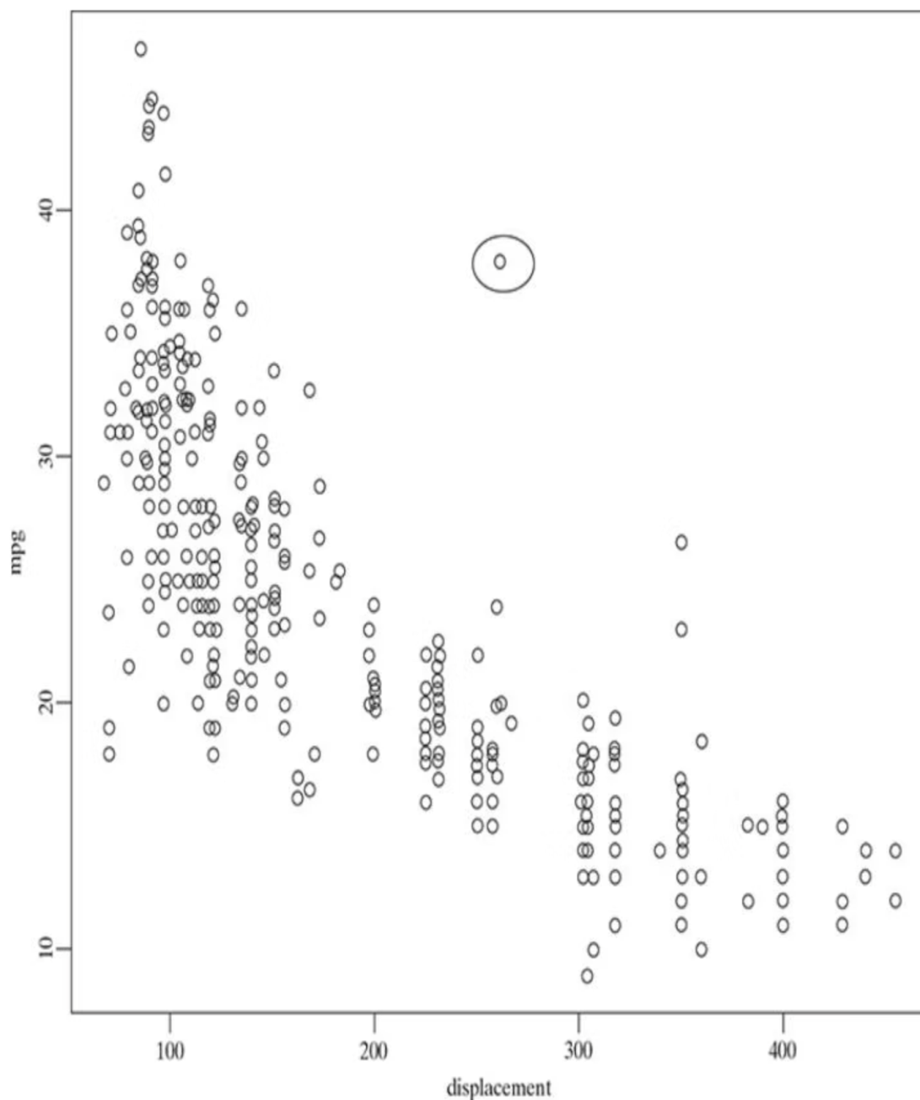
Scatter Plots: Visualizing Relationships
Bivariate Analysis
Scatter plots reveal relationships between two variables by plotting points on coordinates defined by attribute values. It is a two-dimensional plot in which points or dots are drawn on coordinates provided by values of the attributes. The independent variable maps to the x-axis, while the dependent variable maps to the y-axis.
This visualization technique helps identify correlations, trends, and outliers in the data, providing immediate visual insight into how variables interact.
Eg: There is one data element which has a mpg of 37 for a displacement of 250. This record is completely different from other data elements having similar displacement value but mpg value in the range of 15 to 25. This gives an indication that of presence of outlier data values.
The scatter plot of displacement versus MPG demonstrates a clear negative correlation: as displacement increases, MPG steadily decreases. Notable outliers appear, such as a vehicle with 37 MPG at 250 displacement—significantly different from similar displacement values showing 15-25 MPG.

Slide 9
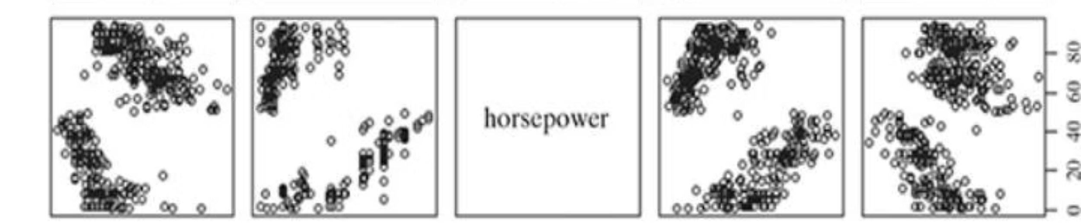
Comprehensive Pairwise Relationships
The pairwise scatter plot matrix captures relationships among five key features: MPG, displacement, horsepower, weight, and acceleration. This comprehensive view reveals varying degrees of correlation across different attribute combinations.
Most attribute pairs show significant relationships, though some—like weight versus acceleration—exhibit weaker correlations. This matrix approach enables simultaneous comparison of multiple variable interactions, accelerating pattern discovery.

Slide 10
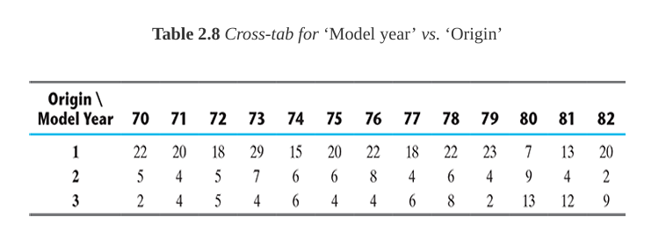
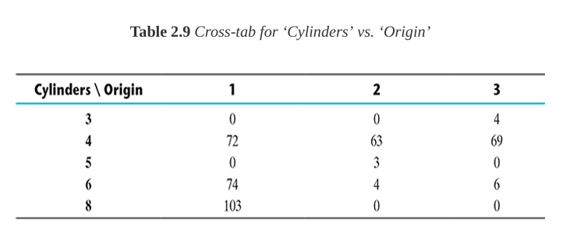
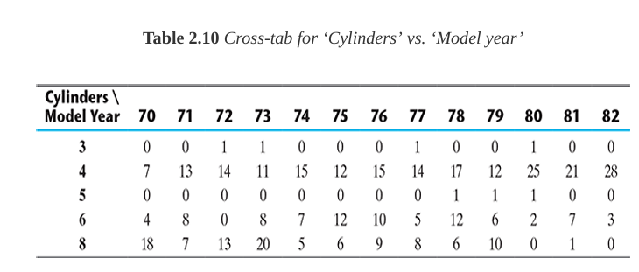
Cross-Tabulations: Categorical Relationships
Model Year vs. Origin
Cylinders vs. Origin
Shows vehicle distribution across North America, Europe, and Asia over different years, revealing regional production patterns and market trends.
Displays how 3, 4, 5, 6, and 8-cylinder vehicles distribute across regions, highlighting regional preferences in engine configurations.
Cylinders vs. Model Year
Tracks cylinder distribution changes over time, revealing evolving automotive design trends and efficiency improvements.
Two-way cross-tabulations present bivariate frequency distributions in a concise matrix format, enabling quick understanding of how categorical attributes relate to each other.

Slide 11
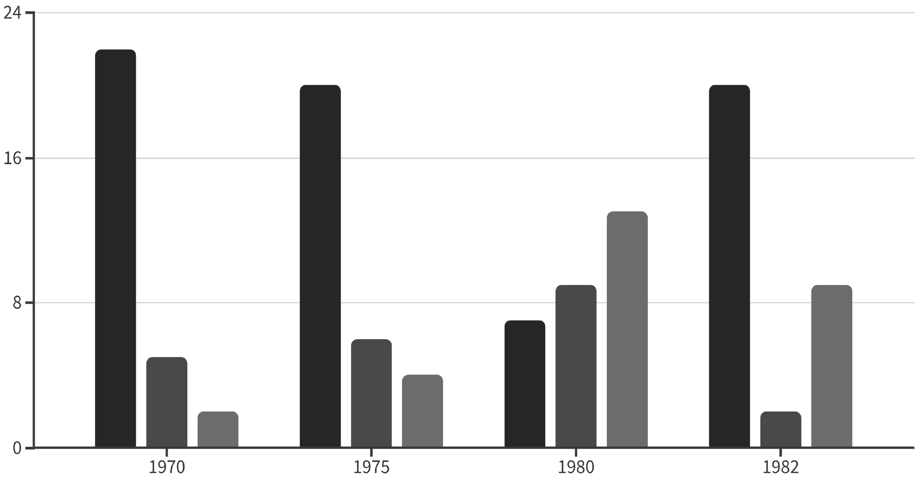
Regional Vehicle Distribution by Year
North America
Europe
Asia
The cross-tabulation reveals shifting production patterns over time. North American vehicle counts fluctuate significantly, while Asian representation grows substantially from 2 vehicles in 1970 to 13 in 1980, reflecting the rise of Asian automotive manufacturers in the global market.

Slide 12
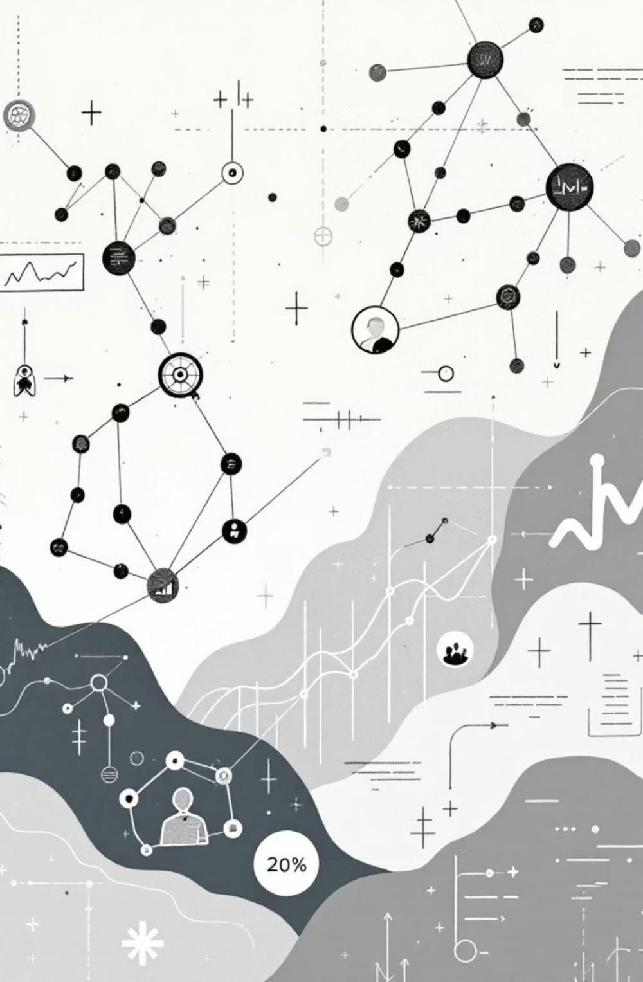
Key Insights from Data Exploration
Distribution Patterns
Histograms reveal central tendencies and spread across numeric variables, helping identify typical values and outliers in the dataset.
Categorical Analysis
Mode serves as the primary measure for categorical data, with frequency counts and proportions providing deeper understanding of category distributions.
Variable Relationships
Scatter plots and cross-tabulations expose correlations and interactions between variables, revealing how changes in one attribute affect another.
Comprehensive Views
Pairwise plots and contingency tables enable simultaneous examination of multiple relationships, accelerating pattern discovery and insight generation.

Slide 13
SUMMARY

Slide 14

THANK YOU!

